Slide 1
Indigenous Oral Histories & Disaster Preparedness Knowledge
Beth Pratt-Sitaula
CEETEP Workshop
http://paintedloveaffair.wordpress.com/category/native-art/

Slide 2
Insert Thunderbird & Killerwhale video
Notes:
CEETEP spends considerable time building the geological evidence for great earthquake/tsunami in PNW. It took more than a decade of concerted effort to convince the majority of geoscientists and we are still working to bring the knowledge to the full rest of the population. We sometimes have the tendency to think that this is a wholly “new” recognition.
In this presentation we feature some of the existing resources regarding Native American and other indigenous stories/histories of earthquake and tsunami. Then we will turn it over to the group to consider how you might integrate such resources into your different teaching sites.
The Native Americans who have lived along the PNW coast have a rich oral tradition that heavily features accounts of earthquakes and tsunami (both “mythic/religious/prehistoric” and historical accounts) – even considering that probably only 1-5% of the oral histories have survived European expansion with its diseases and disruptions (Losey 2000).
The Thunderbird and the Whale from the Pacific NW of North America is an example of metaphorical or mythical account of earthquake and tsunami.
[In fact stories such as this are found worldwide in similar geological settings – ex. Ancient Sumatran story about horned serpent whom the gods covered in earth but who still bucks and shakes to cast off the weight so it is a constant struggle between the monster and the gods.]

Slide 3
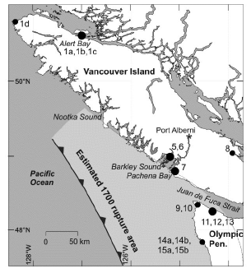
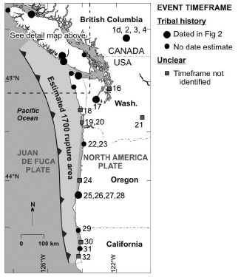
Coastal Cascadia Oral Histories
Source locations of accounts of earthquake-tsunami stories. Recorded 1860-1964. (Ludwin et al 2005)
Notes:
Ludwin was a seismologist from University of Washington. In addition to this work investigating Native American oral traditions for seismic information, she has also used native stories to help identify landslide locations in the Seattle Fault area. The Ludwin et al 2005 paper (Earthquakes and tsunami as elements of environmental disturbance on the Northwest Coast of North America) compiled Native American oral histories along the Cascadia subduction zone and used them to estimate a feasible time period for which the last large Cascadia earthquake-tsunami event occurred.

Slide 4
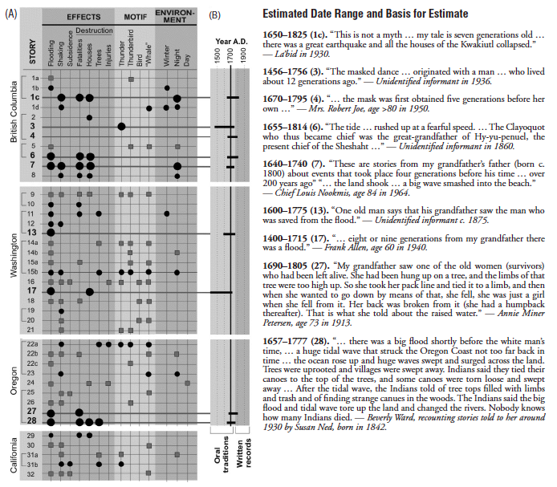
Coastal Cascadia Oral Histories
Tree-ring & Japanese-record estimated event time of January 26 1700, 9 pm
Oral-history-estimated event time of 1690 AD
Notes:
Geoscience research and Japanese histories give an estimated time of January 26th 1700, 9pm. For a explanation of this work, see IRIS Animations “Orphan Tsunami” animation (http://www.iris.edu/hq/programs/education_and_outreach/animations/22).
Of the 32 oral histories included, 9 had temporal information that allowed for an estimated time since the last major event. Using standard assumptions about duration of a generation and age at which memories are retained, Ludwin et al determined an estimated event time of 1690 AD.
Several of the tellers of these stories were careful to specify that these were not ancient myths but actual events to actual people.
Other included details also match our scientific understanding of the event such as accounts of season specifying winter and time of day is mostly given as night.

Slide 5
Run to High Ground
Notes:
Show excerpt from Run to High Ground video
I did:
--Opening few half minute or so to show scene and credits
--Jump to near the end of Viola section (-11:45) and do few minutes of intro about Obi
-- -6:50 minutes – he warns his father
-- -2:20
The oral histories did not just recount occurrences or supernatural descriptions, but also included behavioral and preparedness conditions.
Examples from around Cascadia include
--run to high ground after shaking (Hoh)
--not building/dwelling in certain low-lying regions (Quileute)
--making long ropes to tie canoes to trees in case a big flood comes (Coquille)

Slide 6
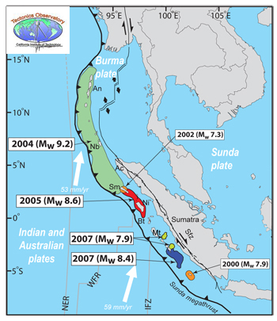
Langi village, Simeulue Island, Indian Ocean
Account by tsunami geologist, Lori Dengler of Cal State Humboldt
Notes:
Some of the best examples in modern times of societal preparation for tsunami come from intact indigenous communities. An inspiring account comes from Simeulue Island off of Sumatra, Indonesia from the 2004 Indian Ocean ocean tsunami.
Dengler, L., 2011, My Word: Surviving by learning from experience. Times-Standard, Eureka, CA (March 26).
In 2005, I was on a tsunami team studying the impacts of the tsunami in the hardest hit areas of Northern Sumatra. We visited community after community in Aceh where all the buildings had been leveled and very few people had survived. Our last stop was Langi Village on Simeulue Island. Langi was the community closest to the epicenter of the December 26, 2004, magnitude 9.2 earthquake. On Dec. 26, the earthquake damaged many of their buildings and first tsunami surges arrived only eight minutes later. Surges continued for hours, the highest reaching 30 to 40 feet and leveling every structure in the village.
I expected the same desolation to greet me in Langi that I had seen on the Aceh coast. I was wrong. We were greeted by throngs of villagers. In Langi, not a single man, woman, or child died in the tsunami. The people in Langi had the shortest amount of time between the earthquake and the tsunami as any place in the Indian Ocean, and yet every one of them had survived.
Why were there no casualties? Langi has no electricity, no computers, and no technological warning system. What the people of Simeulue Island do have is an oral tradition. They have passed stories about the dangers of tsunamis from one generation to the next. If the ground shakes for a minute or longer, everyone knows exactly what to do. Adults grab the children and use carts to wheel the elderly and sick up the hill to an evacuation site where they have stashed supplies and temporary building supplies.
In California, I often hear people expressing concerns about the Cry Wolf syndrome -- if people are asked to evacuate and nothing happens, they will be less likely to do so the next time. So I was very interested in how the Simeulue Islanders dealt with this issue. Earthquakes are fairly common in Sumatra, but great tsunamis are rare. The last deadly tsunami occurred in 1907. When I asked them if they were concerned about “false warnings,” they looked at me as if I were crazy and told me that every earthquake is an opportunity to practice their evacuation skills whether it produces a tsunami or not.

Slide 7
Thoughts & ideas
Mythic stories: Timeless/long-term region-wide stories that describe a restless earth and ocean
Oral histories: Accounts that record specific event/s (sometimes centuries-old)
Preparedness: Strong advice on how to live more safely in a geologically active region

Slide 8
Thoughts & ideas
Stories and histories in many cases belong to the teller. Consideration and respect should be exercised in repeating stories.
Native American cultures are very grounded in Place. Ex. “These lands are vital not only to our subsistence but also to our sense of being as Tlingit people.” (Gabriel George, 2008)
Attributes of indigenous ways of knowing nature: place-based, non/material world are one, relational, mysterious (all is not knowable), observational not experimentational, cyclical time.
Notes:
Some things to keep in mind when using indigenous stories/histories. “Science” and “Indigenous ways of knowing nature” are different and offer potentially complementary ways to consider the world. Please approach with respect and care.

Slide 9
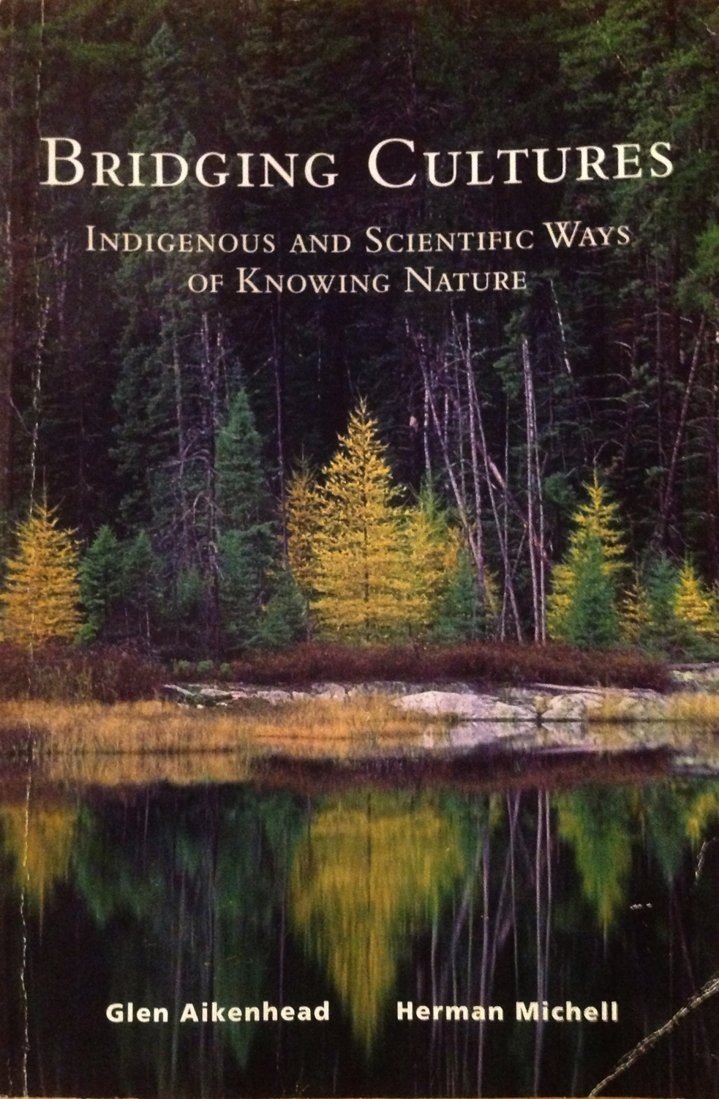
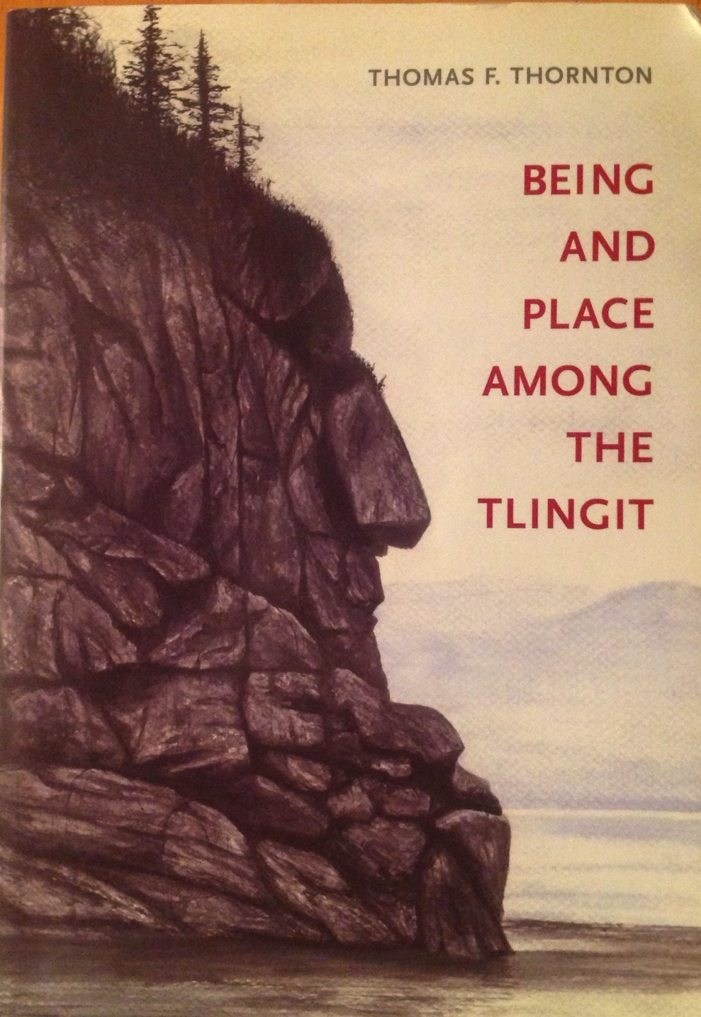
References
Ainkenhead G. and Michell, H., 2011, Bridging cultures: Indigenous and scientific ways of knowing nature. Pearson. pp 196.
Coyote Mentoring, Wilderness Awareness School. Accessed October 13, 2013http://wildernessawareness.org/program/coyote-mentoring/
Dengler, L., 2011, My Word: Surviving by learning from experience. Times-Standard, Eureka, CA (March 26).
Losey, R. J., 2005, Earthquakes and tsunami as elements of environmental disturbance on the Northwest Coast of North America. Journal of Anthropological Archaeology, v 24, p 101-116.
Losey, R. J., 2000, Oral tradition of earthquakes and tsunamis on the Central Cascadia Coast: Variation of account and relations to historically observed patterns across the Northwest Coast. Proceedings of the Fourth Annual Coquille Cultural Preservation Conference, p 1-15.
Ludwin R. S. et. al., 2005, Dating the 1700 Cascadia earthquake: Great coastal earthquakes in Native stories. Seismological Research Letters, v 76, n 2, p 140-148.
McMillan, A. D. and Hutchinson, I., 2002, When the mountain dwarfs danced: Aboriginal traditions of paleoseismic events along the Cascadia Subduction Zone of Western North America. Ethnohistory, v 49, n 1, p 41-68.
Phillips, P. W, 2007, Tsunamis and floods in Coos Bay mythology. Oregon Historical Quarterly, v 108, n 2, p 181-192. http://www.ohs.org/research/quarterly/Summer-2007.cfm
Semken, S, et. al., 2009, Factors that influence sense of place as a learning outcome and assessment measures of place-based geoscience teaching. Electronic Journal of Science Education, v 13, n 2, p 136-159.
Semken, S., & Butler Freeman, C., 2008, Sense of place in the practice and assessment of place-based science teaching. Science Education, V 92, v 1042-1057.
Thorton, T. F., 2008, Being and Place Among the Tlingit. UW Press. pp 247.

Slide 10
How would you use oral histories and native stories with your learners?

