Slide 1



Visualizing the Seismic Wavefield with EarthScope’s Transportable Array
Chuck Ammon, Penn State
Bob Woodward, IRIS
Kevin Furlong, Penn State Thorne Lay, UC Santa Cruz
AGU, Fall 2008

Slide 2
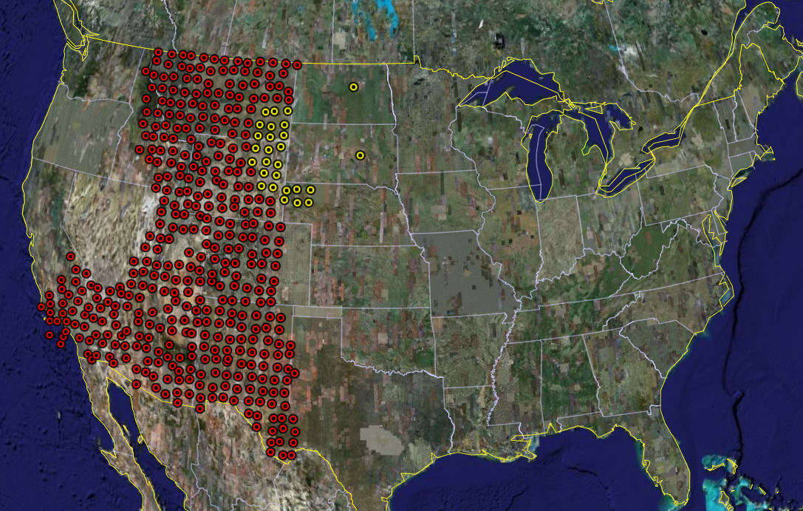
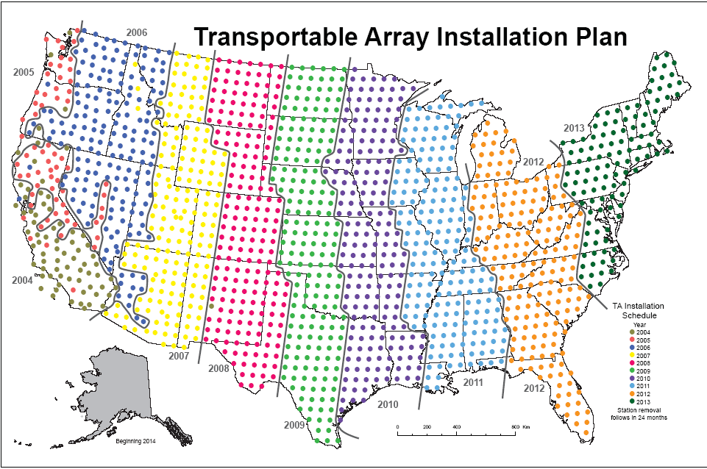
EarthScope USArray Transportable Array
2004
2013
The Transportable Array will occupy 1600 sites across the contiguous US

Slide 3
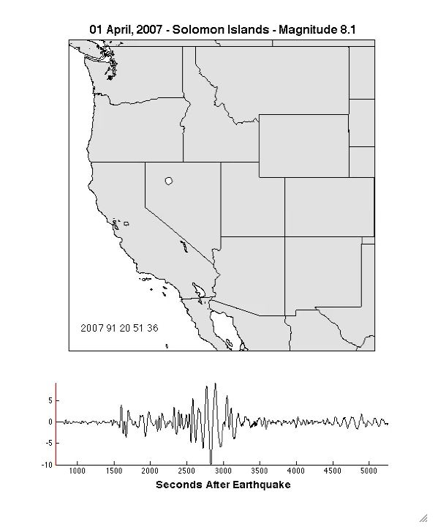
Visualizing
Seismic Data
“Animate” the ground motion at a seismic station

Slide 4
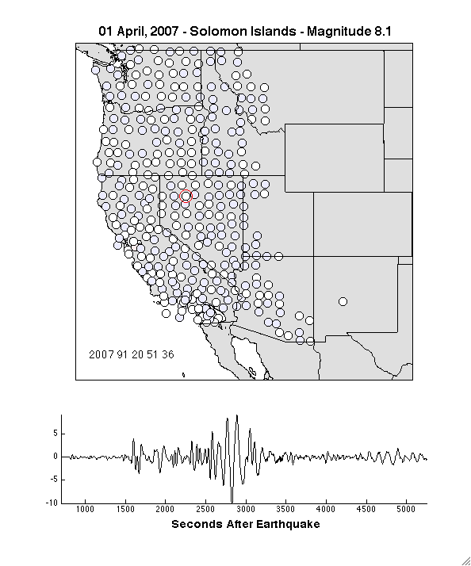
The Seismic
Wavefield
Direct visualization of the wavefield
Direct representation of the data
Data are only bandpass filtered - no other processing

Slide 5
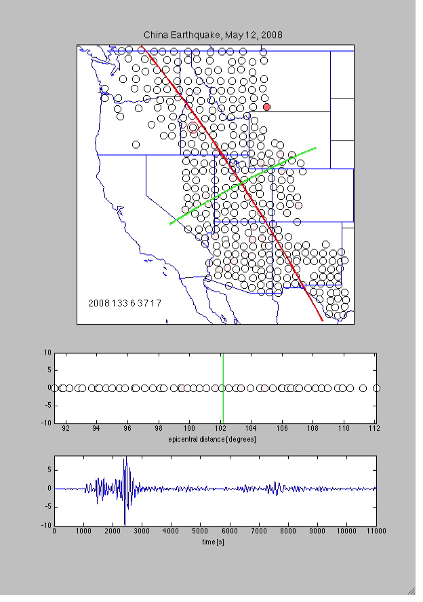
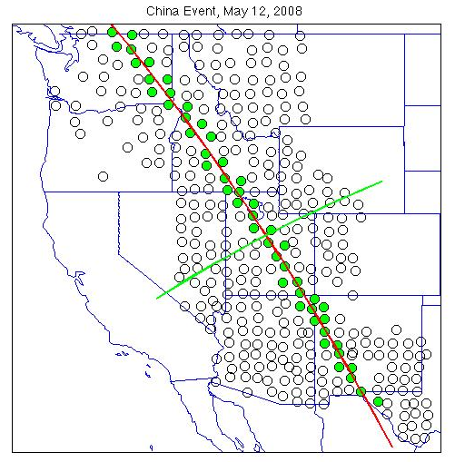
Distance Profile
Stations shown in distance profile

Slide 6
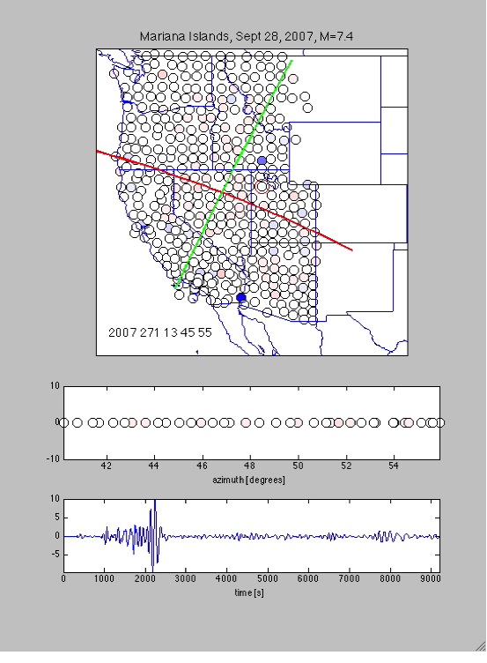
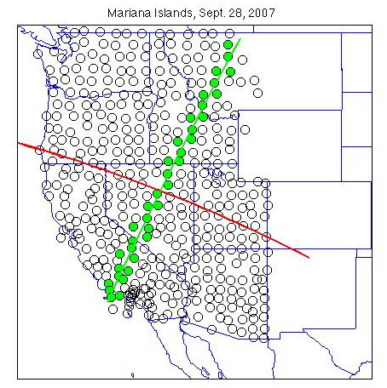
Azimuth Profile
Stations shown in azimuth profile

Slide 7
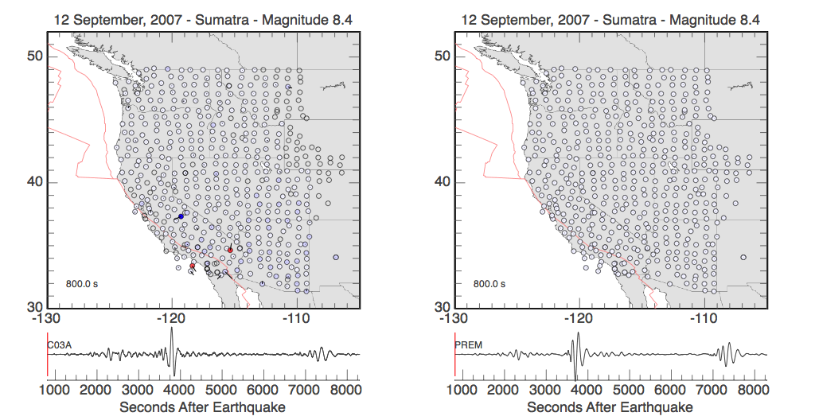
Three Component Visualizations
Observed
Predicted

Slide 8
Tell a Story
The challenge: reach a broader audience
How?
  Embed the wavefield animations in a “complete” story
Address basic questions
  Where was the earthquake?
  How did the energy get to North America
Combine synthesized content with direct representation of the data to tell a story
Represent the physics accurately
Minimize opportunities for muddling the message

Slide 9
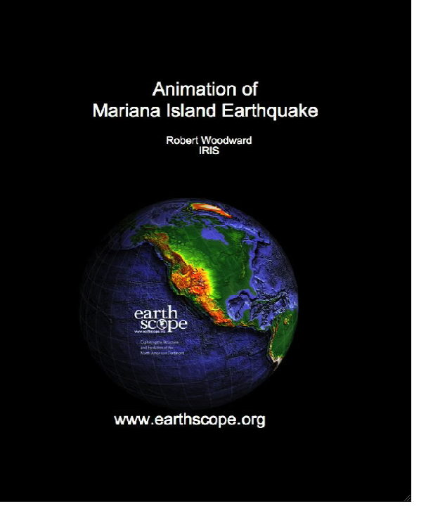

Slide 10

Represent Seismicity
Challenge: Represent global seismicity in time and space on an iPhone touchscreen

Slide 11
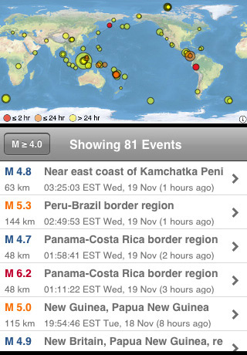
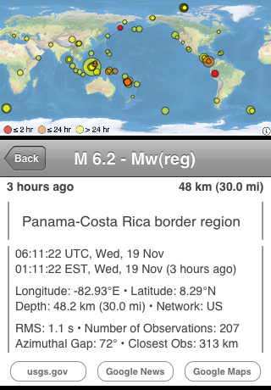
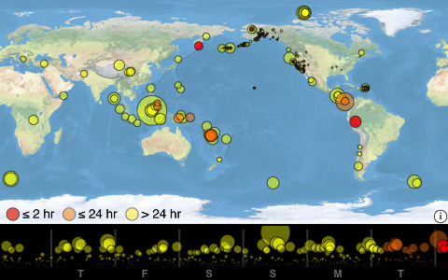
Integrate map, text, timeline, . . .

Slide 12
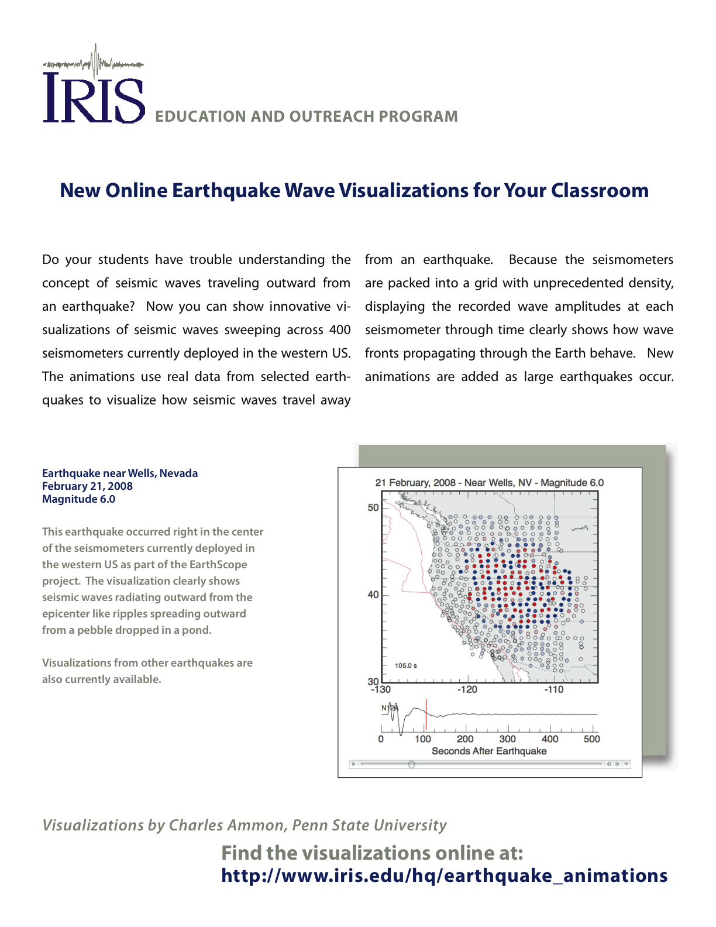
Summary
Wavefield animations provide a science, education, and outreach tool
Extensions to the basic animations broaden the potential reach, but require care to avoid mis-interpretation
See the IRIS booth for a compilation on CD
Free download of the Epicentral iPhone application
  Search for Epicentral on iTunes
More movies on the web
  www.iris.edu/hq/resource/earthquake_wave_visualizations
  eqseis.geosc.psu.edu/~cammon/QA/

