Slide 1
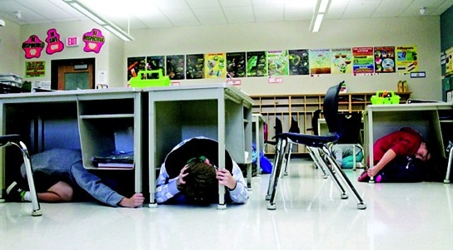
Cascadia Preparedness: Preparing for and surviving the Big One
Cascadia EarthScope Earthquake & Tsunami Education Program
Althea Rizzo~October 2013

Slide 2
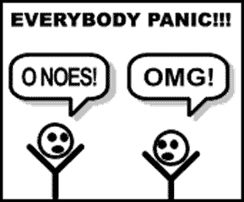
Getting from here to there …

Slide 3
Local Cascadia Event
Survive the Earthquake
Escape the Tsunami
Live the Island Life
Notes:
Now let’s switch gears and talk about the big threat…the Local Event…which is a 1-2-3 Punch! It really is three distinct events… with a fourth which is the recovery/rebuild phase.
In this section we will:
Understand the practical implications of a Local Earthquake & Tsunami
Learn how to:
Survive a Cascadia earthquake with no/minimal Injuries
Escape a Local Tsunami
Prepare to live the Island Life
Extended Thinking: Resilience, Recover, Rebuild…

Slide 4
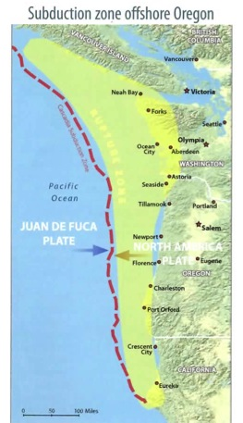
Local Cascadia Earthquake
Cascadia Subduction Zone
Magnitude 8 to 9.0+ Earthquake
4-6 minutes of intense shaking
15 million people in impact zone
Notes:
We’ve been learning about the Cascadia Subduction Zone all week. As you know, it stretches from Northern California all the way up to British Columbia.
Here’s what we can expect when it ruptures: YOU WILL FEEL IT – it will be unmistakable!
Magnitude 8 to 9.0+ earthquake
4 to 6 minutes of intense shaking on the coast
What are the consequences & implications of this kind of shaking?

Slide 5
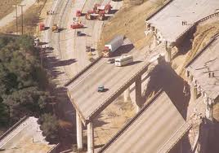
What are the Implications?
Notes:
The shaking will also be felt in the valley, on our major north-south routes like the I-5. Huge implications… Discussion

Slide 6
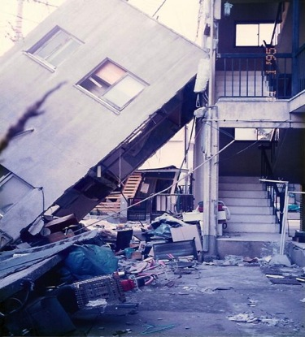
Damage to Homes
Massive sheltering in short to long term
Massive rebuilding
Notes:
Homes and businesses will be damaged. Those not securely fashioned to their foundations may have significant damage.
Most will have broken windows and other damage.
Structural damage/Inspection
Where will we get all the inspectors? (promo relevant courses, i.e. ATC 120, CERT for assessing light, moderate, heavy damage)

Slide 7
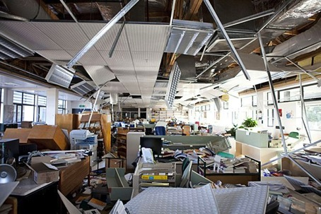
Damage to Schools
300,000 students in buildings subject to collapse during a Cascadia event
Non-structural damage
Needed for cultural continuity
Notes:
Schools will have damage.
Some may have Structural damage
Others may just need extensive Interior clean- up
All will need an inspection
Expect aftershocks…

Slide 8
Damage to Businesses
Billions in damages
Decades to rebuild

Slide 9
Roads Damaged

Slide 10
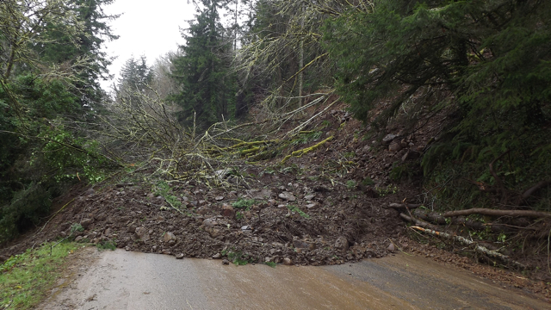
Landslides – Roads Blocked
Yaquina Bay Mudslide March 2012
Notes:
Think about the landslides we get in our environment during winter storms. Now think about those landslide-prone areas with 4-6 minutes of intense shaking.

Slide 11
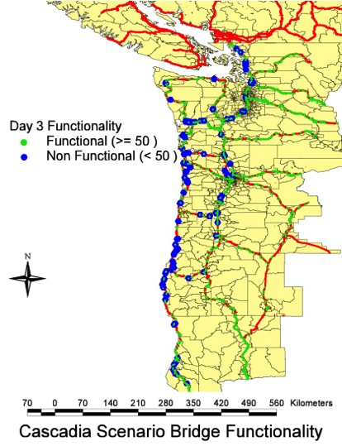
Bridges will Collapse
399 bridges would have totally or partially collapsed
621 bridges would have been heavily damaged.
Most state routes connecting Interstate I-5 with the Oregon Coast Highway would be closed. The estimated time of closure could be 3 to12 months.
The restoration of the entire transportation network could
take 3 to 5 years.
Notes:
In Oregon it is estimated that:
399 Bridges – total or partial collapse (under a M 9.0)
621 Bridges – heavily damaged
Estimated time of closure for most state routes connecting I-5 with the Oregon Coast would be 3 to 12 months… currently.
Talk about the state Resiliency Plan and what we can do now to reduce that time frame…

Slide 12
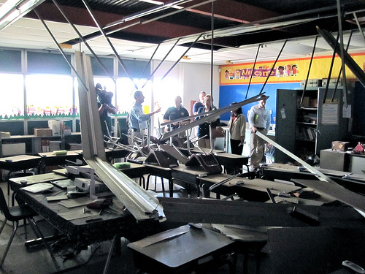
Aftershocks
Notes:
In the first 2 days following the Japan Earthquake, there were 154 aftershocks of magnitude 5 or greater.
Will people want to remain in their buildings (homes, schools, etc) when the ground continues to shake and things continue to fall and buildings are more and more compromised?
Where will they shelter? (cars, tents, buses, etc)

Slide 13
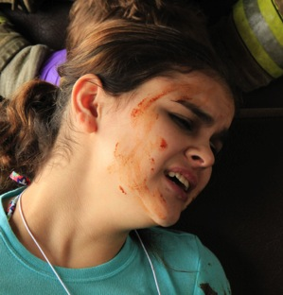
Injuries
Notes:
There will be injuries.
What if people duck, cover & hold properly? What will cause the injuries? Discussion
There won’t be easy access to professional emergency services. Who will help the injured?

Slide 14
Hypothermia
Hypothermia is a significant risk
Rainy Coastal Environment

Slide 15
Survive the Earthquake
Prevention
Protection
Modify Your Behavior
Modify Your Environment
Notes:
Let’s start with practical, inexpensive things you can do to survive the earthquake with little or no injuries.
Earthquakes are very survivable if we take these basic precautions:
Prevention: Change your environment to prevent injuries and damage (securing things, etc)
Protection: Change your behavior to protect yourself (duck, cover, hold & protective gear)
Be part of the solution, not part of the problem.

Slide 16
Prepare in Seven Steps
1- Identify Hazards
2- Create a disaster plan
3- Prepare disaster kits
4- Identify and fix weaknesses
5- Protect yourself during earthquake
6- Evacuate if necessary
7- Follow your earthquake plan

Slide 17
Prepare in Seven Steps
1- Identify Hazards
Start now by identifying items that may fall, topple, or slide.
Secure potentially hazardous and valuable items.

Slide 18
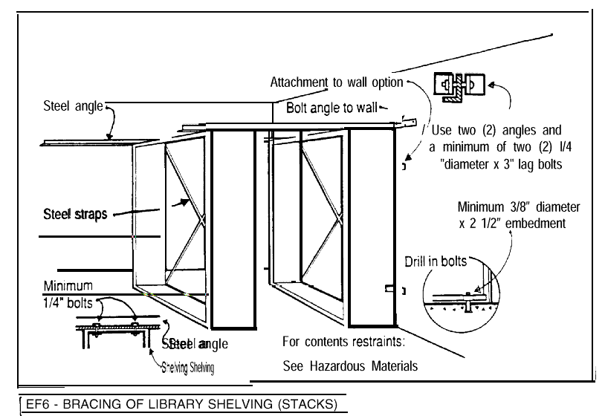
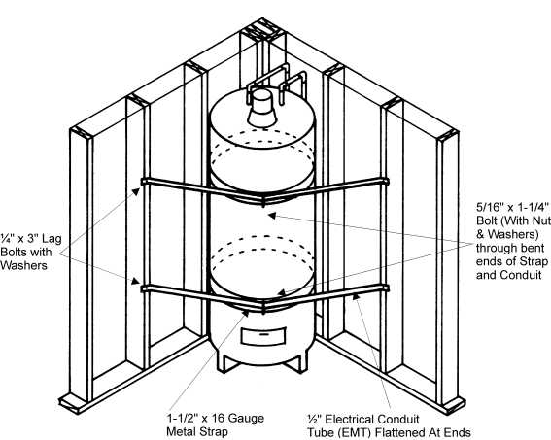
Secure furnishings

Slide 19
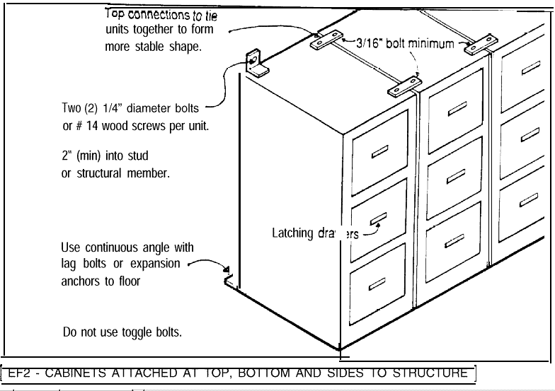
Secure furnishings

Slide 20
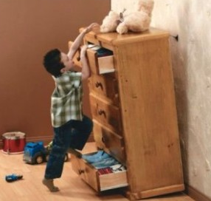
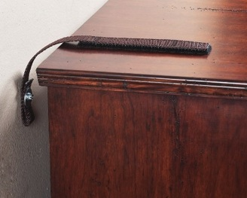
Secure Heavy Furniture
Velcro straps
L brackets
Notes:
This will not only prevent injuries, but will facilitate an easier building evacuation…which is very important, especially if you are in the tsunami zone.
This is very inexpensive and easy to accomplish.

Slide 21
Nothing Above Bed

Slide 22
Tie Supplies to Bed
Flashlight/Head-Lamp
Sturdy Shoes
Leather Gloves
What if you’re in bed when the ground shakes?
Notes:
Reduce injuries after the shaking stops…
Mask (dust or heavy-smoke like substance in the air)
Get on your hand and knees in a ball and cover yourself (especially your head/neck) with your pillow.

Slide 23
Office Hazards
Look at office spaces to see if large objects or even heavy binders could fall and injure you.
Move heavy objects to a lower shelf.

Slide 24
Prepare in Seven Steps
2- Create a disaster plan
Practice Drop, Cover and Hold on.
Plan on how to respond after an earthquake or tsunami
Plan how to communicate and recover
Practice, practice, practice!

Slide 25
But what can I do?
Have a plan! Know what to do!
Who ya gonna call?
Where will my family be and how will I reach them?
Children at school or activities
Plan for pets and livestock
Have an out-of-town emergency contact
How are you going to contact your family if phone service is not available?

Slide 26
But what can I do?
Have a plan! Know what to do!
Where will I get medical help?
Take first aid and CPR classes
Plan for back-up if family needs life-saving medical equipment
Have you taken first aid classes?
What is in your home first aid kit?

Slide 27
But what can I do?
Have a plan! Know what to do!
Am I prepared to live without the essentials?
Food
Water
Medicine
Toilet paper/ Tooth brush
Fill up the gas tank in your car frequently
How much toilet paper do you have in your house right now?

Slide 28
But what can I do?
Have a plan! Know what to do!
How will I pay for things?
Have cash on hand
ATMs/Plastic cards will likely not work
How much do you have on hand?

Slide 29
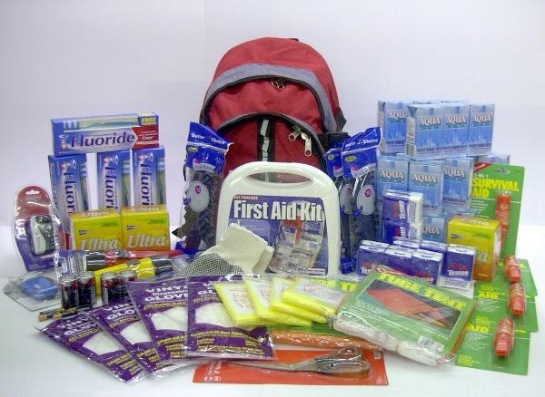
Prepare in Seven Steps
3- Prepare disaster kits
Personal/Office
Household
Car

Slide 30
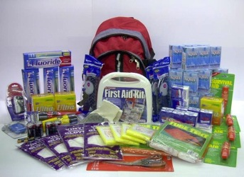
But what can I do?
Go-Kit – minimum of 72 hours
Car
Office
Home
Have 3 weeks worth of:
Food
Water
Medicine
Anything else you deem a necessity
What do you consider a necessity? (got a pet?)
http://www.ready.gov/america/getakit/

Slide 31
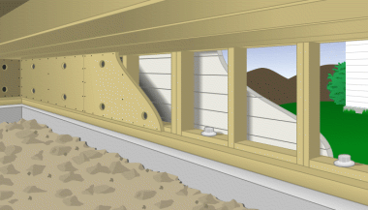
Prepare in Seven Steps
4- Identify and fix weaknesses
Common building problems
Inadequate foundations
Unbraced cripple walls
Soft first stories
Unreinforced masonry

Slide 32
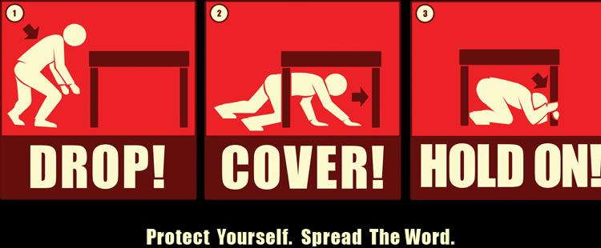
Prepare in Seven Steps
5- Protect yourself during earthquake
Drop, Cover and Hold on

Slide 33
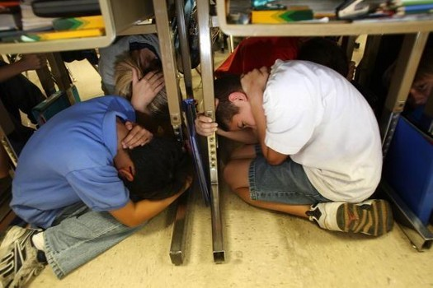
Notes:
So let’s look at the basic earthquake procedure.
Doing this procedure is so important. It will save lives and significantly reduce injuries if it’s done correctly.

Slide 34
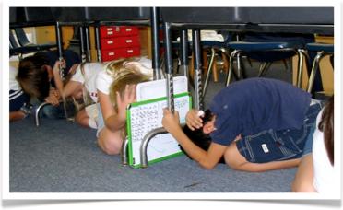
Be a small Target
Body Position
On knees
Protecting neck/head
Hold onto furniture
Curl into a ball
Face Position
Turn away from windows
Close eyes
Notes:
It’s important to get on your hands and knees and NOT on your bottom. Don’t sit down.
If you sit down under a sturdy piece of furniture and something falls on it, you only have the strength of your arms to free yourself.
If you’re on your hands and knees, you have the core strength of your body to free yourself.
Make yourself as small as possible, into a ball almost. This will reduce the likelihood of something falling on you.
Some schools instruct students to use a book or folder to protect their head, neck or face.

Slide 35
Notice Anything?
Notes:
Notice student in center of picture sitting on bottom instead of on hands & knees.
Notice student in front of picture who is not holding on to the desk.
Notice student on right who could make himself a smaller target.
Notice student on left whose head appears to be sticking out from under the desk.
This is a prime example of how teachers need to be trained correctly and then to monitor students when drilling so they can redirect students who are doing the procedure incorrectly. We need to drill correctly.

Slide 36
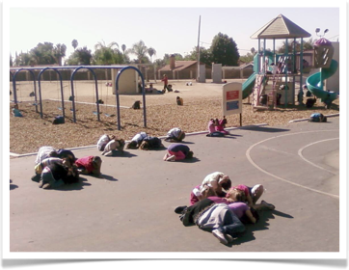
During the Shaking
If Inside, Stay Inside
Classroom
Gymnasium
Band Room
If Outside, Stay Outside
Get away from buildings, trees, light poles, power lines, utilities
Notes:
It’s common for teachers to have questions about where students should “Drop, Cover, and Hold on”. Each classroom is different.
Classroom: Under desks. If they can’t fit underneath their desk, at least try to get their head underneath. If something falls on their legs, that won’t be as severe as if something falls on their head/neck/shoulders.
Gym: Drop, Cover, Hold on next to an interior wall. Get on hands and knees and into make yourself as small as possible.
Band room: Get creative, use the chairs that students sit on to get under…even if it’s just the head/neck/shoulder.
If Outside, some people think they don’t need to Drop, Cover & Hold on. But we do. The earthquake can knock you down and injure you and things may be flying off buildings or overhead objects. We must take a protective posture during earthquakes when we are outside.

Slide 37
In a Car or Bus
Pull over to a safe location
Stop & stay there
Keep seat belt on
After shaking stops, assess your situation
Notes:
Check to see that your Bus Emergency Plan has procedures for earthquakes.
Students should take a protective position in their seats, covering their heads and turning away from windows.
After the shaking stops, assess your situation and attempt to determine if roads are passable.

Slide 38
Wheel Chair Bound
Roll into area with structural protection
Apply brakes
Cover head and eyes to best of ability
Be Advised: rescuers need to drop, cover, and hold on, too!
Notes:
For those who are in wheel chairs and are not able to get onto the floor to do a “Drop, Cover, & Hold on”, practice with them to roll themselves into an area with some structural protection.
If they are able, they can:
Apply the brakes
Cover their head and close their eyes
The Staff member must take their own protective actions so they can be part of the solution after the shaking stops.

Slide 39
3 Common Mistakes
Triangle of Life
DO NOT believe the triangle of life!
Run
DO NOT run out of the building!
Doorway
DO NOT get in a doorway!
Notes:
1. Most people are injured in earthquakes while trying to run out of the building by things falling on them.
2. Doorway: It does not protect you from falling items, and in strong shaking you are unable to stand. The door itself may knock you down, the earthquake may knock you down.
3. You are safer under, not next to a table.

Slide 40
The Triangle of Life Myths
MYTHS
TRUTH
Buildings Collapse
Anticipate
Safe Voids
You can Move
Furniture Crushed
Collapse: Most buildings do not collapse
Moving: Strong shaking makes moving very difficult and dangerous
Voids: The direction of shaking and unique structural aspects of the building make this impossible.
Furniture: People DO survive under furniture or other shelters.
Notes:
The “Triangle of Life” is based on several wrong assumptions:
The Red Cross and FEMA and other reputable national earthquake organizations have refuted the “triangle of life” advice for the United States.
Myth: Buildings always collapse in earthquakes
Truth: Most buildings do not collapse at all, and few completely collapse.
Myth: During strong shaking people can move to a desired location.
Truth: Strong shaking can make moving very difficult and dangerous.
Myth: People can always anticipate how their building might collapse and find the survivable void spaces.
Truth: The direction of shaking and unique structural aspects of the building make this impossible.
Myth: When buildings collapse they always crush all furniture inside.
Truth: People DO survive under furniture or other shelters.

Slide 41
Prepare in Seven Steps
6- Evacuate if necessary
Know if you are in the Zone
Do not wait for an official warning
Check for injuries
Check for damage

Slide 42
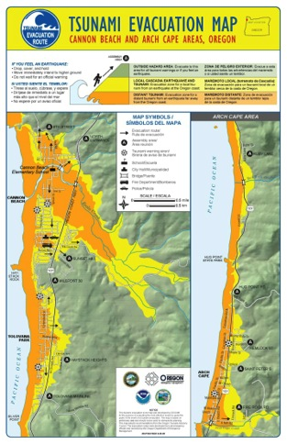
But what can I do?
Have a plan! Know what to do!
Do I live, work or visit in a tsunami hazard zone?
Know your evacuation route and PRACTICE!
Know where you will evacuate to.
If you are in a safe area, stay there!
There will be no official warning.

Slide 43
After the Earthquake
Assess
Glass
Dust
Fire
Darkness
Protect
Gloves
Mask
Flashlight
Evacuate
Obstacles
Assistance
Routes
Notes:
After the ground stops shaking,
Assess your situation: hazards such as glass, dust, fire, darkness
Protect yourself: leather gloves, dust mask, flashlight (fire extinguisher if available) (all this depends on time available – tsunami zone considerations)
Evacuate the building: Obstacles, secondary routes, assist those in need
One of the most common hazards in earthquakes are broken windows – GLASS. This presents a real safety hazard. It is also common for a lot of dust (almost like a heavy smoke) to be floating around. Consider instructing students to cover their mouth and nose with their sleeve while you evacuate to reduce how much dust they breath in. In many cases, the power will be out. Flashlights can be very useful in this situation.
Take supplies with you if you are able…(unless you’re in the tsunami zone and need to hurry)
Tsunami Zone – evacuate immediately to high ground!!! Don’t wait…just go!

Slide 44
Local (Cascadia) Tsunami
Waves & Surges
Arrive in 15+ minutes
Continue 10-12+ hours
Back & Forth
Notes:
Let’s switch gears and talk about what is referred to as a “Local Tsunami.” That is, a tsunami caused by an earthquake near our shore, an earthquake that we FEEL.
Tsunami waves and surges will begin arriving on the Oregon Coast approximately 15-30 minutes after the earthquake starts…
The waves and surges can continue for 10-12 hours or more, possibly even for several days.
The waves and surges come in and go out, in and out, scouring away at structures and landscape, etc…carrying debris and hazardous materials with each wave/surge. (they also swirl around – toilet bowl illustration)

Slide 45
Escape the Tsunami
Learn
Practice
Tsunami zones
Evacuation Routes
Safe Areas
Go on Foot
Assist Others
Consider Options
Notes:
Education
Know the zones
Identify safe areas
2. Practice
3. Safety

Slide 46
Know the Zones Tsunami Evacuation Maps
Notes:
There are two different kinds of maps we can use to learn the tsunami zones. The most commonly used is the “Tsunami Evacuation Map” which is the one made specifically for the public to learn both the Distant and the Local Tsunami Zones. The zones were made based on the worst-case scenario for each the distant and local tsunami.
The other map, the “Tsunami Inundation Map” is used for more in depth planning and shows several different scenarios of tsunami inundation based on the size of the earthquake.

Slide 47
Mobility Challenges?
Notes:
Look at all these people (homes) who live in the “local” tsunami zone (yellow) here in Gleneden Beach! Many of them are elderly and may feel like they cannot possibly (physically) make it to the green (safe) zone in 15 minutes. Especially those right along the shore…it’s just too far for them to walk.
So they decide to give up and not even try. REMEMBER, THERE MAY BE VERTICAL EVACUATION OPTIONS!

Slide 48
Don’t Give Up!
Notes:
Check out a magnitude 8.9…the light purple zone. On this map, most of the homes & buildings in are in the yellow 9.0+ zones. That means that if we have a magnitude 8.9, most of these people’s homes are not going to be inundated with tsunami waves. For those homes right by the shore, they don’t have to go very far to escape the tsunami if it’s an 8.9.
You don’t know where the earthquake is (could be just the southern portion of the subduction zone)
You don’t know how big the earthquake is.
You don’t really know how far the tsunami is coming.
You also don’t know how soon it will arrive.
Move to higher ground. Every step closer you take to higher ground is a step closer to safety.

Slide 49
Identify High Ground
Signs
Evacuation Routes
Safe Areas
Temporary Assembly Areas
Vertical Evacuation Options
Notes:
Know if you’re in the Tsunami Zone WHETHER YOU’RE AT HOME, SCHOOL, WORK, GROCERY STORE, CHURCH, PARK, etc.
Know where “high ground” is (options in case primary route is blocked) even when you’re driving.
Practice walking to high ground
Waves continue to come for 10-12 hours or more (24?)

Slide 50
Practice
Go On Foot
Assist Others
Consider Options
Notes:
Practice from different locations
Make a game of it…where would we go right now if we felt an earthquake?
Don’t forget pets.
Go on foot. Walk or run. Roads will probably be impassible. Some may try to ride a bike… (Time yourself)
Practice evacuating with those needing assistance: children, elderly, those with mobility challenges, pets, etc.
Consider options for routes & assembly areas. Try different routes and assembly areas.

Slide 51
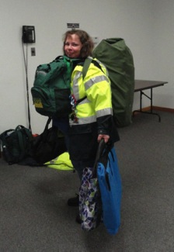
To Carry or Not To Carry Supplies
Situation
Ability
Distance
Time
Notes:
Practice assessing your situation to see if you can also practice carrying emergency supplies
You may or may not want to bring supplies – class discussion (pros and cons)
Consider storing them in advance at a friends house on high ground.
If stopping to go and retrieve your supplies is going to cost your life, don’t do it. You’ve got to escape the tsunami before you can start thinking about those supplies you need to meet your basic needs. First things first.

Slide 52
The Discipline to STAY PUT!
When Do You Return
to the
Tsunami Hazard Zone?
Notes:
Tsunami waves/surges may come for 10-12 hours or more, possibly even days.
Aftershocks, large ones can even produce more tsunami waves.
Debris, hazardous materials
Curiosity Killed the Cat!
There will be a lot to do to meet basic needs. Rather than wait around for the tsunami waves to end, get to work meeting needs and preparing to live the Island Life.

Slide 53
Distant Tsunami
You won’t feel the ground shake
Earthquake Far Away
Limited Inundation
4+ hours before waves arrive
Notes:
EQ in Alaska is biggest threat, biggest impact
YOU WON’T FEEL THE EARTHQUAKE!

Slide 54
Know the “Distant” Zone
Beaches
Harbors
Rivers, Inlets
Other low-lying areas
Notes:
The Distant Tsunami zone is very limited in comparison to the Local Tsunami Zone.
Only evacuate if you are in the Distant Tsunami Zone.

Slide 55
Tsunami Alert Messages West Coast & Alaska Tsunami Warning Center
Alert Level | Threat | Action
Information Statement | Minor waves at most | No action suggested
Watch | Danger level not yet known | Stay alert for more info
Advisory | Strong currents likely | Stay away from the shore
Warning | Inundating waves possible | Full evacuation suggested
Notes:
When a significant earthquake occurs a large distance from the Oregon Coast, from an earthquake that we don’t feel, a Distant Tsunami may be generated. The West Coast and Alaska Tsunami Warning Center (http://wcatwc.arh.noaa.gov/) in Palmer, Alaska is the government organization which provides information to the public regarding tsunami threats to our area. There are four separate alert levels: Information Statement, Watch, Advisory, and Warning. Each has a distinct meaning and suggested action:

Slide 56
Distant Tsunami Notification
Mass Notification Systems
NOAA Alert Radio
Sirens
TV/Radio
Social Media
Notes:
There are several different methods the public may be notified of a coming Distant Tsunami.
Mass Notifications Systems: Phone calls, text messages, email notifications, Reverse 911 type of systems, National Weather Service notifications
Citizen Alert/NWS Alert. (Teach how to sign up.) Smart phone app’s.
SHOW: NOAA Alert Radio – Be sure to get a radio with the “Alert” feature. It’s your own personal siren.
Sirens – some communities have sirens – these are for distant tsunamis
The Media: Traditional (TV, Radio, etc), Social Media (Face Book, Twitter, etc)

Slide 57
Evacuation Before a Distant Tsunami
WHO: Only those in the distant tsunami zone
HOW: Probably by car
WHERE: ???
Notes:
Evacuation for a Distant Tsunami is very different than from a local earthquake/tsunami.
Ask Participants (Pair Share): Where should people go when evacuating for a distant tsunami?
Locals
Visitors/Tourists
Students
Does your school, park, or business have a plan for a Distant Tsunami? (Show LCSD’s Distant Tsunami Plan as a sample)

Slide 58
Re-entry After a Distant Tsunami
Cancellation Message
Re-enter with Caution
Damage
Harbors
Beaches
Low-lying areas
Roads, Bridges
Clean up
Notes:
How do you know when a distant tsunami is over?
Cancellation Message: Wait for cancellation message (from National Weather Service)
Re-enter with caution: Local emergency service officials may provide specific re-entry instructions based on damage to certain areas/infrastructure.
Damage: Possible damage in harbors, near beaches and other low-lying areas. Some roads may be impassible, temporarily, there may be hazardous materials, fires, or other hazards involved.
Clean up: There may be Clean up that is necessary.

Slide 59
SHOULD ANYONE DIE
FROM A DISTANT TSUNAMI?
NO
Notes:
Brief discussion. Why or why not.
Possible points of discussion include:
Multiple warning mechanisms
Plenty of time to evacuate
Smaller inundation area
The answer is NO! Absolutely NOT! With proper education and preparation, nobody should die from a distant tsunami.

Slide 60
Prepare in Seven Steps
7- Follow your earthquake plan
Once safe, continue your disaster preparedness plan.
Stay away from the beach.
Be in communication
If you cannot stay in your home…
Tell a neighbor and your out-of-state contact where you are going

Slide 61
Prepare for Island Life
Psychological
Communication Plan
Meeting Place
Emotional Recovery
Physical
Shelter & Warmth
Water & Food
Medical & Sanitation
Notes:
Now Let’s talk about how to prepare to live in an “island-like” environment.
Meeting basic physical and psychological needs is the primary objective.

Slide 62
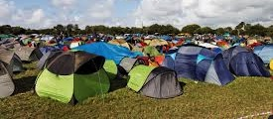
Emotional Recovery
Imagine Extended Camp Life
without infrastructure
Give Everyone a Job!
Notes:
There will be a lot to do and giving people tasks (jobs) will help in their emotional recovery. It will also help accomplish the many things that will need to get done to meet daily needs.
Filling sand bags
Gathering water
Comforting the wounded or emotionally distraught
Taking care of little ones
Setting up shelters
Hunting for food, cooking, cleaning
Collecting fire wood, building fires
Collecting things to sleep on
Digging holes for latrines
Tending to the wounded
Personal care & sanitation (without infrastructure

Slide 63
Without Utilities
No Running Water
No Electricity
No Communications
No Sewer System
No Garbage Pick-up
No Fuel
No Groceries in the Store
No Pharmacy
Notes:
Our normal infrastructure, those things we use constantly will no longer be available.
We won’t be able to call 911 for help. We will need to work together to learn how to survive.

Slide 64
Living Outside (…in Oregon)
Notes:
Remember that the even if you are not in the tsunami zone, the earthquake will have incredible consequences. We will need to prepare to live outside.
Today’s building codes are designed at a level of “Life Safety” rather than occupancy after an earthquake. So even if you’re in a newer home or school or other building, you probably won’t be able to stay inside.
Remember all the aftershocks?!!!

Slide 65
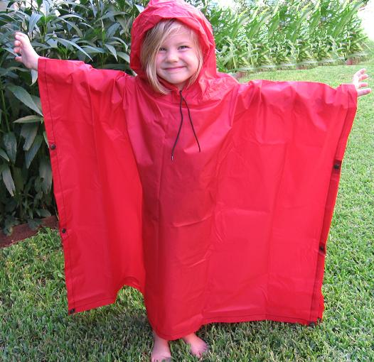
Protection from the Rain
Notes:
Immediate Protection from the Rain
You could keep rain gear in your car or you could simply go to the dollar store and buy a 2-pack of rain ponchos for $1.00.

Slide 66
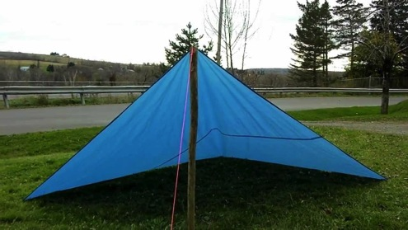
Make-shift Shelter
This is not a viable solution on the Oregon Coast – WIND!
Notes:
People will be making all kinds of make-shift shelters, but we need to consider the windy environment that we live in most of the time…and how to secure shelters so they will be functional and safe.

Slide 67
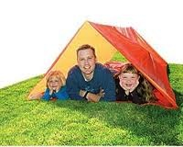
Shelter & Warmth
High Occupancy Tent
Tube Tent
Notes:
Tube Tents are low to the ground so they don’t catch the wind as easily.
Shower curtain & rope at the dollar store
Mylar Blankets, hats, socks, gloves

Slide 68
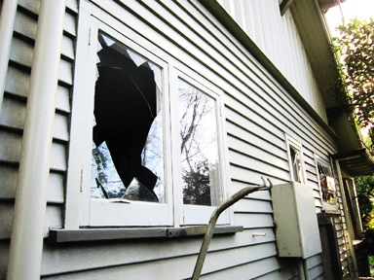
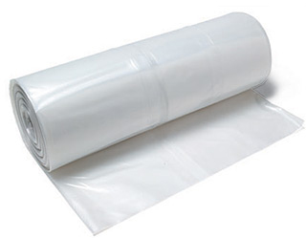
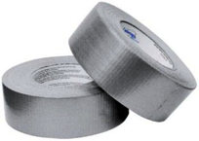
Expect Broken Windows
Plastic Sheeting
Duct Tape
Notes:
Benefits to covering windows (use clear plastic to allow for light to come in):
Protects home from the elements
Protects home from rodents, animals
Once aftershocks have reduced and you begin clean-up (assuming there isn’t structural damage), these become your new windows.
If you’re not able to re-occupy your house, you can use the plastic sheeting for sheltering outside.
Other benefits to having this available – discuss shelter-in-place for hazardous materials threat.

Slide 69
Water
Water Filter Straw
55-Gallon Barrel of Water
Notes:
Need ½ gallon per person per day of drinking water. Another ½ gallon for sanitation.
Water from water heaters that have been securely strapped.
Use water filter straw to filter water from rain water or from creeks/streams not contaminated by the tsunami.
Other stored water (55-gallon barrels, etc)

Slide 70
Food
Notes:
Salvage food from homes, schools, etc. Eat perishable foods first.
Stores will be emptied quickly. Some will be destroyed by the tsunami.
Survival Food Bars don’t take up much room, they last for years, and they are high in calories…which we will need during survival situations.
Gardens, wild foods like berries, hunting, etc.

Slide 71
Sanitation
Notes:
You’ll need a mechanism to dispose of waste…or else disease will crop up quickly.
I keep a Survival Book in the trunk of my car.
Sanitary Supplies
Diapers
Toilet Paper
Hand Sanitizer

Slide 72
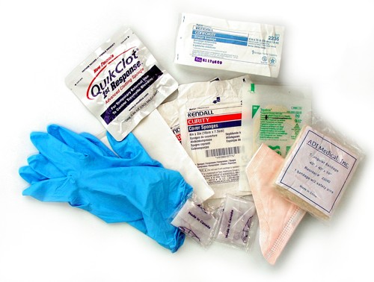
First Aid & Medications
Notes:
Basic first aid supplies are a must. If you have prescription medications that you can’t live without, you’ll need an extra supply and to rotate them.

Slide 73
Will Your Behavior Change?
Practice Evacuation Routes
Gather Supplies
Mass Notification Systems
Duck, Cover, Hold
Communication Plan
Prevention & Mitigation Actions
Build Community Capacity
Notes:
If your behavior changes, for everyone one of these things you do to prepare, you will encourage others to do the same.

Slide 74
Thank you!
Cascadia EarthScope Earthquake & Tsunami Education Program
Althea Rizzo~ October 2013

