Slide 1


Surviving Afterwards
Survive the Earthquake
Escape the Tsunami
Short & Long Term Survival
CEETEP
Sue Graves ~ August 2015

Slide 2
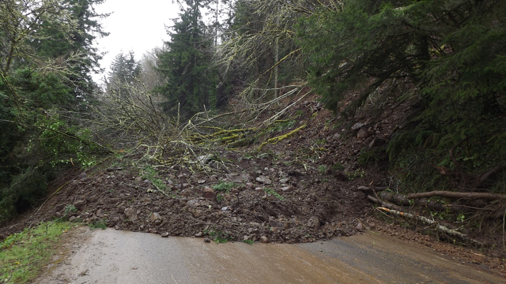
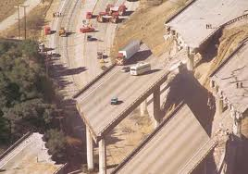
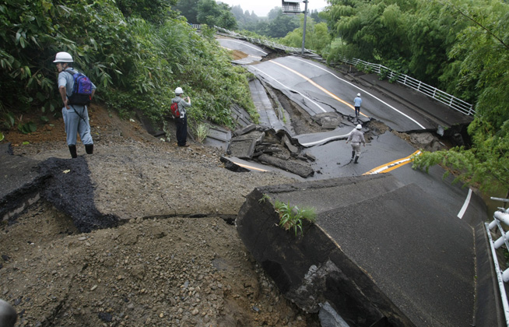
Separated by…
Failed Bridges
Landslides
Buckled Roads
Liquefaction
Notes:
We will be separated physically due to bridge failure, landslides & road failure, debris, hazardous materials…

Slide 3
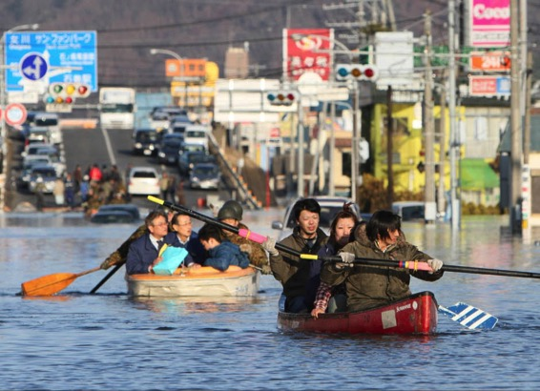
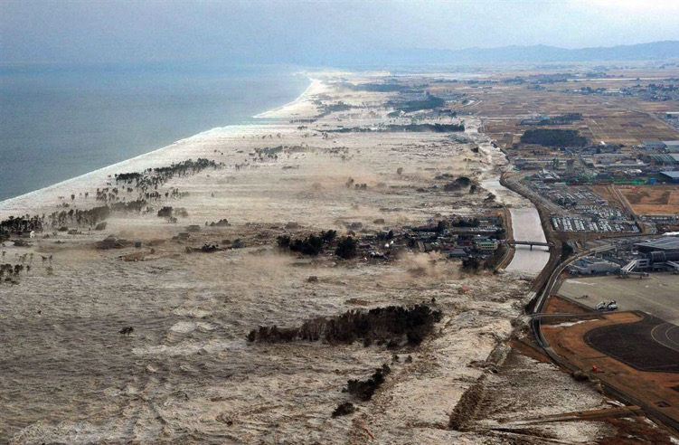
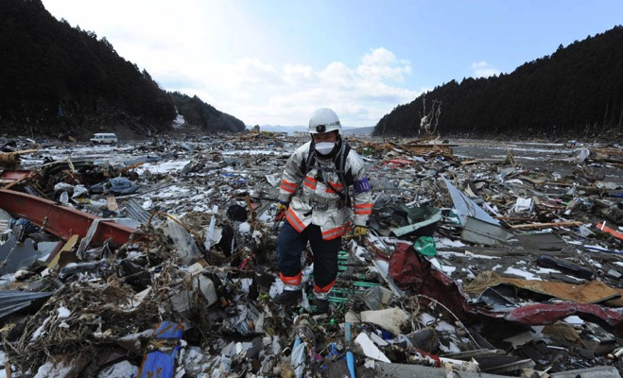
Separated by…
Debris
Hazardous Materials
New Tidal Level
Notes:
We will be separated physically due to bridge failure, landslides & road failure, debris, hazardous materials…
The earthquake & tsunami will divide the coast into several areas that are cut off from each other, essentially creating many islands – if you will.
It will be very difficult to communicate between islands or move between islands.
Let’s prepare so we won’t feel like this picture! Ha ha

Slide 4
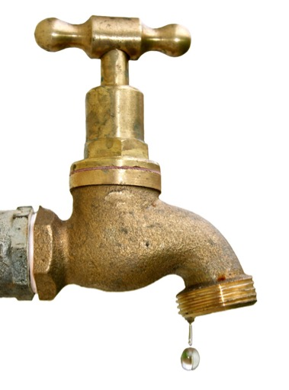
Without Utilities
No Running Water
No Electricity
No Communications
No Sewer System
No Garbage Pick-up
No Fuel
No Groceries in the Store
No Pharmacy
Notes:
Our normal infrastructure, those things we use constantly will no longer be available.
We won’t be able to call 911 for help. We will need to work together to learn how to survive.

Slide 5
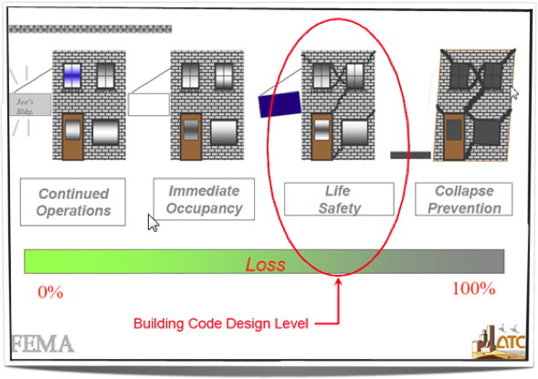
Living Outside
Notes:
Remember that the even if you are not in the tsunami zone, the earthquake will have incredible consequences. We will need to prepare to live outside.
Today’s building codes are designed at a level of “Life Safety” rather than occupancy after an earthquake. So even if you’re in a newer home or school or other building, you probably won’t be able to stay inside.
Remember all the aftershocks?!!!
154 in 1st 2 days after Japan earthquake (magnitude >5)
That’s one aftershock every 18 minutes.

Slide 6
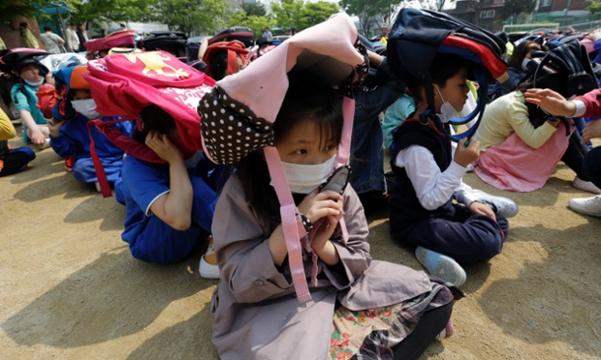
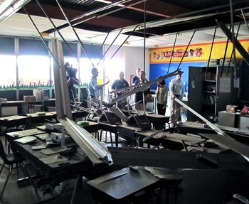
Expect After Shocks
In Japan
  154 Aftershocks in first 2-days alone
  Magnitude 5 or greater
  Many more
School Building probably not SUITABLE for shelter
Drop, Cover & Hold-On
Even Outside

Slide 7
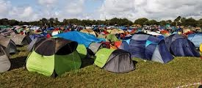
Imagine Extended Camp Life Without Infrastructure
Notes:
There will be a lot to do and giving people tasks (jobs) will help in their emotional recovery. It will also help accomplish the many things that will need to get done to meet daily needs.
Filling sand bags
Gathering water
Comforting the wounded or emotionally distraught
Taking care of little ones
Setting up shelters
Hunting for food, cooking, cleaning
Collecting fire wood, building fires
Collecting things to sleep on
Digging holes for latrines
Tending to the wounded
Personal care & sanitation (without infrastructure

Slide 8
Get Organized
Order vs. Chaos
Find people with good leadership & organizational skills
Incident Commander
Medical Treatment Area
Shelter & Warmth
Water & Food
Sanitation
Supervision & Security
Search & Rescue
Give Everybody a Job

Slide 9
Inventory of Skills
What Can People Do?
Medical Skills
Construction Skills
Childcare Skills
Spanish Language Skills
Building Fire
Counseling Skills
You’ll be amazed at the skills, experience, and abilities people bring to the table.

Slide 10
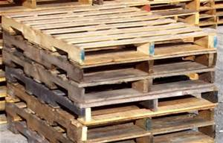
Inventory of Things
Things Available in your Surrounding Area
Bricks, Pallets
Gutters
Shovels
Medical Supplies
Food Items
What do you have available and what can you salvage?
Keep Records

Slide 11
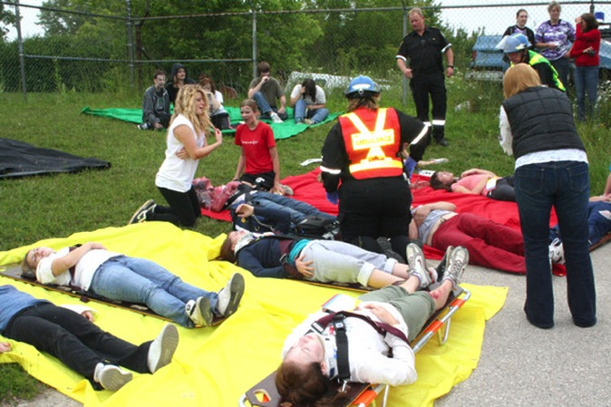
Medical Treatment Area
Who has skills?
  First Aid
  Disaster Medical
  Health Care Professionals
  CERT Members
Set up treatment areas
  Who will be in charge?
  Where will you set up?
  Tend to injured
  Comfort the wounded
Gather medical supplies
  From schools, buildings
  Be creative
  Sheets, cardboard, etc.

Slide 12
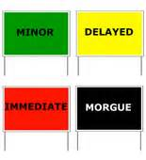
The Reality Nobody Wants to Talk About
How will we deal with the dead?
  Respectfully
  Safely
  Compassionately
Setting up and operating a Morgue

Slide 13
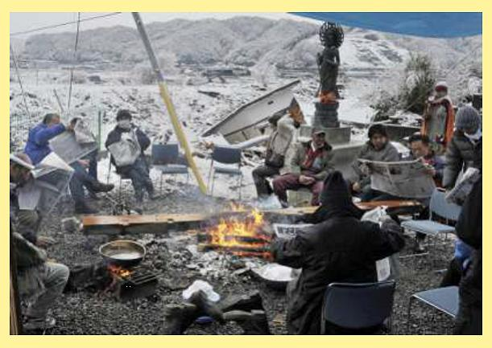
Shelter & Warmth
Hypothermia is a significant risk
Rainy Coastal Environment

Slide 14
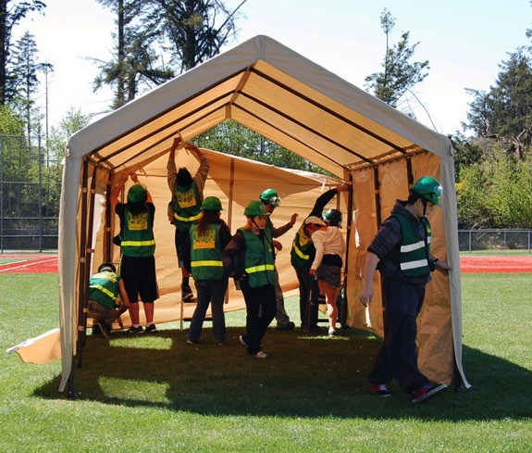
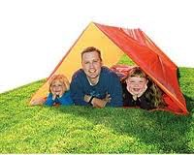
Shelter
Tents
Tarps & Rope
Shower Curtains
Secure from Wind
Sandbags
High Occupancy Tent
Tube Tent

Slide 15
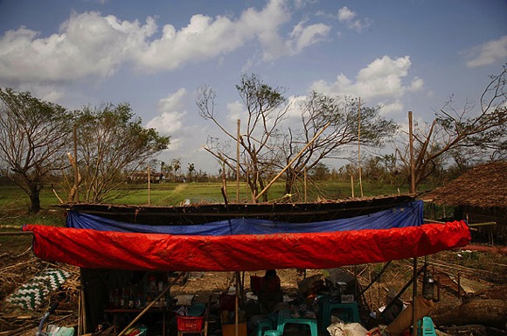
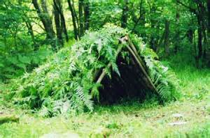

Make-shift Shelters
Build a Fort!
Use Available Resources
Be Creative
Think about stability – WIND
Think about security – Wild Animals
Notes:
People will be making all kinds of make-shift shelters, but we need to consider the windy environment that we live in most of the time…and how to secure shelters so they will be functional and safe.

Slide 16
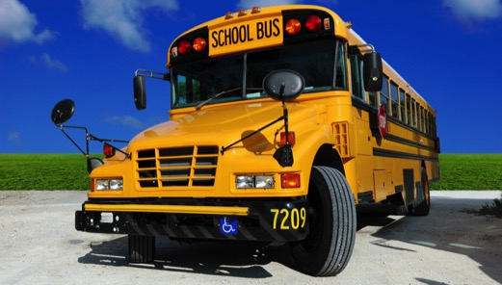
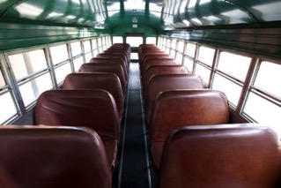
Other Shelter Possibilities
Buses, cars, trucks, campers
Sheds
Baseball Dugouts
Single story structures
  Minor Damage
  Clean up glass
  Cover windows with plastic sheeting
  Remove everything that could fall: Think Aftershocks

Slide 17
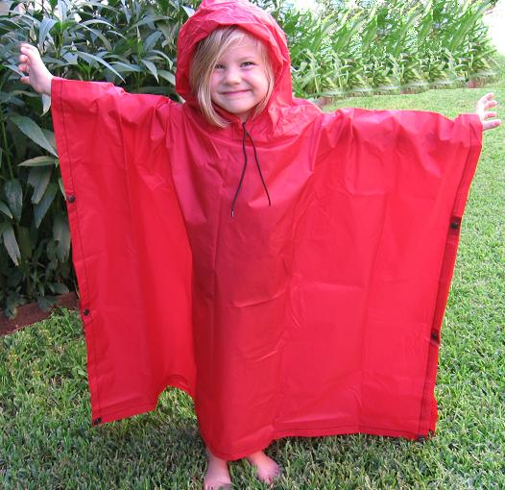
Warmth
Rain Ponchos
Mylar Blankets
Hats, Socks, Gloves, Jackets
Camp Fires
  Collect Firewood
  Collect Rocks, Bricks, etc.
  Safety, Safety, Safety

Slide 18
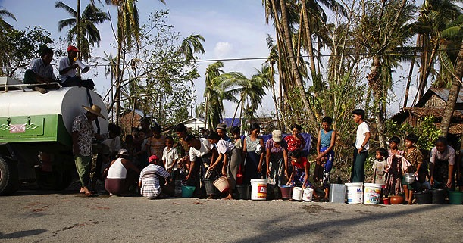
Water: Is this Realistic?
The water supply will be destroyed
Need water to survive
½ gallon per person, per day

Slide 19
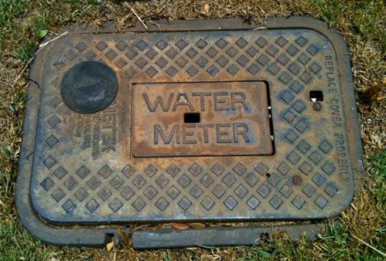
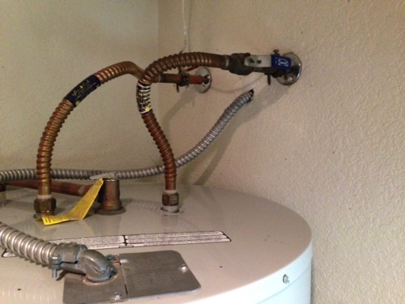
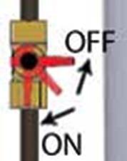
Protect Water Sources at Home
Water Heater
Water in Pipes
Notes:
Need ½ gallon per person per day of drinking water. Another ½ gallon for sanitation.
Water from water heaters that have been securely strapped.
Use water filter straw to filter water from rain water or from creeks/streams not contaminated by the tsunami.
Other stored water (55-gallon barrels, etc)

Slide 20
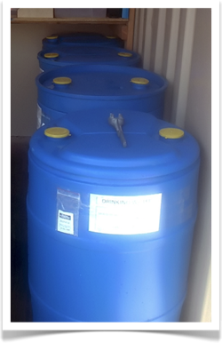
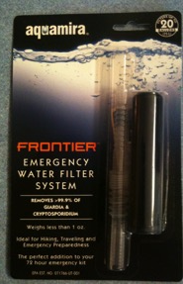
Water is Essential
Cached Water Supplies
  Immediate Rationing
  Check Expiration
  Purification & Filtering
Water Collection Systems
  Rain Water Harvesting
  Scout out Creeks/Streams not contaminated
Water Filtration Systems
55-Gallon Barrel of Water
Water Filter Straw
Notes:
Need ½ gallon per person per day of drinking water. Another ½ gallon for sanitation.
Water from water heaters that have been securely strapped.
Use water filter straw to filter water from rain water or from creeks/streams not contaminated by the tsunami.
Other stored water (55-gallon barrels, etc)

Slide 21
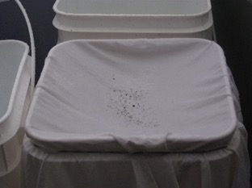
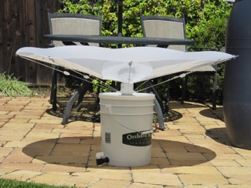
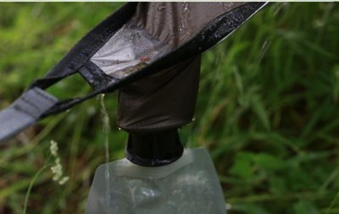
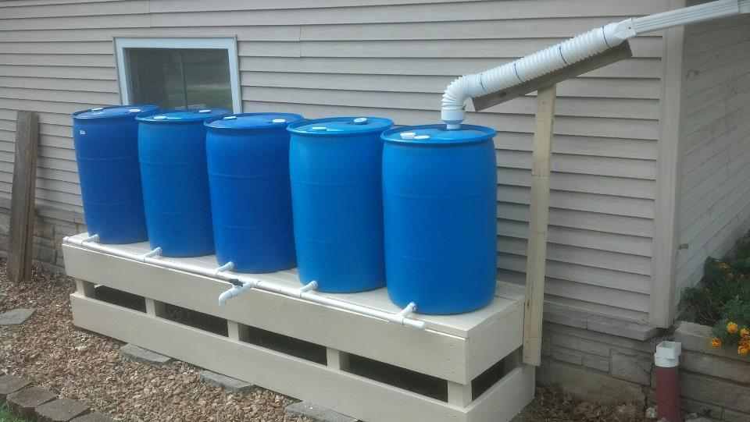
Water Collection Systems
Be Creative!
Get Right to Work On This!

Slide 22
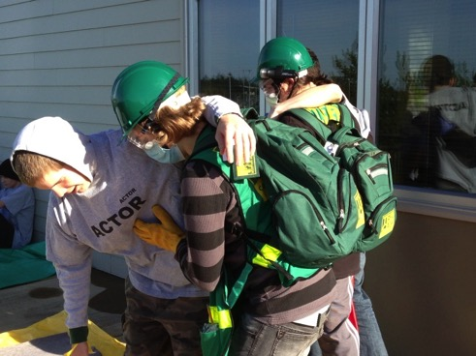
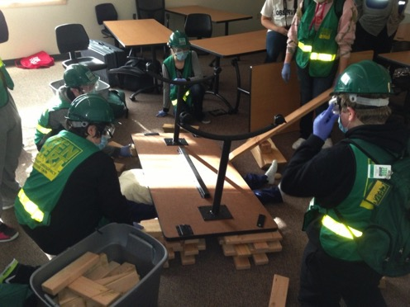

Search & Rescue
Community Emergency Response Teams (Teen CERT)
Who will safely rescue those who are trapped?
Protective Gear & Supplies
CERT Members
  Light Fire Suppression
  Disaster Medical
  Light Search & Rescue
  Disaster Psychology
  Incident Command System
School: Teen CERT Webinar http://rems.ed.gov/TeenCertEnhancingSchoolEmergMgrment.aspx
Adults: CERT http://www.fema.gov/community-emergency-response-teams/

Slide 23
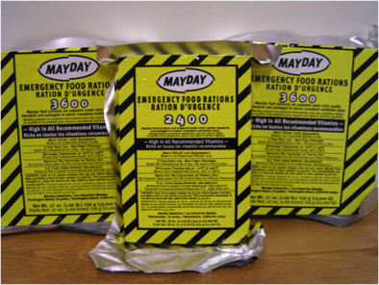
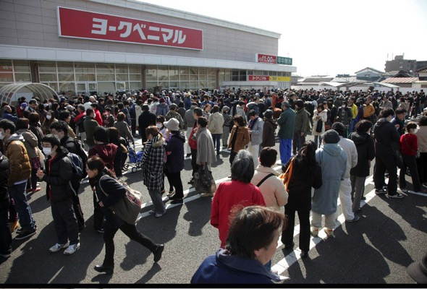
Food Possibilities
Who will be in charge?
Cached Food
Salvage from:
  School Kitchens
  Abandoned Homes??
    Document, document, document
Eat perishable foods first
Carefully Ration Food Supplies
Notes:
Salvage food from homes, schools, etc. Eat perishable foods first.
Stores will be emptied quickly. Some will be destroyed by the tsunami.
Survival Food Bars don’t take up much room, they last for years, and they are high in calories…which we will need during survival situations.
Gardens, wild foods like berries, hunting, etc.

Slide 24


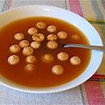

Food Possibilities
Find Plants, Edibles, Berries
Hunting
BOOKS!
Notes:
Salvage food from homes, schools, etc. Eat perishable foods first.
Stores will be emptied quickly. Some will be destroyed by the tsunami.
Survival Food Bars don’t take up much room, they last for years, and they are high in calories…which we will need during survival situations.
Gardens, wild foods like berries, hunting, etc.

Slide 25

Food Possibilities
Fishing & Clamming
Are Problematic
Due to Hazardous Materials
Contamination

Slide 26
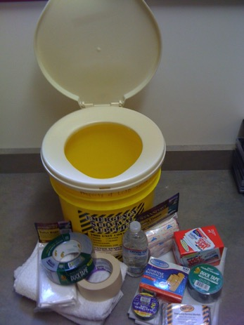
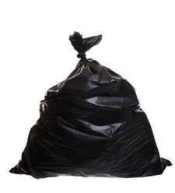
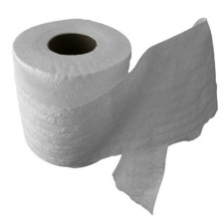
Sanitation
Who will be in charge?
Identify Locations for Toilets
  Privacy
  Safety
  Health
Gather Supplies
Put people to work setting up systems, digging holes for latrines, etc.
Notes:
You’ll need a mechanism to dispose of waste…or else disease will crop up quickly.
I keep a Survival Book in the trunk of my car.
Sanitary Supplies
Diapers
Toilet Paper
Hand Sanitizer

Slide 27

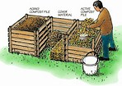
Sanitation
Systems for disposing of Human Waste
  Composting
Notes:
You’ll need a mechanism to dispose of waste…or else disease will crop up quickly.
I keep a Survival Book in the trunk of my car.
Sanitary Supplies
Diapers
Toilet Paper
Hand Sanitizer

Slide 28
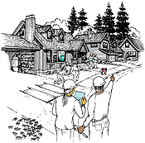
Neighborhood Preparedness
First Responders may be overwhelmed
Neighbors will be the first ones to offer assistance.
Map Your Neighborhood
Training
Caching Supplies
In a disaster, your most immediate source of help are the neighbors living around you
Notes:
Slide 16. Neighborhood Preparedness
First Responder capabilities such as fire, police, medics, and utility personnel will be overwhelmed and unable to immediately assist individuals
During the March 11th event, many jurisdictions lost command and management facilities, key staff were killed in the tsunami, and communication were destroyed by damage to facilities. For example, the town of Otsuchi lost its mayor, seven senior staff, and 31 other municipal employees in the tsunami.
Neighbors will likely be the first ones to offer you assistance. Neighbors that are prepared are more effective in their response to a disaster -
Map Your Neighborhood (MYN) provides excellent guidance on developing a neighborhood program
Action Messages:
Take care of yourself and help others if you can
Help create a MYN in your neighborhood

Slide 29
Map Your Neighborhood Video
https://www.youtube.com/playlist?list=PLA218D92E24E04C53

Slide 30
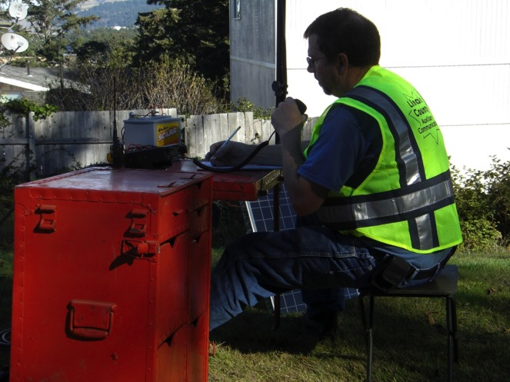
Training
Community Emergency Response Team
Red Cross
  Shelter Ops & Management
  First Aid
Amateur Radio Operator
Post-Earthquake Building Evaluations
Animals in Disasters
Survival Skills
Notes:
Build capacity in yourself and your community by getting trained with advanced skills for disaster response.
Community Emergency Response Team (CERT) training
Amateur Radio Operator
Red Cross Shelter Ops/Management
Build Neighborhood or School Disaster Caches

Slide 31
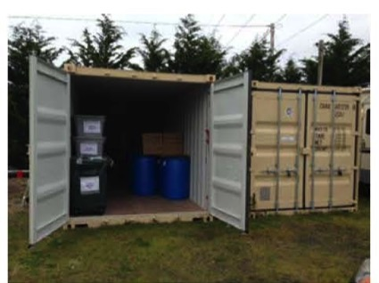
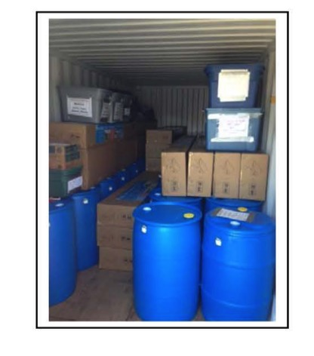
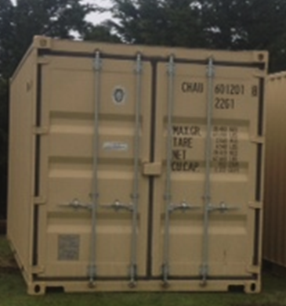
Caching Supplies
School or Neighborhood Caches
20’ x 8’ Steel Shipping Containers
Basic Survival Supplies

Slide 32
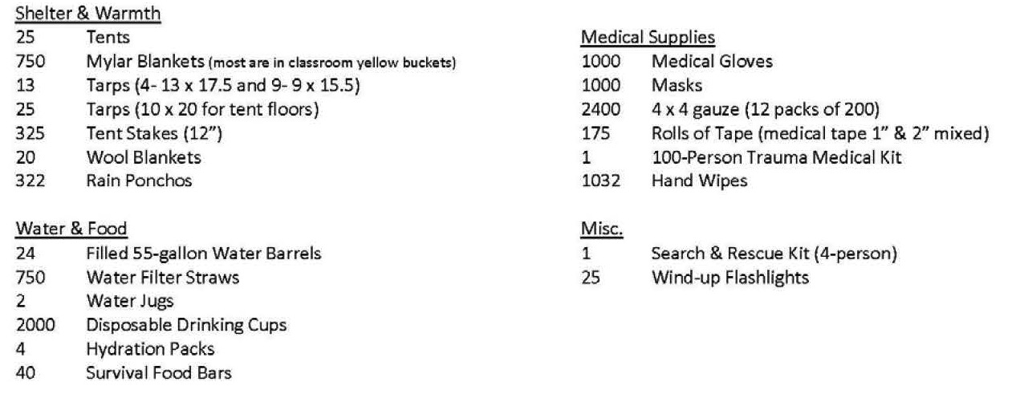
Sample
School Disaster Cache Contents

Slide 33
School Response Plan
Evacuate
-Account for Everyone
-Supervise Students
Immediate Needs
-Medical
-Search & Rescue
-Shelter from Weather
-Restrooms
Reunification
-Reunite Students with Families
-Move Students to Shelter Location
Activate Disaster Cache
-Shelter & Warmth
-Water & Food
-Sanitation
-Supervision

Slide 34
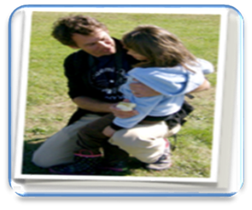
Security & Supervision
Student Accountability & Supervision
Security
Reunification & Release
Long-term care of students
WHO WILL STAY TO CARE FOR STUDENTS?
Notes:
Anchor: chants, songs, activities, routines
Perseverance: Means never giving up!

Slide 35
Separate Populations
Secure
Student Sheltering Area
Family Reunification Area
Community Sheltering Area

Slide 36
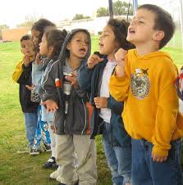
Emotional Needs
Give Students Jobs
  Helps with emotional recovery
  Helps with survival
  Be part of the solution – meaning
Structure & Organization
  Routines & Predictability
  Positive, Peaceful, Encouragement, Reassurance, Hope
  Calming Activities (songs, chants)
Singing
Notes:
Anchor: chants, songs, activities, routines
Perseverance: Means never giving up!

Slide 37
Get Organized
Order vs. Chaos
Team in Charge
Emergency Response
Shelter & Warmth
Water & Food
Sanitation
Children
Medical
Search & Rescue
Morgue
Hazard Mitigation
Tents
Clothing
Campfires
Maintenance
Gathering Water
Purifying Water
Distribution
Gathering Food
Preparing Food
Toilet Needs
Washing
Waste Disposal
Security
Supervision
Accountability
Family Reunification
Psychological Needs
Protecting People
Protecting Things
Protecting Area
Makeshift Jail???
Communications

Slide 38

We’re In This Together
We Can Do This!
Notes:
Anchor: chants, songs, activities, routines
Perseverance: Means never giving up!

Slide 39
School Resources
Rems.ed.gov
Lincoln.k12.or.us
Susan.graves@Lincoln.k12.or.us
Notes:
Anchor: chants, songs, activities, routines
Perseverance: Means never giving up!

