Slide 1
Beauty and the Beast
Binder Foldout & CEETEP Poster

Slide 2


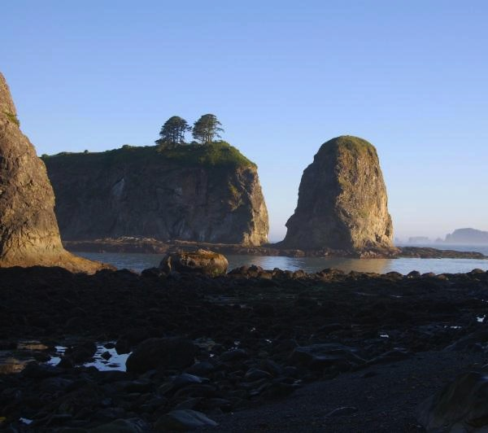
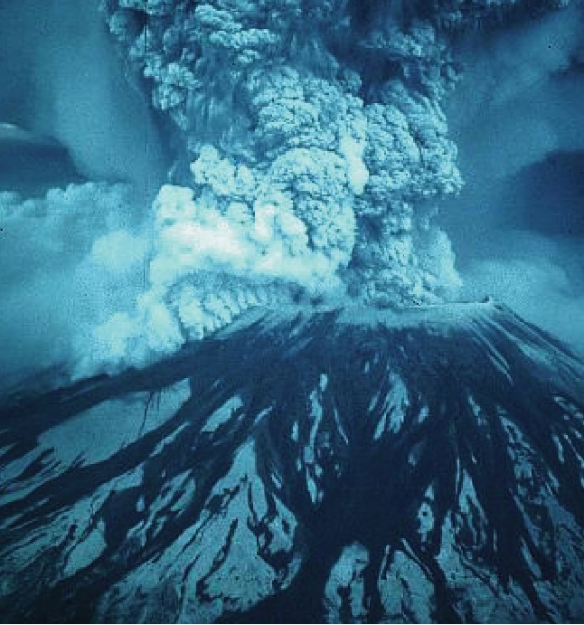
Beauty and the Beast
“The same geological processes that threaten our lives with earthquakes, tsunamis, and volcanic eruptions also nourish our spirits by creating the spectacular mountains, valleys, and coastlines of the Pacific Northwest.”
Mt. St. Helens National
Volcanic Monument
Olympic National Park

Slide 3
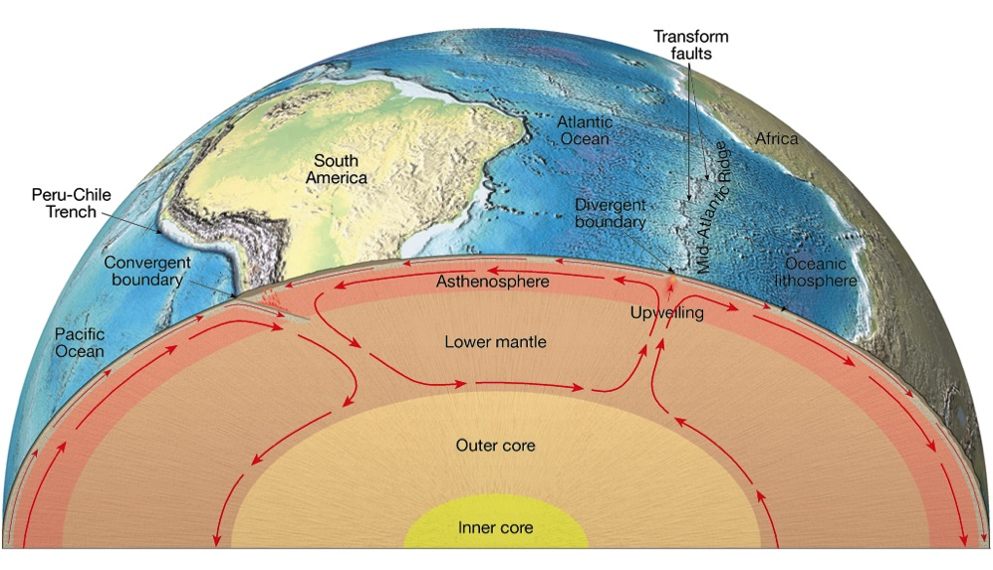
Plate Tectonics
The Earth’s interior is convecting.
Plates are driven by cooling of Earth.
Gravity provides the “ridge push” and “trench pull” forces to move plates.
Notes:
An important principle is that the energy that makes plates and moves them around on the Earth is heat energy from Earth’s interior. Simply stated, convection of hot material from Earth’s interior up to the surface to cool then back into the hotter interior is an efficient way for our planet to cool. The heat in Earth’s interior is about 50% from formation of Earth during the development of our solar system (accretion changes gravitational potential energy to kinetic energy to heat upon impact) and 50% from decay of naturally occurring radioactive elements (principally U, Th, K).

Slide 4
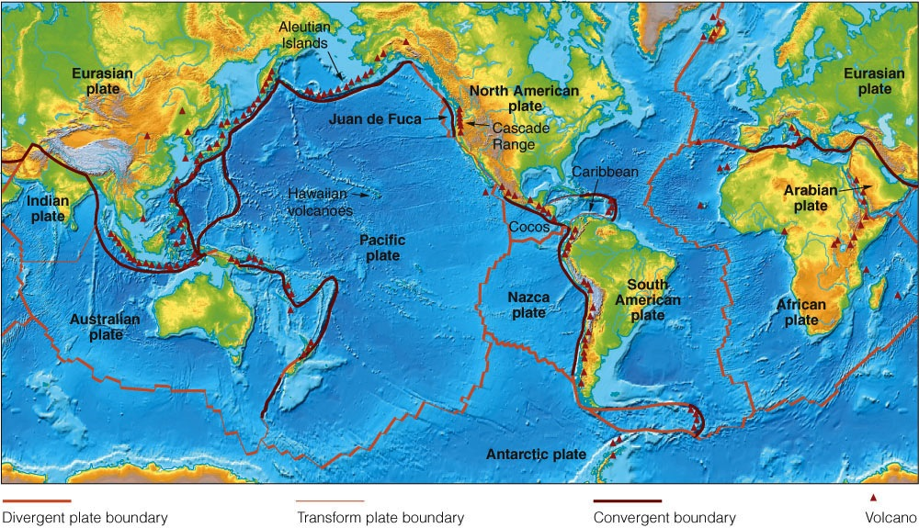
About a dozen plates; some plates have continents; some don’t.
Plates move a few centimeters per year (the rate of fingernail growth).
Volcanoes and earthquakes are concentrated at plate boundaries.
Notes:
Any map of plates shows that there are about a dozen large plates and a number of smaller plates. Rate of plate motions are typically an inch or two per year. Slow rates, but very important when these rates act over 100s of millions of years. See John Lahr’s web site for documentation of his finger nail growth: http://jclahr.com/science/earth_science/thumbnail/index.html
It is an oversimplification to say that ALL earthquakes and volcanoes occur at or near plate boundaries but there is a very strong concentration of earthquakes and volcanoes near plate boundaries. If you understand how plate motions produce earthquakes and volcanoes, you can explain 80% of earthquakes and volcanoes.

Slide 5
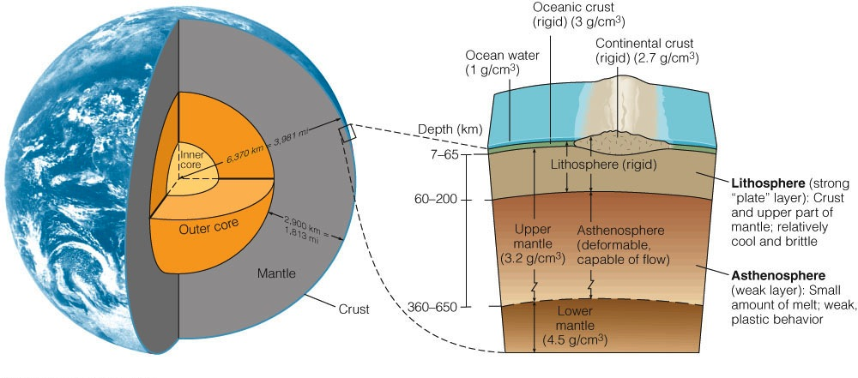
Lithosphere in Earth Context
continental crust
oceanic crust
Thickness of lithosphere (= tectonic plates) ~ 100 km.
Lithosphere is crust on top and mantle on bottom.
Oceanic crust is basalt, thickness = 7 km.
Continental crust is granite, average thickness = 40 km.
Granite is less dense than basalt.

Slide 6
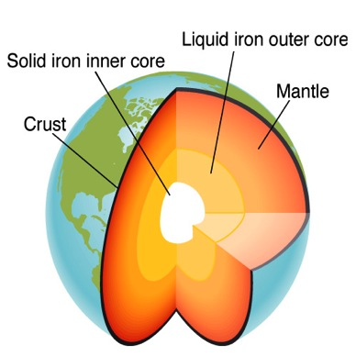
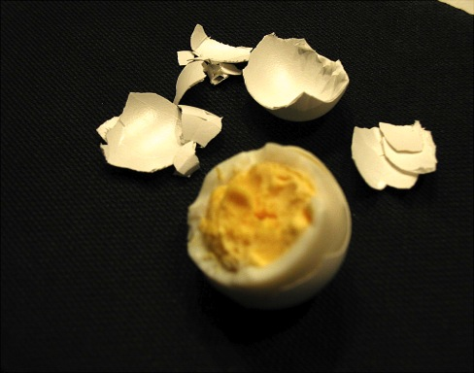
Earth
- vs - Egg
Earth –vs- Egg
Earth radius = 6370 km
Lithosphere thickness = 100 km
What % of Earth radius is lithosphere?
Egg radius = 0.75 inch
Egg shell thickness = 0.015 inch
What % of egg radius is shell?
How do these compare?
~ 2%
1.6%
2%
Lithosphere is to Earth as shell is to egg.

Slide 7
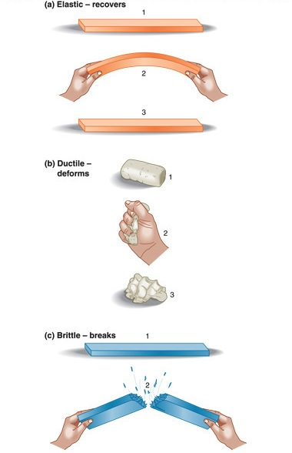
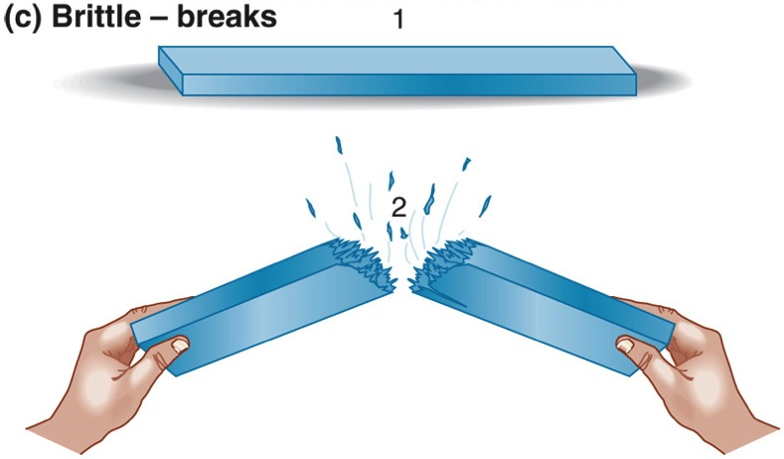
Mechanical Behaviors
Rock Tongs
Elastic: bends and recovers.
Brittle: elastic UP TO A LIMIT,
then BREAKS.
COLD rocks are brittle.
Ductile: permanent deformation.
WARM rocks are ductile.

Slide 8
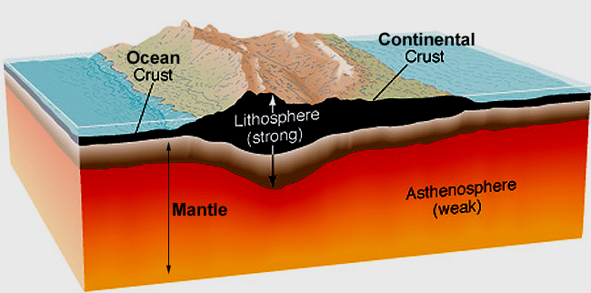
Lithosphere (= Tectonic Plate)
Granite
40 km thick,
variable
Basalt
7 km thick
Lithosphere: outer ~100 km.
Contains crust + upper mantle.
Cold, rigid, and brittle; can fracture.
Asthenosphere: deeper, hotter mantle.
Can flow like silly putty.
A VISCOELASTIC SOLID. NOT LIQUID!!
Notes:
Big Hunk demonstration.

Slide 9
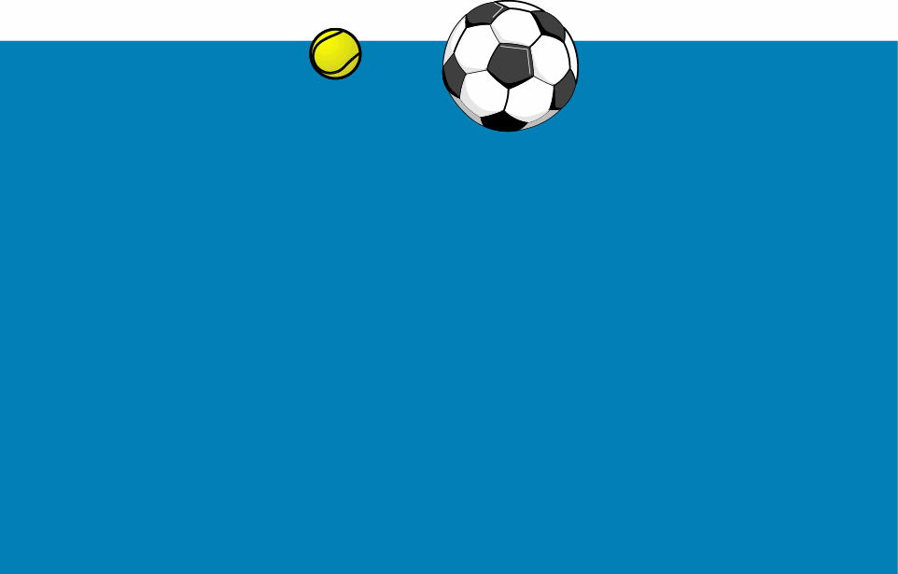
“Oceanic Crust”
“Continental Crust”
“Earth’s Mantle”
Parks and Plates
©2005 Robert J. Lillie

Slide 10
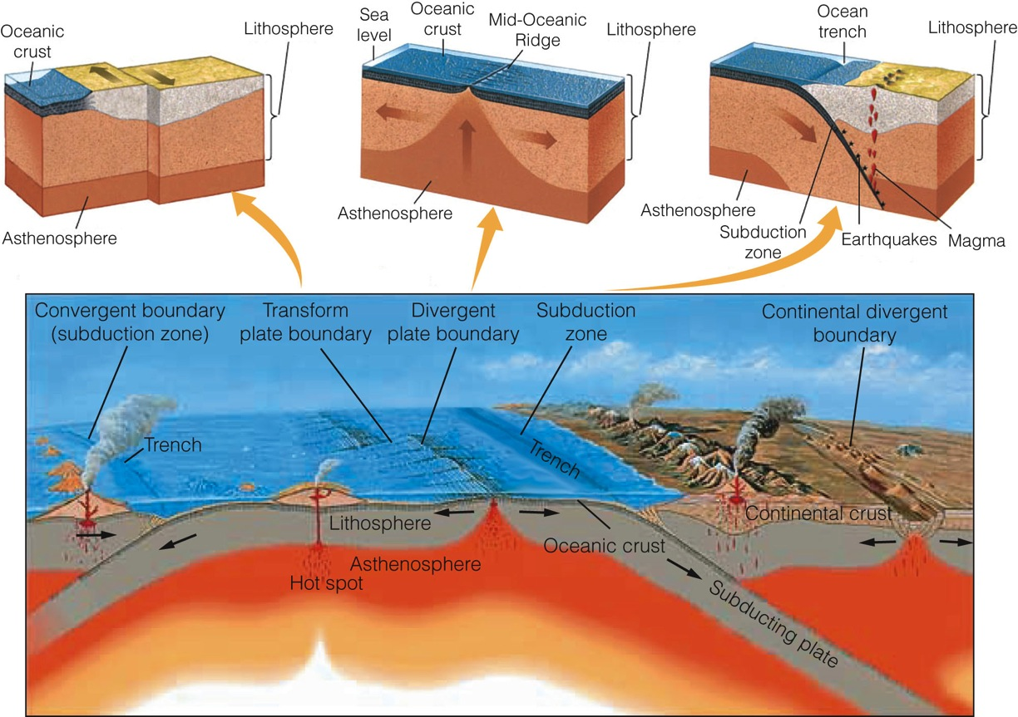
Three Kinds of Plate Boundaries
Transform
Divergent
Convergent

Slide 11
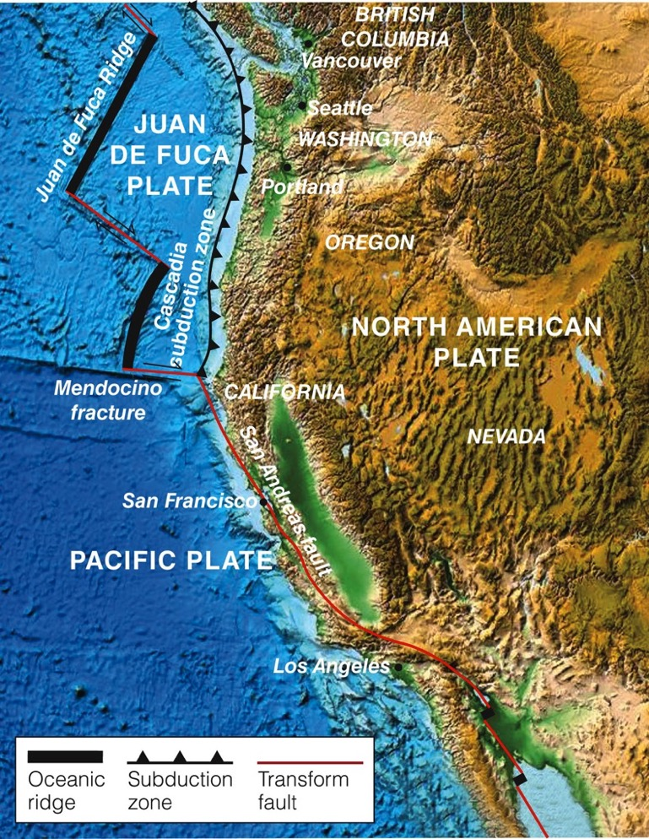
Plate Boundaries of the Western US

Slide 12
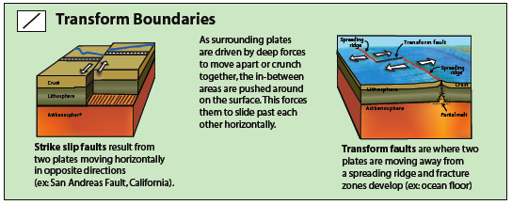
Transform Plate Boundary
Strike-slip faulting
Notes:
Plates can have three kinds of motion across boundaries: 1. They can move away from each other like at a divergent boundary (= spreading ocean ridge or a rift zone); 2. They can move toward each other to make a convergent boundary. 3. They can slide past each other horizontally at a transform boundary. When two plates carrying continents converge, a continental collision occurs where continental crust piles us. Continental crust is lower density than mantle rocks, so continental rocks cannot be “subducted” into the mantle. If continental rocks are pushed into the mantle, they will soon pop up again. This is like trying to push a piece of styrofoam into a swimming pool. You can push the styrofoam into the water (with some force) but, when you let it go, it pops back to the surface because it is much less dense than the water on which it floats.

Slide 13
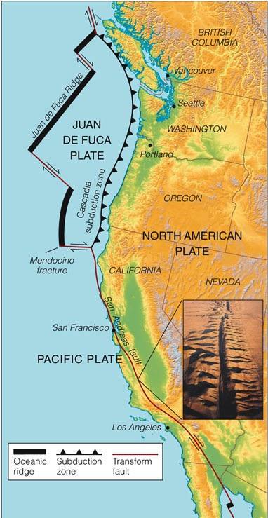
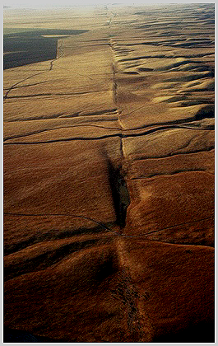
San Andreas Fault
North
American
Plate
Pacific
Plate

Slide 14
Strike-Slip Fault
Strike slip animation here
Produced by shearing forces.
Notes:
What is stress? Stress = force per unit area, like pound per square inch or newtons per square meter. We can classify stresses as : 1. Extension = stresses that tend to pull materials apart. 2. Compression = stresses that tend to squish materials together. 3. Shearing = stress that tend to bend materials. For rocks in Earth’s crust, extension tends to break rocks forming faults. Compressional stresses can result in either folding or faulting. Shearing stresses can result in folding or faults.
Animations of fault motions can be found at http://www.iris.edu/gifs/animations/faults.htm

Slide 15
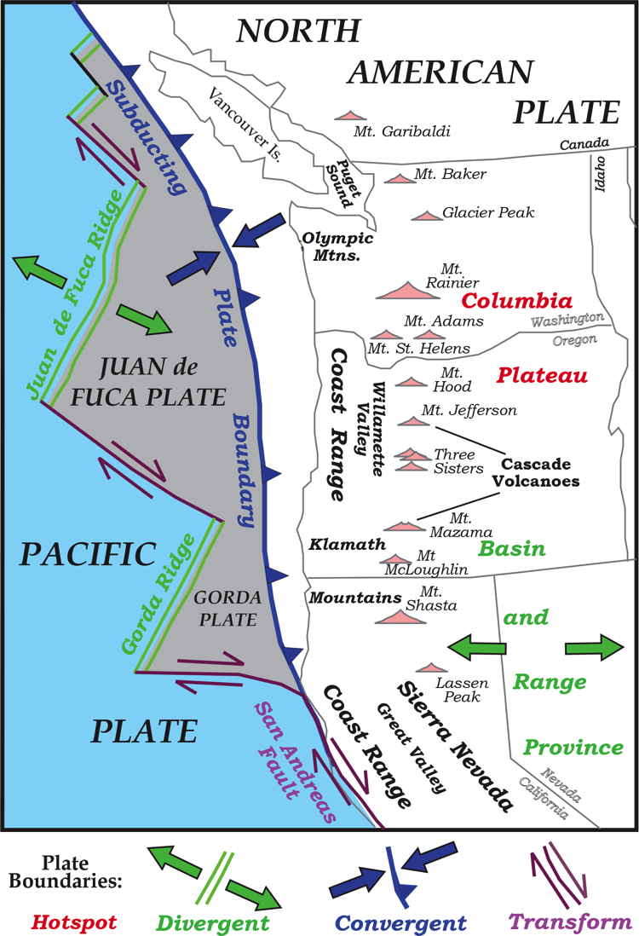
Transform Plate
Boundaries

Slide 16
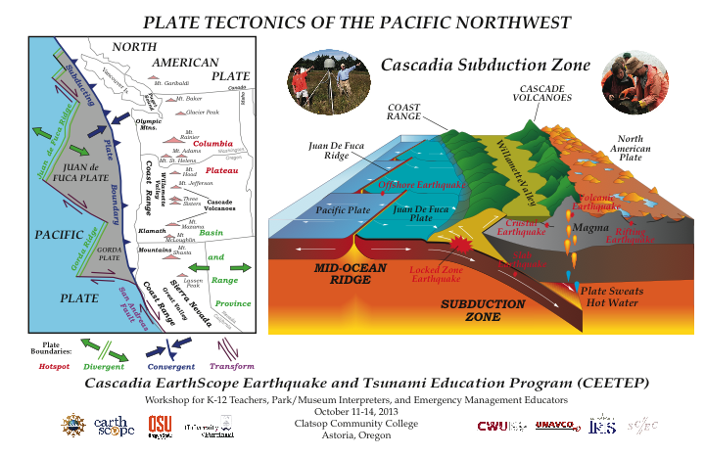
Transform Plate Boundaries

Slide 17
Earthquakes on Transform Boundaries
Strike-slip faulting with horizontal motion parallel to fault.
Shallow depths, almost never deeper than 20 km. Why?
Many small EQs (M<6). Some strong (M6) and major (M7) EQs.

Slide 18
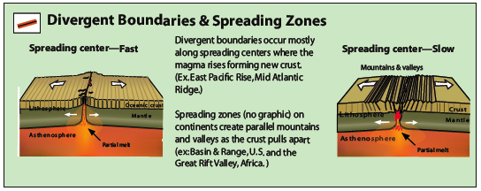
Divergent Plate Boundaries
Spreading ocean ridges
Continental rift zones

Slide 19
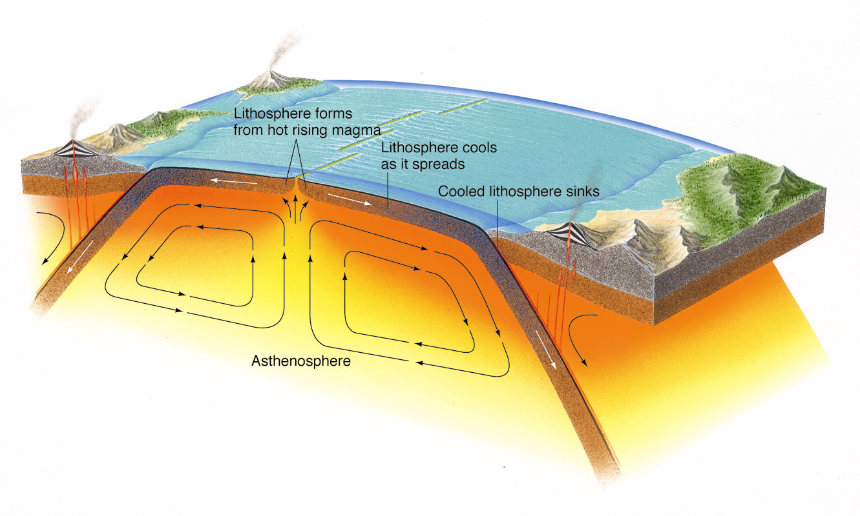
Divergent Boundaries in Oceans are Seafloor Spreading Centers
Example: Mid-Atlantic Ridge.

Slide 20
Divergent
Plate
Boundaries

Slide 21
Divergent Plate Boundaries

Slide 22
Foam Faults
Normal Fault
Normal fault animation here
Produced by extensional forces.
Notes:
What is stress? Stress = force per unit area, like pound per square inch or newtons per square meter. We can classify stresses as : 1. Extension = stresses that tend to pull materials apart. 2. Compression = stresses that tend to squish materials together. 3. Shearing = stress that tend to bend materials. For rocks in Earth’s crust, extension tends to break rocks forming faults. Compressional stresses can result in either folding or faulting. Shearing stresses can result in folding or faults.
Animations of fault motions can be found at http://www.iris.edu/gifs/animations/faults.htm

Slide 23
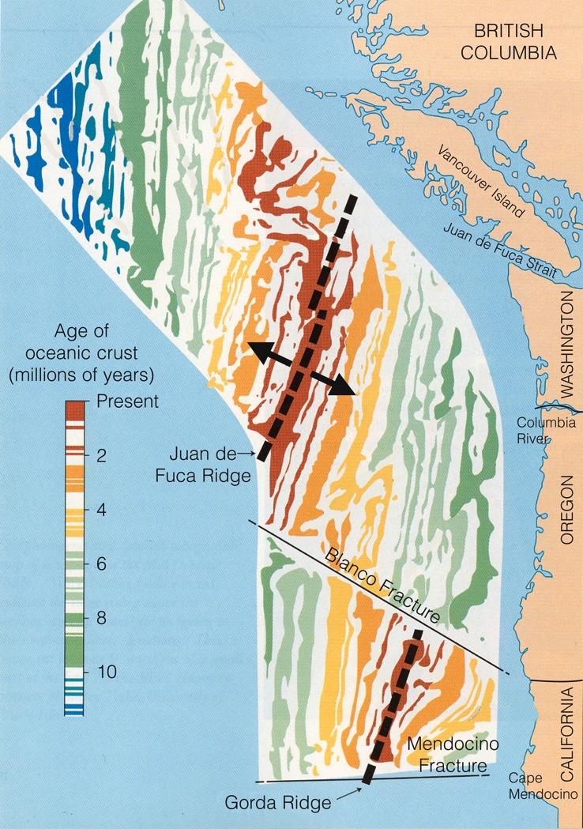
New oceanic plate formed at the spreading ridge. Plate is young at the ridge and gets older with distance away from the ridge.
Juan de Fuca Plate is “only” 10 million years old when it subducts.
Age of Juan de Fuca and Gorda Plates

Slide 24
Earthquakes on Divergent Boundaries
Normal faulting due to extension.
Shallow depths, rarely deeper than 10 km. Why?
Many small EQs (M<6). Some strong (M6) and major (M7) EQs.

Slide 25
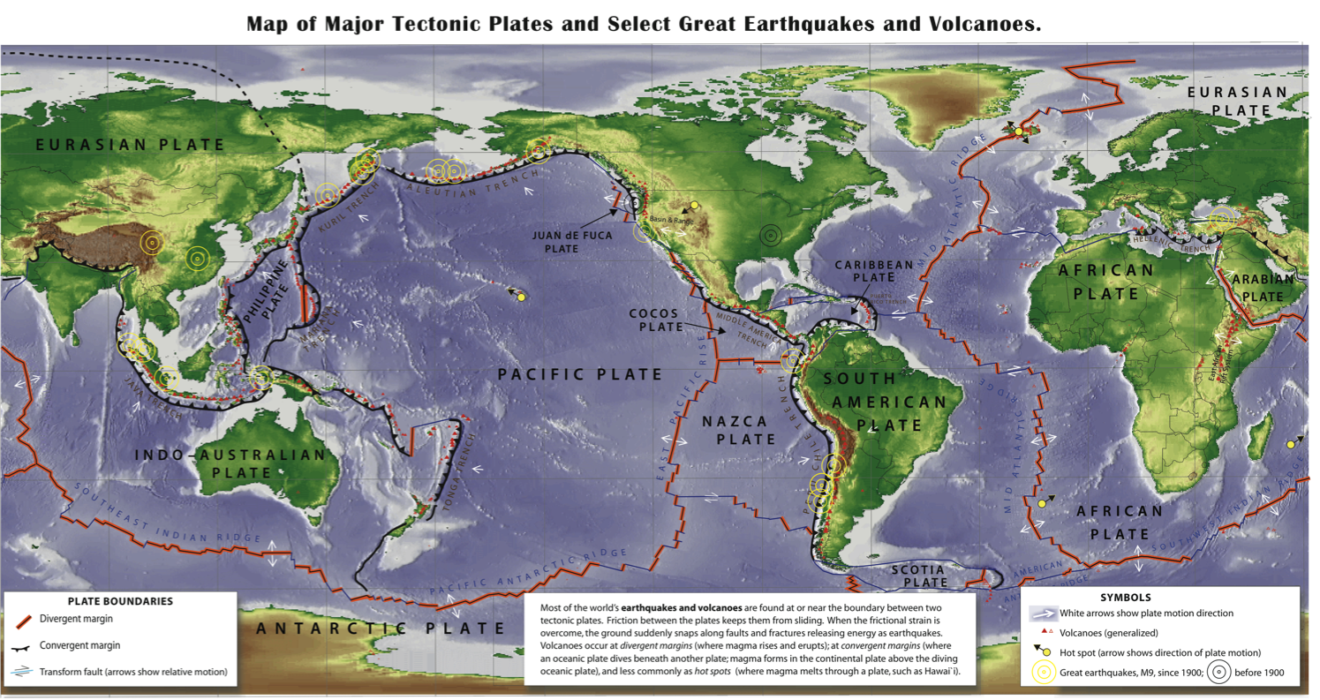
World Map of Plates
Explore Spreading Ocean Ridges
and Transform Plate Boundaries

Slide 26
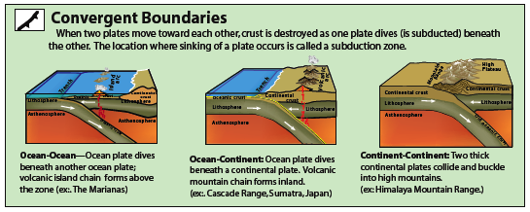
Convergent Plate Boundaries
Ocean - Ocean subduction zone, Marianas
Ocean – Continent subduction zone, Cascadia
Continent – Continent collision zone, Himalayas

Slide 27

Why does an oceanic plate subduct beneath a continental plate?
Swimming Pool
“Earth’s Mantle”
Parks and Plates
©2005 Robert J. Lillie

Slide 28
“Oceanic Crust”
“Continental Crust”
“Earth’s Mantle”
Parks and Plates
©2005 Robert J. Lillie

Slide 29
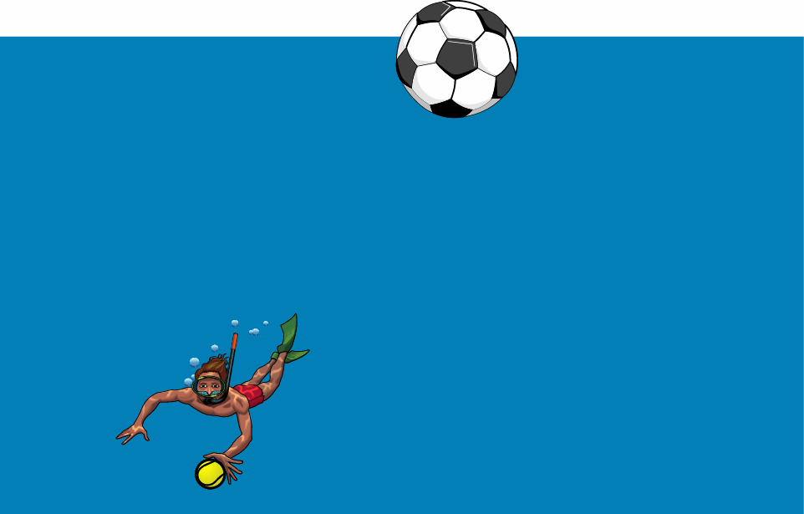
Easy to Subduct.
Parks and Plates
©2005 Robert J. Lillie

Slide 30
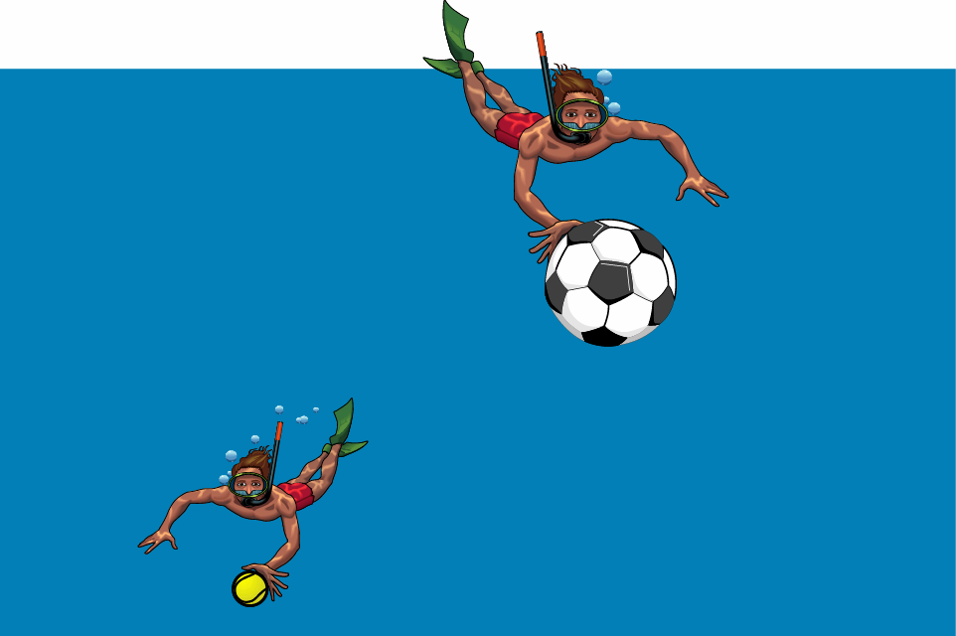
Hard to Subduct!
Parks and Plates
©2005 Robert J. Lillie

Slide 31
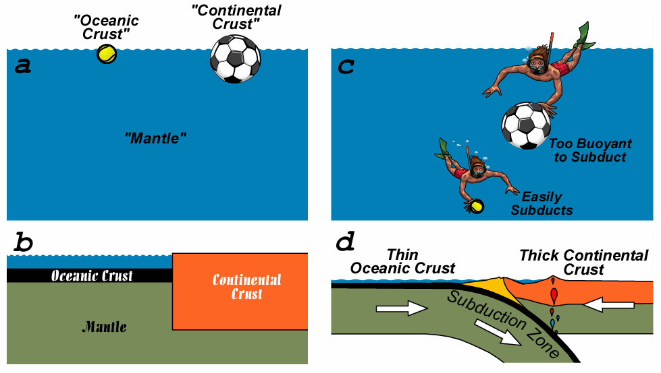
Continental Crust is THICKER, and therefore MORE BOUYANT than Oceanic Crust
Parks and Plates
©2005 Robert J. Lillie

Slide 32
Plate capped with thin Oceanic Crust subducts beneath plate capped with thick Continental Crust
Parks and Plates
©2005 Robert J. Lillie

Slide 33
Convergent
Plate
Boundary
Entire region is the
“Cascadia Subduction Zone”

Slide 34
Cascadia Subduction Zone

Slide 35
Foam Faults
Reverse (Thrust) Fault
Reverse fault animation here
Produced by compressional forces.
Notes:
What is stress? Stress = force per unit area, like pound per square inch or newtons per square meter. We can classify stresses as : 1. Extension = stresses that tend to pull materials apart. 2. Compression = stresses that tend to squish materials together. 3. Shearing = stress that tend to bend materials. For rocks in Earth’s crust, extension tends to break rocks forming faults. Compressional stresses can result in either folding or faulting. Shearing stresses can result in folding or faults.
Animations of fault motions can be found at http://www.iris.edu/gifs/animations/faults.htm

Slide 36
Earthquakes on Convergent Boundaries
Thrust faulting due to compression.
EQs to 100 km depth on plate boundary megathrust AND within the converging plates.
EQs to greater depths occur within subducting oceanic plate.
Wide range of magnitudes. Most M8 & M9 great EQs are shallow megathrust events in subduction zones.

Slide 37
Cascadia Animation

Slide 38
World Map of Plates
Explore Convergent Plate Boundaries

Slide 39
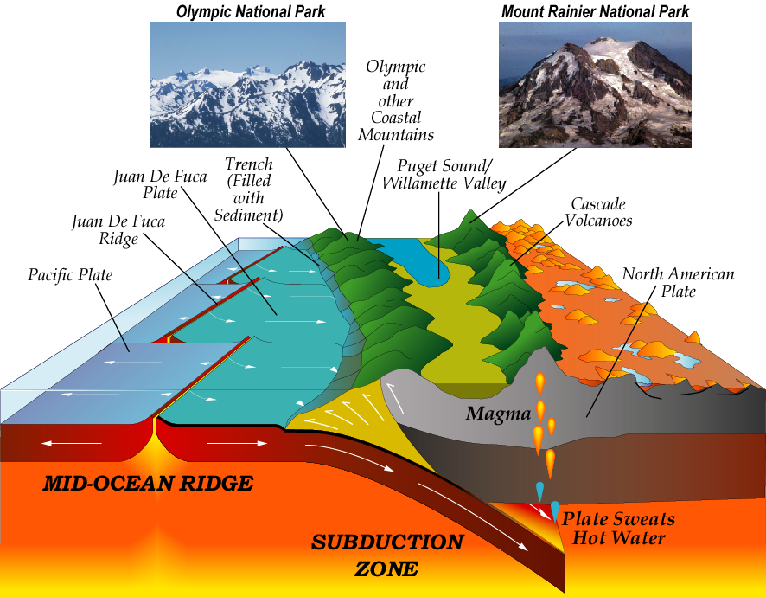
National Parks in two mountain ranges.
Robert J. Lillie Bernard Garcia
Parks and Plates
©2005 Robert J. Lillie

Slide 40
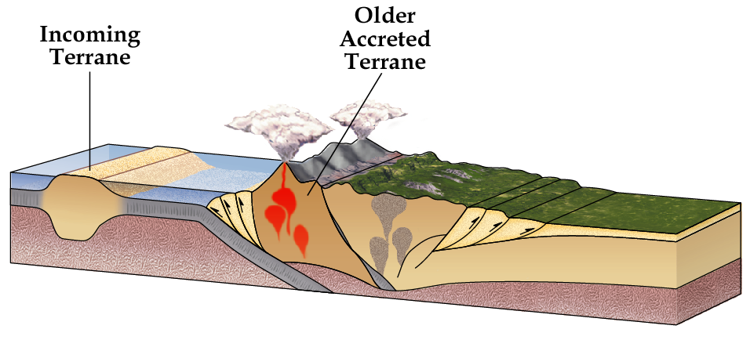
Terrane Accretion
A TERRANE consists of crust that is too thick and buoyant to subduct. The continent grows outward as terranes are added to the margin.

Slide 41
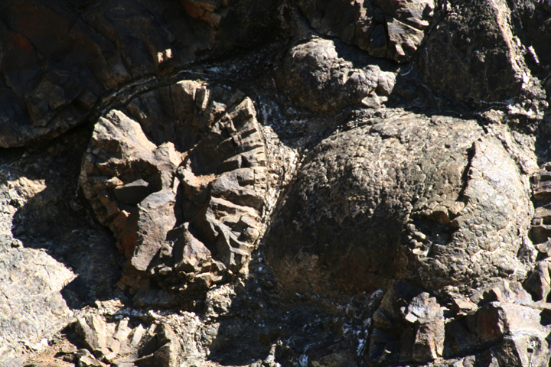
Siletz River Volcanics in Coast Range
55 Million Years Old Oceanic Basalt Lava Flows
Photo by Bob Lillie at Marys Peak Recreation Area

Slide 42
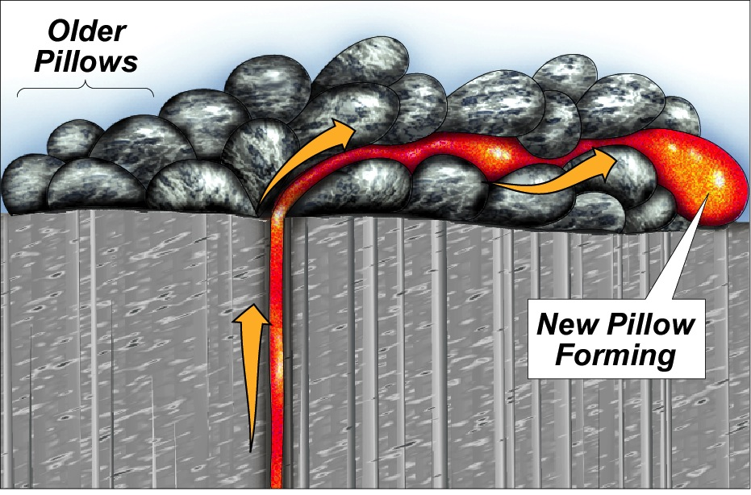
Formation of Pillow Lava
Lava Erupts into Cold Ocean Water
Oceanic Crust

Slide 43
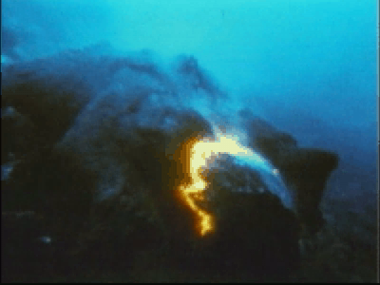
Video of Pillow Lava

Slide 44
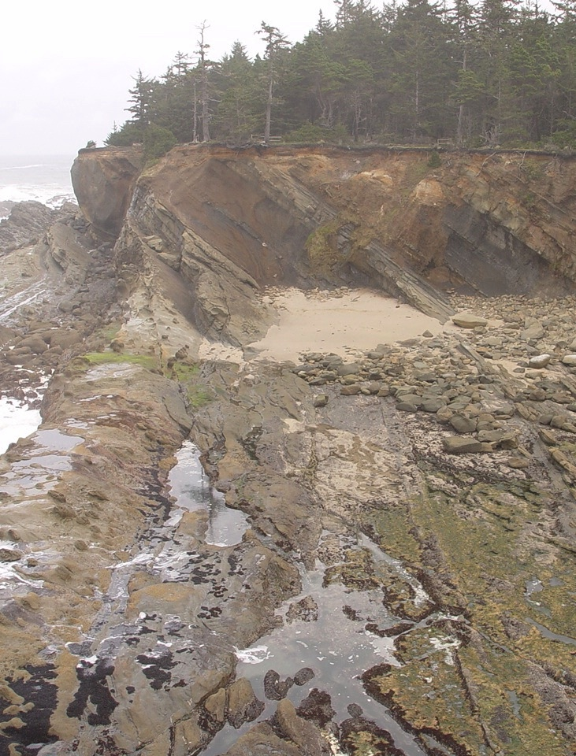
Shore Acres State Park
Marine sedimentary layers deposited on the seafloor then scraped off onto the continental margin.

Slide 45
Terrane Accretion
Terrane accretion animation here

Slide 46
Beauty and the Beast

Slide 47
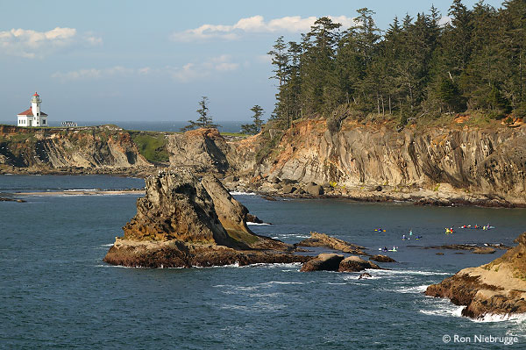

Slide 48
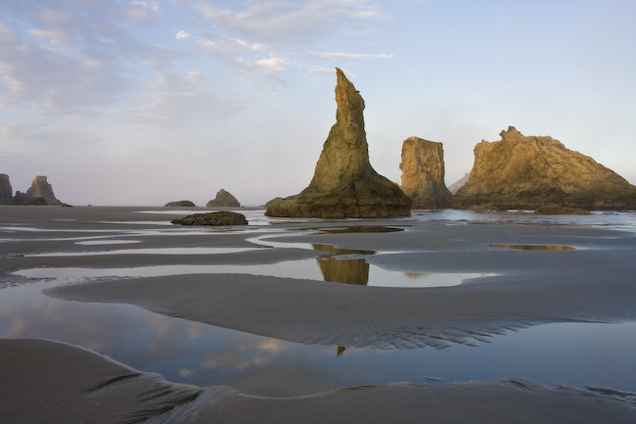

Slide 49


Slide 50
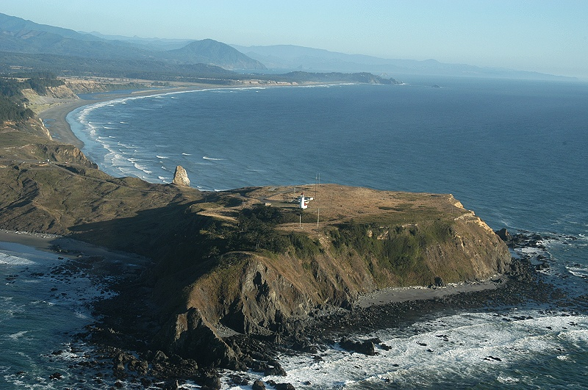

Slide 51
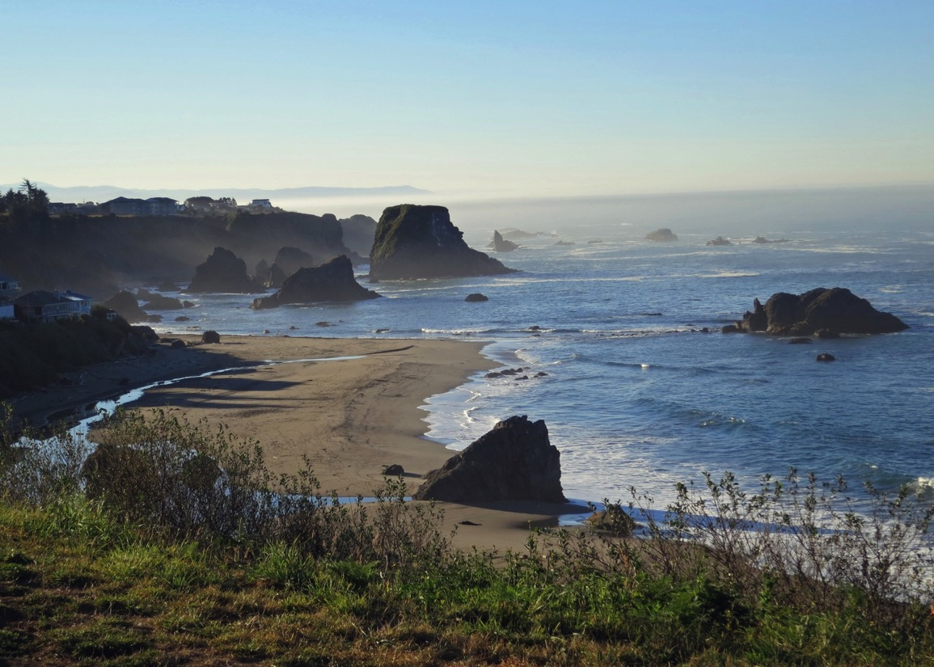

Slide 52
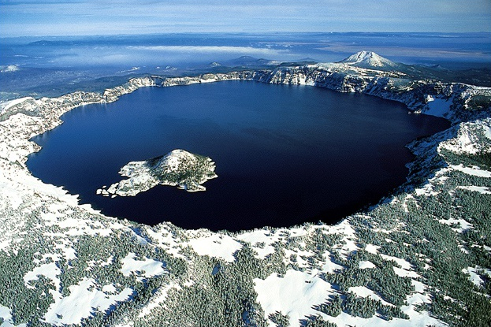

Slide 53
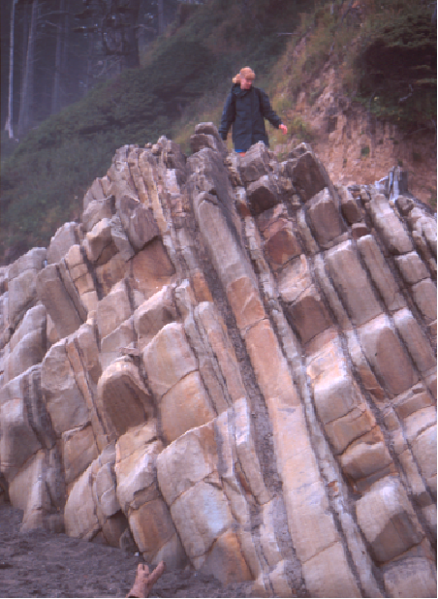
Olympic National Park
Coastal Ranges
Marine sedimentary layers deposited on the seafloor then scraped off onto the continental margin.

Slide 54
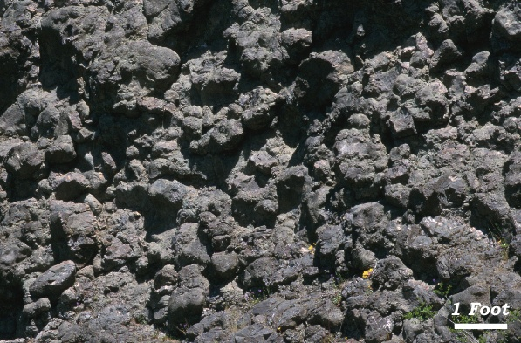
Olympic National Park
Pillow Basalt

