Slide 1
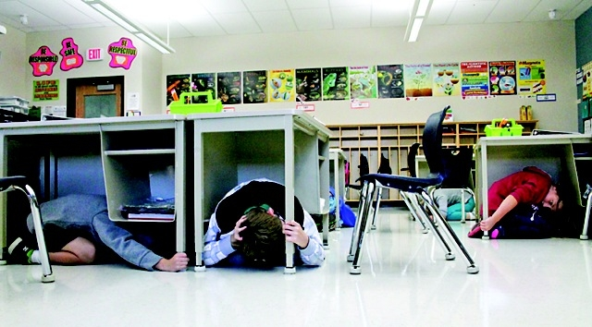
Surviving a Cascadia Earthquake
CEETEP
Sue Graves ~ August 2015

Slide 2
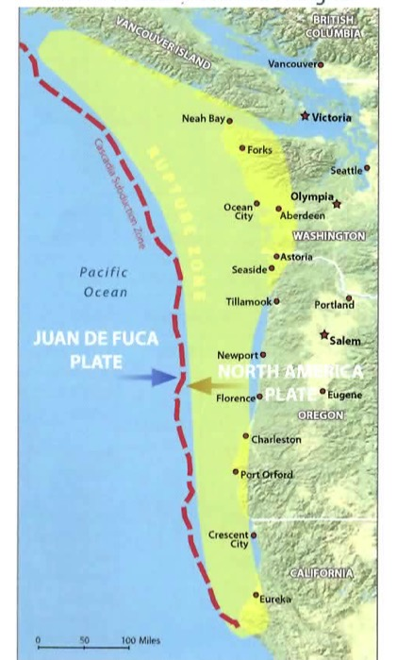
Local Cascadia Earthquake
Cascadia Subduction Zone
Earthquake is Here!
You Will Feel It!
Warning: The Ground Shaking
Magnitude 8 to 9+
4-6 minutes of Intense Shaking
Notes:
We’ve been learning about the Cascadia Subduction Zone all week. As you know, it stretches from Northern California all the way up to British Columbia.
Here’s what we can expect when it ruptures: YOU WILL FEEL IT – it will be unmistakable!
Magnitude 8 to 9.0+ earthquake
4 to 6 minutes of intense shaking on the coast
What are the consequences & implications of this kind of shaking?

Slide 3
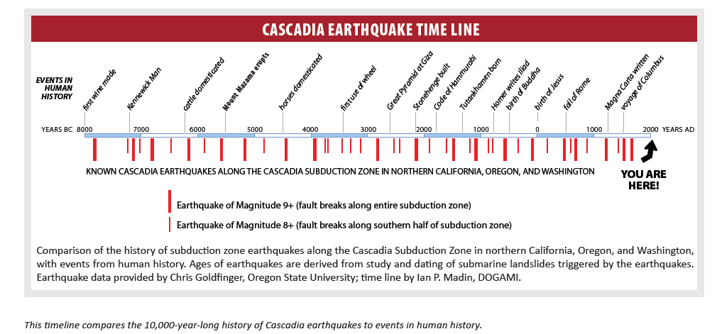
10,000-Year History of Cascadia
41 ruptures = average of 243 years
Notes:
Chris Goldfinger’s research shows 41 ruptures of the Cascadia Subduction Zone (partial & complete ruptures combined).
It’s been 313 years since the last rupture.

Slide 4
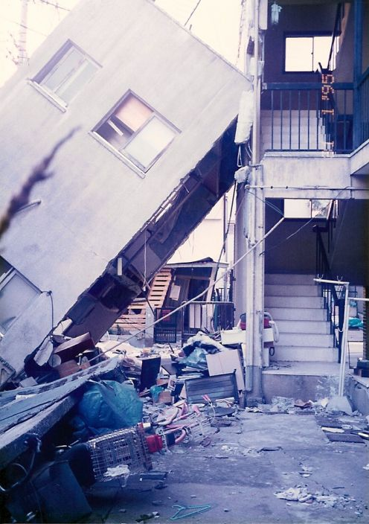
Damage to Homes
Notes:
Homes will be damaged. Those not securely fashioned to their foundations may have significant damage.
Most will have broken windows and other damage.
Structural damage/Inspection
Where will we get all the inspectors? (promo relevant courses, i.e. ATC 120, CERT for assessing light, moderate, heavy damage)

Slide 5
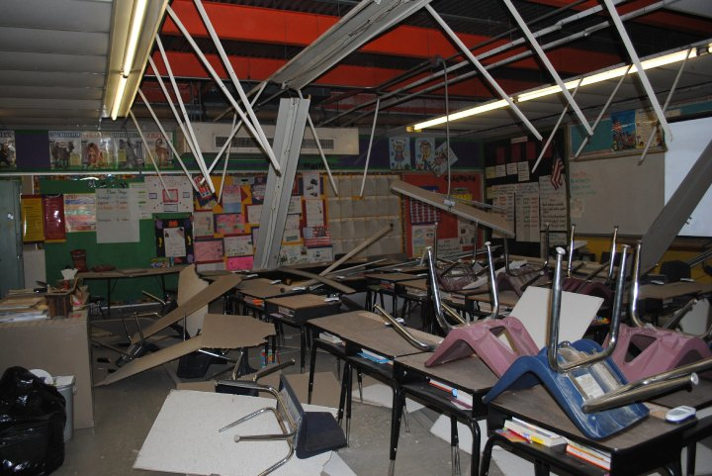
Damage to Schools
Structural Damage
Non-structural Damage
Buildings will require Inspections
Continual Aftershocks
Notes:
Schools will have damage.
Some may have Structural damage
Others may just need extensive Interior clean- up
All will need an inspection
Expect aftershocks…

Slide 6
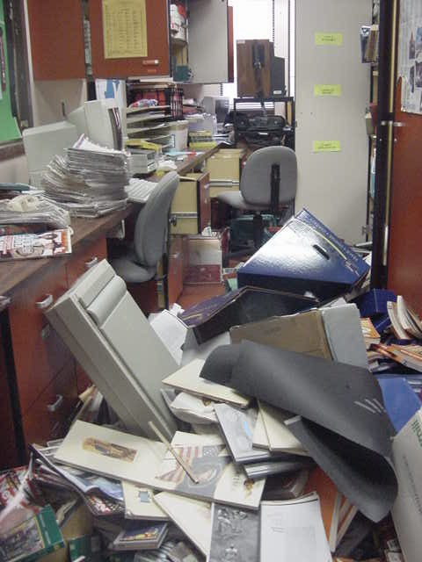
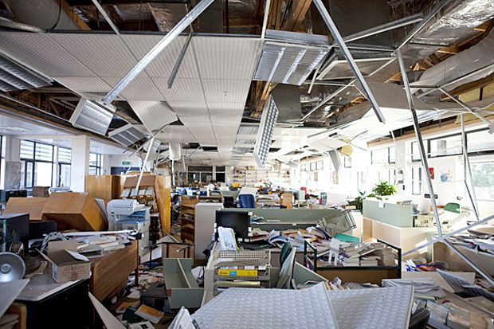
Damage to Businesses
Structural & Non-Structural Damage
Damage to Contents & Loss of Inventory
Loss of Income
Long-Term Closure & Recovery Issues

Slide 7
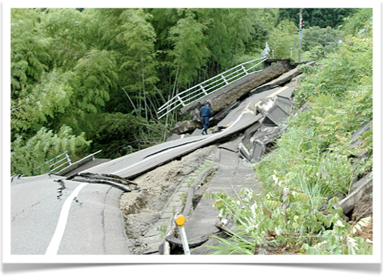
Roads Damaged
Liquefaction
Landslides
Buckling
Lateral Spreading

Slide 8
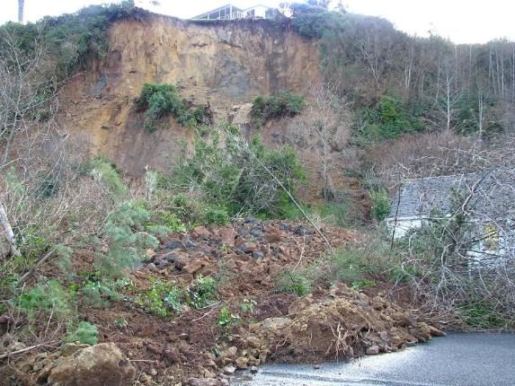
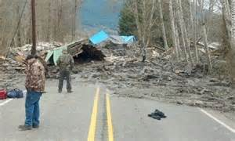
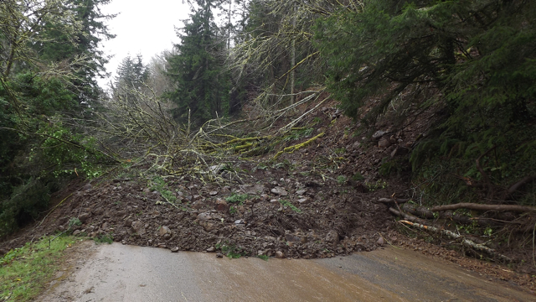
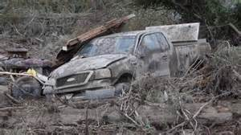
Landslides
Waldport, OR
Oso Landslide – March 2014
Yaquina Bay Mudslide March 2012
Notes:
Think about the landslides we get in our environment during winter storms. Now think about those landslide-prone areas with 4-6 minutes of intense shaking.

Slide 9
Bridges will Collapse
Notes:
In Oregon it is estimated that:
399 Bridges – total or partial collapse (under a M 9.0)
621 Bridges – heavily damaged
Estimated time of closure for most state routes connecting I-5 with the Oregon Coast would be 3 to 12 months… currently.
Talk about the state Resiliency Plan and what we can do now to reduce that time frame…

Slide 10
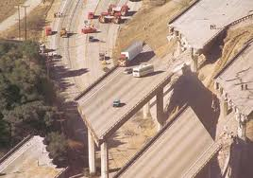
What are the Implications?
Think about the I-5 Corridor
Notes:
The shaking will also be felt in the valley, on our major north-south routes like the I-5. Huge implications… Discussion

Slide 11
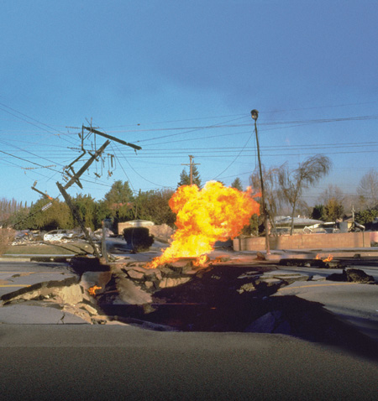
Gas Lines Ruptured
Notes:
Fires are very common in earthquakes

Slide 12
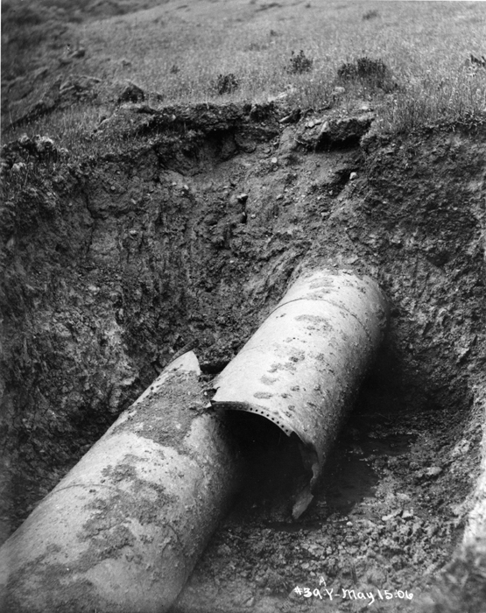
Water Supply Damage
Notes:
This map shows an estimate of the water and wastewater facilities in the Cascadia region with expected damage state of moderate or more under the 90th percentile case.
Need Water to survive. ½ gallon per person per day of drinking water. Another ½ gallon for sanitation, etc.

Slide 13
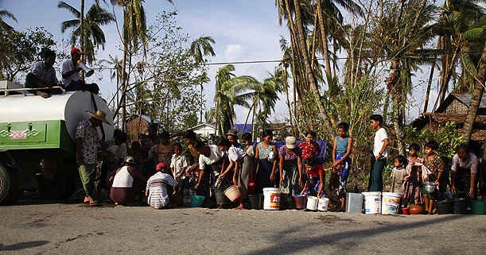
Is this Realistic?
The water supply will be destroyed
Need water to survive
½ gallon per person, per day

Slide 14
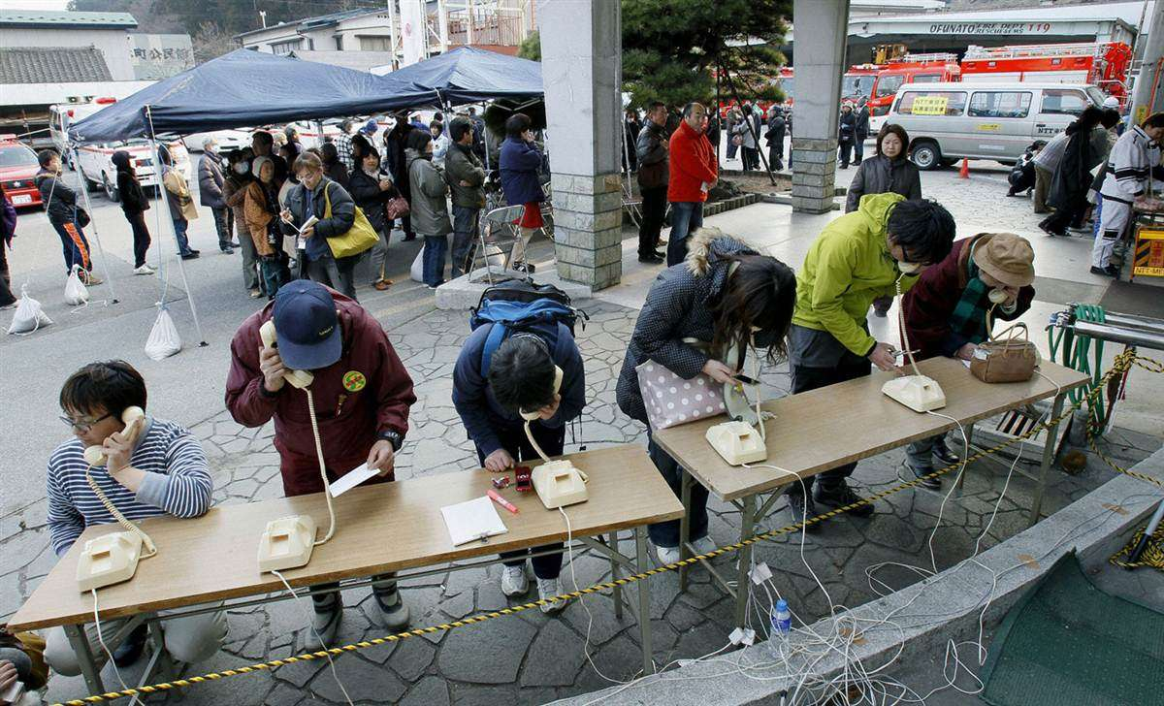
Broken Communication
Notes:
Broken Communication Systems: Perhaps one of the most difficult separations will be our lack of functioning technology in order to communicate with loved ones, with emergency officials, etc.
Is this picture realistic for us?

Slide 15
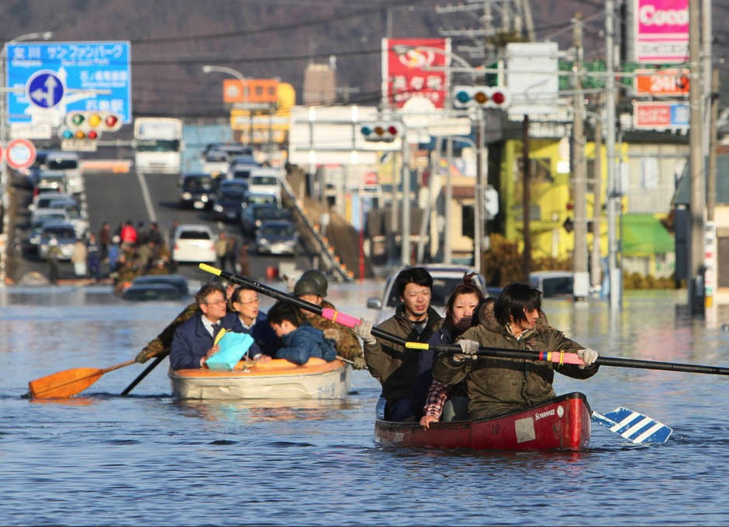
New Tidal Level
Notes:
We will also have a new tidal level that will cause temporary and perhaps permanent geographic separation.

Slide 16
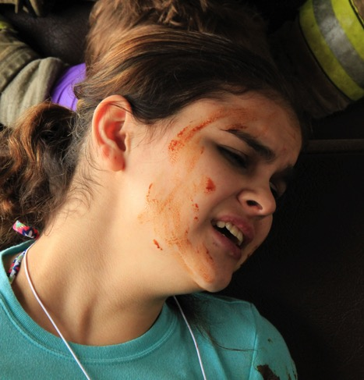
Injuries
Notes:
There will be injuries.
What if people duck, cover & hold properly? What will cause the injuries? Discussion
There won’t be easy access to professional emergency services. Who will help the injured?

Slide 17
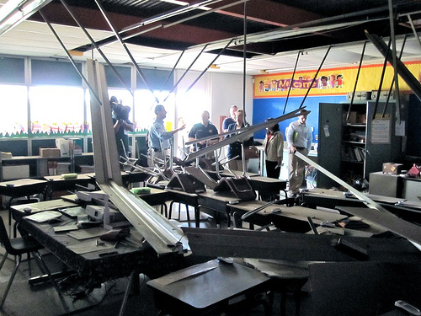
Aftershocks
Notes:
In the first 2 days following the Japan Earthquake, there were 154 aftershocks of magnitude 5 or greater.
Will people want to remain in their buildings (homes, schools, etc) when the ground continues to shake and things continue to fall and buildings are more and more compromised?
Where will they shelter? (cars, tents, buses, etc)

Slide 18
Hypothermia
Hypothermia is a significant risk
Rainy Coastal Environment

Slide 19
POSITION YOURSELF TO
SURVIVE
Make a Plan
Furniture
Water Heater
Prepare Supplies
Bedroom
Practice Protecting Yourself
Drop, Cover, Hold-on
Inside, Outside
Bedroom
Foundation
Car
Desk
Evacuate
Home
Go-Kit
Car/Bus
Gas Shut-off
Prepare Your Environment
Meeting Place
Communications
Children at School
Notes:
Prevent/Reduce Injuries
Facilitate Evacuation
Prevention: Change your environment to prevent injuries and damage (securing things, etc)
Protection: Change your behavior to protect yourself (duck, cover, hold & protective gear)
Be part of the solution, not part of the problem.

Slide 20
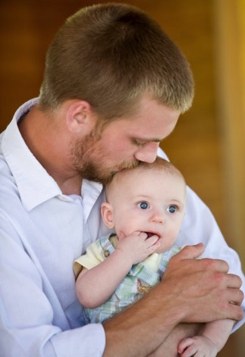
Make a Family Plan
Meeting Place
What about your children?
Keep information updated at school
Pets
Elderly, Disabled

Slide 21
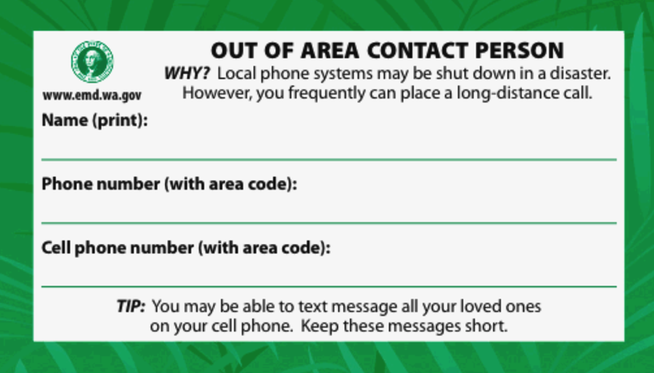
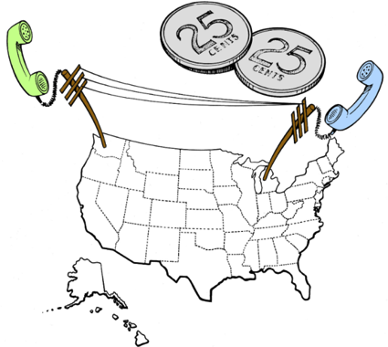
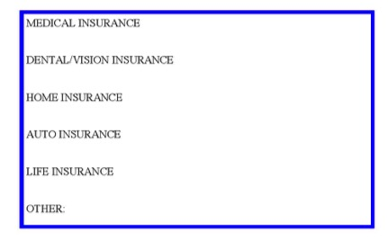
Have a Family Communication Plan
Notes:
Psychological Basic Needs: If you don’t know where your family members are or if they are ok, you will have a difficult time psychologically meeting yours or others’ basic needs.
All members of my family carry an out-of-state contact & phone number with them at all times.
Update School Info and who is allowed to take your children in an emergency.
Designate family meeting places based on different scenarios.

Slide 22
Have an Out of Area Contact!
http://www.kitsapdem.org/streaming-videos.aspx

Slide 23
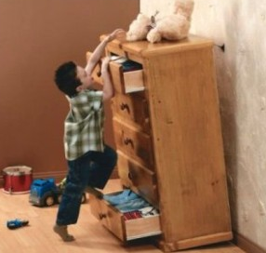
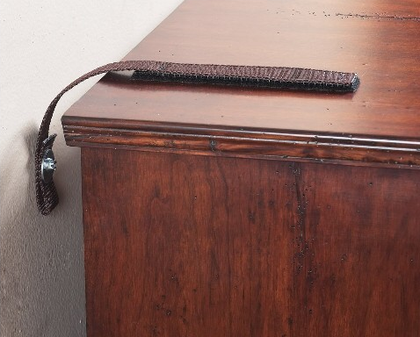
Secure Heavy Furniture
Velcro straps
L brackets
Notes:
This will not only prevent injuries, but will facilitate an easier building evacuation…which is very important, especially if you are in the tsunami zone.
This is very inexpensive and easy to accomplish.

Slide 24
How to Secure a Bookcase
Video can be found at: http://www.emd.wa.gov/preparedness/prep_personal_prep_video_index.shtml#HowtoSecure

Slide 25
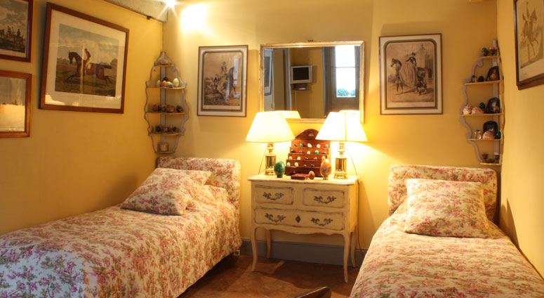
Nothing Above Bed

Slide 26
CUREE-Cal Tech Woodframe Project
http://www.curee.org/projects/woodframe/video/task_1-1-1/index.html
Permission to re-use this footage is granted as long as credits include:
Consortium of Universities for Research in Earthquake Engineering (or CUREE)
University of California at San Diego
Federal Emergency Management Agency
Notes:
Do you need to make some adjustments in your bedroom? How about your children’s?
Do your school children, park visitors, or community members understand this?
Consortium of Universities for Research in Earthquake Engineering (or CUREE) at the University of California at San Diego and partially funded by FEMA. It was called the CUREE-Cal Tech Woodframe Project.
http://www.curee.org/projects/woodframe/index.html
http://www.curee.org/projects/woodframe/video/task_1-1-1/index.html

Slide 27
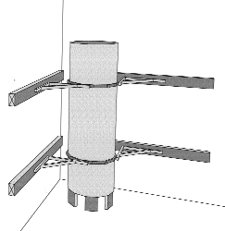
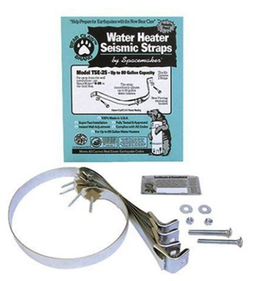
Secure Water Heater
https://www.youtube.com/watch?v=RrUqO2HJIns
Source of Drinking Water
Prevent Damage
Gas leaks - fire

Slide 28
Learn Gas Shut-Off Protocol
After Major Earthquake
If you Smell Rotten Eggs
Use Non-sparking tool
Only Gas Company Can Turn Gas Back On
Notes:
Learn how to shut off your gas meter (and your neighbors) after an earthquake or if you smell rotten eggs.
Location, tool, lowest valve.
If you shut if off, only the gas company can turn it back on.
Prevent Fires!

Slide 29
Secure House to Foundation
Notes:
Saves lives
Reduces injuries
Reduces property damage
We recently got tie-downs for our manufactured home and they only cost $75 each installed. Certainly something that can be budgeted for.

Slide 30
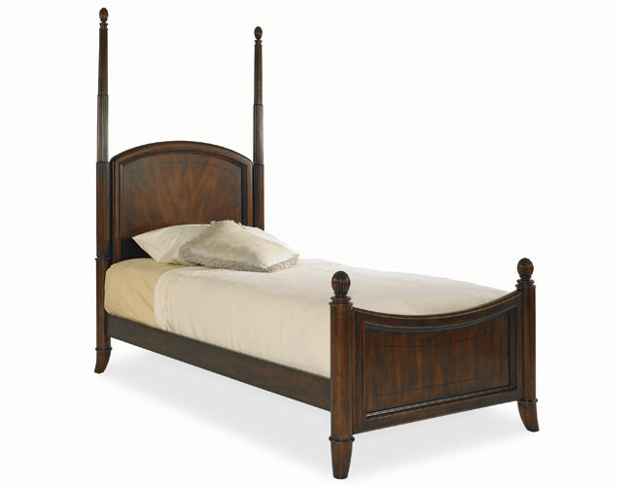
Tie Supplies to Bed
Flashlight/Head-Lamp
Sturdy Shoes
Leather Gloves
What if you’re in bed when the ground shakes?
Notes:
Reduce injuries after the shaking stops…
Mask (dust or heavy-smoke like substance in the air)
Get on your hand and knees in a ball and cover yourself (especially your head/neck) with your pillow.

Slide 31
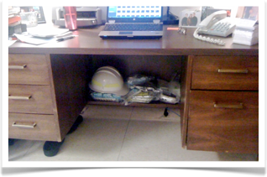
Supplies under Desk
Flashlight/Head-Lamp
Leather Gloves
Whistle
Hard Hat
Dust Mask
Notes:
Consider keeping some basic supplies underneath each teacher or staff members’ desk. A hard hat, dust mask, leather gloves, whistle, flashlight, etc.
Mask (dust or heavy-smoke like substance in the air)
Get on your hand and knees in a ball and cover yourself (especially your head/neck) with your pillow.

Slide 32
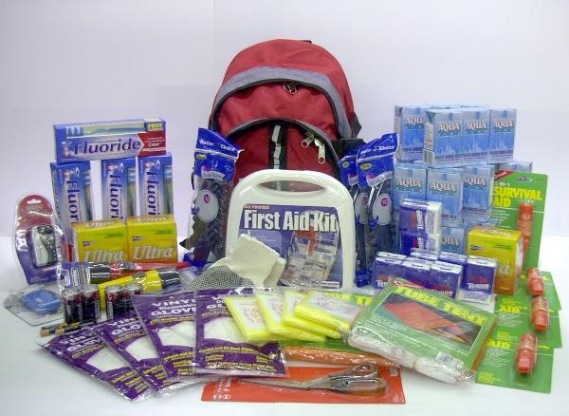
Go-Kit/Stay Kit
Car, Home, Work
Water/Food
Shelter/Warmth
Cash
Medications
Sanitation

Slide 33
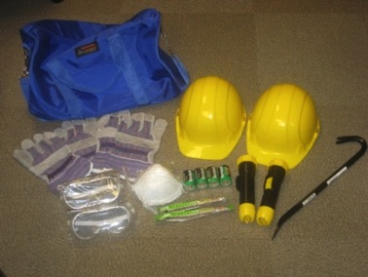
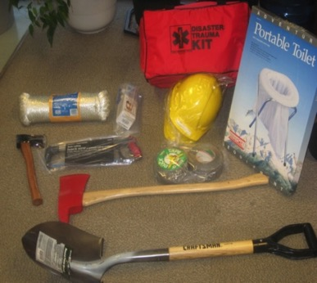
30-Gallon Trash Can on Wheels
First Aid supplies
Flashlights
Extra batteries
Battery operated lanterns
Rain Gear
Blankets or sleeping bags
Tools (wrench, pliers, shovels, work gloves)
Fire Extinguishers
Tarps
Hard Hats
Notes:
Demonstrate Backpack

Slide 34
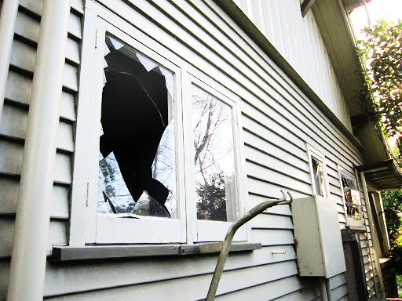
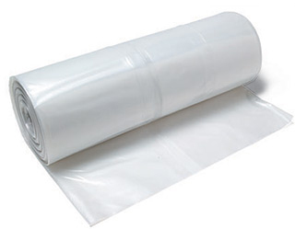
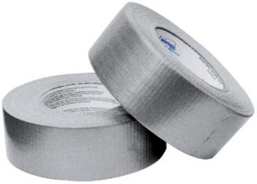
Expect Broken Windows
Plastic Sheeting
Duct Tape
Notes:
Benefits to covering windows (use clear plastic to allow for light to come in):
Protects home from the elements
Protects home from rodents, animals
Once aftershocks have reduced and you begin clean-up (assuming there isn’t structural damage), these become your new windows.
If you’re not able to re-occupy your house, you can use the plastic sheeting for sheltering outside.
Other benefits to having this available – discuss shelter-in-place for hazardous materials threat.

Slide 35
Emergency Preparedness Drill
https://www.youtube.com/watch?v=Zhmk8IEDSrs

Slide 36
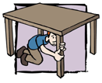
Drop, Cover & Hold-on
Notes:
DROP down to the floor in the room where you are. Don’t try to run out of the building during the earthquake. More people are injured during quakes while trying to run outside the building than from staying inside and taking protective actions.
Take COVER under something sturdy, a desk, table or other furniture that is not likely to tip over or easily crush. Crouch down on your knees and cover your head with your arms. If sturdy furniture is not available, crouch down on your knees near an interior wall and cover your head with your arms.
HOLD onto the furniture and be prepared to move with it. HOLD the position until the ground stops shaking. If possible, stay away from mirrors, tall furniture, and other things that might fall on you. Turn away from windows, light fixtures and suspended objects.

Slide 37
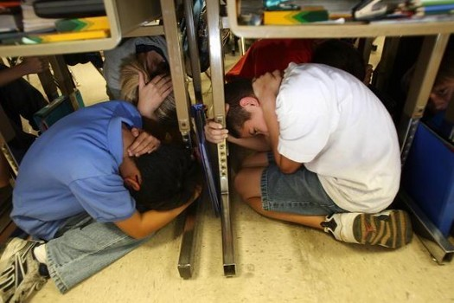
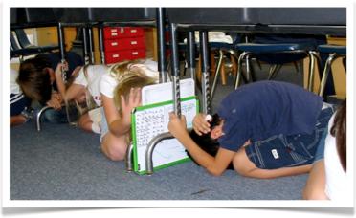
Be a small Target
Body Position
On knees
Protecting neck/head
Hold onto furniture
Curl into a ball
Face Position
Turn away from windows
Close eyes
Notes:
It’s important to get on your hands and knees and NOT on your bottom. Don’t sit down.
If you sit down under a sturdy piece of furniture and something falls on it, you only have the strength of your arms to free yourself.
If you’re on your hands and knees, you have the core strength of your body to free yourself.
Make yourself as small as possible, into a ball almost. This will reduce the likelihood of something falling on you.
Some schools instruct students to use a book or folder to protect their head, neck or face.

Slide 38
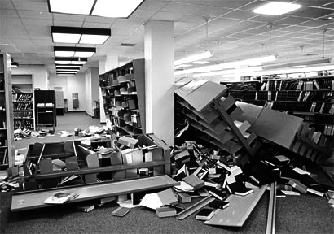
4 – 6 minutes is a long time…

Slide 39
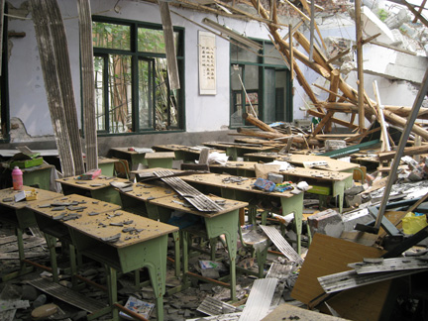
Duck, Cover & Hold-On Until the Shaking Stops

Slide 40
Notice Anything?
Notes:
Notice student in center of picture sitting on bottom instead of on hands & knees.
Notice student in front of picture who is not holding on to the desk.
Notice student on right who could make himself a smaller target.
Notice student on left whose head appears to be sticking out from under the desk.
This is a prime example of how teachers need to be trained correctly and then to monitor students when drilling so they can redirect students who are doing the procedure incorrectly. We need to drill correctly.

Slide 41
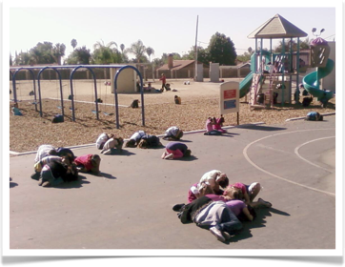
During the Shaking
If Inside, Stay Inside
Classroom
Gymnasium
Band Room
If Outside, Stay Outside
Get away from buildings, trees, light poles, power lines, utilities
Notes:
It’s common for teachers to have questions about where students should “Drop, Cover, and Hold on”. Each classroom is different.
Classroom: Under desks. If they can’t fit underneath their desk, at least try to get their head underneath. If something falls on their legs, that won’t be as severe as if something falls on their head/neck/shoulders.
Gym: Drop, Cover, Hold on next to an interior wall. Get on hands and knees and into make yourself as small as possible.
Band room: Get creative, use the chairs that students sit on to get under…even if it’s just the head/neck/shoulder.
If Outside, some people think they don’t need to Drop, Cover & Hold on. But we do. The earthquake can knock you down and injure you and things may be flying off buildings or overhead objects. We must take a protective posture during earthquakes when we are outside.

Slide 42
Wheel Chair Bound
Roll into area with structural protection
Apply brakes
Cover head and eyes to best of ability
Be Advised: rescuers need to drop, cover, and hold on, too!
Notes:
For those who are in wheel chairs and are not able to get onto the floor to do a “Drop, Cover, & Hold on”, practice with them to roll themselves into an area with some structural protection.
If they are able, they can:
Apply the brakes
Cover their head and close their eyes
The Staff member must take their own protective actions so they can be part of the solution after the shaking stops.

Slide 43
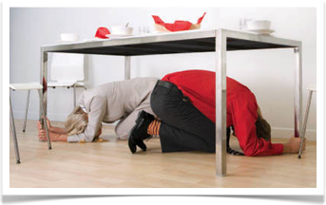
What About Adults
Staff should also Drop, Cover & Hold-on
Even during drills!
Notes:
Staff members should also physically perform the “Drop, Cover, Hold On” procedure…even during drills.
Staff members who have an emergency plan for their families are much more likely to be able to fully engage and help with the response and recovery efforts at school.

Slide 44
3 Common Mistakes
Triangle of Life
DO NOT believe the triangle of life!
Run
DO NOT run out of the building!
Doorway
DO NOT get in a doorway!
Notes:
1. Most people are injured in earthquakes while trying to run out of the building by things falling on them.
2. Doorway: It does not protect you from falling items, and in strong shaking you are unable to stand. The door itself may knock you down, the earthquake may knock you down.
3. You are safer under, not next to a table.

Slide 45
The Triangle of Life Myths
MYTHS
TRUTH
Buildings Collapse
Anticipate
Safe Voids
You can Move
Furniture Crushed
Collapse: Most buildings do not collapse
Moving: Strong shaking makes moving very difficult and dangerous
Voids: The direction of shaking and unique structural aspects of the building make this impossible.
Furniture: People DO survive under furniture or other shelters.
Notes:
The “Triangle of Life” is based on several wrong assumptions:
The Red Cross and FEMA and other reputable national earthquake organizations have refuted the “triangle of life” advice for the United States.
Myth: Buildings always collapse in earthquakes
Truth: Most buildings do not collapse at all, and few completely collapse.
Myth: During strong shaking people can move to a desired location.
Truth: Strong shaking can make moving very difficult and dangerous.
Myth: People can always anticipate how their building might collapse and find the survivable void spaces.
Truth: The direction of shaking and unique structural aspects of the building make this impossible.
Myth: When buildings collapse they always crush all furniture inside.
Truth: People DO survive under furniture or other shelters.

Slide 46
In a Car or Bus
Pull over to a safe location
Stop & stay there
Keep seat belt on
After shaking stops, assess your situation
Notes:
Check to see that your Bus Emergency Plan has procedures for earthquakes.
Students should take a protective position in their seats, covering their heads and turning away from windows.
After the shaking stops, assess your situation and attempt to determine if roads are passable.

Slide 47
The Great Oregon Shake Out
Watch Video:
When the Earth Shakes at
http://www.shakeout.org/oregon/
Notes:
Encourage participation in the Great Oregon Shake Out.

Slide 48
What Happens
After
The shaking stops?

Slide 49
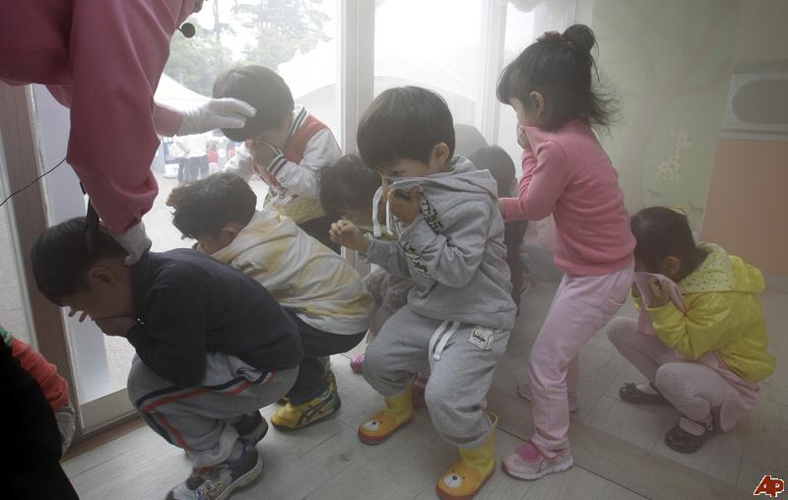
After the Earthquake
Assess
Broken Glass
Dust, Dark
Debris
Fire, Smoke
Injuries
Protect
Cover your mouth
Carefully get up
Evacuate
Instructions
Help Each Other
Hazards
Door - Routes
Supplies
Notes:
After the ground stops shaking,
Assess your situation: hazards such as glass, dust, fire, darkness, injuries
Protect yourself: leather gloves, dust mask, flashlight (fire extinguisher if available)
Evacuate the building: Obstacles, secondary routes, assist those in need
One of the most common hazards in earthquakes are broken windows – GLASS. This presents a real safety hazard. It is also common for a lot of dust (almost like a heavy smoke) to be floating around. Consider instructing students to cover their mouth and nose with their sleeve while you evacuate to reduce how much dust they breath in. In many cases, the power will be out. Flashlights can be very useful in this situation.
Take supplies with you if you are able…(unless you’re in the tsunami zone and need to hurry)

Slide 50
School Response Plan
Evacuate
-Account for Everyone
-Supervise Students
Immediate Needs
-Medical
-Search & Rescue
-Shelter from Weather
-Restrooms
Reunification
-Reunite Students with Families
-Move Students to Shelter Location
Activate Disaster Cache
-Shelter & Warmth
-Water & Food
-Sanitation
-Supervision

Slide 51
Are You Ready to Survive?
CEETEP
Sue Graves ~ August 2015

