Slide 1
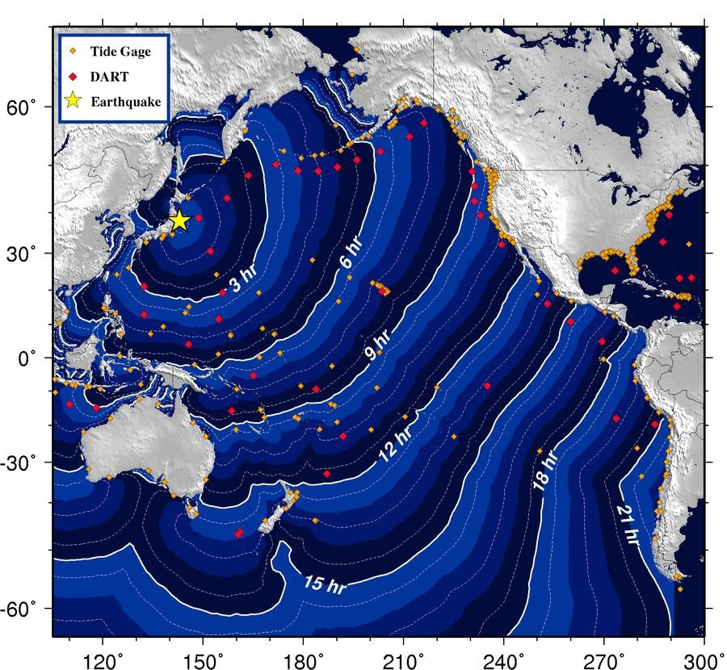
Pacific Ocean Tsunami Generated by Japan Earthquake
Near the earthquake, there were only ~20 minutes to evacuate.
A “local tsunami” for Japan.
Travel times are well known for tsunamis crossing the Pacific Ocean.
At distant locations, there were hours of advance warning. A “distant tsunami” for Oregon coast.

Slide 2
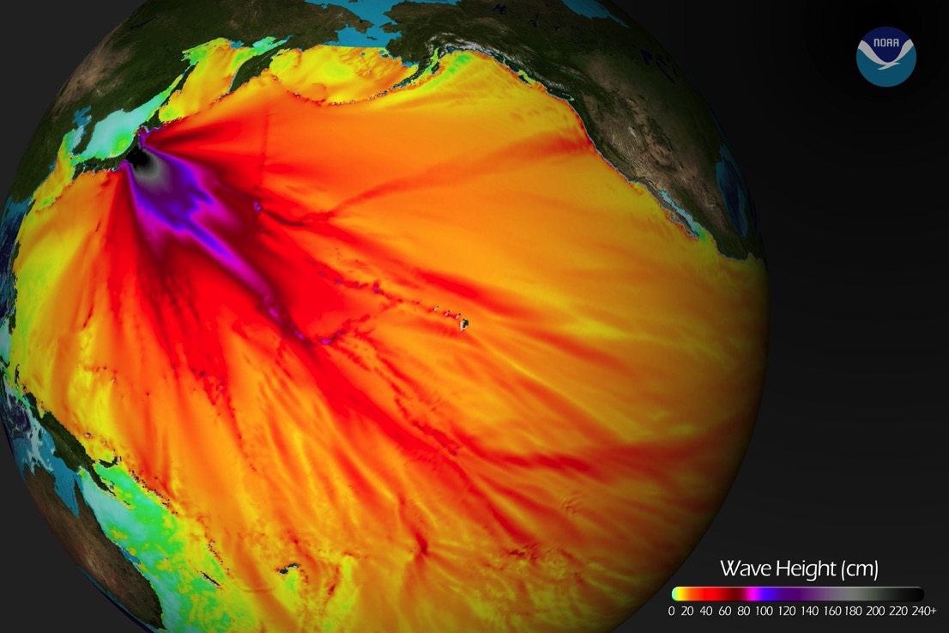
Pacific Ocean Tsunami Generated by Japan Earthquake
Tsunami height model shows forecast wave height (in cm).
Ocean floor bathymetry affects the wave height because of reflections and refractions from seafloor features and islands.
Tsunami evacuations were ordered for Hawaii, Oregon, and northern California but not Washington. Wave heights were accurately predicted.

Slide 3
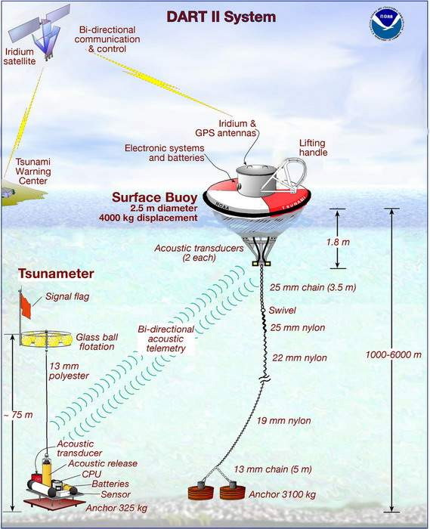
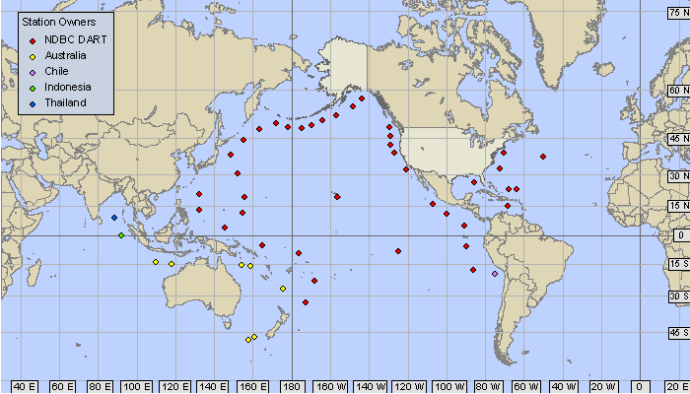
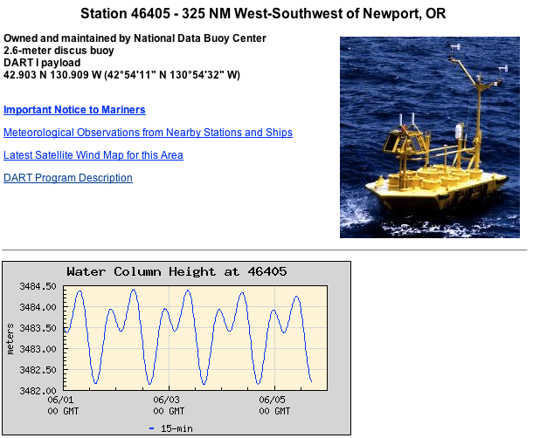
Deep-ocean Assessment and
Reporting of Tsunami (DART)

Slide 4
Pacific Ocean Tsunami Generated by Japan Earthquake
Peak-to-trough wave height was nearly 2 m at nearest DART buoy in 4000 m water depth!
Travel time to Oregon and Washington coast was about 9 hours.
Largest waves affected OR and CA MANY hours after first waves arrived.

Slide 5
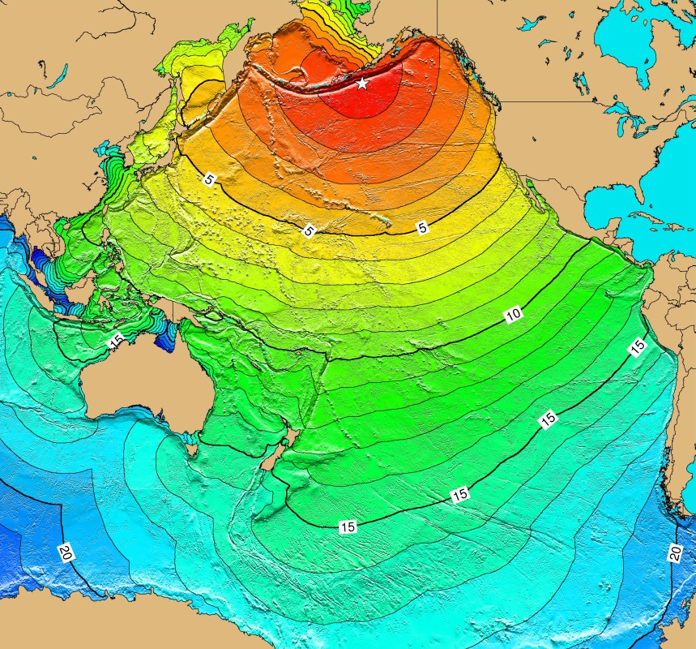
Pacific Ocean Tsunami Generated by Alaska Earthquake
About four hours travel time to Oregon Coast.
Tsunami from 1964 Alaska EQ killed 4 children on Beverly Beach. The largest of 28 distant tsunamis to affect Oregon coast since 1854.
Significant damage in Seaside and Cannon Beach. Major destruction and 13 deaths in Crescent City, CA.

Slide 6
Damage in Cannon Beach from 1964 Alaska Tsunami
Bridge over Elk Creek (now Ecola Creek) destroyed and displaced 300 m upstream.
House torn from foundation and displaced 400 m upstream.
From Priest and others, DOGAMI Special Paper 41, 2009.

Slide 7
Distant Tsunami Inundation Map for Bandon, Oregon

Slide 8
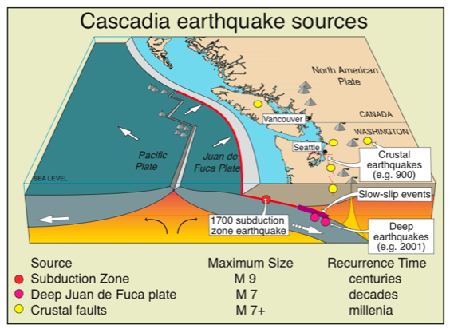
Past Great Cascadia Earthquakes and Tsunamis
Juan de Fuca subducts beneath Pacific Northwest portion of North American Plate at Cascadia subduction zone.
Last great Cascadia earthquake occurred on
January 26, 1700 at about 9:00 PM local time.
Analogous to Sumatra 2004, Chile 2010, and Tohoku, Japan 2011 great earthquakes.

Slide 9
Yuriage
Some Coast Areas Now Below Sea Level
Before After
Some areas that were above sea level on march 10
dropped below sea level on March 11, 2011.
This also happened along the Washington - Oregon coast during the 1700 AD great Cascadia earthquake.

Slide 10
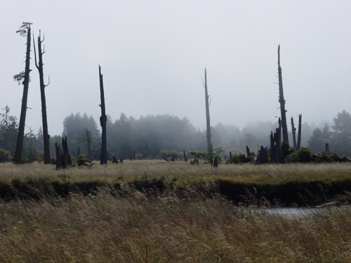
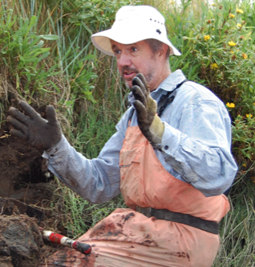
Drowned Forests of Coastal Oregon and Washington
Ghost forest on Copalis River
Brian Atwater, USGS Seattle
Coastal “drowned forests” record the history of slow uplift between and sudden subsidence during great Cascadia earthquakes.

Slide 11
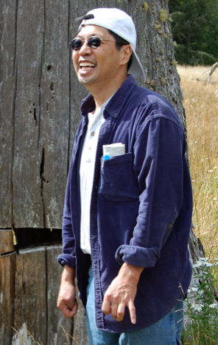
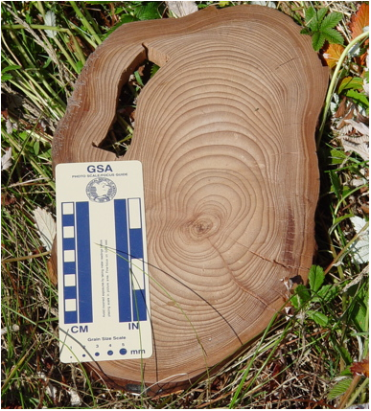
Drowned Forests of Coastal Oregon and Washington
David Yamaguchi
Trees in “drowned forests” near shore died when the ground dropped and seawater killed the trees. Compare rings from victim trees with rings from witness trees on higher ground.
Result: Trees died between fall 1699 and spring 1700.

Slide 12
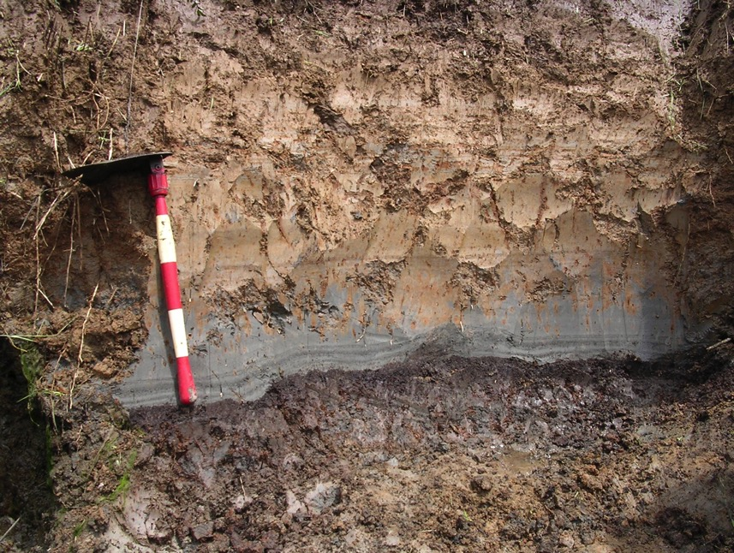
Three-Layer Cake of
Cascadia Tsunami Geology
Cupcake Geology
Niawiakum River east of Willapa Bay
Organic-rich forest soil covered by tsunami sand then intertidal mud and clay on top.

Slide 13

Cascadia Tsunami Geology
Multiple sand layers.
One for each wave of the tsunami!
inland
Clump of marsh grass

Slide 14
Making a Ghost Forest
Notes:
Show Formation of Ghost Forest animation of discovery of the 1700 AD great Cascadia earthquake as illustration of scientific discovery.

Slide 15
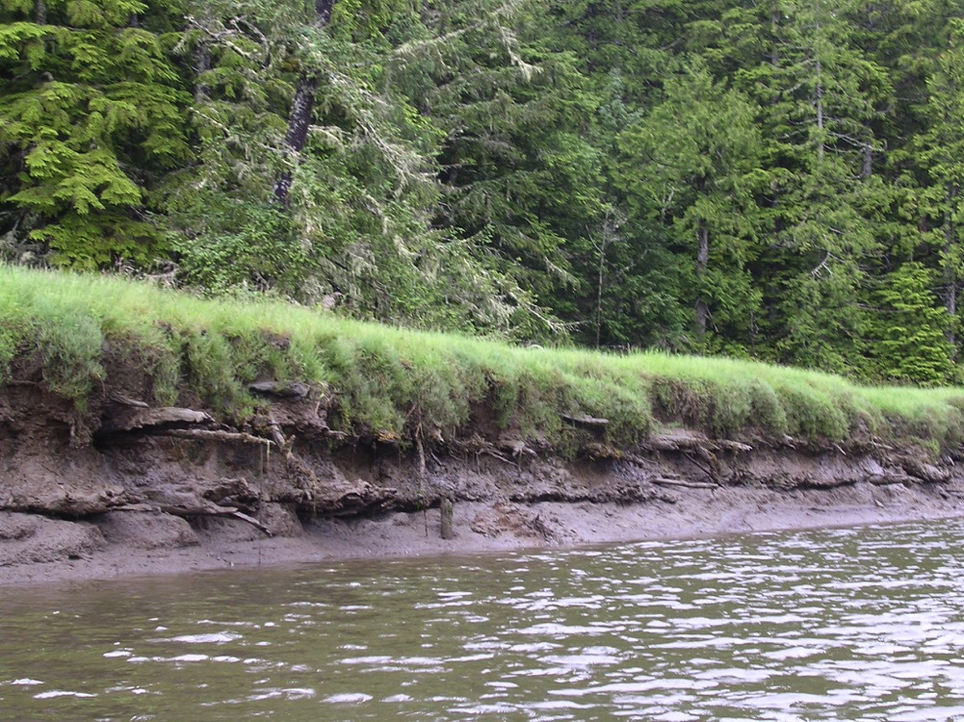
Buried Forest Soils
1700 AD
860(?) AD
Niawiakum River, east of Willapa Bay, WA.
Notes:
This photo shows roots Sitka spruce trees that were killed by ground subsidence during the 1700 AD great Cascadia earthquake AND the preceding great Cascadia earthquake. This field site is located on the Niawiakum River just east of Willapa Bay in southwestern Washington state.
VIRTUAL FIELD EXPERIENCE: A virtual field experience for this field site is provided on this DVD at: 6.TOTLE VFE and Field Trips > Virtual Field Experiences
To run the virtual field experience from this DVD, open the “index.html” file in the Virtual Field Experiences folder in a web browser such as Safari or Firefox or Explorer.

Slide 16
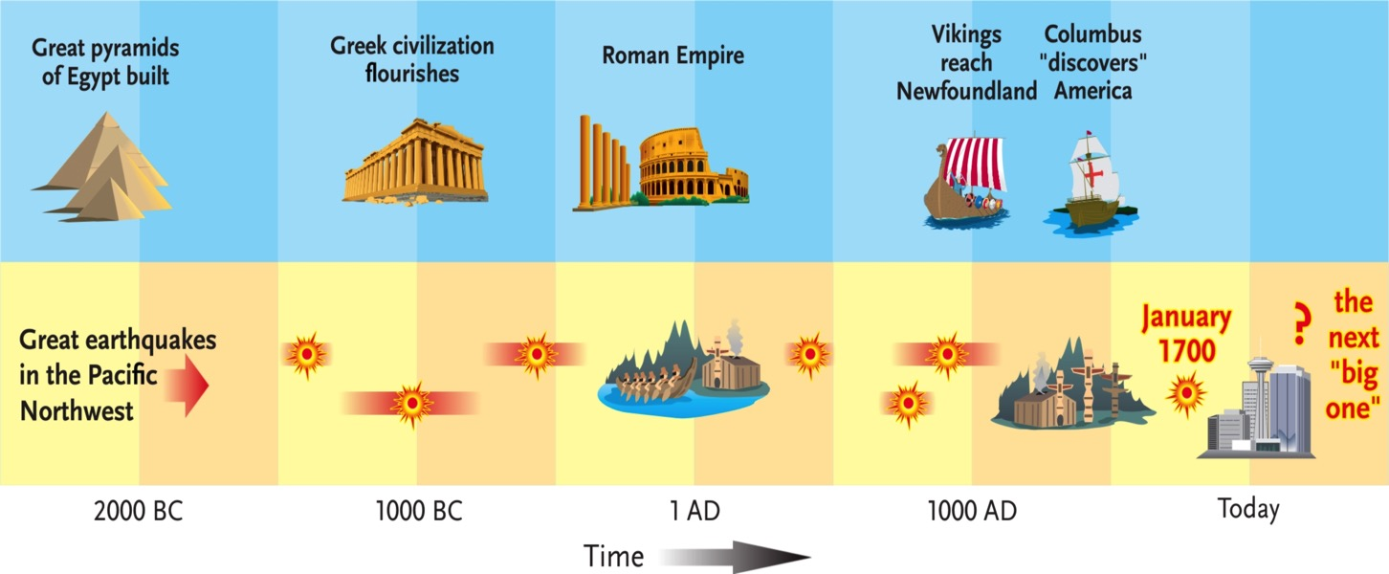
Recent Great Cascadia Earthquakes
Average time between earthquakes = Recurrence time.
Recurrence time for Great Cascadia EQs = 500 years.
We are at 315 years and counting.
Notes:
From At Risk: Earthquakes and Tsunamis on the West Coast, by J. Clague and others.

Slide 17
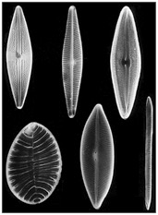
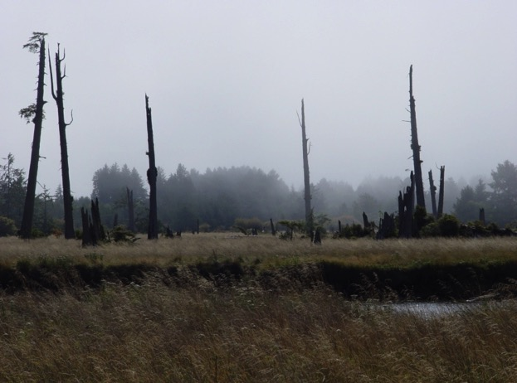
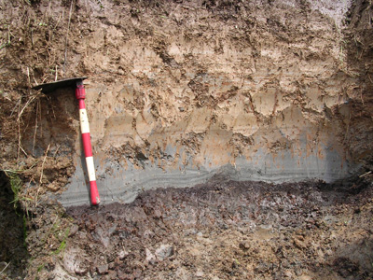
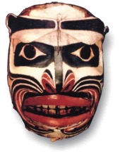
Cascadia Tsunami Geology Storyline
Great earthquake January 26, 1700 @ 9 PM
Ghost forests, buried soils, diatoms, tsunami sand sheets, liquefaction, turbidites, Native American oral history, and written Japanese history.
Intertidal mud & clay
Tsunami sand
Forest soil

Slide 18
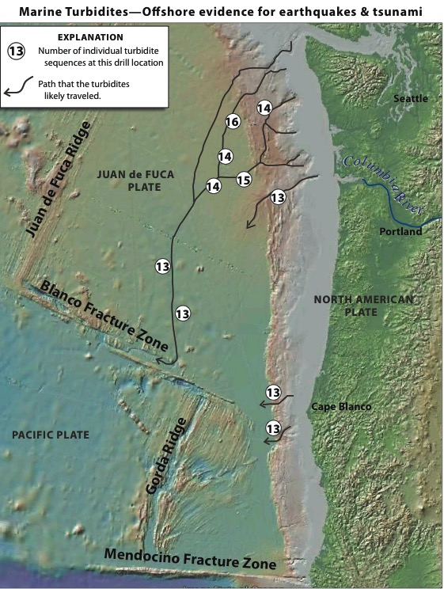
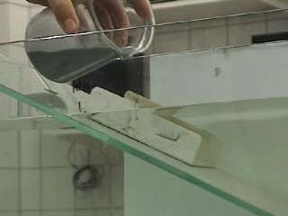
Turbidite in a Jar
Turbidites in Marine Sediment Cores
Sediment deposited on continental shelf can surge down submarine canyons in turbidity currents. The resulting “turbidite” layer has coarse sand on bottom and fine clay on top.

Slide 19
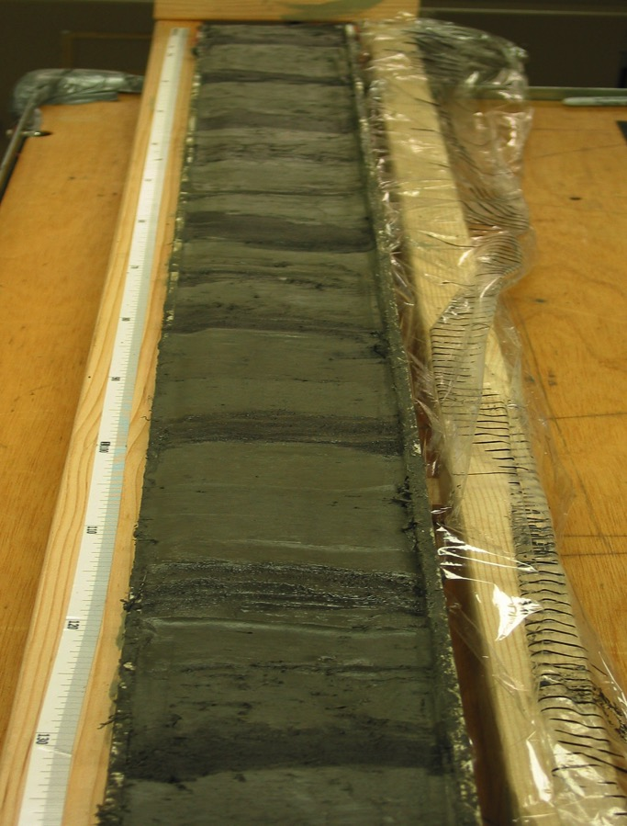
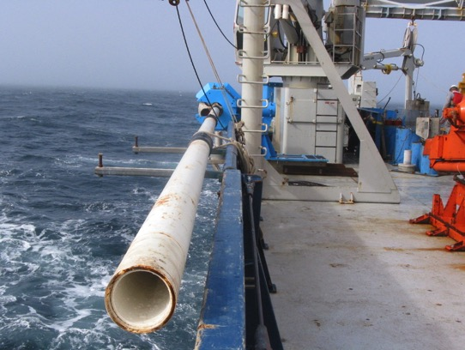
Turbidites in Marine Sediment Cores
Chris Goldfinger (OSU).
Shaking by great Cascadia earthquakes caused turbidity currents.
Ages of many seafloor turbidites match from offshore northern CA to BC.
Requires great earthquakes that ruptured entire or large segments of the plate boundary.

Slide 20
Turbidites: The Movie

Slide 21
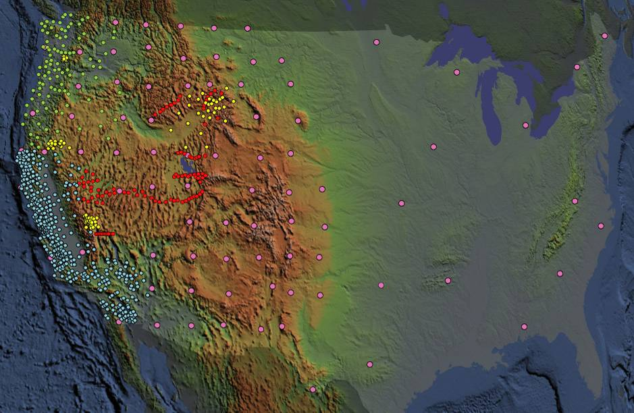
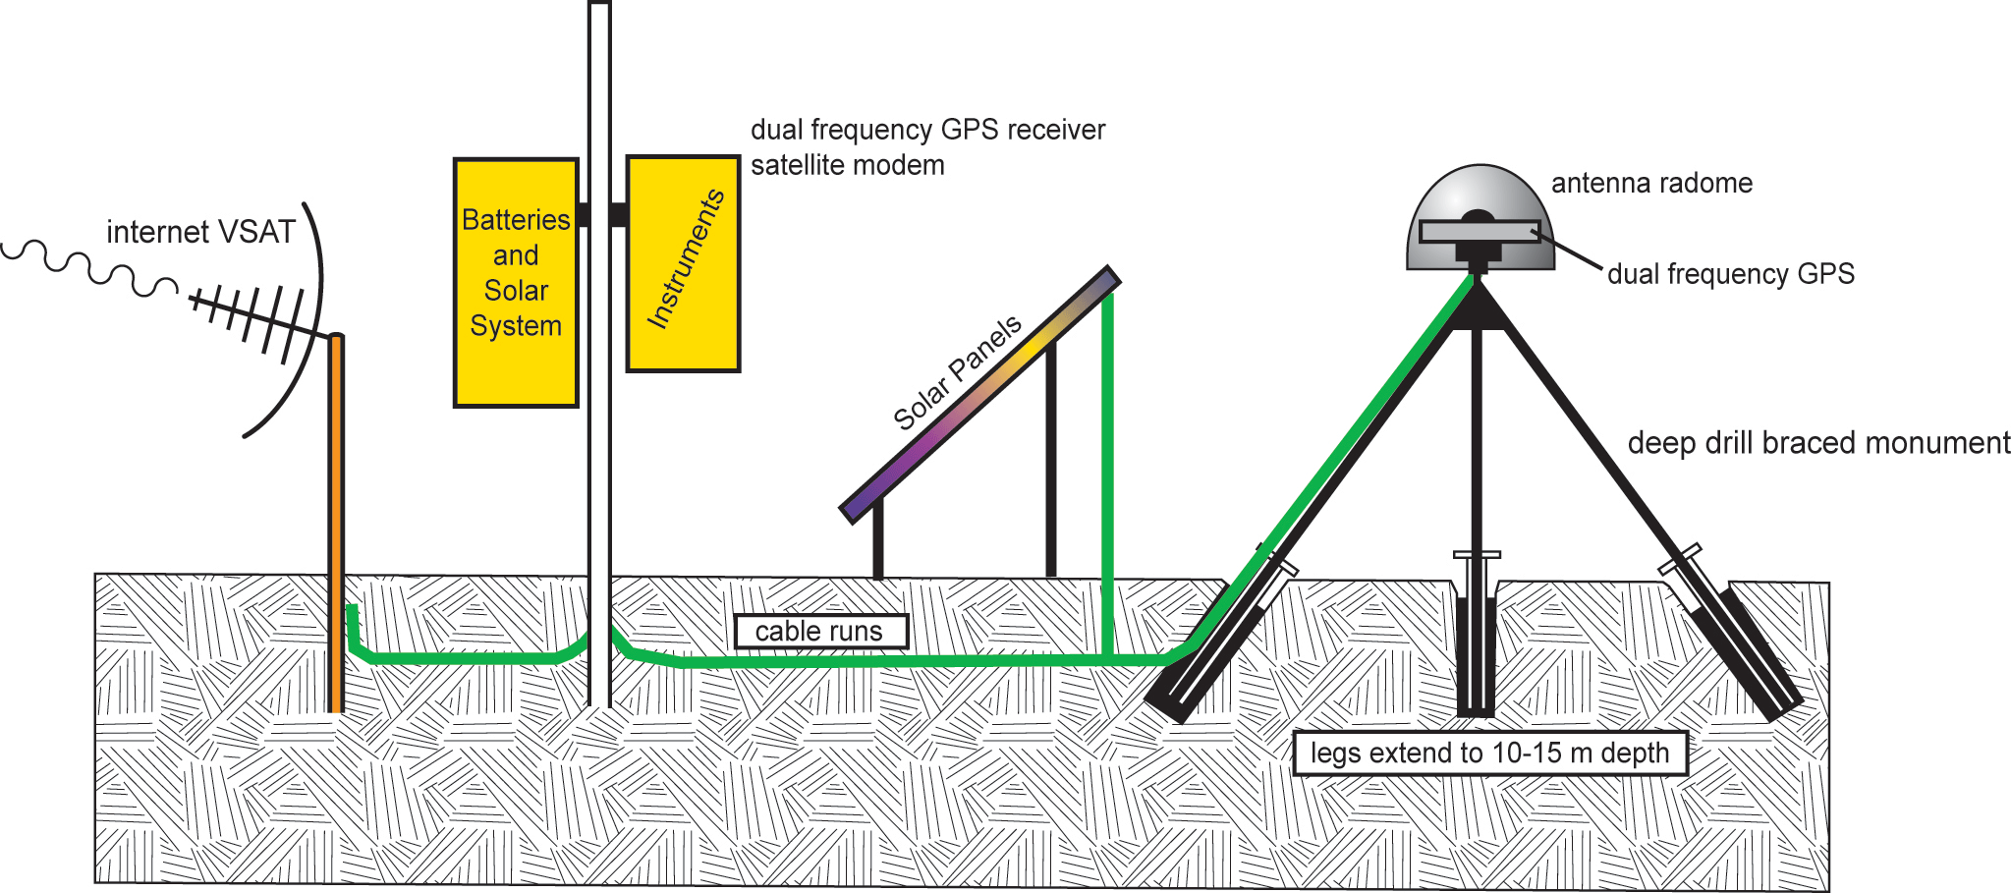
Plate Boundary Observatory (PBO)
-1100 permanent Global Positioning System (GPS) stations
-78 Borehole Seismometers
-74 Borehole Strainmeters (BSM)
-26 Tiltmeters
-6 Laser Strainmeters (LSM)
Measure the broad temporal and spatial spectrum of plate boundary deformation

Slide 22
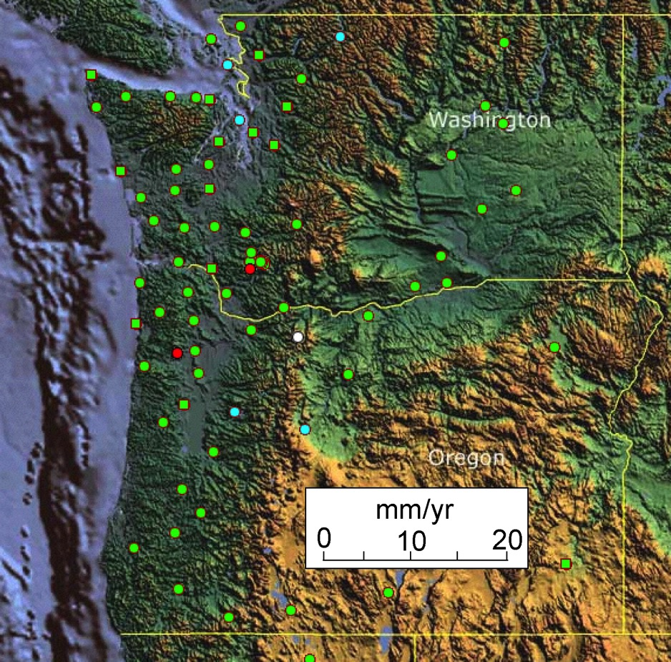
Cascadia Locked and Loading
Examine motions of GPS stations due to Juan de Fuca - North America plate convergence.
Astoria
Juan de Fuca Plate

Slide 23
Astoria, OR GPS Observations
Northward motion
= 0.29 inch/yr
Eastward motion
= 0.33 inch/yr
Total motion
= 0.44 inch/yr
Total motion since 1700 AD
= 11.5 feet

Slide 24
Cascadia GPS Animation

Slide 25
Cascadia Locked and Loading
GPS Gum Drop
Stations on coast are moving NE faster than stations in urban corridor.
Cascadia subduction zone boundary is “locked and loading” as it stores elastic energy that will be released in the next great Cascadia earthquake.
If the next great Cascadia earthquake happens tomorrow, Pacific Beach will jump 5.35 meters (17.5 feet) southwest.
Neah
Bay
Pacific
Beach
Tumwater
Othello
Kelso
Tillamook
Wasco
La Grande
Newport
Corvallis
Juan de Fuca Plate

Slide 26
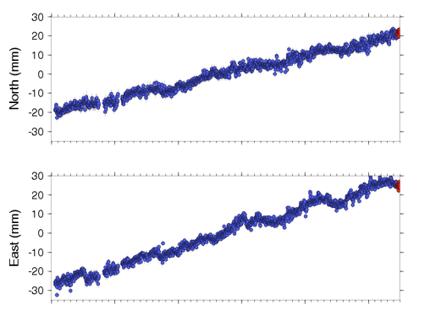
Neah Bay, WA GPS Data
42 mm / 5.5 yr = 7.6 mm/yr
56mm / 5.5 yr = 10.2 mm/yr
2004
2005
2006
2007
2008
2009

Slide 27
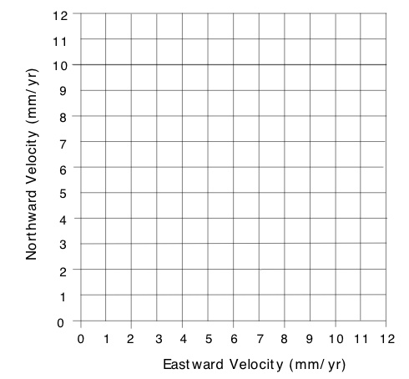
Neah Bay, WA GPS Velocity
12.4 mm / yr

Slide 28
Episodic Tremor and Slip
GPS receivers in western part of the Willamette Valley and Puget Lowlands, as well as the eastern fringe of the Coast Ranges, move in a “sawtooth pattern”.
They move NE most of the time but backslide to the SW every 10 to 16 months.
Low-amplitude seismic vibrations accompany the backwards motion.
This is “Episodic Tremor and Slip”, a major new discovery.
Neah
Bay
Pacific
Beach
Tumwater
Othello
Kelso
Tillamook
Wasco
La Grande
Newport
Corvallis
Juan de Fuca Plate

Slide 29
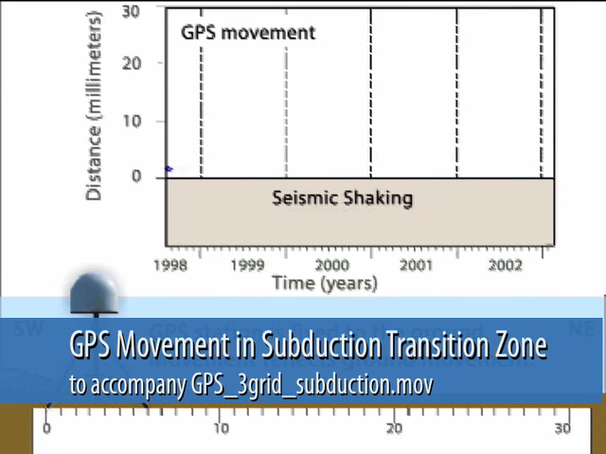

Episodic Tremor and Slip
Animation by JENDA JOHNSON

Slide 30
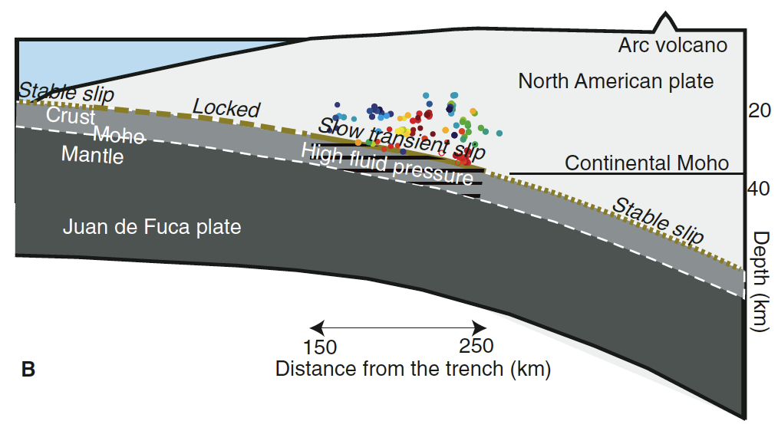
Episodic Tremor and Slip
Two-Block EQ Model
Slow slip between North American and Juan de Fuca plates at
20 – 40 km depth. A transitional behavior between the shallow locked zone and the continuously slipping zone deeper than 40 km.

Slide 31
Episodic Tremor and Slip
Animation by JENDA JOHNSON

Slide 32
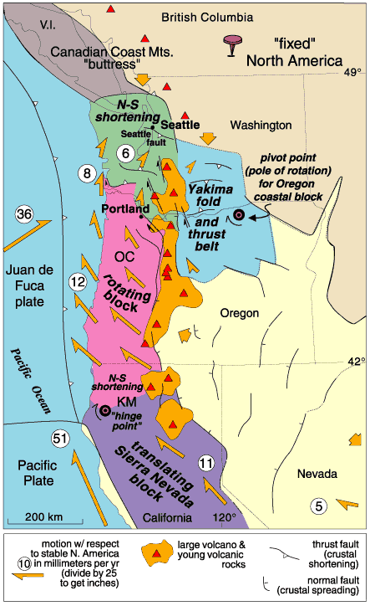
PNW Crustal Block Motions
PNW Crustal Block Model
Crustal blocks are in slow motion. They grind against each other causing EQs along their edges. They also deform internally to make faults and folds.

Slide 33
Animation on Crustal Block Motions

Slide 34
PNW Crustal Block Motions
PNW Crustal Block Model
Explore the model.
Note rotation of Coast Range blocks and opening of Basin and Range in southeastern Oregon.

Slide 35
Crustal Earthquakes in Oregon 1841 - 2002
Mt Angel, 1993
Klamath Falls, 1993

Slide 36
Cascadia Earthquake Early Warning

Slide 37
Local Cascadia Tsunami
DOGAMI has published Tsunami Inundation Maps based on modeling of tsunamis generated by great earthquakes on the Cascadia subduction zone.
Important factors:
Western edge of North American plate.
Displacement during great earthquakes:
How much? How deep? A splay fault?
Bathymetry of ocean floor on continental slope and shelf.
Shoreline topography.
Note that WA continental shelf is wider than OR continental shelf.

Slide 38
Continental Shelf Deformation? Splay Faults?

Slide 39
Local Tsunami Inundation Map for Bandon
Tsunami Inundation Maps
SM = “small” M8.8 Cascadia EQ
of 9 m displacement
(300 years of plate motion).
M = “medium” M8.9 Cascadia EQ
of 15 m displacement
(500 years of plate motion).
L = “large” M9.0 Cascadia EQ
of 23 m displacement
(750 years of plate motion).
XL = “extra-large” M9.1 Cascadia EQ of 35 m displacement
(1100 years of plate motion).
XXL = “extra-extra-large” M9.2 Cascadia EQ of 40 m displacement
(1200 years of plate motion).
Numbers refer to rupture model.

Slide 40
Tsunami Evacuation Map for Bandon, Oregon
Wave-Tank Tsunami Model
Distant tsunami evacuation zone determined from maximum Alaska tsunami.
Local Tsunami Evacuation Zone determined from maximum Cascadia tsunami.

Slide 41
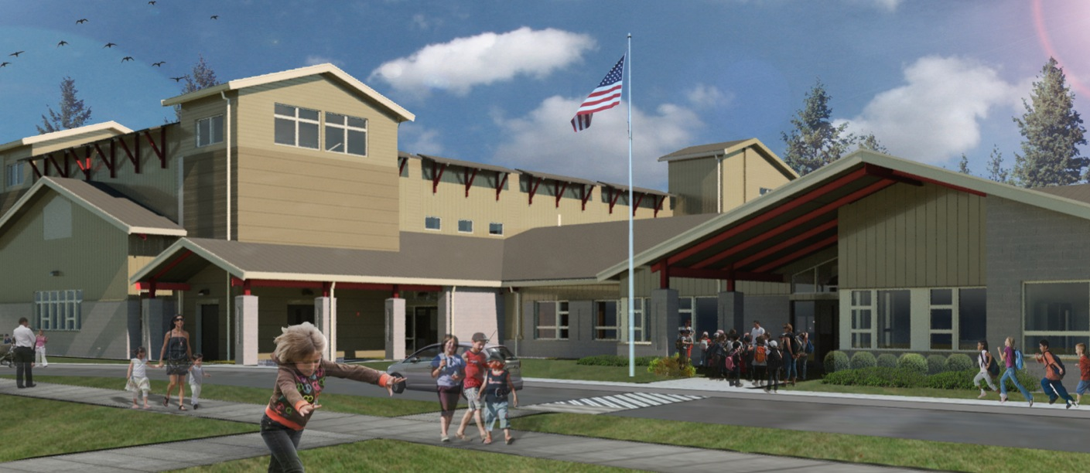
Ocosta Elementary School
If you can’t get out, go up.

Slide 42
NOAA Video on Vertical Evacuation from Tsunamis
Notes:
URL = http://www.fema.gov/medialibrary/media_records/8086

Slide 43
IRIS Home Page
Educational Resources
Notes:
IRIS Home Page: http://www.iris.edu/hq/

Slide 44
IRIS “Educational Resources” Page
Animations
Notes:
IRIS Educational Resources Page: http://www.iris.edu/hq/programs/education_and_outreach
IRIS Animations Page: http://www.iris.edu/hq/programs/education_and_outreach/animations

Slide 45
IRIS Home Page
Recent Earthquake
Teachable Moments
Notes:
IRIS Recent Earthquakes Teachable Moments Page: http://www.iris.edu/hq/retm

Slide 46
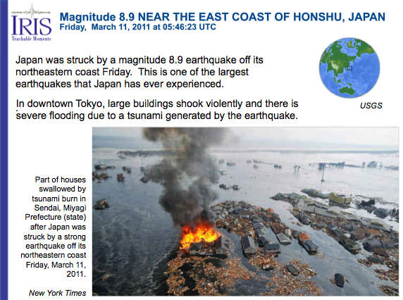
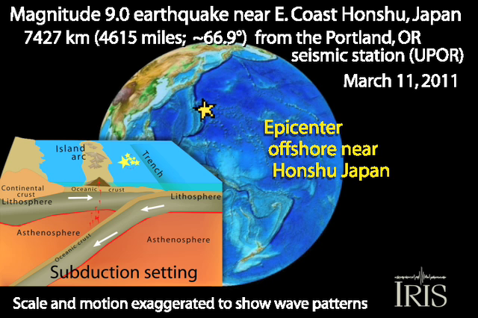
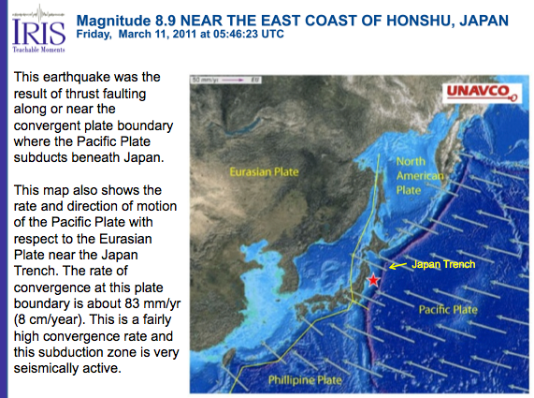
IRIS Recent Earthquake Teachable Moments
Notices developed for all M > 7 earthquakes worldwide.
336,000 views Jan 1 – March 19, 2011.
Sign up for the listserv to receive email notice when new RETMs are posted.
Notes:
Japan March 11, 2011 Recent Earthquake Teachable Moment: http://www.iris.edu/hq/retm/event/1328

Slide 47
Tsunami Evacuation Map for Bandon, Oregon
Distant tsunami evacuation zone determined from maximum Alaska tsunami.
Local Tsunami Evacuation Zone determined from maximum Cascadia tsunami.

Slide 48
Cascadia Earthquake Displacement Models
Example for a “medium” size (M8.9) Cascadia earthquake
(500-year recurrence time and 15 m offset).
M1: Shallow displacement occurs on splay fault.
M2: Displacement to deformation front.
M3: Displacement stops a few km below the seafloor.

Slide 49
Cascadia Earthquake Vertical-Offset Models
Example for a “medium” size (M8.9) Cascadia earthquake.
M1: Produces 5 m uplift of seafloor offshore from Newport.
M2: Produces 4 m uplift of seafloor offshore from Newport.
M3: Produces 4 m uplift of seafloor offshore from Newport.
Note the change in shape of uplifted seafloor area.

Slide 50
Measured GPS Velocities
What’s up with southwestern Oregon?
Shouldn’t ALL the velocities vectors on PNW coast be parallel to Juan de Fuca motion as it converges with North America?

Slide 51
Compression of Pacific Northwest Continental Margin
Juan de Fuca – North America convergence ALONE should produce simple pattern of velocities like this.

Slide 52
Crustal Block Motions + Plate Convergent Motions
Convergence
velocities in red.
+
Crustal block
Motion velocities in orange.
=
Observed GPS velocities.

