Slide 1
Surviving a Tsunami
Soo – nah - me
CEETEP
Sue Graves ~ August 2015
Notes:
In this session, we will explore how to prepare for two entirely different events: a distant tsunami and a local tsunami.

Slide 2
What is a Tsunami
Japanese for “harbor wave”
Series of waves & surges
5-60 minutes apart
Wave lengths are 10-100s miles long, so we cannot see the next wave.
Grows in height as it nears the shore.
Travels fast in deep ocean (400-500 mph), but slows down at coast (10-30 mph).
No connection with the tides
Notes:
Tsunamis are a series of traveling waves of extremely long wavelength and time period. They are generated when an entire column of water is suddenly moved vertically, such as by the occurrence of a great earthquake.

Slide 3
What does a Tsunami look like?
Rapidly rising/falling sea level
Wall of water, surges
Flood, strong currents
Receding wave
Seafloor exposed
Ocean drawdown
Fast flowing, debris-laden river
Objects become battering rams
Erodes, scours, deposits mud
2011 Japan Tsunami
Notes:
In Japan 2011 Tsunami, the wave run-up heights were up to 133 feet in some places and it traveled up to 6 miles inland in some places.

Slide 4
What causes a Tsunami?
Shallow, undersea Earthquakes
Underwater Landslides
Volcanic Eruptions
Meteor
Notes:
Tsunamis are a series of traveling waves of extremely long wavelength and time period. They are generated when an entire column of water is suddenly moved vertically, such as by the occurrence of a great earthquake.

Slide 5
Two Types
Plenty of Warning
Very Survivable
Local
Tsunami
Very Little Warning
Large Inundation Area
Small Inundation Area
Survivability based on Evacuation
Distant
Tsunami
CEETEP
Sue Graves ~ August 2015
Notes:
In this session, we will explore how to prepare for two entirely different events: a distant tsunami and a local tsunami.

Slide 6
Distant Tsunami
Earthquake far away
You won’t feel the ground shake
4+ hours before waves & surges arrive
Limited areas of inundation
Notes:
EQ in Alaska is biggest threat, biggest impact
YOU WON’T FEEL THE EARTHQUAKE!

Slide 7
Know the “Distant” Zone
The ORANGE Zone
Beaches
Harbors
Rivers, Inlets
Other low-lying areas
Some neighborhoods
Some business areas
Notes:
The Distant Tsunami zone is very limited in comparison to the Local Tsunami Zone.
Only evacuate if you are in the Distant Tsunami Zone.

Slide 8
Tsunami Alert Messages National Tsunami Warning Center
Alert Level | Threat | Action
Information Statement | Minor waves at most | No action suggested
Watch | Danger level not yet known | Stay alert for more info
Advisory | Strong currents likely | Stay away from the shore
Warning | Inundating waves possible | Full evacuation suggested
Notes:
When a significant earthquake occurs a large distance from the Oregon Coast, from an earthquake that we don’t feel, a Distant Tsunami may be generated. The National Tsunami Warning Center (http://wcatwc.arh.noaa.gov/) in Palmer, Alaska is the government organization which provides information to the public regarding tsunami threats to our area. There are four separate alert levels: Information Statement, Watch, Advisory, and Warning. Each has a distinct meaning and suggested action:

Slide 9
Distant Tsunami Notification
Mass Notification Systems
NOAA Alert Radio
Sirens
TV/Radio
Social Media
Notes:
There are several different methods the public may be notified of a coming Distant Tsunami.
Mass Notifications Systems: Phone calls, text messages, email notifications, Reverse 911 type of systems, National Weather Service notifications
Citizen Alert/NWS Alert. (Teach how to sign up.) Smart phone app’s.
SHOW: NOAA Alert Radio – Be sure to get a radio with the “Alert” feature. It’s your own personal siren.
Sirens – some communities have sirens – these are for distant tsunamis
The Media: Traditional (TV, Radio, etc), Social Media (Face Book, Twitter, etc)

Slide 10
Evacuation During a Distant Tsunami Warning
WHO: Only those in the distant tsunami zone
HOW: Probably by car
WHERE: ???
Notes:
Evacuation for a Distant Tsunami is very different than from a local earthquake/tsunami.
Ask Participants (Pair Share): Where should people go when evacuating for a distant tsunami?
Locals
Visitors/Tourists
Students
Does your school, park, or business have a plan for a Distant Tsunami? (Show LCSD’s Distant Tsunami Plan as a sample)

Slide 11
Re-entry After a Distant Tsunami
Cancellation Message
Re-enter with Caution
Damage
Harbors
Beaches
Low-lying areas
Roads, Bridges
Clean up
Notes:
How do you know when a distant tsunami is over?
Cancellation Message: Wait for cancellation message (from National Weather Service)
Re-enter with caution: Local emergency service officials may provide specific re-entry instructions based on damage to certain areas/infrastructure.
Damage: Possible damage in harbors, near beaches and other low-lying areas. Some roads may be impassible, temporarily, there may be hazardous materials, fires, or other hazards involved.
Clean up: There may be Clean up that is necessary.

Slide 12
SHOULD ANYONE DIE
FROM A DISTANT TSUNAMI?
NO
Notes:
Brief discussion. Why or why not.
Possible points of discussion include:
Multiple warning mechanisms
Plenty of time to evacuate
Smaller inundation area
The answer is NO! Absolutely NOT! With proper education and preparation, nobody should die from a distant tsunami.

Slide 13
Distant Tsunami Plan
Notes:
Does your school or bus department have a Distant Tsunami Plan?

Slide 14
Local (Cascadia) Tsunami
Waves & Surges
Arrive in 15+ minutes
Continue 10-12+ hours
Back & Forth
Notes:
Let’s switch gears and talk about what is referred to as a “Local Tsunami.” That is, a tsunami caused by an earthquake near our shore, an earthquake that we FEEL.
Tsunami waves and surges will begin arriving on the Oregon Coast approximately 15-30 minutes after the earthquake starts…
The waves and surges can continue for 10-12 hours or more, possibly even for several days.
The waves and surges come in and go out, in and out, scouring away at structures and landscape, etc…carrying debris and hazardous materials with each wave/surge. (they also swirl around – toilet bowl illustration)

Slide 15
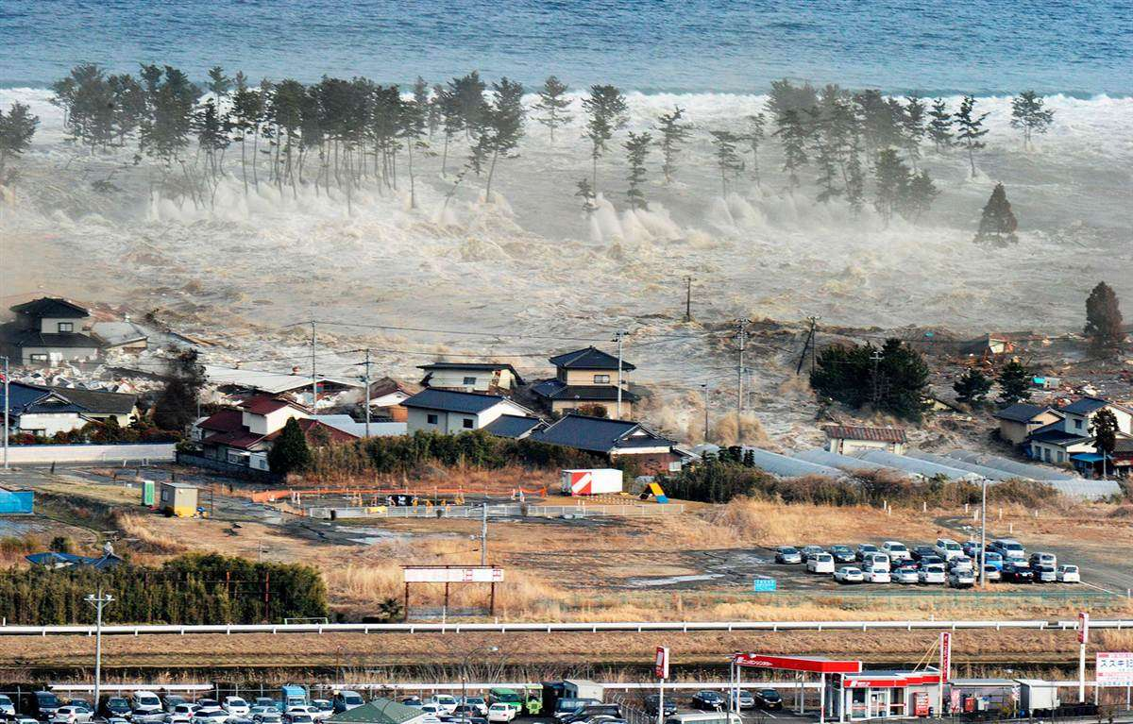
Buildings Destroyed

Slide 16
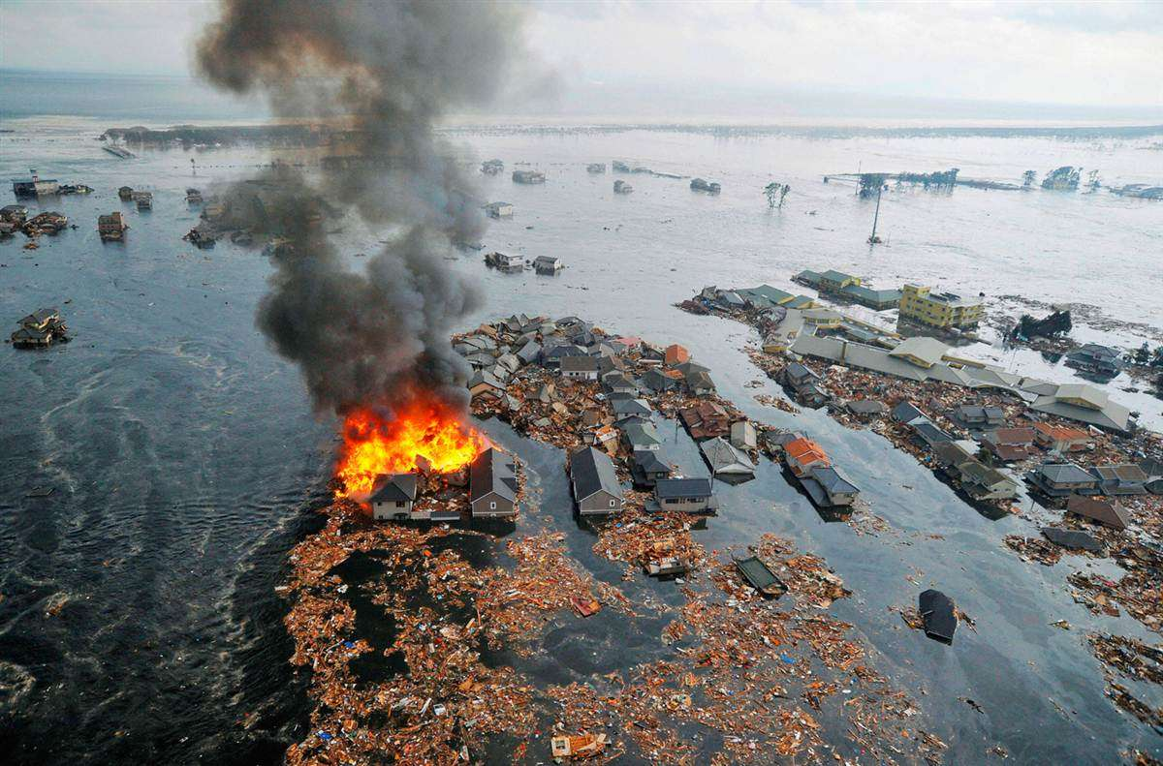
Fires
Notes:
The tsunami waves & surges will create damage of their own.

Slide 17
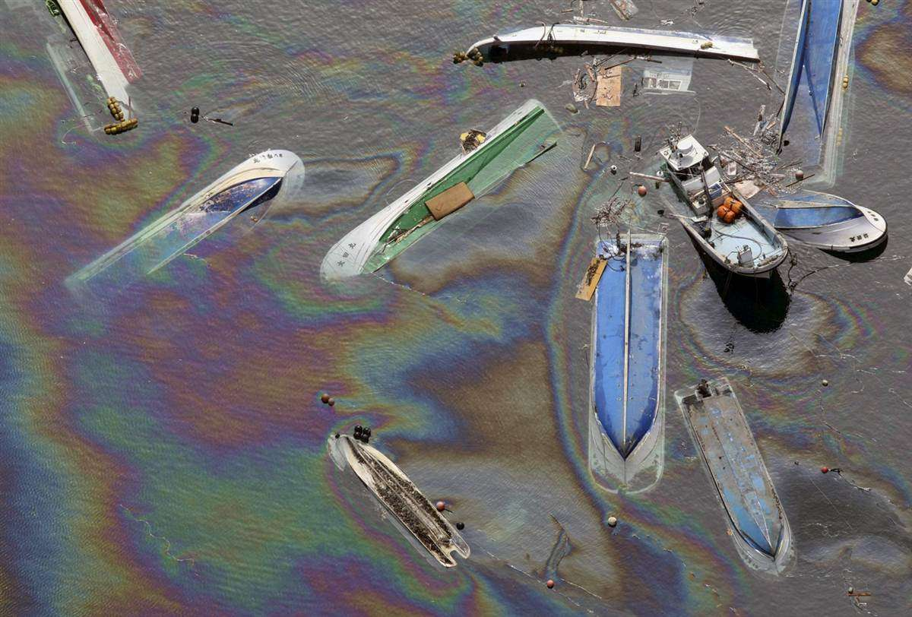
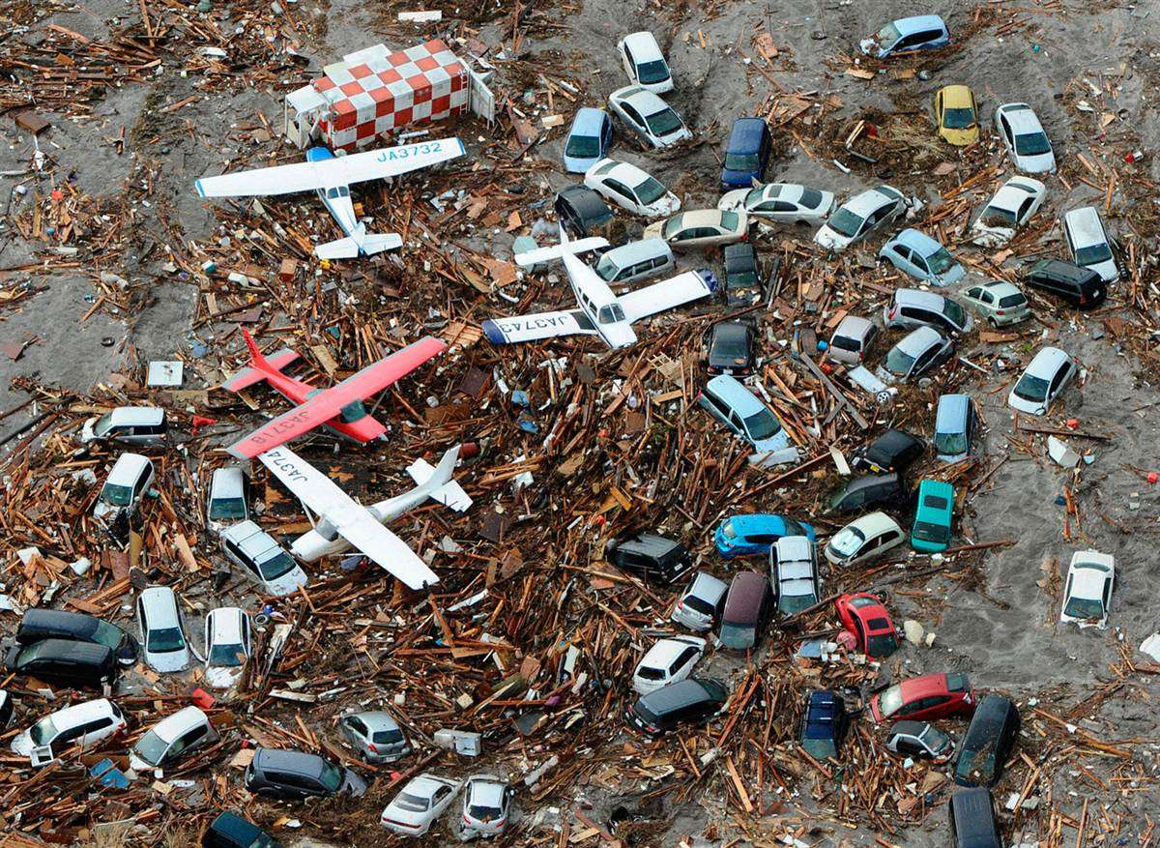
Harbors & Airports Destroyed

Slide 18
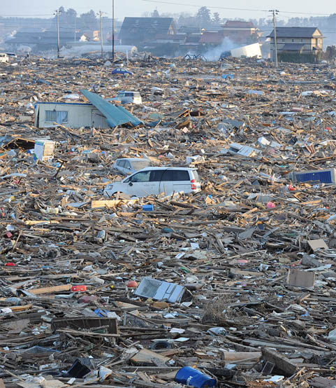
Hazardous Materials & Debris
Notes:
With all the hazardous materials spilled into our bays and oceans, is it likely that we will be able to fish, clam, crab, etc? And if we could, would it be safe to eat them?
How will we get through the debris to move to other areas or find loved-ones without injuring ourselves?
What will we do with the debris?
How will we move it?

Slide 19
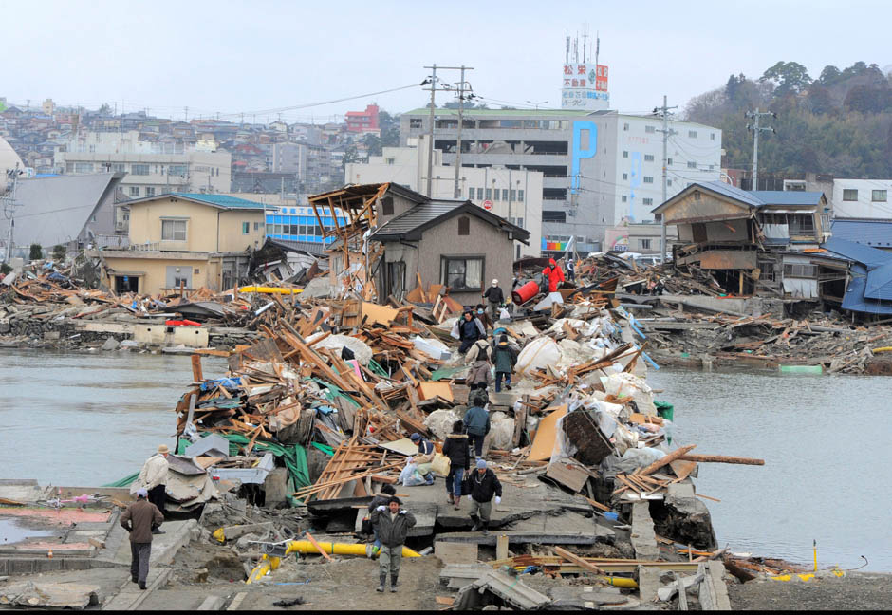
Roads Destroyed or Blocked

Slide 20
Injuries & Death
Notes:
There will be injuries, but probably more deaths from the local tsunami.

Slide 21
Rescues

Slide 22
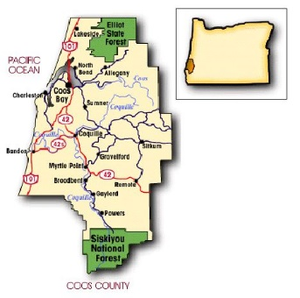
Separated by…
Failed Bridges
Landslides
Debris
Hazardous Materials
Notes:
We will be separated physically due to bridge failure, landslides & road failure, debris, hazardous materials…

Slide 23
New Tidal Level
Notes:
We will also have a new tidal level that will cause temporary and perhaps permanent geographic separation.

Slide 24
Escape the Tsunami
Learn
Practice
Tsunami zones
Evacuation Routes
Safe Areas
Go on Foot
Assist Others
Consider Options
Bikes???
Notes:
Education
Know the zones
Identify safe areas
2. Practice
3. Safety

Slide 25
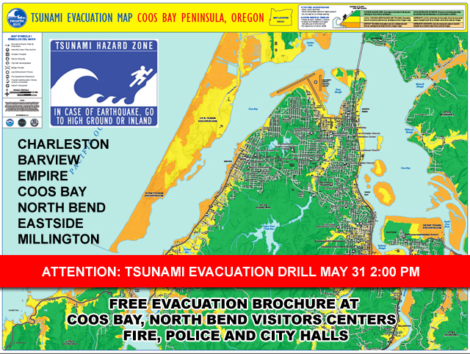
The Local Zone – YELLOW The Distant Zone - ORANGE
Notes:
There are two different kinds of maps we can use to learn the tsunami zones. The most commonly used is the “Tsunami Evacuation Map” which is the one made specifically for the public to learn both the Distant and the Local Tsunami Zones. The zones were made based on the worst-case scenario for each the distant and local tsunami.

Slide 26
Plan Ahead – Be Aware
Signs
Evacuation Routes
Safe Areas
Temporary Assembly Areas
Vertical Evacuation Options
Notes:
Know if you’re in the Tsunami Zone WHETHER YOU’RE AT HOME, SCHOOL, WORK, GROCERY STORE, CHURCH, PARK, etc.
Know where “high ground” is (options in case primary route is blocked) even when you’re driving.
Practice walking to high ground
Waves continue to come for 10-12 hours or more (24?)

Slide 27
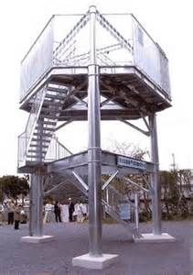
Vertical Evacuation
http://www.fema.gov/medialibrary/media_records/8086

Slide 28
Mobility Challenges?
Notes:
Look at all these people (homes) who live in the “local” tsunami zone (yellow) here in Gleneden Beach! Many of them are elderly and may feel like they cannot possibly (physically) make it to the green (safe) zone in 15 minutes. Especially those right along the shore…it’s just too far for them to walk.
So they decide to give up and not even try. REMEMBER, THERE MAY BE VERTICAL EVACUATION OPTIONS!

Slide 29
Tsunami Inundation Map
Notes:
The other map, the “Tsunami Inundation Map” is used for more in depth planning and shows several different scenarios of tsunami inundation based on the size of the earthquake.
Check out a magnitude 8.9…the light purple zone. On this map, most of the homes & buildings in are in the yellow 9.0+ zones. That means that if we have a magnitude 8.9, most of these people’s homes are not going to be inundated with tsunami waves. For those homes right by the shore, they don’t have to go very far to escape the tsunami if it’s an 8.9.
You don’t know where the earthquake is (could be just the southern portion of the subduction zone)
You don’t know how big the earthquake is.
You don’t really know how far the tsunami is coming.
You also don’t know how soon it will arrive.
Move to higher ground. Every step closer you take to higher ground is a step closer to safety.

Slide 30
Don’t Give Up!

Slide 31
Practice
Go On Foot
Assist Others
Consider Options
Notes:
Practice from different locations
Make a game of it…where would we go right now if we felt an earthquake?
Don’t forget pets.
Go on foot. Walk or run. Roads will probably be impassible. Some may try to ride a bike… (Time yourself)
Practice evacuating with those needing assistance: children, elderly, those with mobility challenges, pets, etc.
Consider options for routes & assembly areas. Try different routes and assembly areas.

Slide 32
Practice
Participate in
drills

Slide 33
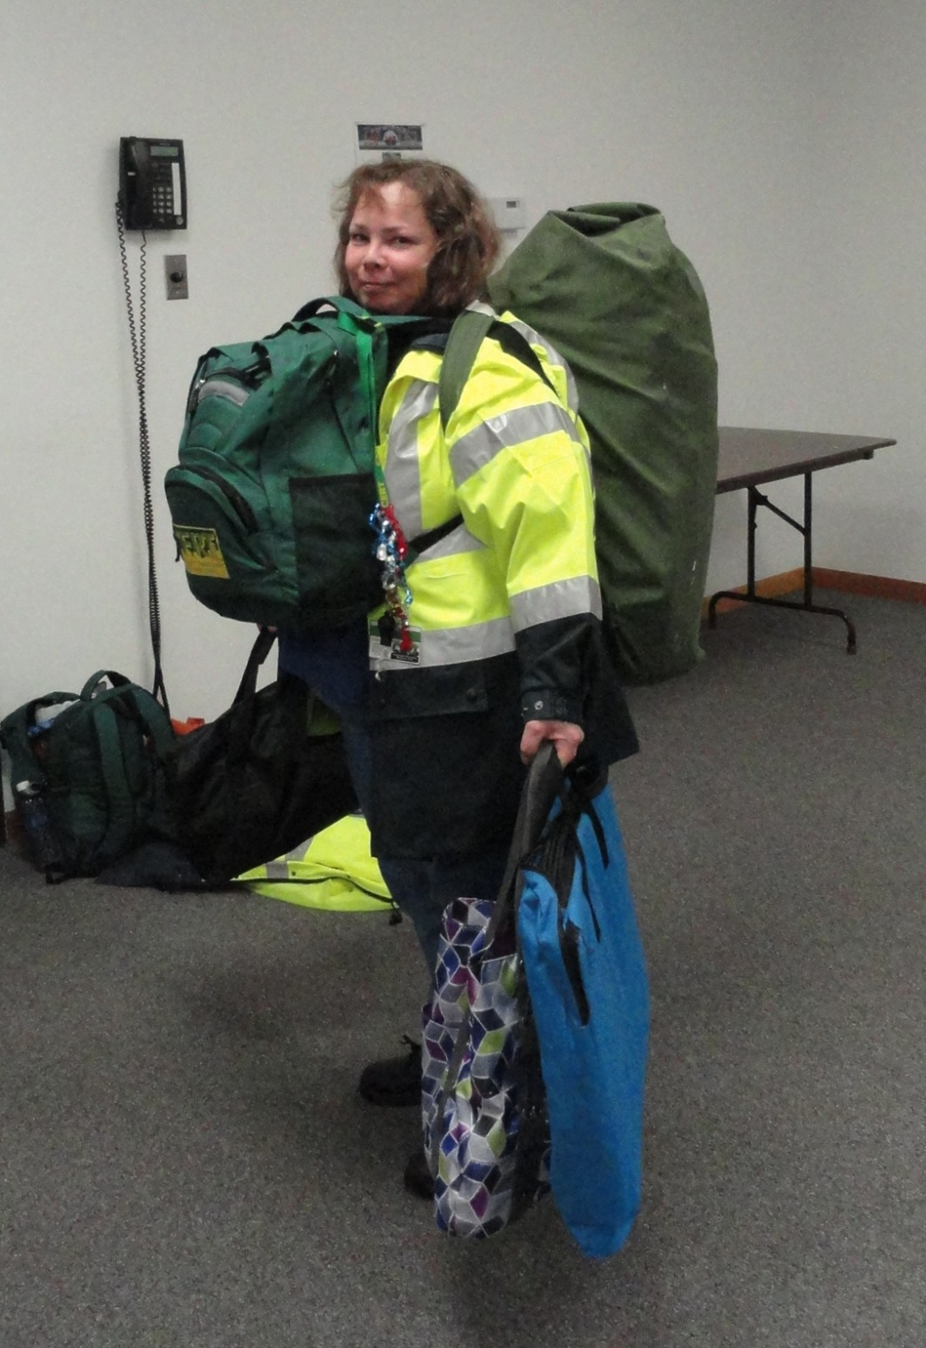
To Carry or Not To Carry Supplies
Situation
Ability
Distance
Time
Notes:
Practice assessing your situation to see if you can also practice carrying emergency supplies
You may or may not want to bring supplies – class discussion (pros and cons)
Consider storing them in advance at a friends house on high ground.
If stopping to go and retrieve your supplies is going to cost your life, don’t do it. You’ve got to escape the tsunami before you can start thinking about those supplies you need to meet your basic needs. First things first.

Slide 34
The Discipline to STAY PUT!
When Do You Return
to the
Tsunami Hazard Zone?
Notes:
Tsunami waves/surges may come for possibly 24 hours or more, possibly even days.
Aftershocks, large ones can even produce more tsunami waves.
Debris, hazardous materials
Curiosity Killed the Cat!
There will be a lot to do to meet basic needs. Rather than wait around for the tsunami waves to end, get to work meeting needs and preparing to live the Island Life.

Slide 35
2011 Tohoku Tsunami
In some places, wave heights were up to 133 feet
In some places, waves traveled up to 6 miles inland

Slide 44
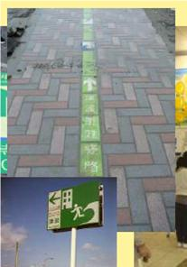
Lessons Learned
At least 101 of Japan’s designated Tsunami Evacuation Sites were inundated by the tsunami.
Notes:
Our Japanese neighbors are one of the most prepared nations in the world. They are an inspiration to us. However, they didn’t believe a Magnitude 9 was possible, so their preparedness didn’t go that far.
We need to prepare for the worst so we will be ready for any size event.

Slide 45
Do it Now!
WHAT WILL YOU DO
TO SURVIVE A TSUNAMI?

