Slide 1

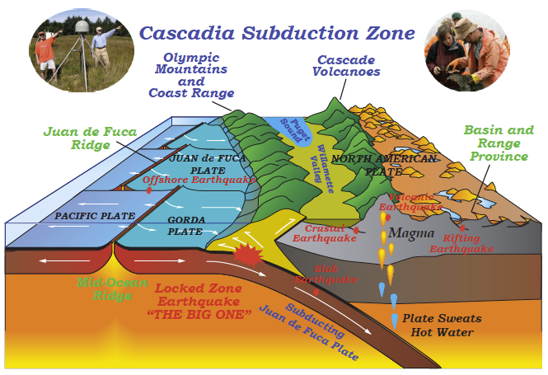


CEETEP
Cascadia EarthScope Earthquake and Tsunami Education Program
Professional development workshops for coastal teachers, interpreters, and emergency management educators.
Bob Butler
University of Portland
Nancee Hunter
Oregon State University
Beth Pratt-Sitaula
Central Washington
University
Bob deGroot
Southern California
Earthquake Center
Lori Dengler
Humboldt State
University

Slide 2
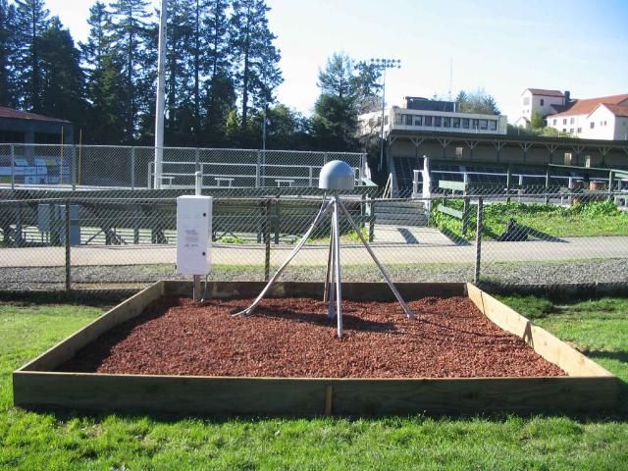
Introductions
CEETEP
Instructors
Participants
EarthScope
Quake Catcher Networks
HSU Campus
GPS Station

Slide 3
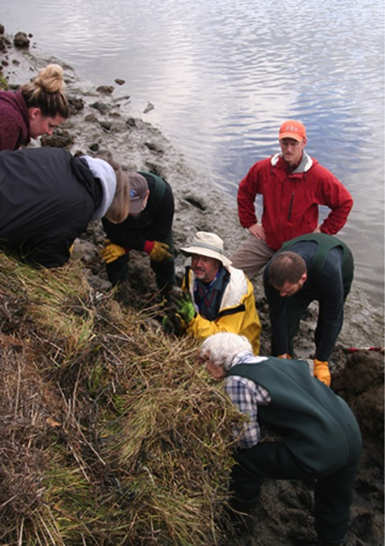
CEETEP
Primary Aim: Improve disaster resilience through educator professional development
Goals – Participants will:
  Learn Geoscience and be able to
  communicate about earthquake and
  tsunami science and research
  Understand Risk and be able to
  communicate about Cascadia
  geohazards
  Take Action and be able to work
  with learners to improve preparedness
  Exchange Pedagogy on how to teach
  about EarthScope, hazards/risk, and
  preparedness

Slide 4


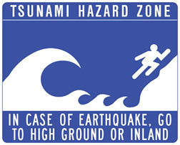
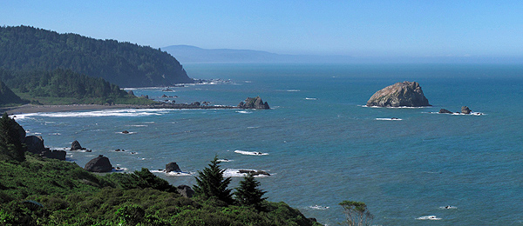
Beauty and the Beast
“The same geological processes that threaten our lives with earthquakes and tsunamis also nourish our spirits by creating the spectacular headlands and beaches of the Pacific Northwest.” – Dr. “Ranger” Bob Lillie
http://www2.humboldt.edu/bgsa/contact.html
Notes:
There are many things about coastal Cascadia that are stunningly beautiful and well worth cherishing. Without the tectonic forces focused here, the coast would not be nearly as rugged and magnificent. We can acknowledge the hazards without living in fear of them.

Slide 5
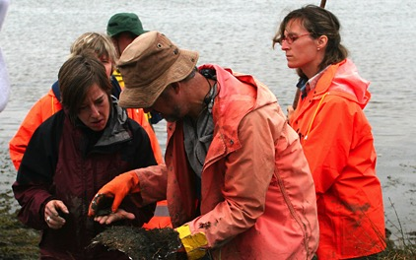
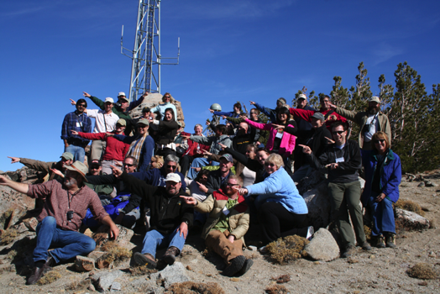
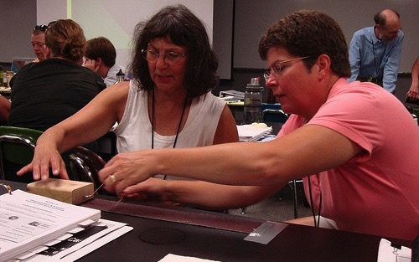
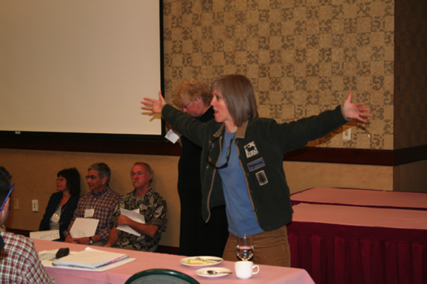
CEETEP Precursors
Teachers on the Leading Edge (TOTLE)
Workshops for Earth Science Teachers in Oregon and Washington
(2005 - 2011)
EarthScope Education and Outreach
Workshops for Interpretive Professionals in Parks and Museums
(2008 - 2015)

Slide 6
Traditional View
Science (EarthScope, Cascadia)
Scientists
Colleges & Universities
Training
Formal Learning
Free-Choice Learning
Educators
Teachers
Interpreters
K-12
Parks & Museums
Emergency
Management
Educators
Students
The Public
Meanings (Geoscience, Hazards, Preparedness)
Notes:
More traditionally “training” sessions were thought of scientists imparting knowledge to others…

Slide 7
Rethinking the View
Science (EarthScope, Cascadia)
Scientists
Formal Learning
Free-Choice Learning
Not: “Dumbing It Down” ☹
Students
The Public
Meanings (Geoscience, Hazards, Preparedness)
Notes:
Often this might have been considered “dumbing down”…

Slide 8
CEETEP View
Greater resilience in Cascadia & America
Partner organizations & further dissemination
Meanings (Geoscience, Hazards, Preparedness)
Students
The Public
Instead: “Storying It Up” ☺
Formal Learning
Free-Choice Learning
Scientists
Science (EarthScope, Cascadia)
Notes:
But in the CEETEP program we see this as finding compelling “stories” that can be communicated to students, visitors, and residents. It is CEETEP’s overarching goal that by giving meaning to the topics of geoscience, hazards, and preparedness, we can help galvanize change towards greater resilience in Cascadia and America…

Slide 9
Greater resilience in Cascadia & America
Partner organizations & further dissemination
Meanings (Geoscience, Hazards, Preparedness)
Students
The Public
Emergency
Management
Educators
Educators
K-12
Teachers
Park
Interpreters
Formal Learning
Free-Choice Learning
Scientists
Joint professional development in coastal communities
Science (EarthScope, Cascadia)
Notes:
Teachers, interpreters, and EM educators are key professionals needed to translate and carry the message from scientists to a broad range of learners. The join professional development of different educators in these smaller coastal communities, gives support and collaboration where otherwise it might feel like there are too few partners in the work.

Slide 10
Galvanizing change in preparedness
Research on behavioral change (Wood 2012; Mileti 2011)
  Simple consistent messaging on what TO DO
  From many trusted sources
  For a long long time
  Seeing others take preparedness steps
FEMA (2010) suggests that science classrooms are under-utilized for hazard and preparedness connections
FEMA, Bringing Youth Preparedness Education to the Forefront: A Literature Review and Recommendations, Federal Emergency Management Administration. 21 pp., 2010. Available from: http://www.citizencorps.gov/resources/research/prepresearch.shtm
Mileti and colleagues (National Hazards Center, University of Colorado) http://www.colorado.edu/hazards/
Wood, M. M., D. S. Mileti, M. Kano, M. M. Kelley, R. Regan, & L. B. Bourque, Communicating Actionable Risk for Terrorism and Other Hazards, Risk Analysis, v. 32, 601–615, 2012.
Notes:
The structure and ideas behind the workshop’s preparedness components is built on current social science research on behavioral change.

Slide 11
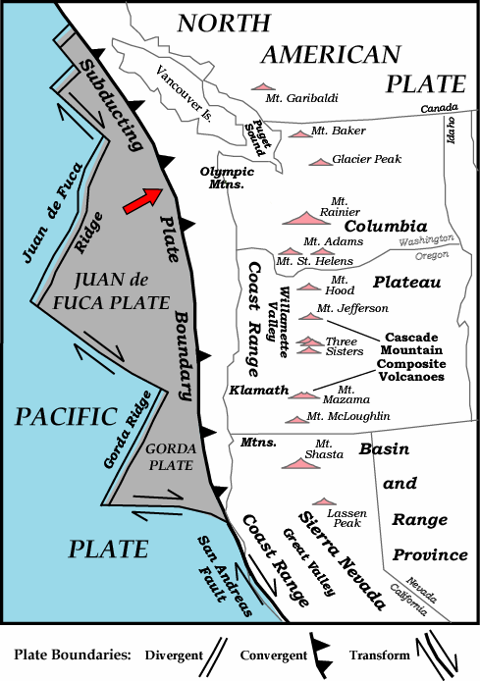
CEETEP
Cascadia EarthScope Earthquake and Tsunami Education Program
Workshops on Cascadia Science and Preparedness:
Washington
August & October 2014
North & Central Oregon
August & October 2013
Coos Bay, Oregon
August 2015
Arcata, California
October 2015
Parks and Plates ©2005 Robert J. Lillie

Slide 12
Workshop space info
Main room – Goodwin Forum, Nelson Hall East
Food & beverages – Nelson Rm 106
Water fountain & restrooms – across the hall
Breakout sessions & team planning space – same two rooms & Rm 113
Parking – Easy over the weekend; Monday is reported to be the hardest day to park on campus.

Slide 13
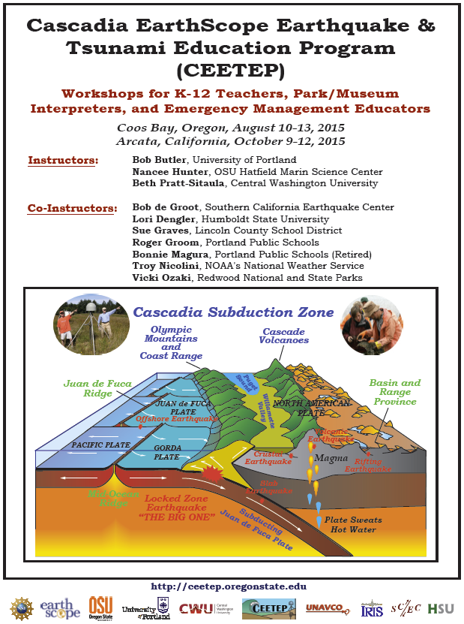
CEETEP Binder & Resources
Forms
Feedback (white, front pocket)
Contact lists
Agenda
Resources (thick section in the middle)
Digital resources
Post-it notes (use them for questions)
Educator resource boxes – take at your convenience unless there is a note

Slide 14
Agenda Day 1- Getting started
Day 1
8:30 | Coffee, tea, juice, snacks for those who arrive early
9:00 | Introductions: CEETEP, EarthScope, Participants, Instructors, Quake Catcher Network. Please sit with your Action Team
10:15 | Break (Coffee, tea, juice, snacks)
10:30 | Beauty and the Beast: Plate Tectonics and Geological Hazards of the Pacific Northwest
12:00 | Thoughts/questions/reflection Welcome from HSU President Lisa Rossbacher
12:15 | Lunch
1:00 | Basics of Earthquake and Tsunami Science and Hazards and Related Teaching Activities
3:15 | Break (Coffee, tea, juice, snacks)
3:30 | Surviving a Cascadia Subduction Zone Earthquake
4:30 | Reflection, Questions, Implications
5:10 | Forms: Reimbursements; Stipends; Photo Permissions; Logistics for Day 2 Field Trip
5:30 | Adjourn

Slide 15
Agenda Day 2- Field Trip
Day 2
7:30 | Coffee, tea, juice, snacks (Van Matre Hall – near the stadium)
8:00 | Depart
8:05 | Stop 1: HSU GPS Station
9:30 | Stop 2: Redwood National Park Kuchel Visitor Center
10:45 | Stop 3: Tsunami Geology at Lagoon Creek
11:45 | Lunch
12:30 | Stop 4: Tsunami Evacuation Walk
1:45 | Stop 5: Crescent City Harbor
2:30 | Stop 6: Interpreting Geohazards at Battery Point
3:00 | Drive back
4:30 | Adjourn

Slide 16
Agenda Day 3 – Cascadia
Day 3
8:30 | Coffee, tea, juice, snacks for those who arrive early
9:00 | Cascadia Earthquakes and Tsunami and Related Teaching Activities
10:30 | Break (Coffee, tea, juice, snacks)
10:45 | Cascadia Earthquakes and Tsunami and Related Teaching Activities
12:00 | Thoughts/questions/reflection
12:15 | Lunch
1:00 | Tsunami: Are You Ready?
1:45 | Native American & Indigenous Oral Histories
2:30 | Birds-of-a-Feather Breakout Session
3:15 | Break (Coffee, tea, juice, snacks)
3:30 | Science Storytelling through Interpretation
3:45 | Storytelling as a means for change: Tsunami Boat Book
4:00 | Exchange of Pedagogies
4:30 | Action Teams: Action Plan Development. Teams work on post-workshop plans (also prep 10-minute presentation for Day 4)
5:30 | Adjourn
+6:00 | Barbeque at Lori Dengler’s house – McKinleyville, CA

Slide 17

Tsunami Boat Book
By Sunday afternoon – please have read the book
Come with ideas of how you might use in your education setting?
(each person gets a copy
to keep)

Slide 18
Agenda Day 4 – Bringing it together
Day 4
8:30 | Coffee, tea, juice, snacks for those who arrive early
9:00 | Digital Resources
9:55 | Preparedness for Post-event Personal and Community Survival
10:40 | Break (Coffee, tea, juice, snacks)
10:55 | Break Out Sessions | Tsunami Vertical Evacuation Structures Teachers | Hazard Inventory Interpreters & EM Educators
11:45 | Break Out Sessions | Tsunami Vertical Evacuation Structures Interpreters & EM Educators | Hazard Inventory Teachers
12:30 | Lunch
1:15 | Action Teams: Final preparations for Action Plan and 10-minute presentation
2:30 | Action Teams: Presentations of plans
3:45 | Break (Coffee, tea, juice, snacks)
4:00 | Post-Workshop Assessment. Survey and focus groups.
5:30 | Adjourn

Slide 19
Share-a-thon
Expected: Brookings, OR
Saturday March 5, 2015 9:30 am-3 pm
Participants from Coos Bay and Arcata workshops
Present on activities under taken related to CEETEP topics
Action team members will support each other
  Can do collaborative project as a whole team
  Communicate as work separately as individuals or sub-groups

Slide 20
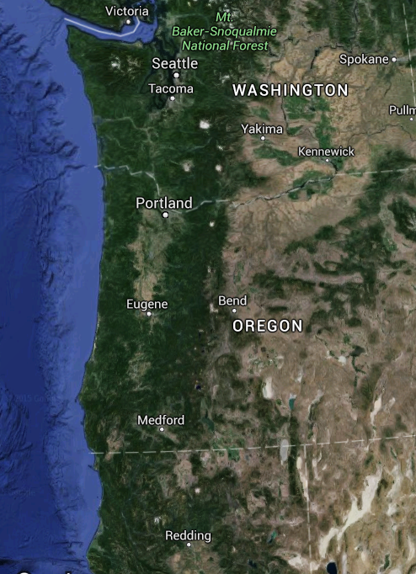
CEETEP
Arcata, CA
October 9-12, 2015
2
CEETEP Principal Investigators & California Partners
1. Bob Butler, University of Portland, Portland
2. Beth Pratt-Sitaula, Central Washington University, Ellensburg & UNAVCO, Boulder, CO
3. Nancee Hunter, Hatfield Marine Science Center, Oregon State Univ., Newport OR
4. Bob de Groot, Southern California Earthquake Center, Los Angeles, CA
5. Lori Dengler, Humboldt State University, Arcata, CA
Master Teachers and Co-Instructors
6. Roger Groom, Mt. Tabor Middle School, Portland
7. Dorie Lanni, Humboldt County EM
8. Troy Nicolini, National Weather Service
9. Vicki Ozaki, Redwood Nat. & State Parks
10. Jay Patton, Humboldt State University
11. Adam Woolace, UNAVCO
1
6
3
2
5
7-11
4

Slide 21
CEETEP
Arcata, CA
October 9-12, 2015
Logistical Goddess in Residence
12. Kerry Sherin, Arcata, CA
External Evaluator
13. Michael Coe, Cedar Lake Research, Portland
Animator/Videographer
14. Jenda Johnson, Portland
Observers
15. Jo Ann Allen, Santa Cruz County Office of Education (EQ Country Alliance)
16. Tina Dura, Rutgers University
17. Kate Long, CalOES
18. Kevin Miller, CalOES
19. Cynthia Pridmore, California Geological Survey
13
14
16
17-19
12
15

Slide 22
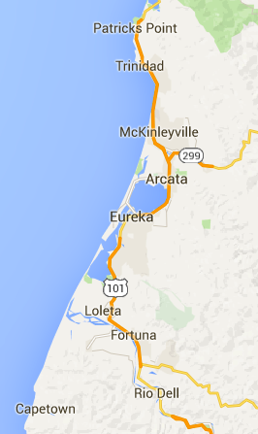
Action Team 1– Humboldt County
20-second Intro
Who are you?
Your organization and/or educational setting?
Optional:
What you particularly hope to get from CEETEP?
K-12 Teacher
Ellen Osten Fortuna, CA Toddy Thomas Middle Sch.
Sheryl Steiner Rio Dell, CA Monument Middle School
Park/Museum Interpreter
Leisyka Parrott North Coast Bureau of Land Managem.
Emergency Management Educator
Dorie Lanni Eureka, CA Humboldt County EM
Jan Marnell Eureka, CA CA Office of Emergency Services

Slide 23
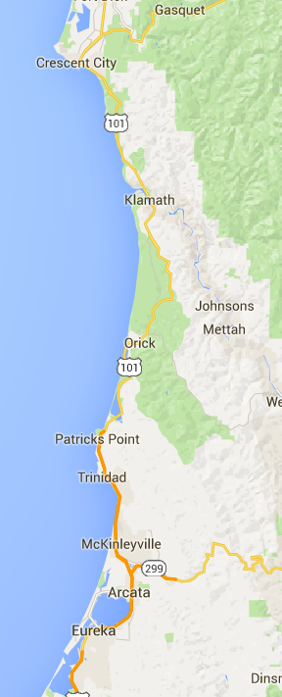
Action Team 2 – Arcata
20-second Intro
Who are you?
Your organization and/or educational setting?
Optional:
What you particularly hope to get from CEETEP?
K-12 Teacher
Michelle Dobrowolski Manila, CA Redwood Coast Montessori
Jessie Hobba Arcata, CA Sunny Brae Middle School
Sarah Pennisi Arcata, CA Sunny Brae Middle School
Park/Museum Interpreter
Suzie Fortner Arcata, CA Friends of the Dunes
Emergency Management Educator
Ruth Sturtevant Eureka/Arcata Humboldt State University

Slide 24
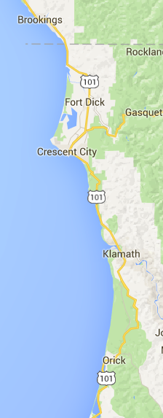
Action Team 3 – Del Norte County
20-second Intro
Who are you?
Your organization and/or educational setting?
Optional:
What you particularly hope to get from CEETEP?
K-12 Teacher
Diane Cavaness Brookings, OR Azalea Middle School
Robyn Parker Crescent City, CA Del Norte County High Sch
Park/Museum Interpreter
Denise Doyle-Schnacker Crescent City, CA Del Norte Unified Schools
Rick Hiser Crescent City, CA Redwood Parks Asso
Emergency Management Educator
Charlie Helms Del Norte County Crescent City Harbor Distr
Cindy Henderson Del Norte County Del Norte Fire Training
Thomas Phillips Del Norte County Del Norte Ambulance

Slide 25
Action Team 4 – Eureka
20-second Intro
Who are you?
Your organization and/or educational setting?
Optional:
What you particularly hope to get from CEETEP?
K-12 Teacher
Ami Brusca Eureka, CA Aldergrove Charter School
Steve Catton Eureka, CA Lafayette Elementary Sch
Karina Junge Eureka, CA Winship Middle School
Park/Museum Interpreter
Jerab Pino Eureka, CA Clarke Historical Museum
Emergency Management Educator
Chris Emmons Eureka, CA Humboldt Bay Fire
Brian Gerving Eureka, CA City of Eureka

Slide 26
Action Team 5 – Humboldt County
20-second Intro
Who are you?
Your organization and/or educational setting?
Optional:
What you particularly hope to get from CEETEP?
K-12 Teacher
Patrick Clancy Humboldt County McKinleyville High School
Park/Museum Interpreter
Laura Goforth North District Redwood National Park
Shaina Niehans Kuchel Visitor Cen Redwood National and State Parks
Emergency Management Educator
Ryan Aylward Eureka, CA National Weather Service Brian Merrill Humboldt County California State Parks

Slide 27
Get to know your team
Several minute intro – Each member of the team should share a little more details about their:
  Teaching setting and audience
  Existing strengths or experience with geoscience and preparedness
  Goals for gaining knowledge and abilities in teaching tsunami and earthquake education

Slide 28
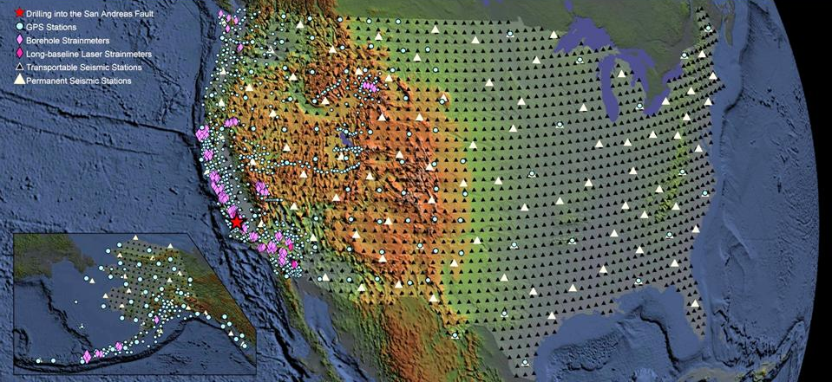
EarthScope
EarthScope
A National Science Foundation (NSF) effort to …..
    Explore the structure and evolution of North American continent
    Study processes that cause earthquakes and volcanic eruptions
    EarthScope has three main “observatories”
Drillhole across San Andreas Fault
875 GPS Instruments
175 Borehole Strainmeters
5 Long-Baseline Laser Strainmeters
400 Seismometers at 2,000 sites
100 Permanent Seismometers
Notes:
EarthScope is a multi-decade geophysical initiative

Slide 29
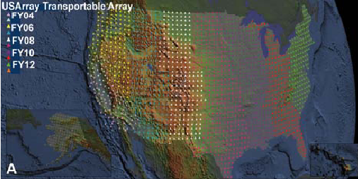
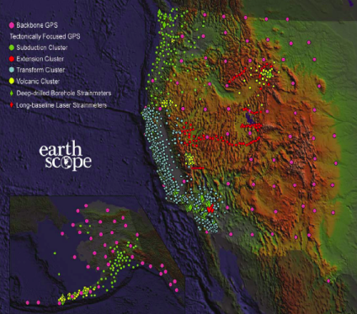
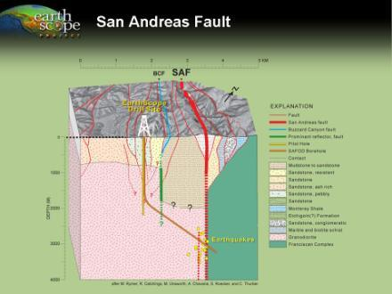
EarthScope Observatories
USArray
Seismometers
Geodetic Instruments
Deep Drillhole
PBO
SAFOD
Plate Boundary Observatory
San Andreas Fault Observatory at Depth
Notes:
EarthScope is composed of three Observatories. For the purposes of CEETEP, PBO and USArray are relevant.

Slide 30
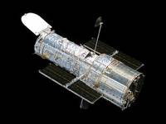
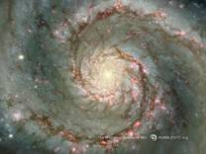
EarthScope
“Like a Hubble Telescope aimed into the Earth”
Drillhole across San Andreas Fault
875 GPS Instruments
175 Borehole Strainmeters
5 Long-Baseline Laser Strainmeters
400 Seismometers at 2,000 sites
100 Permanent Seismometers

Slide 31
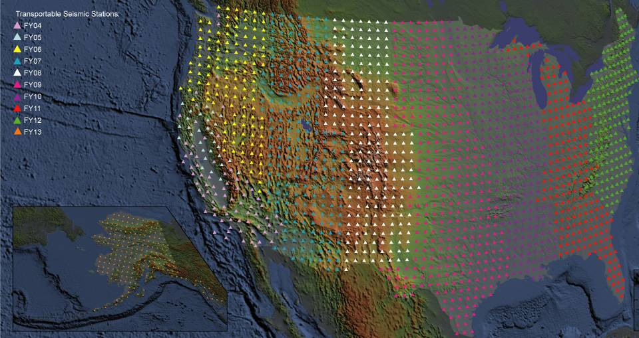
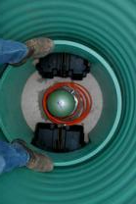
1. USArray
    Includes 400 Transportable Seismometers
    Each station occupies a site for 1½ to 2 years
    10 years to leap-frog across the country
IRIS
(Incorporated Research Institutions for Seismology)
Washington, DC
Seismometer
http://anf.ucsd.edu/stations/deployment_history.php

Slide 32
Visualizations
Seismic Waves Moving Across USArray
China, 2008
Bob Woodward - IRIS
Insert animation here

Slide 33
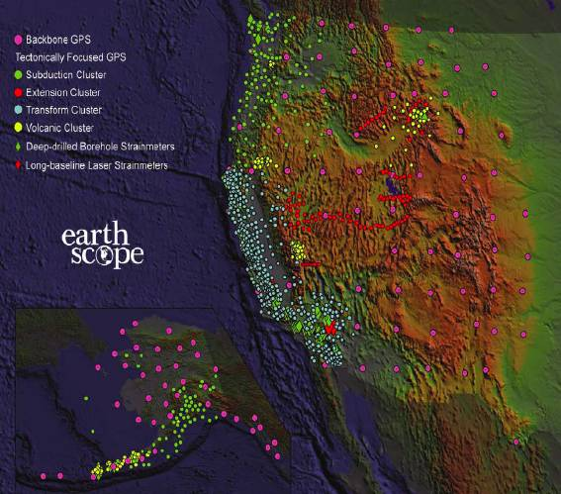
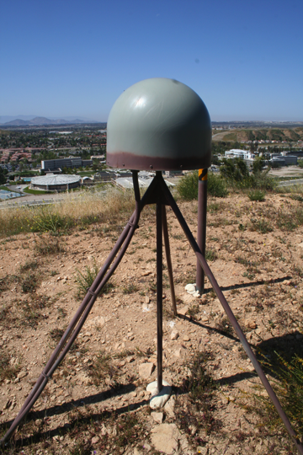
2. PBO
Plate Boundary Observatory
    High precision GPS
    Strainmeters
GSP Station
UNAVCO
Boulder, CO

Slide 34
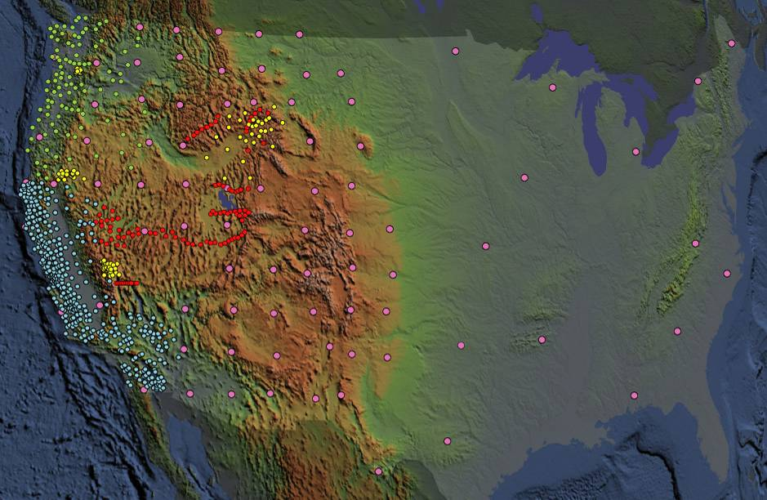
EarthScope GPS Stations
2. PBO
Plate Boundary Observatory
Backbone Network
Subduction Cluster Volcanic Cluster
Transform Cluster Extension Cluster
Notes:
Presentation notes:
1. Geodetic network divided into "clusters" for ease of deployment
2. Data is held in common
3. Transform cluster looks to measure long-term deformation due to San Andreas - is stress moving to the East?
4. Subduction cluster is being used to investigate Episodic Tremor and Slip - how much deformation is accommodated this way?
5. Extension cluster seeks to explain Basin and Range Paradox
6. Volcanic cluster looks to measure magma chamber inflation
7. Backbone will provide background deformation, including isostatic glacial rebound

Slide 35
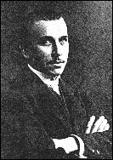
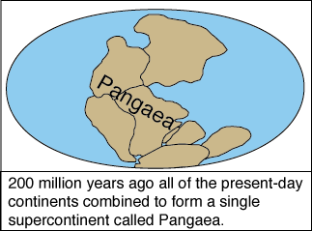
Visionary
Wegener's Dream
"This [direct measurement of continental drift] must be left to the geodesists. I have no doubt that in the not too distant future we will be successful in making a precise measurement of the drift of North America relative to Europe."-- Alfred Wegener, 1929
Notes:
The visionary scientists who first proposed continental drift, predicted nearly a century ago that we would someday be able to measure the actual movement of different continents.

Slide 36
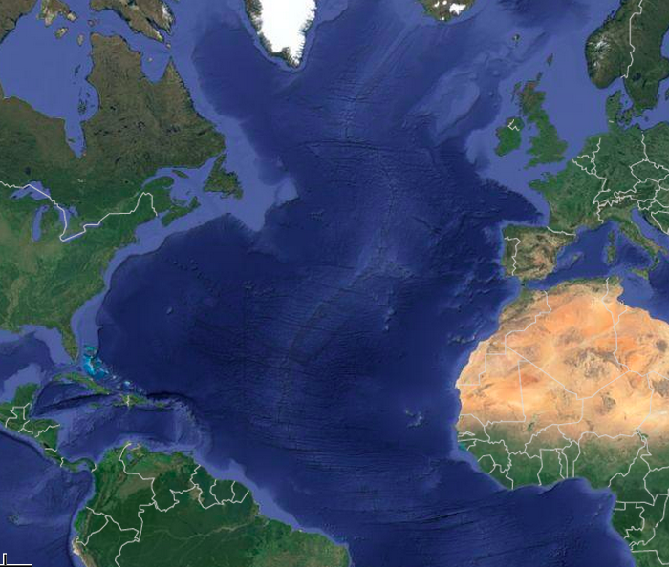
Geologically-measured spreading rates
20-30 kilometers/million years
20-30 millimeters/year
~1 inch/year
Notes:
Using different methods, we have been able to estimate remarkably consistent rates of movement over millions of years.

Slide 37
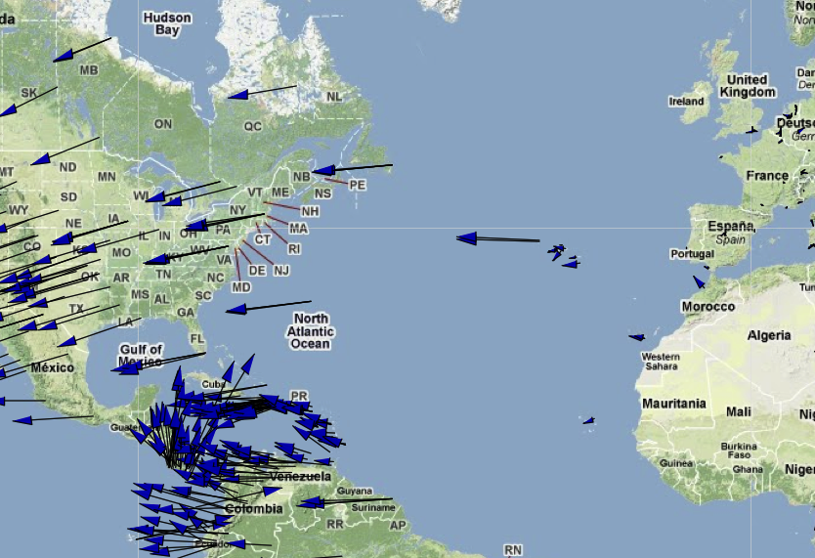
GPS Measurements:
Motion of North America relative to Europe.
Wegener’s Dream come true!
~1 inch/year

Slide 38
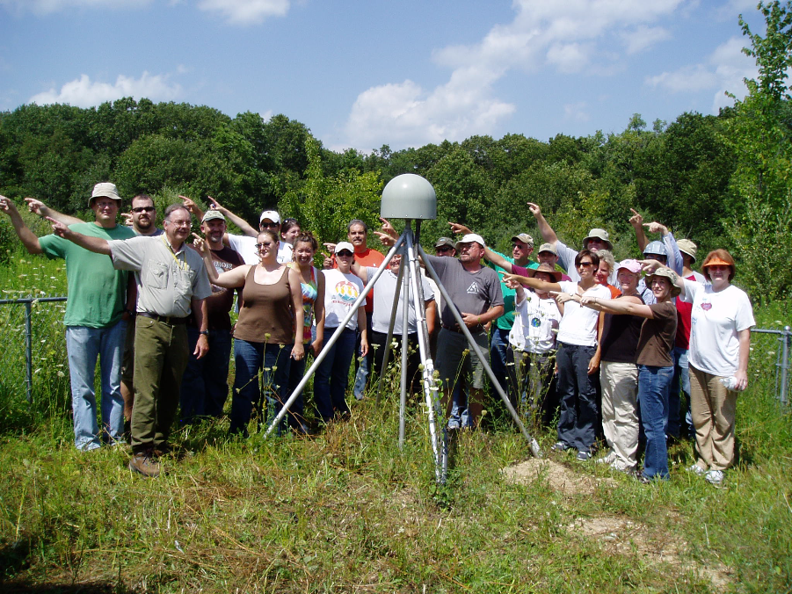
Illinois EarthScope Teacher Workshop
Illinois EarthScope 2010

Slide 39
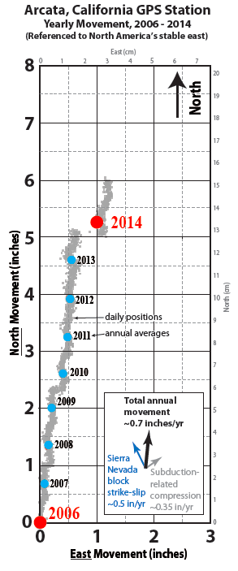
Robert J. Lillie

Slide 40
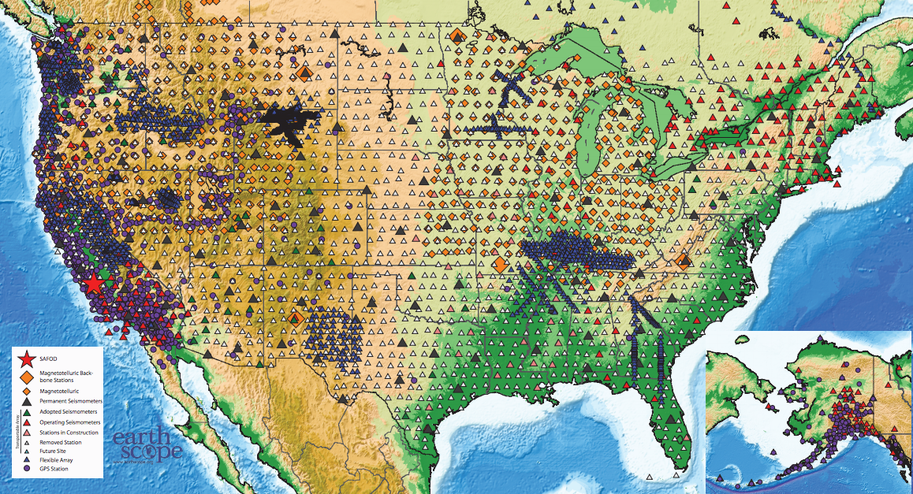
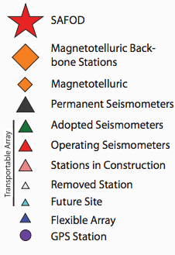
EarthScope Station Status
June 2015
http://www.earthscope.org/science/maps/current-status-map/

Slide 41
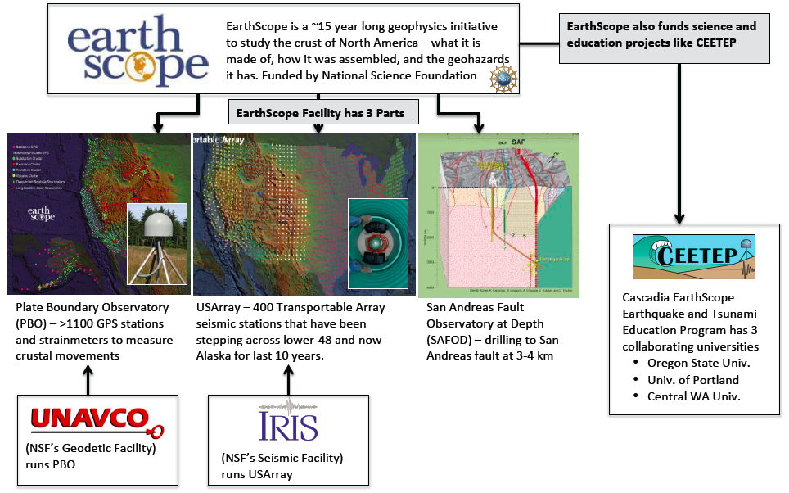
EarthScope Cheat Sheet

Slide 42

Earth Science Literacy Principles
1. Earth scientists use repeatable observations and testable ideas to understand and explain our planet.
2. Earth is 4.6 billion years old.
3. Earth is a complex system of interacting rock, water, air, and life.
4. Earth is continuously changing.
5. Earth is the water planet.
6. Life evolves on a dynamic Earth and continuously modifies Earth.
7. Humans depend on Earth for resources.
8. Natural hazards pose risks to humans.
9. Humans significantly alter the Earth.
Big Ideas:
1. Earth scientists use repeatable observations and testable ideas to understand and explain our planet.
2. Earth is 4.6 billion years old.
3. Earth is a complex system of interacting rock, water, air, and life.
4. Earth is continuously changing.
5. Earth is the water planet.
6. Life evolves on a dynamic Earth and continuously modifies Earth.
7. Humans depend on Earth for resources.
8. Natural hazards pose risks to humans.
9. Humans significantly alter the Earth.
Notes:
Of the Big Ideas that are considered essential to earth science literacy – EarthScope research particularly speaks to four of them.

Slide 43
EarthScope
EarthScope
Sense of Place …..
    Our hometowns and other special places are part of exciting new exploration and discovery.
    Our communities are not standing still—they are moving!
Drillhole across San Andreas Fault
875 GPS Instruments
175 Borehole Strainmeters
5 Long-Baseline Laser Strainmeters
400 Seismometers at 2,000 sites
100 Permanent Seismometers
Notes:
As we come to understand the dynamic nature of the land under our feet, it gives us another layer of understanding about our place and our communities.

Slide 44
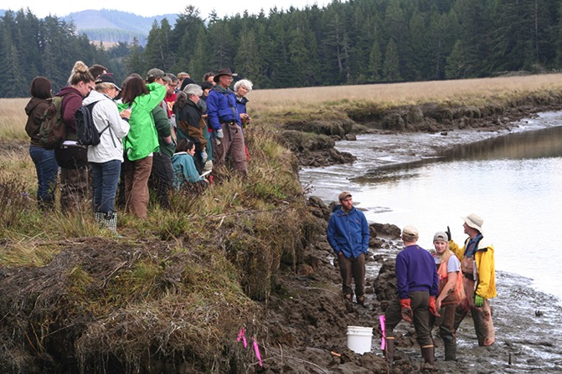
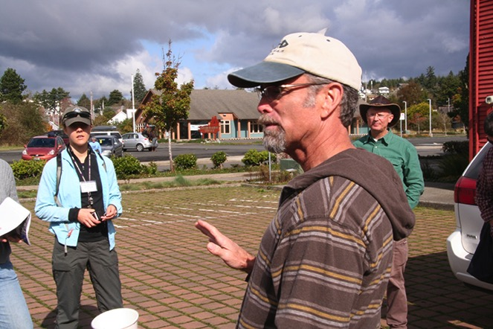
Education and Outreach Goals
  Create high profile EarthScope identity
  Promote science literacy through informal education
  Advance formal education in the classroom
  Foster use of data, discoveries, technology
  Establish sense of community ownership
  Create high profile EarthScope identity
  Promote science literacy through informal education
  Advance formal education in the classroom
  Foster use of data, discoveries, technology
  Establish sense of community ownership

Slide 45
Questions to consider
What activity/ies do you think you will use?
How might you adapt things for your particular education setting/audience?

Slide 46
Substitute Payment
If you have not already – email ceetep@oregonstate.edu to give heads up
School district needs to send invoice to:
Oregon State University – CEETEP
Attn: Marlene Jasperson
2030 SE Marine Science Drive
Newport, OR 97365
Address is also in the major workshop info email from mid-September
* C.E.U. - If any non-teachers would CEU, please let me know and we will put you on the list

Slide 47
Field Trip Logistics
Backpack or bag
Layered clothes/jacket
Sunscreen/sunglasses
Water bottles
Field Trip Guide (NOT your binder)
Optional
Notebook
Camera
Favorite snack
Bug repellent
High Ground T-shirt & ShakeOut bags

Slide 48
Field Trip Logistics
HSU Van – Lori (11)
  Team 1 (5), Team 2 (5)
HSU Van – Jay (11)
  Team 3 (7), Beth, Tina, Cindy
HSU Van – Kerry (11)
  Team 4 (6), Bob deG, Kevin, Jo Anne, Kate
Sheina’s car (4)
  Ryan, BobB, Dave B
Roger’s truck (5)
  Vicki O, rest of Team 5 (3)

