Slide 1

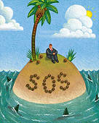
Surviving After the Earthquake and Tsunami
Survive the Earthquake
Escape the Tsunami
Short & Long Term Survival
CEETEP
Adapted from Sue Graves’
August 2015 presentation

Slide 2
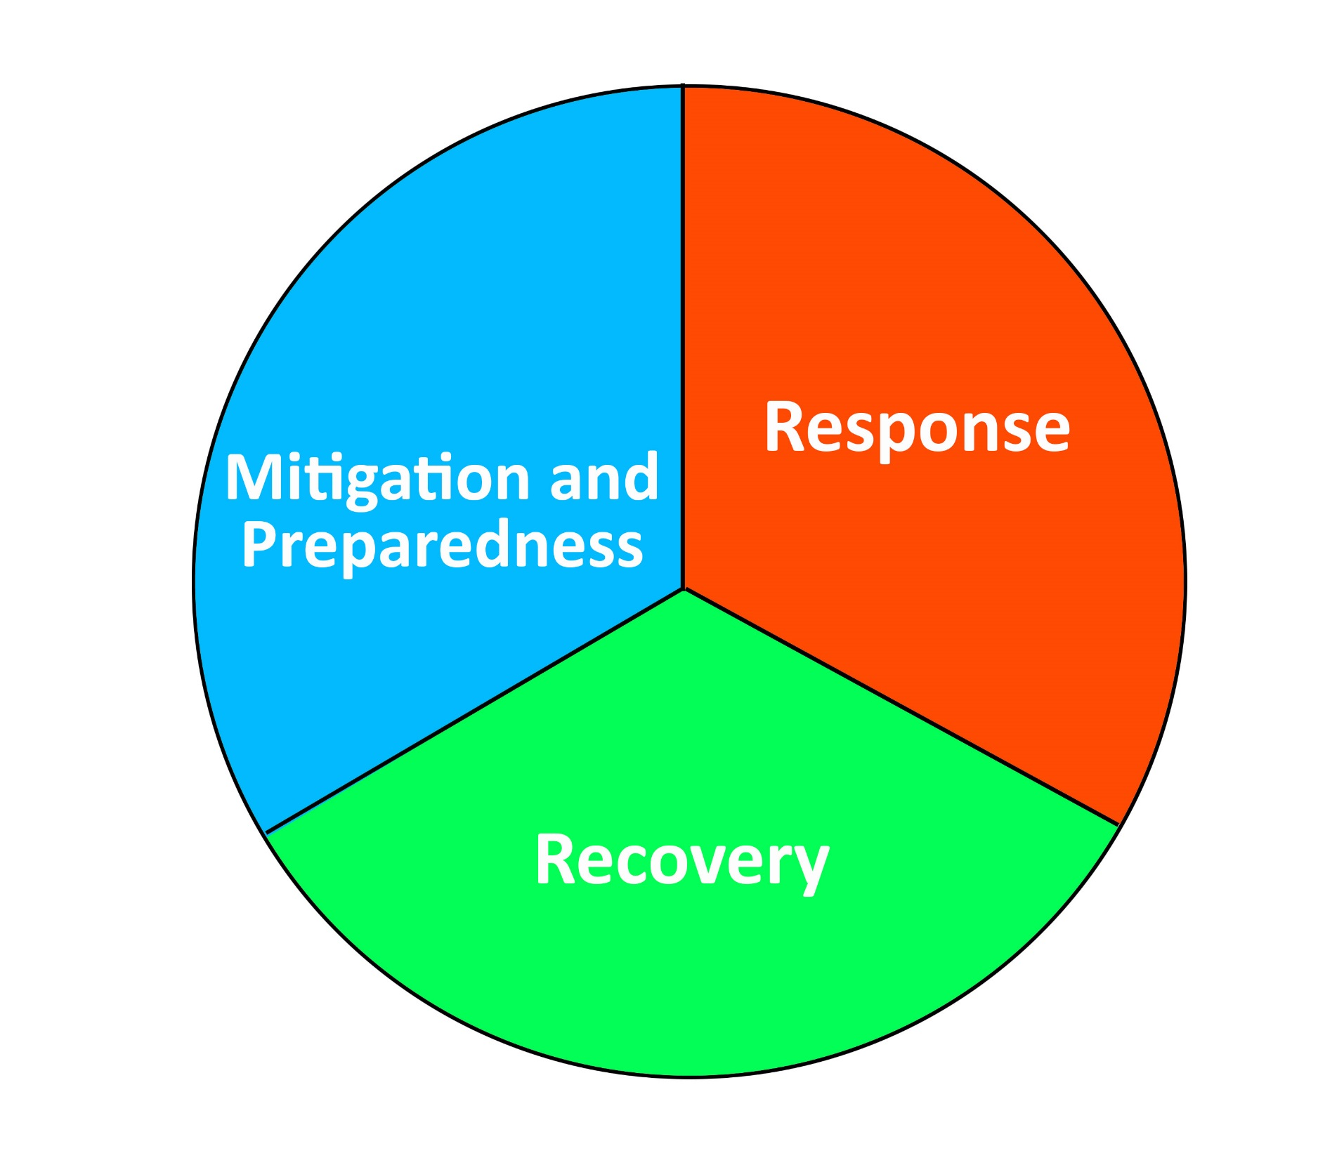

Slide 3

What to Expect When You’re Expecting a Cascadia Subduction Earthquake

Slide 4
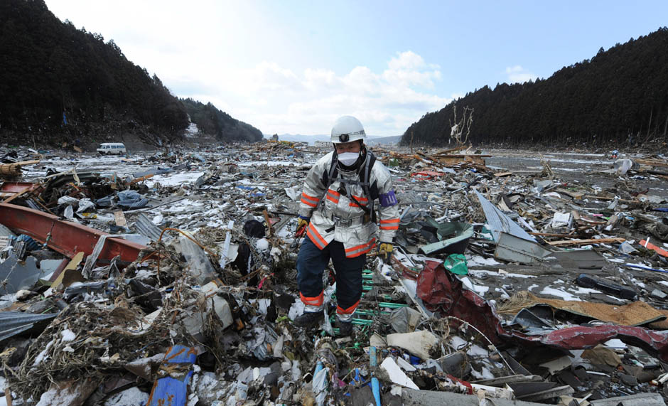
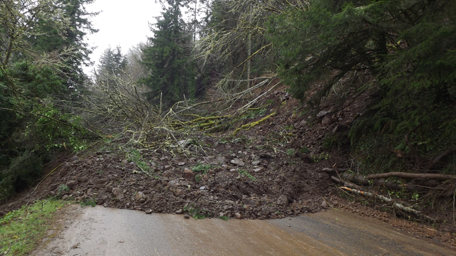
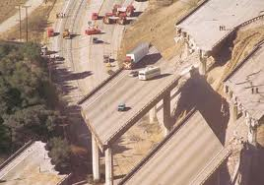
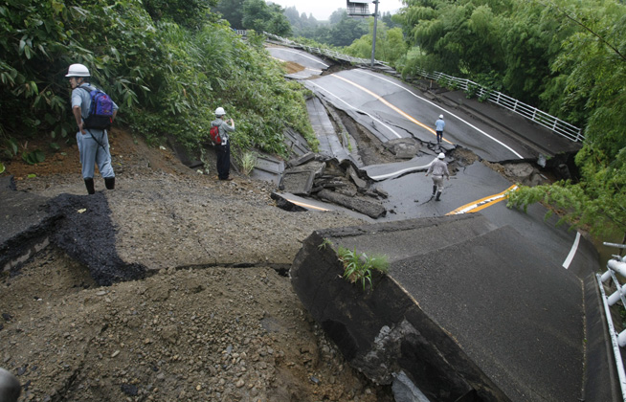
Debris
Damaged Roadways and Bridges
Landslides
Notes:
We will be separated physically due to bridge failure, landslides & road failure, debris, hazardous materials…

Slide 5

Impact on Utilities & Services
No Running Water
No Electricity
No Communications
No Sewer System
No Garbage Pick-up
No Fuel
No Groceries in the Store
No Pharmacy
Notes:
Our normal infrastructure, those things we use constantly will no longer be available.
We won’t be able to call 911 for help. We will need to work together to learn how to survive.

Slide 6
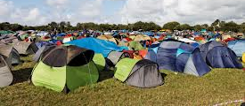
Imagine Extended Camp Life Without Infrastructure
Notes:
There will be a lot to do and giving people tasks (jobs) will help in their emotional recovery. It will also help accomplish the many things that will need to get done to meet daily needs.
Filling sand bags
Gathering water
Comforting the wounded or emotionally distraught
Taking care of little ones
Setting up shelters
Hunting for food, cooking, cleaning
Collecting fire wood, building fires
Collecting things to sleep on
Digging holes for latrines
Tending to the wounded
Personal care & sanitation (without infrastructure

Slide 7
Where are emergency responders?
Search and Rescue
Fires
Emergency Debris Clearance
Critical Infrastructure Restoration
Critical Medical Needs
Establishing Emergency Response Structure
Ascertaining safety of our own families

Slide 8
Emergency Supplies
Home
Go Bags for Evacuation
Workplace Emergency Supplies
Classroom

Slide 9
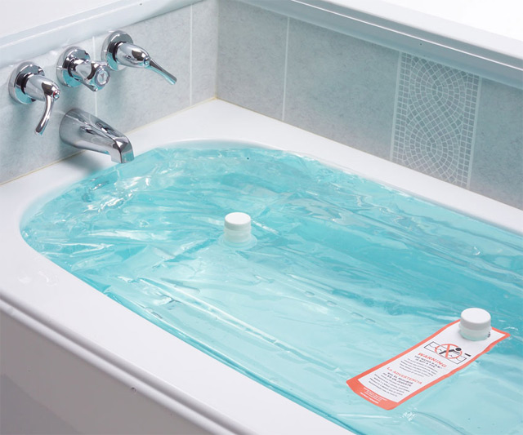
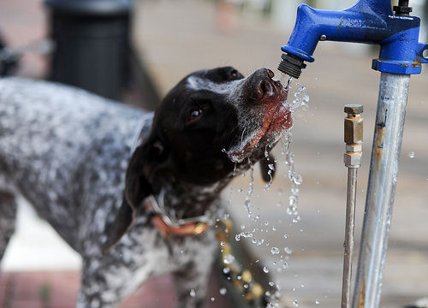
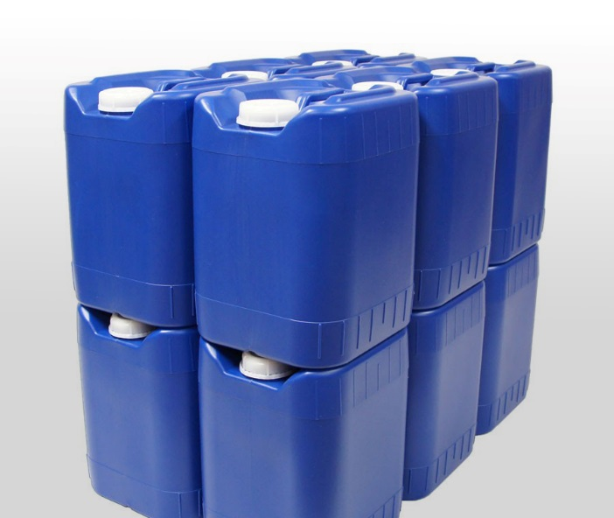
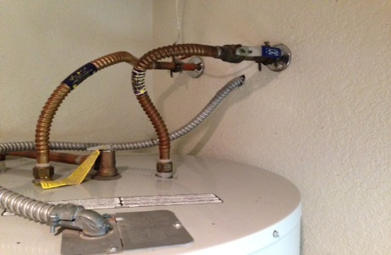
Water!
1 gallon per person per day
Add extra for pets and for cooking
Water purification
Notes:
Need ½ gallon per person per day of drinking water. Another ½ gallon for sanitation.
Water from water heaters that have been securely strapped.
Use water filter straw to filter water from rain water or from creeks/streams not contaminated by the tsunami.
Other stored water (55-gallon barrels, etc)

Slide 10
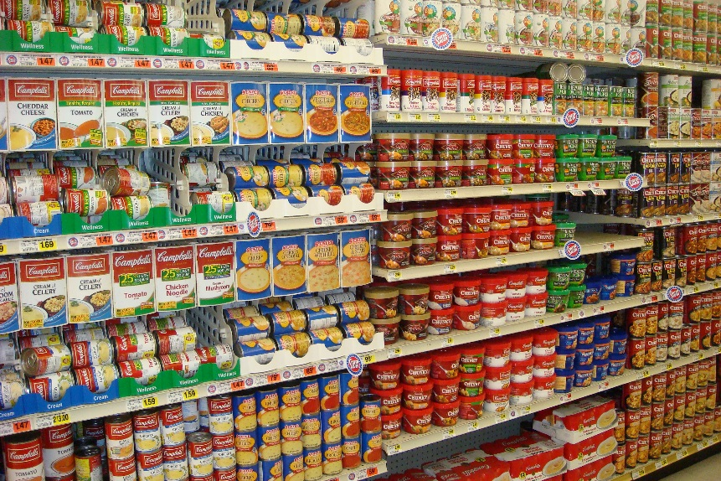
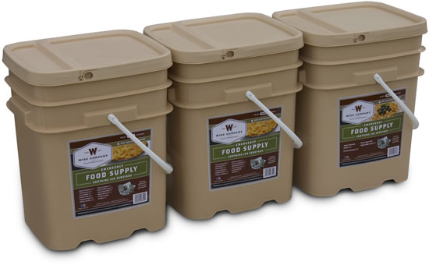
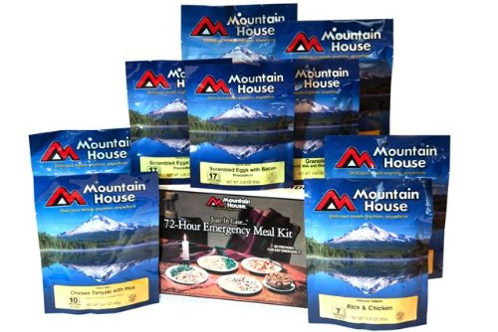
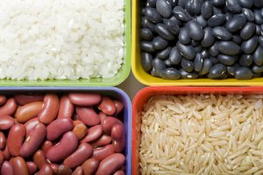
Food

Slide 11
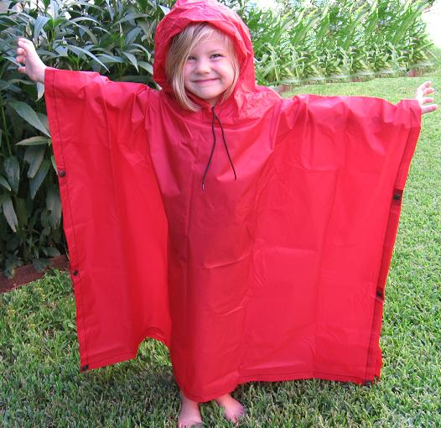
Shelter & Warmth
Camping supplies – tents, camp stoves, propane, tarps
Car supplies – blankets, pillows
Hats, socks, gloves, jackets

Slide 12
Classroom Supplies
Basic necessities – water, food, shelter, sanitation
  Enlist parents to build your classroom kit
Comfort kits
  Individual kits in large Ziploc bags
    Snacks, note, picture, blanket

Slide 13

Communications
September 2015 AT&T Outage Impacts
Land lines
Cell phones
Radios
  HAM
  2-way

Slide 14
Communications Plan
How will you contact your loved ones following a major local disaster?
Local communications – establish multiple redundancies
Designate an out-of-area contact

Slide 15

Reunification Planning
How will you reunite with your loved ones following a major local disaster?
School reunification planning – If your school doesn’t have a plan for your students, make one.
Family reunification planning – Home, near home, outside neighborhood
Designate an emergency contact near your child(ren).
American Red Cross Safe & Well

Slide 16
Resources
CERT
Ready.gov
American Red Cross
USGS
National Weather Service/NOAA/NTWC
Humboldt 2-1-1
Emergency Notifications

