Slide 1
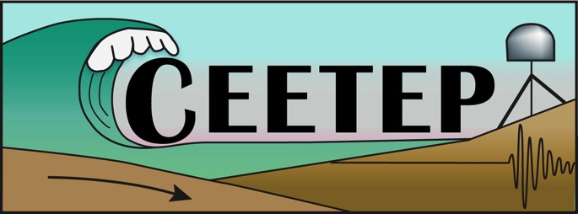
Cascadia EarthScope Earthquake and Tsunami Education Program - CEETEP -
Breakout Session
Vertical Evacuation Structures
45 minutes

Slide 2
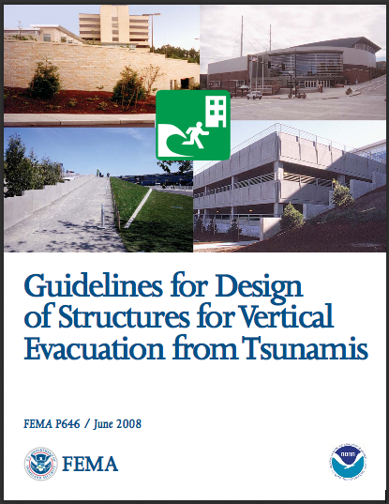
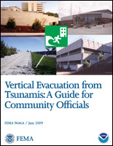
Vertical Evacuation Resources
Notes:
Main FEMA guidelines

Slide 3
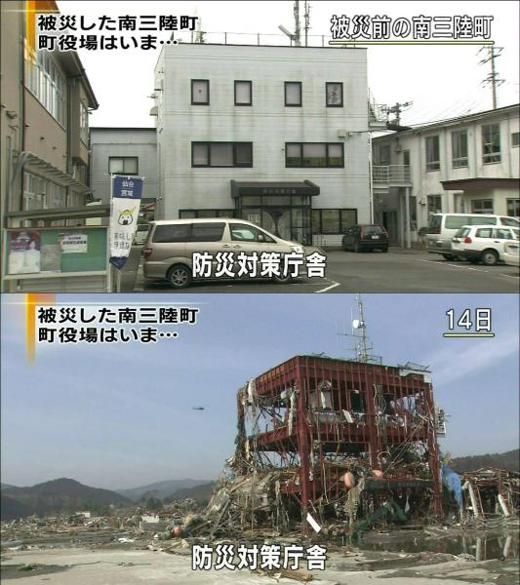
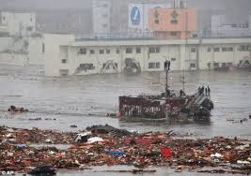
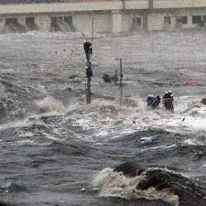
Tohuku Japan 2010
Notes:
Minamisanriku, Japan, about 45 km north of Sendai
From: http://jsw.newpacificinstitute.org/?p=7091
The Disaster Prevention Center is now a rusted skeleton. The height of the wave is clear from the damage at the bent handrails on the fire escape at the rear of the building: handrails on the third floor are bent over. Once the tsunami struck, there was to be no hide. The mayor’s meeting was in this very building, he survived by climbing to the top of the antenna, as did nine other people. A further twenty people lost their lives, including Miki Endo, who stayed at her station on the second floor.
Building behind DPC is the hospital. Water is running out of the 4th floor windows.

Slide 4
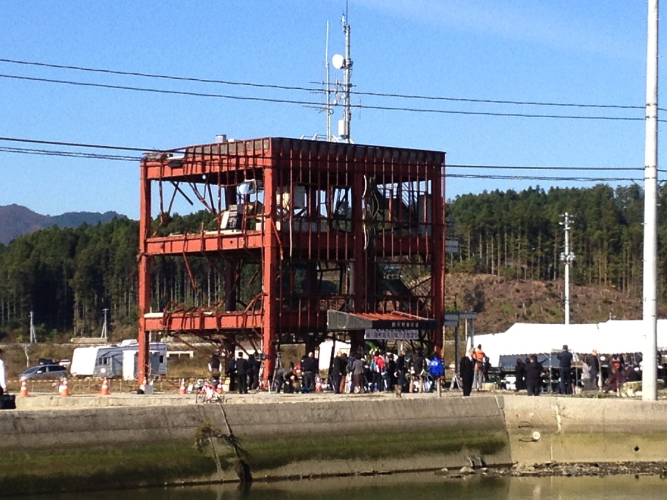
Minaminsanriku DPC now
Notes:
From Lori Dengler, photographer:
This photo on Nov. 2 2013 - it was the "farewell" ceremony before the demolition of the building was scheduled to begin in the following days. The central government intervened and prevented the demolition much to the dismay of the local residents. Notice the people in suits.

Slide 5
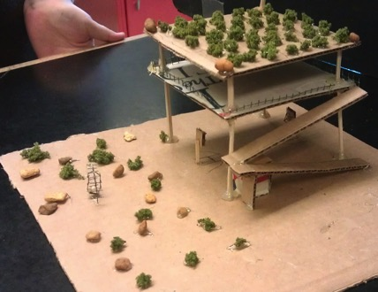
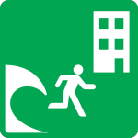
Vertical Evacuation Design
Brainstorm/Review:
What are some design elements to consider?
Background Information
Activity, Part A
Notes:
Need to think about:
Location – where is it needed? High population centers, where high ground isn’t available, touristed areas
Strong enough to withstand initial shaking and waves
Accessibility –
Size / # of people
Supplies – island life
Safety –
Communication
Pre-existing building? Retrofit?

Slide 6
Vertical Evacuation Design Elements
Pre-existing buildings? Retrofits?
Location – where is it needed? High population centers, where high ground isn’t available, high tourist areas, access to it is compromised (i.e. bridges)
Strong enough to withstand initial shaking and waves
Scouring effect on foundations/walls
Accessibility
Size of building and # of people it can support
Supplies – “island life”
Safety - of people, of supplies
Communication

Slide 7
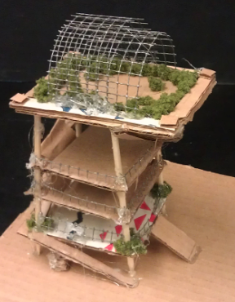
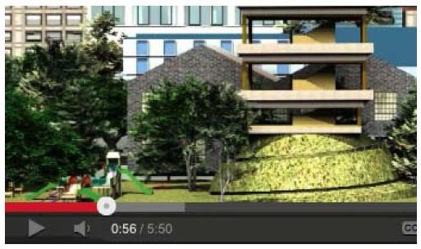
Vertical Evacuation
FEMA/NOAA Video
Could you use this with your audiences?
How?
Notes:
http://us.stormsmart.org/2012/05/01/new-video-on-tsunami-vertical-evacuation-shelters/ - link from document on DVD: CEETEP DVD/3. Cascadia Earthquakes & Tsunamis/4. ACTIVITIES_Cascadia Earthquakes & Tsunamis/Tsunami Activities
Part A: Learning about Vertical Evacuation Structures

Slide 8
Vertical Evacuation Issues
Besides the actual structure design, what are other issues involved with TVES locations?

Slide 9
Vertical Evacuation Issues
Technical
Administrative / Management
Political
Economic
Legal
Ecological
Community involvement
Can community get to it (i.e. bridge loss)

Slide 10
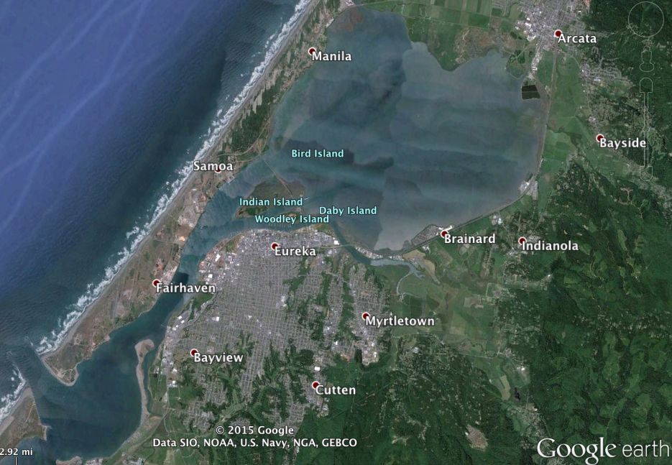
Local Vertical Evacuation Options

Slide 11
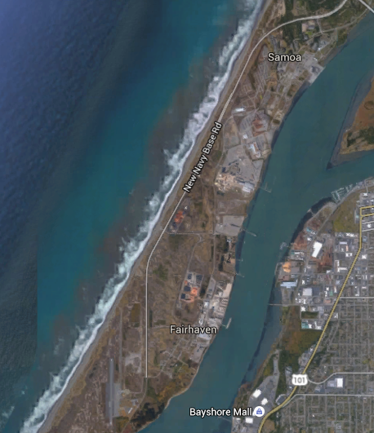
3 miles from Fairhaven to Samoa’s high ground

Slide 12
Two alternatives
Retrofit the waterplant to be a vertical evacuation facility
Build a berm at the site of the highest dune

Slide 13
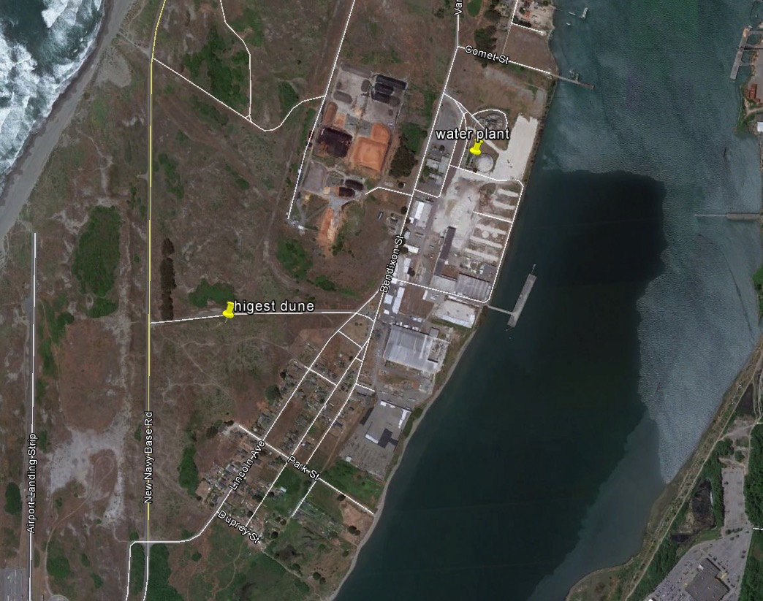

Slide 14
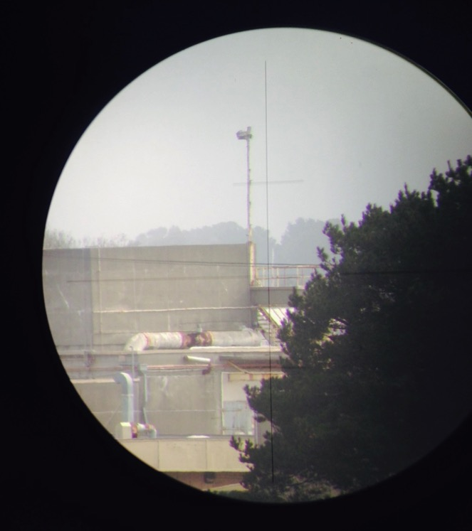
Waterplant vs. Highest Dune
This is a photo through the lens of my level, shot from the highest dune.
This is the horizontal cross hair
This is the deck that people would stand on. The level was 4 ‘ above the dune and this middle rail is 1.5 feet above the deck, so the dune is 2.5 feet lower than the water plant.

Slide 15
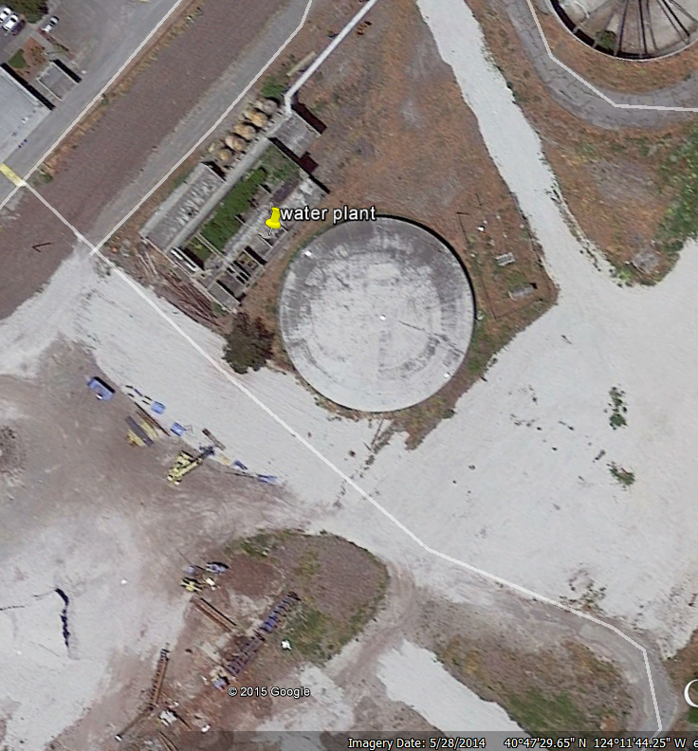
Issues:
Seismic safety of structure
Liquefaction
Access by public
Distance to town
Positives:
Less cost
No permitting issues

Slide 16
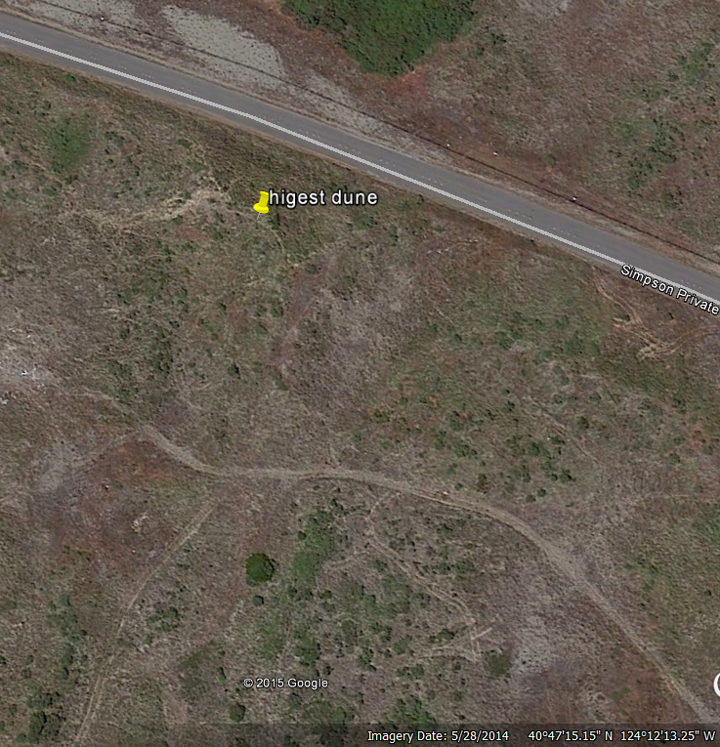
Issues:
Coastal Commission/ESA
Costly
Positives:
Access - public property
Closer to town

Slide 17
Proposed Solution to Coastal Commission
Build the berm
Armor it
Then reconstruct natural dunes back over the top
Do a full dune restoration in the process
Provide visitor serving access and interpretation

Slide 18
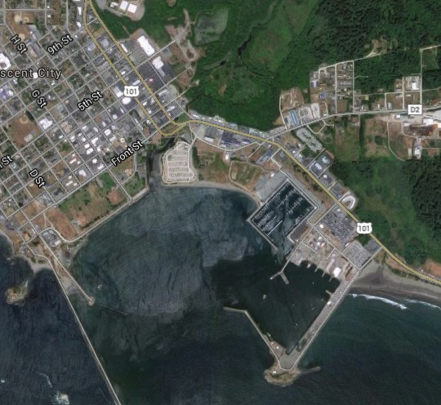
Crescent City Concept
High Ground

Slide 19
The Tsunami Experience A Vertical Evacuation Center
First and Foremost, the Tsunami Experience Center (TEC) is a Vertical Evacuation Center designed to save lives
There are over 480 hotel rooms within a half mile of the Tsunami Experience
There are over 300 RV spaces within a half mile of the Tsunami Experience
It is an approximately 11 minute walk to the Tsunami Experience Center (TEC) from the most distant of the lodging facilities in the harbor area
This is sufficient time to protect people seeking shelter in the case of a Cascadia Event

Slide 20
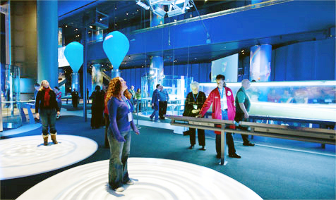
The Tsunami Experience When it’s not an Evacuation Center?
In an era of rising sea levels, the TEC is designed to be a learning center focused on tsunami preparedness
The first floor will highlight hands-on displays and electronic presentations designed to engage and captivate visitors
A 48 seat 3D/4D theater is located on the first floor – the only such theater to be found within 350 miles of Crescent City
Visitors can experience 3D excitement and thrilling 4D movement in the theater

Slide 21
Vertical Evacuation
Binder, pg. 271
Need/want feedback!
Multiple aspects and avenues for engagement
Reading and Math skills – basic concepts about Vertical Evacuation and building design
Determining appropriate locations
Designing and constructing structure
Presenting and explaining
Notes:
Reading and Math

Slide 22
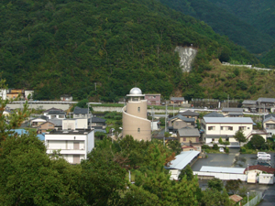
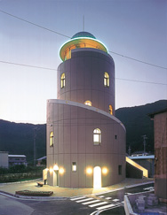
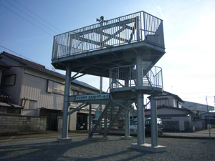
Nishiki Tower
Existing
Towers
in Japan
TasukaruTower
Notes:
Nishiki Tower:
An impressive five-story, 22-m-tall reinforced concrete structure resembling a lighthouse. Founded on a 4-m-deep layer of sand and gravel, the tower is supported on concrete piles extending 6 m below grade. It was designed to withstand the impact of a 10-ton ship at a velocity of 10 m/sec. For day-to-day use, it features public restrooms, a meeting room, firefighting equipment storage space, and 73 square meters of refuge space for evacuees.
Tasukaru (Life-Saving) Tower: Mie Prefecture: a basic steel platform providing temporary refuge at 5.8 m above ground level for about 50 people.

Slide 23
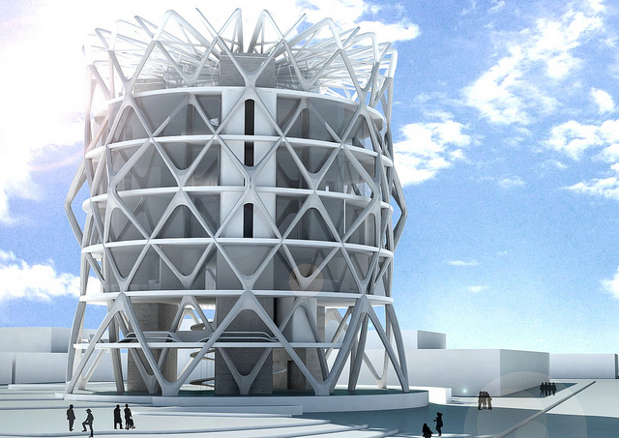
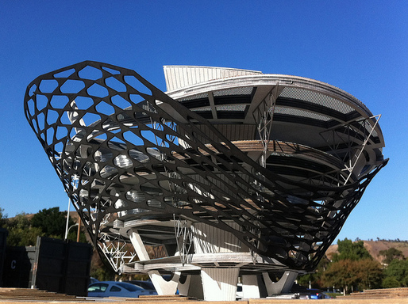
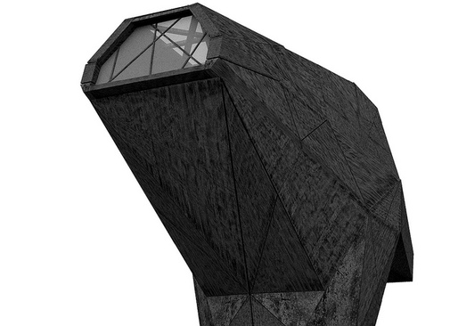
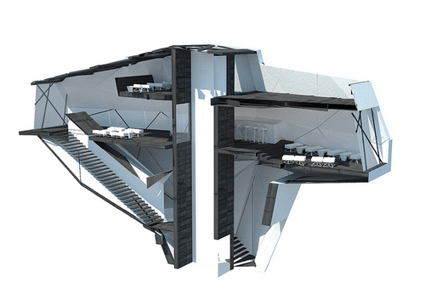
Cal P0ly Pomona Design Competition
Notes:
Architect News article about Cal Poly Pomona program http://archinect.com/news/article/31542133/student-projects-cal-poly-pomona-tvef-tsunami-vertical-evacuation-facility-studio
Upper left image:
Hotel Aurelia program optimizes on the necessary coastal location of each structure, and allows for modular units to be composed and implemented within the free plan. The modularity of the structure allows building to be higher or lower based on the needs of the surrounding community. All the main components of the building are precast and sized to fit on trucks.
Upper right image:
Project Domo Nebulus, looked into reducing the footprint and allowed more refuge footage as the structure went upward during the tsunami while serving as a aeroponic farm and as an open market in other times.
Lower two images:
One project named JA3HM2 was a neighborhood bar which doubled as a tsunami shelter which is estimated to occur every hundred years.

Slide 24
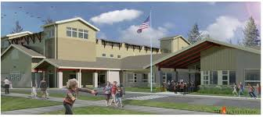
Ocosta Elementary School in Westport, WA
1st Vertical Evacuation Building in the U.S.!
Notes:
30 feet high, holds 1000 people,
Paula Ackerlund, Superintendent
Tim Walch, Chief Hazards Geologist, DNR
Cale Ash – Degenkolb Engineers

Slide 25
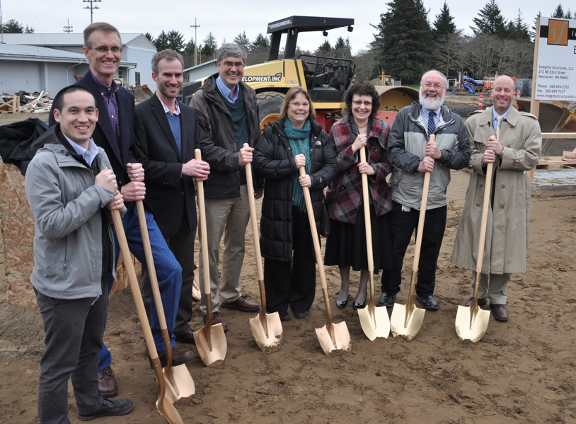
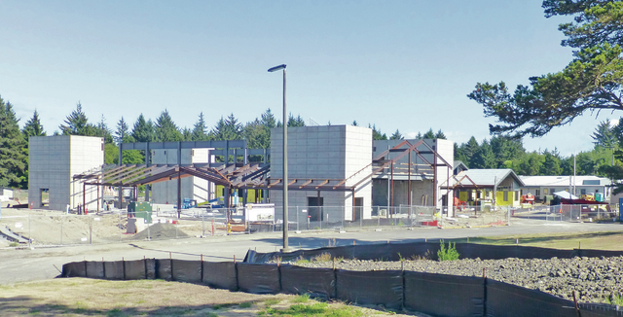
Ocosta Elementary School
Under
construction!

Slide 26
Vertical Evacuation – Building Code
American Society of Civil Engineers (ACSE) Building Codes
New chapter: Tsunami Loads and Effects
2015 Comment and Review
2016 Released
2018 Adopted
~ 2020 Part of local law

Slide 27
Vertical Evacuation – 2500 year event

Slide 28
Vertical Evacuation – Building Code
Applies to buildings in inundation zones in CA, OR, WA, HI, AK (but others could adopt)
Not required for residential or shorter buildings
Required for:
>65 ft
Higher risk factor buildings like school, hospitals

Slide 29
Community Vulnerability
From the Proceedings of the National Academy of Science, April 2015
Notes:
three primary community groups:
(i) relatively low numbers of exposed populations with varied demographic sensitivities
(ii) high numbers of exposed populations but sufficient time to evacuate before wave arrival
(iii) moderate numbers of exposed populations but insufficient time to evacuate.

Slide 30
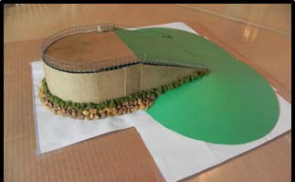
Vertical Evacuation
Teachers: Activity Plan
Part B: Where to put the thing?
Physical Maps
GoogleEarth
Need to know:
Ground elevation
Predicted wave height
But wait . . .
Does your area need one??
Or can a pre-existing building be used?
Notes:
Part B: Finding an appropriate location –
Using GoogleEarth is different from what directions say, which is to use actual maps
Add in bit on zooming in to your area
Use tool feature to measure out area using criteria to find how many people could fit

Slide 31
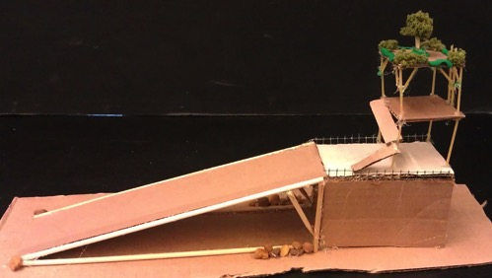
Vertical Evacuation
Maps – which ones?
Tsunami Hazard Maps – in your map roll!
Compare to contour lines on map
Notes:
Tsunami inundation map
Street maps
Business maps – show where lots of people are

Slide 32
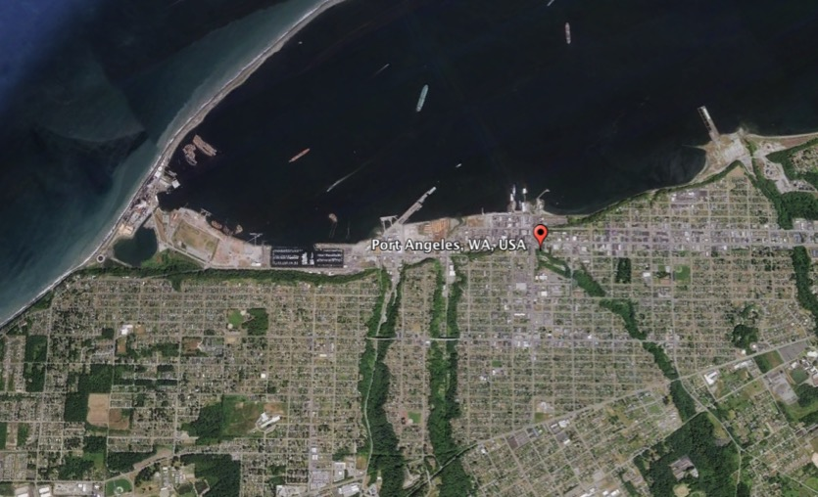
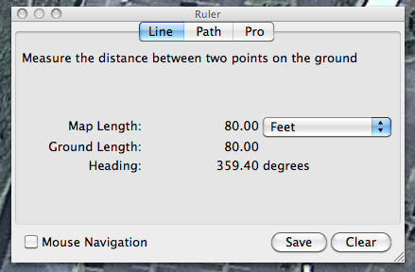
Vertical Evacuation
GoogleEarth
Best case – get .kmz file of inundation zones to overlay (if they exist . . .)
Can use Ruler Tool to measure length to determine square footage
Notes:
Part B: Finding an appropriate location
Using GoogleEarth is different from what directions say, which is to use actual maps
Add in bit on zooming in to your area
Use tool feature to measure out area using criteria to find how many people could fit

Slide 33
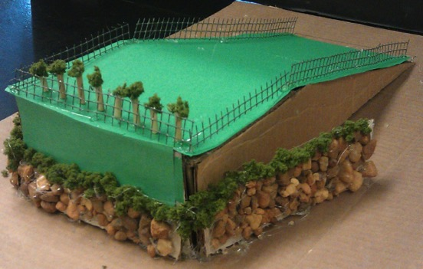
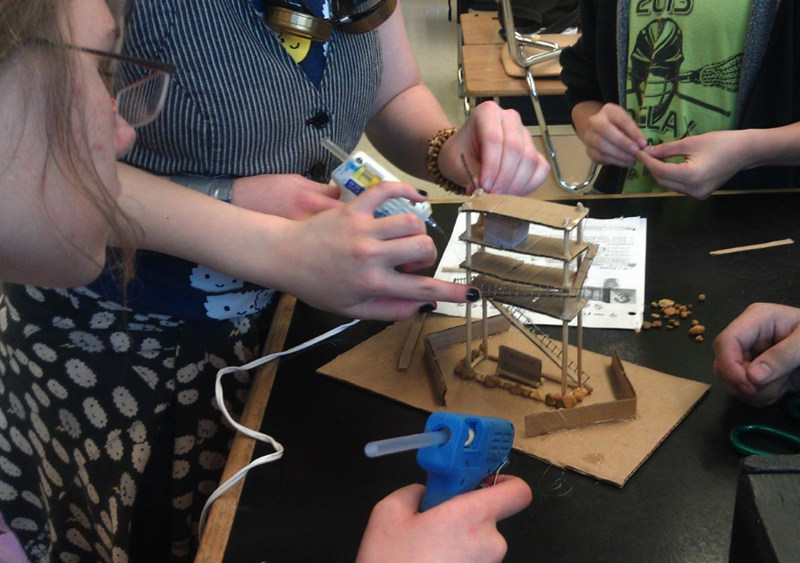
Vertical Evacuation
Teachers/PI/EM:
Part C: Construction process
Math considerations:
10 ft² per person
Notes:
Part C: Designing and Constructing
Note: Designing is hard! The math for scale is hard! Get ready for it. There are design criteria
Building takes right time depending on ability and materials. These kids took two hours to design (after getting through the math) and two hours to actually construct structures.

Slide 34
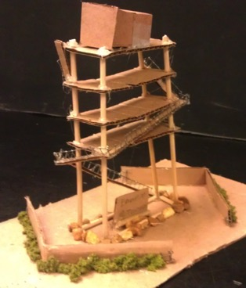
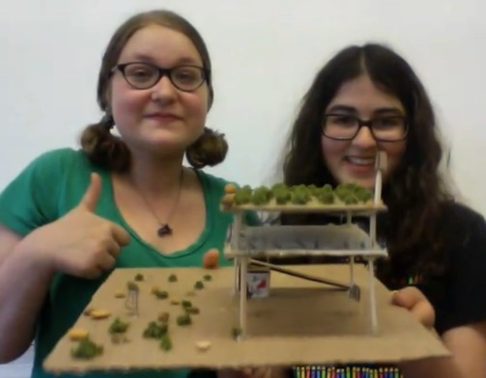
Vertical Evacuation
Part D: Allow me to explain . . .
Notes:
Part D: Presenting the structure and discussing how it meets design criteria.
Video of kids presenting: CEETEP DVD/3. Cascadia Earthquakes & Tsunamis/4. ACTIVITIES_Cascadia Earthquakes & Tsunamis/Tsunami Activities/Vertical Evacuation Structures

Slide 35
Vertical Evacuation Standards Correlation
Science and Engineering Practices
Asking questions and defining problems
Developing and using models
Planning and carrying out investigations
Analyzing and interpreting data
Using mathematics and computational thinking
Constructing explanations and designing solutions
Engaging in argument from evidence
Obtaining, evaluating, and communicating information
Notes:
Ask folks to read these and see which ones are hit by this project

Slide 36
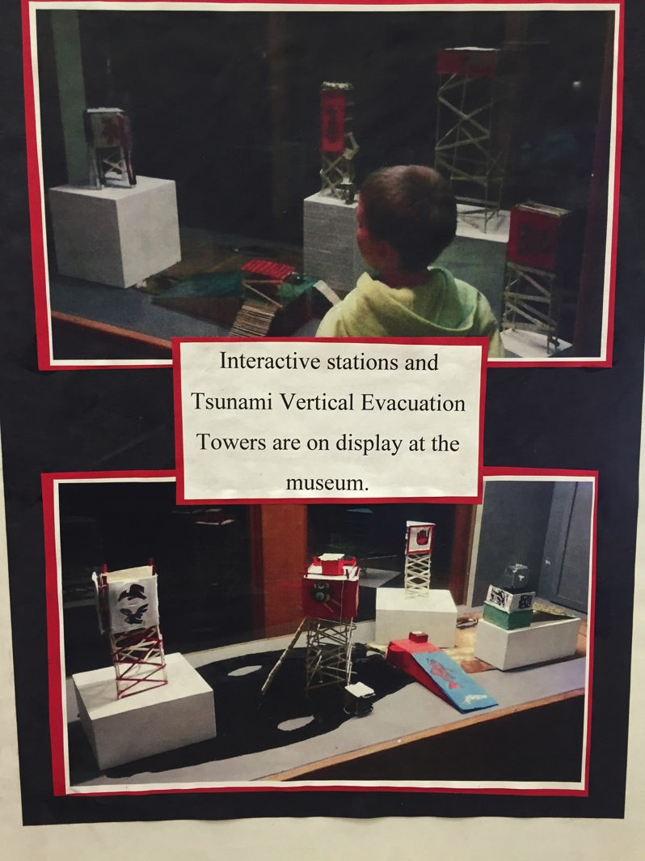
TVES Examples
CEETEP March 2015 Share-a-thon

Slide 37
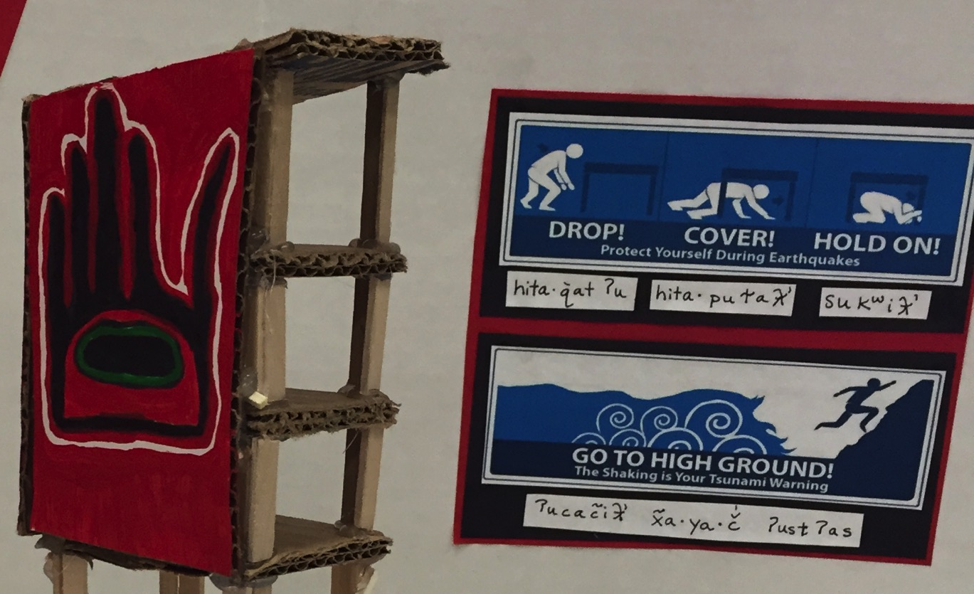
TVES Examples

Slide 38
Vertical Evacuation
How could YOU use this?
Possible Extensions –
Build, shake, and inundate?
Hatfield Marine Science Center – lego building
International Building Codes - 2019-ish
Structure in inundation zone must be VES
Questions??
Notes:
Build it – shake it – then run water around it?
Wave Tank at OSU
Something over 6 stories must be VES (with exceptions), i.e. hotels

Slide 40
Slides not used for Arcata presentation follow:

Slide 41
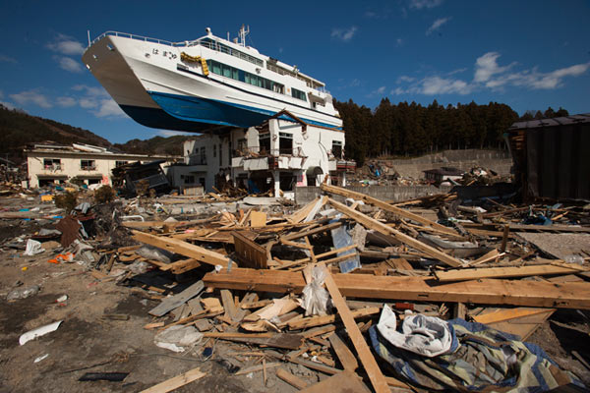
Not what we mean . . .
Notes:
In Otsuchi, Japan, north of Sendai

Slide 42
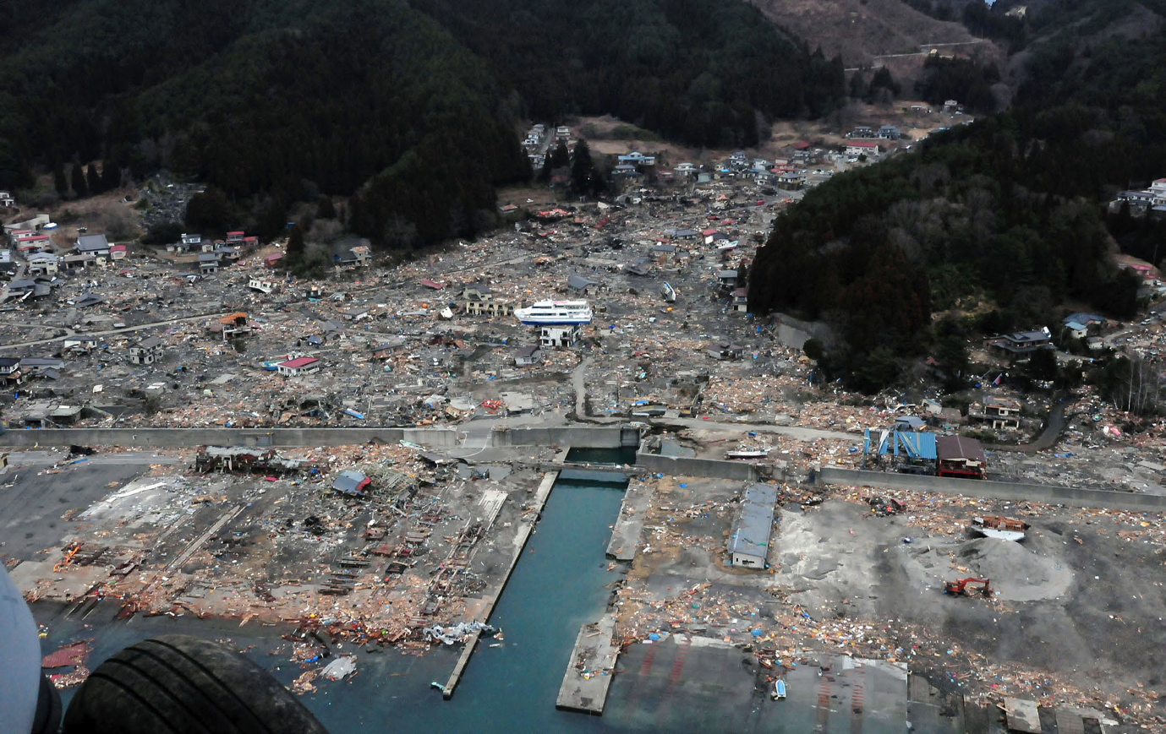
Not what we mean . . .
Notes:
In Otsuchi, Japan, north of Sendai

Slide 43
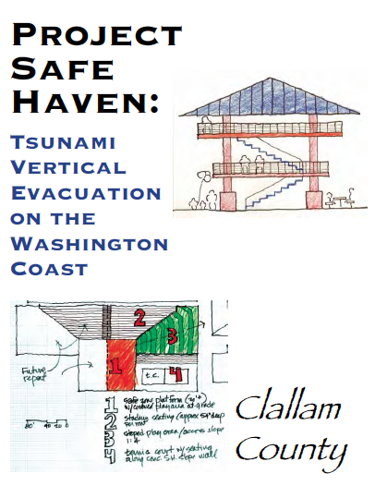
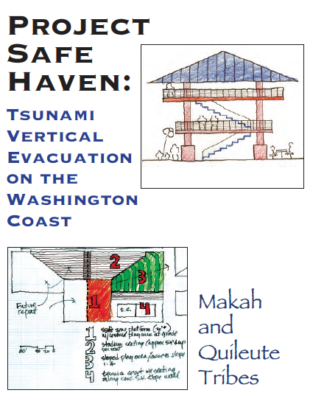
Vertical Evacuation Resources
Notes:
For further information and lots of examples that are place-dependent, check these out from WA state

Slide 44
Vertical Evacuation – OR Law
379 Line – enacted in 1995
No new critical facility buildings below that line

Slide 45
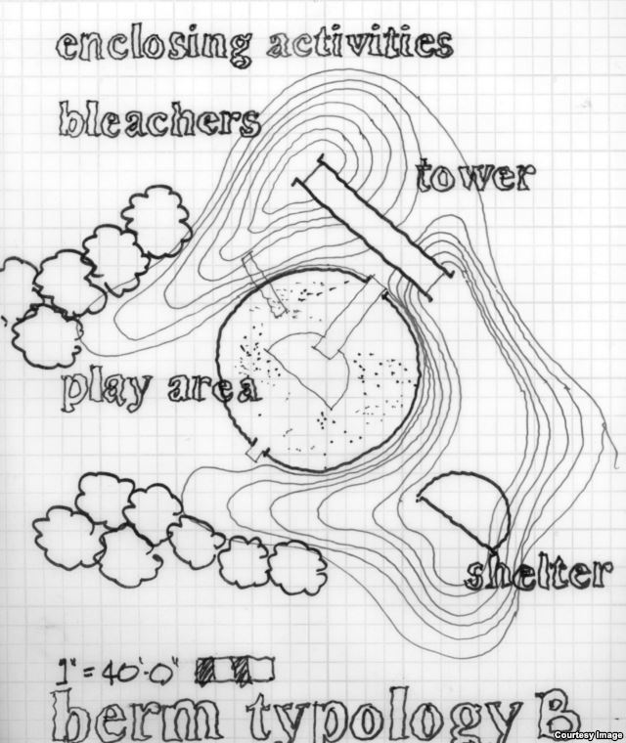
Long Beach Elementary School, WA
$840,000
Projected cost according to Project Safe Haven

Slide 46
Vertical Evacuation Modeling
Notes:
Seaside – older animation

Slide 47
Vertical Evacuation Modeling
Notes:
Seaside – note the additions of the 2 vertical structures

