Slide 1
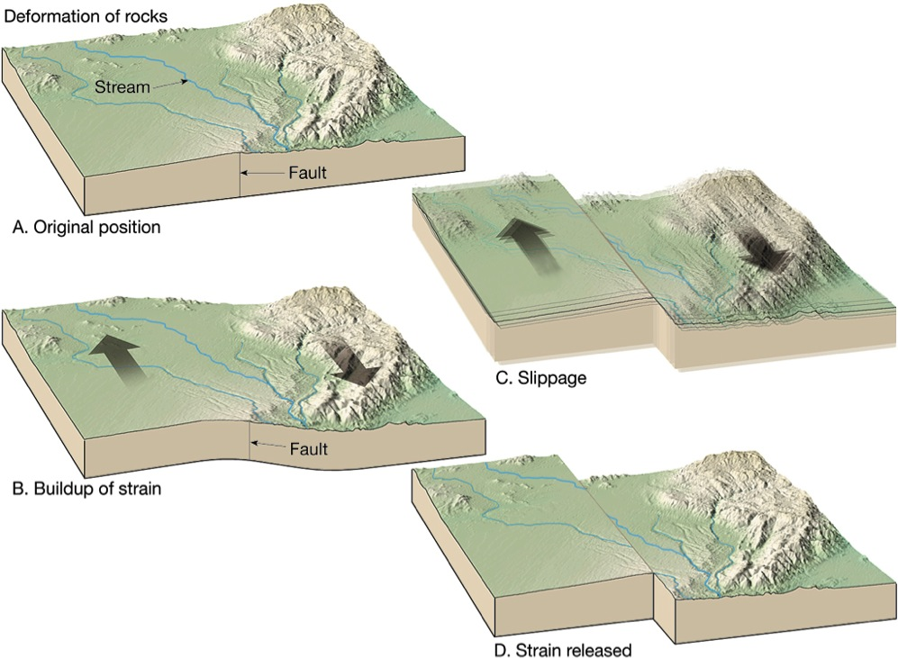
Stick-slip: Elastic Rebound Theory
Jerky motions on faults produce EQs
Earthquake Machine
Three Fs of earthquakes: forces, faults, and friction.
Slow accumulation and rapid release of elastic energy.
Notes:
The mechanics of earthquakes. Basically earthquakes result from the “jerky” motion of rocks along faults. Slip on faults generally does not occur in a smooth, steady fashion but rather as a series of jerks. “Elastic rebound theory” was developed by J.R. Reid during his studies of the San Andreas Fault after the disastrous 1906 San Francisco earthquake. This four-part diagram presents the essence of elastic rebound theory. Between A and B, forces slowly bend rocks adjacent to the fault. Strain energy is stored in the rocks as they are bent. C. When stress along the fault exceeds the strength of rocks on the fault, the rocks on opposite sides of the fault suddenly snap producing an earthquake. D. The rocks on opposite sides of the fault end up in a new position with much of the stored strain energy released by the earthquake. Then the “earthquake cycle” starts again. The interaction of forces, faults, and friction (the 3 Fs) controls earthquakes.

Slide 2
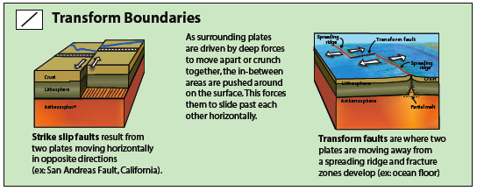
Three Basic Types of Plate Boundaries
Transform
Strike-slip faulting
Magnitudes generally < 7
BUT San Andreas Earthquakes up to M8
Notes:
Plates can have three kinds of motion across boundaries: 1. They can move away from each other like at a divergent boundary (= spreading ocean ridge or a rift zone); 2. They can move toward each other to make a convergent boundary. 3. They can slide past each other horizontally at a transform boundary. When two plates carrying continents converge, a continental collision occurs where continental crust piles us. Continental crust is lower density than mantle rocks, so continental rocks cannot be “subducted” into the mantle. If continental rocks are pushed into the mantle, they will soon pop up again. This is like trying to push a piece of styrofoam into a swimming pool. You can push the styrofoam into the water (with some force) but, when you let it go, it pops back to the surface because it is much less dense than the water on which it floats.

Slide 3
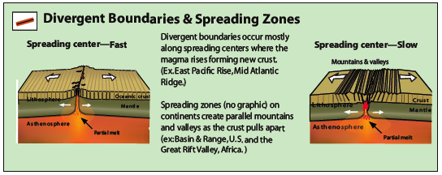
Three Basic Types of Plate Boundaries
Divergent (e.g. spreading ocean ridge)
Normal faulting Magnitudes < 6

Slide 4
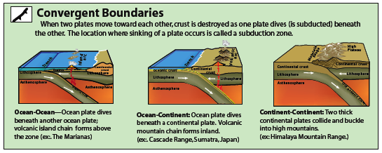
Three Basic Types of Plate Boundaries
Convergent (e.g. subduction zone)
Magnitudes up to 9 or larger
Depths to 700 km

Slide 5
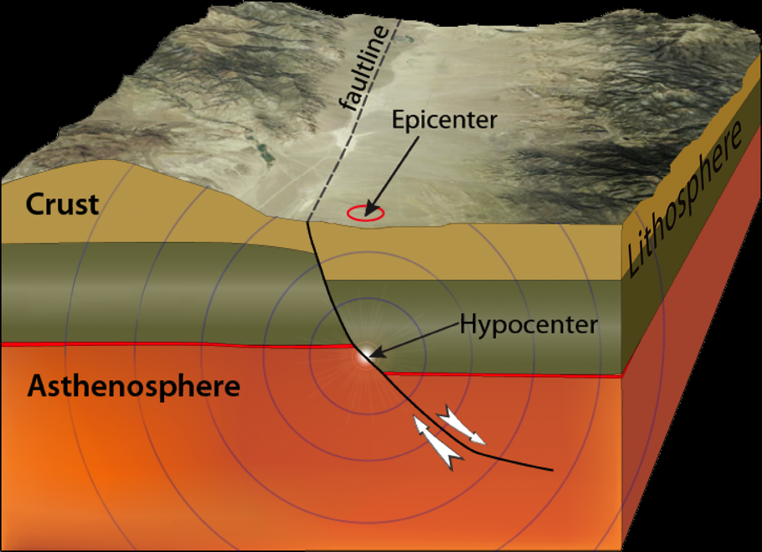
Hypocenter or Focus: Point WITHIN
Earth where EQ occurred.
Epicenter: Location on Earth’s surface directly ABOVE the EQ.
Notes:
Some A, B, Cs of earthquakes: Earthquakes occur along faults IN the Earth, NOT on the surface of the Earth. The actual place in the Earth where an earthquake occurs is called the “Focus”. This diagram shows the earthquake waves (seismic waves) moving out from the earthquake focus. The “Epicenter” is the place on the surface of the Earth directly above the earthquake. In news about earthquakes, the epicenter is often reported; this is generally where the earthquake damage will be greatest because it is the surface point closest to the earthquake. To describe where in the Earth an earthquake occurred, you must determine the “epicenter” AND the depth of the earthquake.

Slide 6
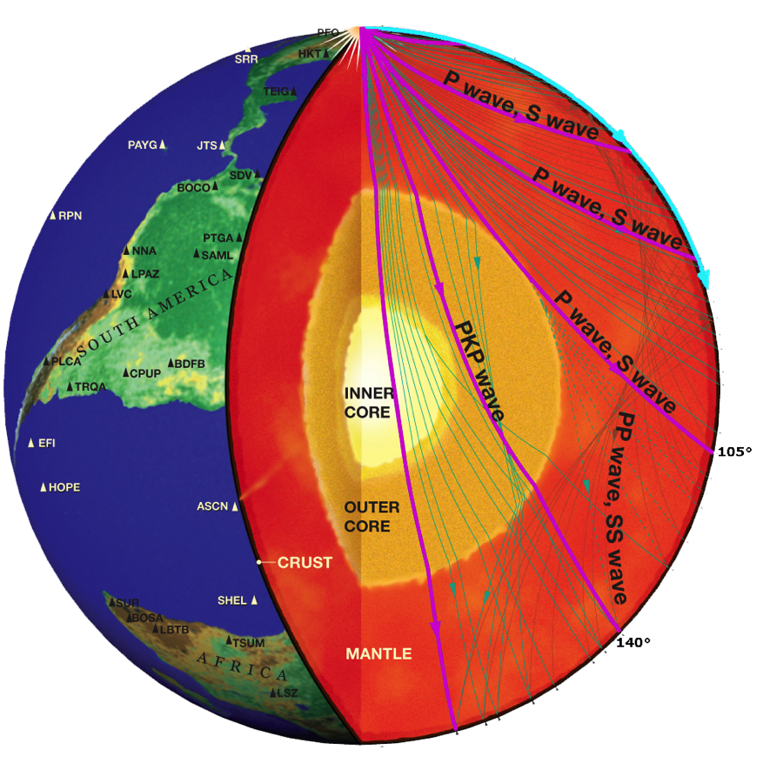
Body waves
(P and S) travel inside Earth.
Body Waves and Surface Waves
Surface waves travel along Earth’s surface.
While P- and S- waves radiate outward in all directions, surface waves travel along the surface of the earth and decrease in amplitude with depth.
Notes:
Earth’s interior structure and seismic raypaths that are used to determine the Earth structure.
For large earthquakes, seismic waves will be generated that travel through and around the entire Earth. This diagram is a cross section of the whole Earth showing crust, mantle, and core. “Body waves” are seismic waves that travel through the interior (the body) of the Earth. Surface waves travel around the perimeter of the Earth with oscillations that are dominantly in the upper 50 to 100 kilometers of the planet. The computer program “Seismic Waves” can be used to animate the body waves and surface waves from several recent large earthquakes. This is quite useful to help students understand that there are many kinds of seismic waves generated by large earthquakes and these waves can have complicated paths including bounces (reflections) and bending (refractions) at the boundaries between Earth’s crust, mantle, and core. In fact, studies of these seismic waves provide much of what we know about the structure of the interior of Earth.
VIDEO lectures of this presentation are on this DVD in the folder: 3. VIDEOS_Earthquake & Tsunami > 3. VIDEOS_Earthquake & Tsunami
> LECTURE_Seismic Wave Paths_Butler.mov andﾊ LECTURE_Types of Seismic Waves_Butler.mov
(Or on the web: http://www.iris.edu/hq/programs/education_and_outreach/videos )
Graphic from IRIS One-pager, “Exploring the Earth Using Seismmology” which can be downloaded from http://www.iris.edu/edu/onepagers.htm
POSTER and accompanying animation in: 2. Earthquakes & Tsunamis > 4. ACTIVITIES_Earthquake & Tsunami > Exploring Earth Using Seismology_IRIS POSTER

Slide 7
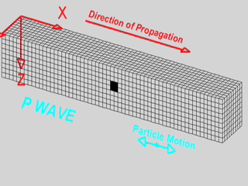
P Waves Are Pressure Waves
Seismic Slinky
P waves are fastest seismic waves.
Notes:
VIDEO: of this presentation is on this DVD in the folder: 3. VIDEOS_Earthquake & Tsunami > 3. VIDEOS_Earthquake & Tsunami LECTURE_Types of Seismic Waves_Butler.mov
(or on the web: http://www.iris.edu/hq/programs/education_and_outreach/videos)
ANIMATIONS: are on this DVD in the folder: 2. Earthquakes & Tsunamis > 2. ANIMATIONS_Earthquake & Tsunami > Seismic Wave Motion-Braile
This is a good place to break for demonstrations of P waves and S waves in a slinky. Taping two slinkies together gives the best demonstration as they can be stretched out a longer distance to watch the waves propagate. It is best to keep the slinky on the floor. If you use a metal plus a plastic slinky taped together, you will see the “seismic waves” reflect backward at the boundary as they react to the change in material properties.
ACTIVITIES: are on this DVD in the folder: 2. Earthquakes & Tsunamis > 4. ACTIVITIES_Earthquake & Tsunami > Seismic Slinky
Professor Larry Braile of Purdue University has produced some great teaching resources for this activity. See http://web.ics.purdue.edu/~braile/edumod/slinky/slinky.htm
Simple description of Slinky Activity:
When an earthquake occurs it generates different types of seismic waves, each characterized by speed and direction. P and S waves that emanate from the hypocenter of the quake, inside the Earth are called body waves. The P and S waves have distinctive particle motions and travel at different speeds (figures on next page). By using a slinky as an analogy for the waves, you can see the difference between compressive P waves and S, or shear waves. In the Earth, P waves zip along at over 225 miles per hour (360 km/hr) through solid rock, compressing and dilating the Earth in the direction of travel
PROCEDURE**
1. PARTNER METHOD: Hold one end of the slinky and have your partner stretch the slinky about 2–3 meters apart across the floor. Entire slinky touches floor.
FIXED-END METHOD: Attach one end of slinky to a fixed object and one person stretches it out along floor or long table. Experiment with best distance.
2. Create P waves (compressional waves) Note that the motion of each coil is either compressional or extensional with the movement parallel to the direction of propagation. Because the other person is holding the slinky firmly, the P wave will reflect at that end and travel back along the slinky. The propagation and reflection will continue until the wave energy dies out.
METHOD 1: Tightly gather ten coils of the slinky into your hand and release the coil. Watch the coils compress and dilate until they reach the other end. Draw your results showing the movement of the wave through the slinky in the table on the following page.
METHOD 2: One person should cup his or her hand over the last 3-4 coils of the slinky and, when the slinky is nearly at rest, hit that hand with the fist of the other hand. The compressional disturbance that is transmitted to the slinky will propagate along the slinky to the other person.
METHOD 3: Have rapid-push hand motion generate compression as shown in the animation opposite.
3. Create S waves (shearing waves) by quickly moving one end of the slinky to the left and back to the center in a quick whip-like motion (animation below). The S wave is more similar to a plucked guitar string than to compressive sound waves.
Analysis: Answer the following questions using complete sentences.
1. Contrast the movement of P and S waves in the slinky?
2. How did the density of the slinky affect the speed of the waves?
3. What happened to the wave when it reached the boundary between the plastic and metal slinkies?
Conclusion: Communicate your findings in writing using complete sentences. Remember to include the problem you were investigating, the results of your investigation, and the accuracy of your predictions.
SOME THINGS YOU CAN DO:
4. Draw your results showing the movement of the wave through the slinky on the worksheet on next page.
5. After you have drawn both types of waves, have two other group members stretch the second slinky across the floor so that it is at an equal length to yours. Create a P wave while the other group creates an S wave. Watch both waves travel down to the end of the slinky, and record which wave moves faster or slower in the worksheet table.
6. Have one member of your group of four pull in several coils of one slinky so that both slinkys are the same length, but one slinky is pulled tighter than that other.
7. Create one P wave on each slinky, and watch to see which p wave moves more quickly to the end of the slinky. Record your results in the table.
8. Create one S wave on each slinky, and watch to see which s wave moves more quickly to the end of the slinky. Record your results in the table.
9. Use string or tape, attach the end of the metal slinky to one end of the plastic slinky. Create P and S waves once again and record your results on the worksheet.

Slide 8
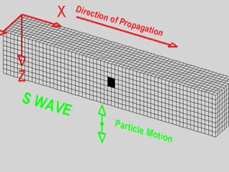
S Waves Are Shear Waves
Seismic Slinky
S waves are slower than P waves but faster than surface waves.
Notes:
Read previous slide for activities and animation resources.
Deformation propagates. Particle motion consists of alternating transverse motion. Particle motion is perpendicular to the direction of propagation (transverse). Transverse particle motion shown here is vertical but can be in any direction. However, Earth’s layers tend to cause mostly vertical (SV; in the vertical plane) or horizontal (SH) shear motions. Material returns to its original shape after wave passes.

Slide 9
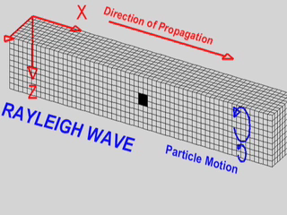
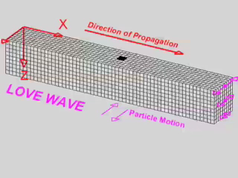
Surface Waves
Amplitude greatest at surface, decreasing with depth.
Slower than P or S waves.
Often are largest amplitude and most damaging seismic waves.
Notes:
Some teachers choose not to teach about surface waves, and stay with just the P and S waves. That is permissible, but often the rolling surface waves can be the most destructive. The waves area named after the people who discovered them. These surface waves can be confusing.
RAYLEIGH WAVE: Deformation propagates. Particle motion consists of elliptical motions (generally retrograde elliptical) in the vertical plane and parallel to the direction of propagation. Amplitude decreases with depth. Material returns to its original shape after wave passes.
LOVE WAVE: Deformation propagates. Particle motion consists of alternating transverse motions. Particle motion is horizontal and perpendicular to the direction of propagation (transverse). To aid in seeing that the particle motion is purely horizontal, focus on the Y axis (red line) as the wave propagates through it. Amplitude decreases with depth. Material returns to its original shape after wave passes.
ANIMATIONS: web.ics.purdue.edu/~braile/edumod/waves/WaveDemo.pdf or www.iris.washington.edu/hq/files/programs/...and.../SeismicWaves.ppt
VIDEO: of this presentation is on this DVD in the folder: 3. VIDEOS_Earthquake & Tsunami > 3. VIDEOS_Earthquake & Tsunami LECTURE_Types of Seismic Waves_Butler.mov
(or on the web: http://www.iris.edu/hq/programs/education_and_outreach/videos)
ANIMATIONS: are on this DVD in the folder: 2. Earthquakes & Tsunamis > 2. ANIMATIONS_Earthquake & Tsunami > Seismic Wave Motion-Braile

Slide 10
Human Waves
Modeling P, S, and Surface Waves
Seismic Slinky

Slide 11
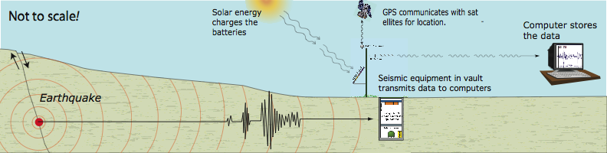
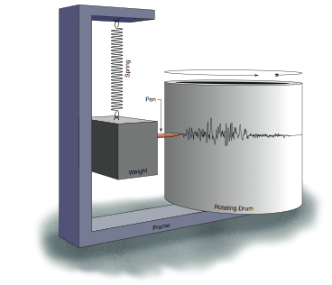
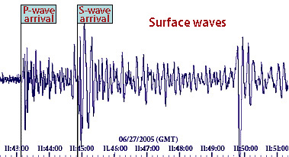
A seismograph detects and records EQs.
How do scientists detect earthquakes?
When an earthquake occurs the seismic waves travel through the Earth to the seismic station where the information is transmitted to distant computers.
A seismogram is the
EQ record.
Notes:
The seismometer is the instrument that is supersensitive to ground motions and therefore can detect the minute ground motions produced by a distant earthquake.
Seismograph—This is the amplifier and recorder. An instrument that records vibrations of the Earth, especially earthquakes. Seismograph generally refers to the seismometer and a recording device as a single unit.
Seismometer—This is the detector. A sensitive instrument that can detect waves emitted by even the smallest earthquakes.
A seismogram is the graphical representation that the seismometer makes of a particular earthquake. As seen on the seismograph in the bottom figure, the order of arrival of seismic waves is: P wave, then S wave, then surface waves.
When interpreted for us, a seismogram looks pretty simple. In actuality, it is rarely so. It takes a trained eye to discern what all the movements from different seismometers means. Some record horizontal movement (N-S or E-W), others record vertical movement (up-down).
ANIMATIONS: Watch animations on Seismographs_Vertical_&_Horizontal.mov on this DVD in the folder: 2. Earthquakes & Tsunamis > 2. ANIMATIONS_Earthquake & Tsunami
Seismographs-Vertical & Horiz Instruments
(Or on line at: http://www.iris.edu/hq/programs/education_and_outreach/animations/8)

Slide 12
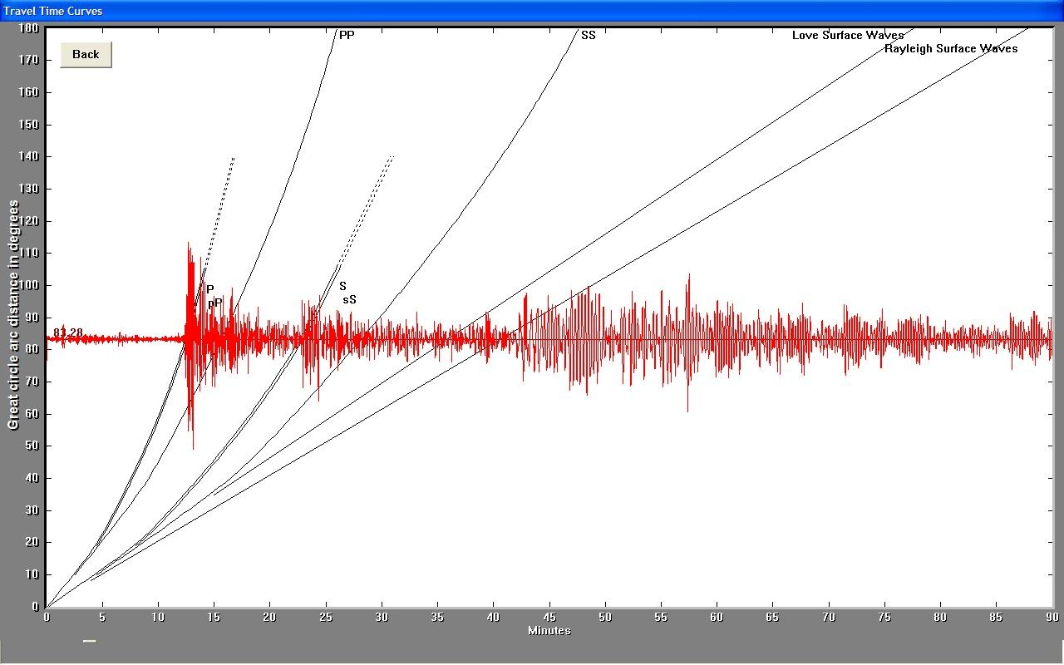
M7.7 Earthquake off Northern Chile Nov 14, 2007
University of Portland AS-1 Seismometer
P waves
~12 min
~720 sec
S waves
~22 min
~1320 sec
Surface waves
~42 min
~2500 sec

Slide 13
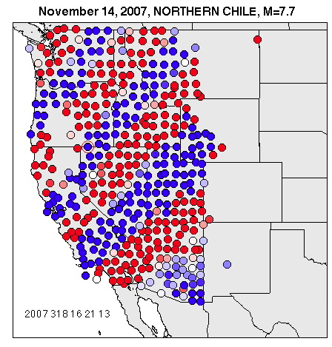
USArray
Animations
Seismic Waves from Chile Earthquake

Slide 14
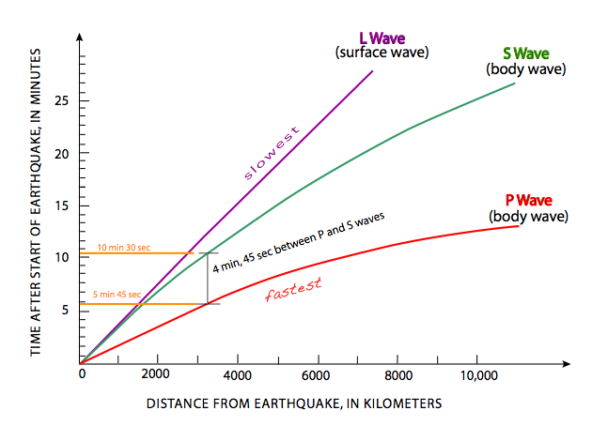
Distance of EQ from seismometer?
Determined from S arrival time - P arrival time.
Notes:
A classic classroom earthquake activity described in almost every textbook treatment of earthquakes is how to determine the distance of an earthquake from a seismic station (= seismometer) using the travel time for P waves and S waves from that earthquake. This graph shows the travel time for P waves and S waves against distance from the earthquake as measured on the Earth’s surface in kilometers. For this example, the P wave arrived at the station 4 minutes and 15 seconds after the earthquake occurred; the S wave arrived at the station 8 minutes after the earthquake occurred. The time difference of 3 minutes and 45 seconds between the P wave arrival and the S wave arrival determines the distance of the earthquake from the seismometer as about 2400 km. From this information alone, you cannot tell what the direction is from the seismometer to the earthquake that could have occurred anywhere on a circle 2400 kilometers radius from the seismometer.

Slide 15
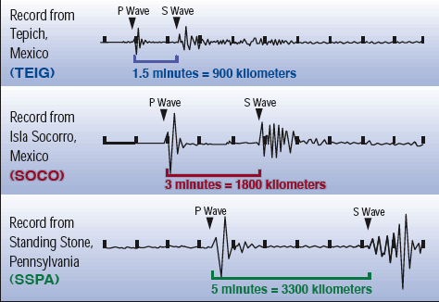
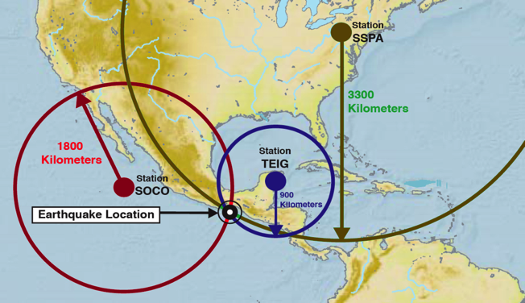
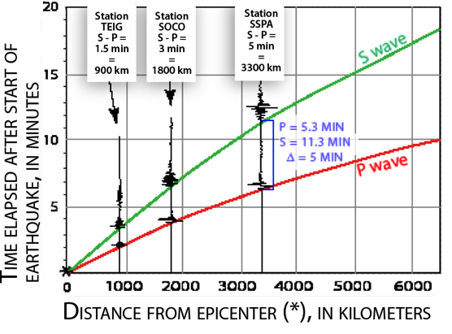
Locating an Earthquake
Determine distance of EQ from three seismic stations by calculating the S minus P arrival times.
Plot them on the travel-time graph.
Intersection of the circles gives the location.
1
3
2
Notes:
If you have determinations of the distance of an earthquake from three seismic stations, you can triangulate the location of an earthquake. For a “regional earthquake”, you can do this problem on a flat map using a compass to draw circles around the three seismic stations with radius equal to the distance of the earthquake from those stations. The circles should intersect at the epicenter of the earthquake.
THE WORLD IS A GLOBE: For a distant earthquake (e.g. in the middle of the Atlantic Ocean), you must deal with the complexity of spherical geometry, although the principles of triangulation are the same.
In this slide an earthquake off the coast of southern Mexico is recorded by 3 stations listed in figure 1 above. If you just figure out how much time elapsed between the P and S waves, you can plot them on the lower graph (figure 2) to see how far each quake was from the epicenter. You slide each seismogram along between the green and red slopes of the graph until the P-wave arrival touches the red line and the S-wave arrival touches the green line.
Then you make great circles of those diameters around each station. There is only one location that it can be. If you have only 2 seismometers there are two potential earthquake locations.
ANIMATIONS: are on this DVD in the folder: 2. Earthquakes & Tsunamis > 2. ANIMATIONS_Earthquake & Tsunami > HowAreEQLocated_WalkRunActivity.swf
ACTIVITY: 2. Earthquakes & Tsunamis > 4. ACTIVITIES_Earthquake & Tsunami > Epicenter Triangulation > HowAreEQLocated_WalkRunActivity.swf
(or download from: http://www.iris.edu/hq/programs/education_and_outreach/animations/interactive
ACTIVITY: 2. Earthquakes & Tsunamis > 4. ACTIVITIES_Earthquake & Tsunami
This interactive FLASH download also has a description of using groups of students on a grid to map out “seismic wave” arrival times shown on next page.
ONE PAGER: No. 6. How are Earthquakes Located?” download from: http://www.iris.edu/hq/publications/brochures_and_onepagers/edu

Slide 16
Moment Magnitude
Pasta Quake

Slide 17
M > 5 PNW Earthquakes 1980 – Present

Slide 18
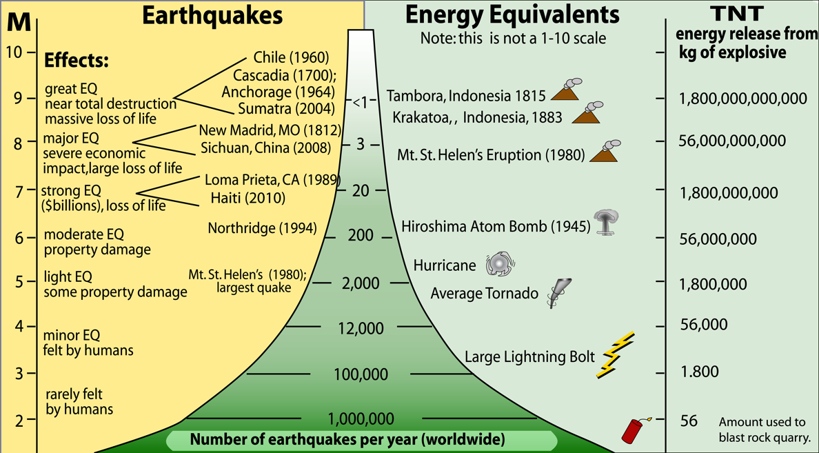
Magnitudes and Energy of Earthquakes
Annual Numbers of EQs
MOST of the energy is released by around
20 magnitude-7 and larger EQs every year.
Notes:
As indicated in previous slide, as magnitude increases by 1.0, ground motion changes by a factor of 10. The change in energy with magnitude is even more dramatic. A change of magnitude by 1.0 corresponds to a change in energy released by a factor of 32!
Notice the dramatic change in number of earthquakes of different sizes. Small earthquakes are MUCH more frequent than large earthquakes. However, because the energy changes by a factor of 32 with an increase of 1.0 in magnitude, large earthquakes account for most of the energy released in earthquakes. There are about 20 earthquakes of magnitude 7.0 or greater each year and these release 80% of all seismic energy.
Earthquake Energy—To rephrase, for each unit of magnitude the amplitude of the waves increases by a factor of 10, but the duration also increases, so the energy released increases by a factor of 32!
RESOURCE: See file “No. 3. How Often do Earthquakes Occur?” on website http://www.iris.edu/hq/publications/brochures_and_onepagers/edu

Slide 19
Earthquake Intensity:
Violence and Effects of Ground Shaking.
I. Not felt.
II. Felt only by a few people.
III. Felt noticeably by people indoors.
IV. Felt indoors by many, outdoors by few people.
V. Felt by nearly everyone; many awakened. Some dishes, windows broken.
VI. Felt by all; some heavy furniture moved.
VII. Considerable damage in poorly-built structures; No damage to well-built structures.
VIII. Great damage to poorly-built structures; considerable damage to ordinary buildings.
IX. Damage great in substantial buildings, with partial collapse.
X. Some well-built wooden structures destroyed; most masonry and frame structures destroyed.
XI. Few masonry structures remain standing; Bridges destroyed.
XII. Damage total.
Magnitude/Intensity Comparison
Intensities typically observed at locations near epicenter.
Notes:
Intensity is a measure of the effects of an earthquake in a particular location (e.g. did buildings fall down or just shake a bit?). Intensity is thus different in different places during the same earthquake whereas any particular earthquake has only one magnitude (determined from a measure of the amplitude of ground oscillations produced by that earthquake adjusted to a standard distance). Most damage results from strong shaking during the passage of seismic waves, which spread out from the fault over a large region. Shaking may be severe enough and long enough to collapse weak buildings, overturn furniture, topple water heaters and storage tanks, and collapse unsafe dams. These effects can result in further damage through fires resulting from broken gas mains and fallen electric wires, the loss of water to fight fires because of broken water mains, oil spills caused by failure of storage tanks, and flooding resulting from dam failure. Shaking can also cause landslides. These in turn can damage buildings, roads, and pipelines built on slide areas or downhill from them.
INTENSITY VS MAGNITUDE: The severity of an earthquake can be expressed in terms of both intensity and magnitude. However, the two terms are quite different, and they are often confused. The size of the earthquake is called its magnitude. There is one magnitude for each earthquake. Magnitude scales, like the Richter magnitude and moment magnitude, measure the size of the earthquake at its source. Thus, they do not depend on where the measurement of the earthquake is made. Often, several slightly different magnitudes are reported for an earthquake. This happens because different measurement procedures will often give slightly different magnitudes for the same earthquake. The intensity of shaking from an earthquake varies depending on where you are during the earthquake. The intensity of a M5 earthquake right under you is much greater than a M7 earthquake 300 miles away. Intensity scales measure the amount of shaking at a particular location. Sediment-filled valleys will shake much more than bedrock hills.

Slide 20
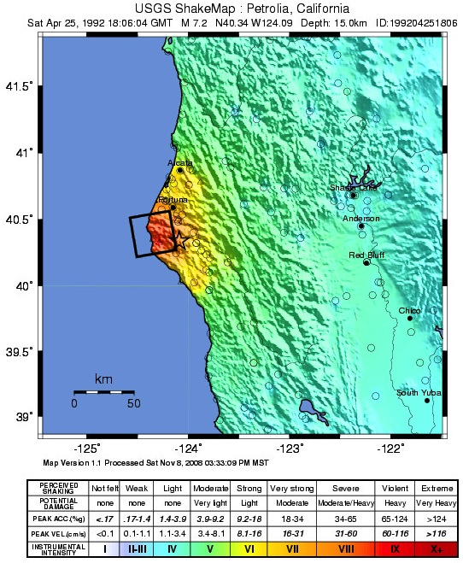
Earthquake Intensity:
Violence and Effects of Ground Shaking.
What controls Intensity?
Magnitude—More energy released.
Distance—Shaking decays with distance.
Depth—Deeper EQ yields less shaking at the surface.
Geology—Weak sediments can amplify shaking.
Building style
Duration of shaking.

Slide 21
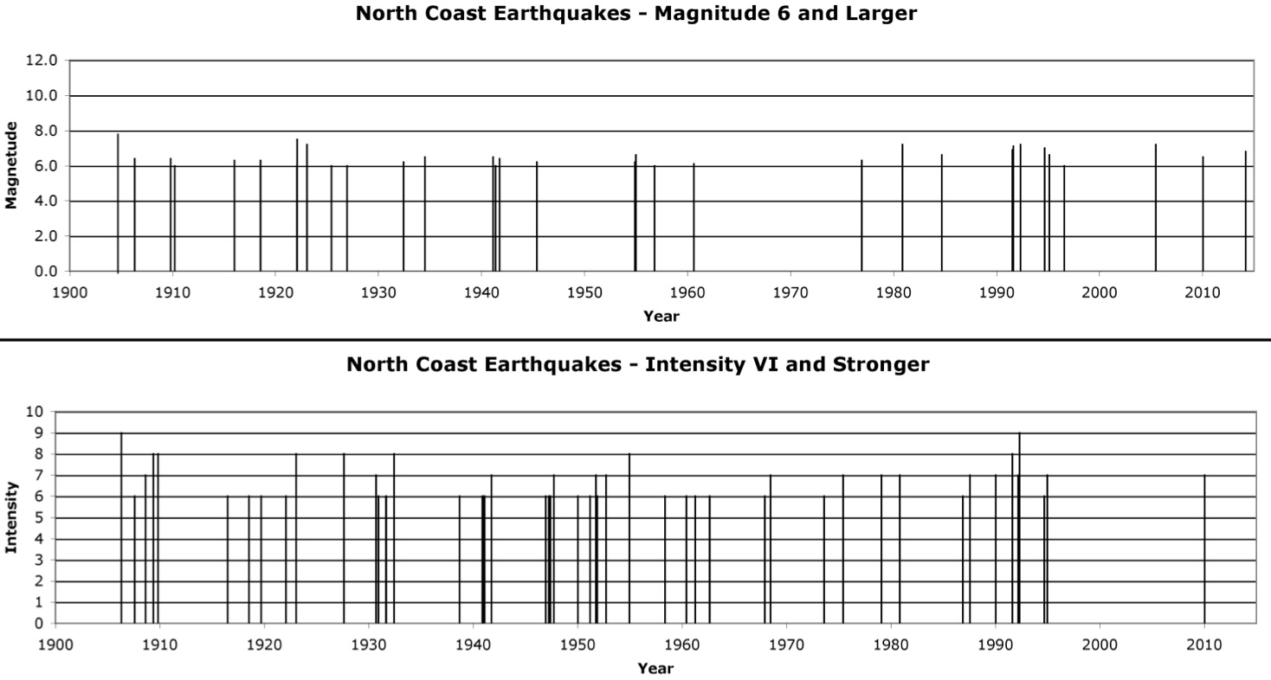
Northern CA Magnitude & Intensity Timeline
1906
San Francisco
1992
Cape Mendocino

Slide 22
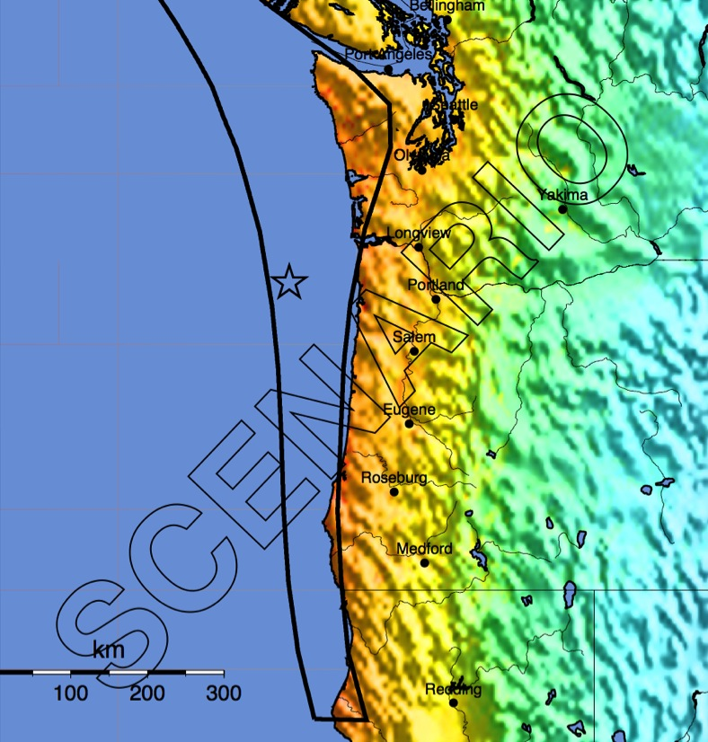
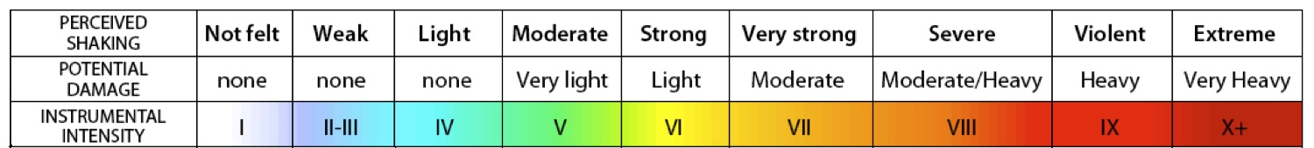
ShakeMap for 2011 Japan M9 EQ
ShakeMap for M9 Scenario Cascadia EQ

Slide 23
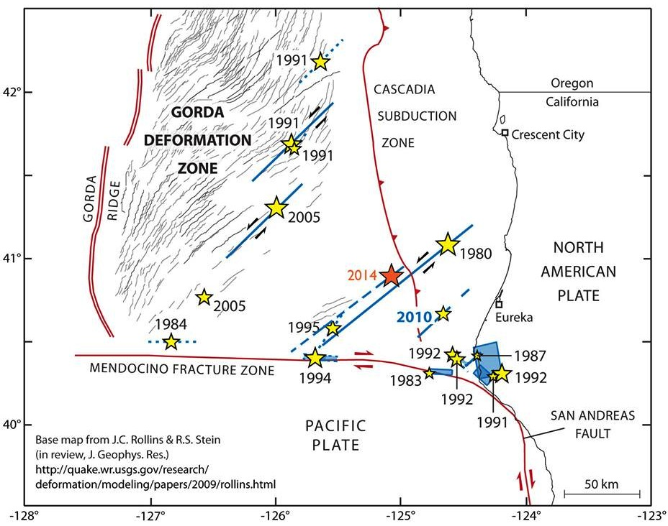
M>6 Earthquakes Offshore Northern CA Since 1980
MENDOCINO FAULT

Slide 24
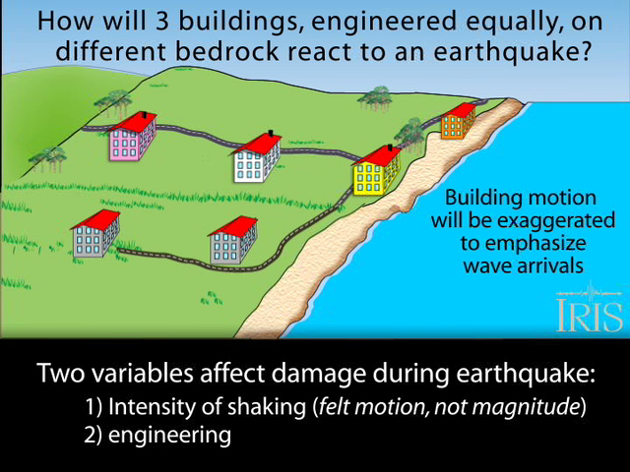
Effects of Near-Surface Geology
Amplitude of oscillation increasing
Notes:
This drawing does not show the S and P-wave arrivals on the seismogram. Rather, it shows how the seismic wave oscillates as it enters different materials.
The least damage occurs where buildings are constructed on bedrock. Note that the seismogram signal through “solid bedrock” is a high-frequency, low-amplitude.
By the time the seismic wave reaches the “well-consolidated sediment” it begins to wobble with more amplitude but less frequently.
The “poorly consolidated” sediment is even worse.
As the wave enters the “water-saturated sand and mud” the wave records a low-frequency, high-amplitude signal. It really gets rolling and can cause liquifaction [during ground shaking, some sandy, water-saturated soils can behave like liquids rather than solids. See the activity in the Exploratorium website noted below.]
Background below from http://www.exploratorium.edu/faultline/activezone/liquefaction.html]
During a quake, the squeezing done by the seismic waves happens very quickly, and the water doesn’t have time to flow out of the way of the sand particles. So as the particles try to move into a denser configuration, they push on the water, causing an increase in water pressure.This increased pressure causes the forces at the contact points between the sand particles to decrease. If the water pressure is high enough, it can reduce the interparticle forces to zero, which means that the sand particles ﾒfloatﾓ away from each other. For a brief time, the sand particles are suspended in the water. This is liquefaction. The soilﾕs loss of strength occurs because thereﾕs no contact between the particles of sand.So What? Many buildings in the San Francisco Bay Area are built on landfill, sand, or mud that can liquefy. Liquefaction caused much of the damage during the 1989 Loma Prieta earthquake. It has also been responsible for major destruction in other quakes, including Kobe, Japan, in 1995 and Mexico City in 1985.

Slide 25
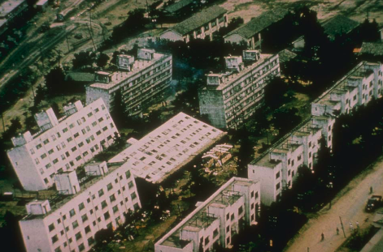
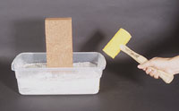
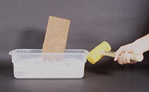
Liquefaction
What happens to a structure built on a weak foundation when an earthquake strikes?
Liquefaction
M7.4 Niigata, Japan 1964
Source: National Geophysical Data Center
Notes:
By building a model “shaker table” and using water-saturated sand, we can demonstrate how liquefaction works. Vibrations of water-saturated sand can cause the sand to become “quick”. This means is looses strength and buildings on top of water-saturated sand and mud can sink during earthquake shaking. In Portland and the Puget Sound regions, there is much water-saturated ground around rivers and bays that is vulnerable to liquefaction. These areas are likely to sustain more damage during earthquakes than are areas underlain by hard bedrock.
Another good demonstration is to place a vibrator, such as a rotary sander against the table and watch the brick sink.
For a demonstration of a liquefaction activity go to http://www.exploratorium.edu/faultline/activezone/liquefaction.html
Try the activity with and without water added to the sand.

Slide 26
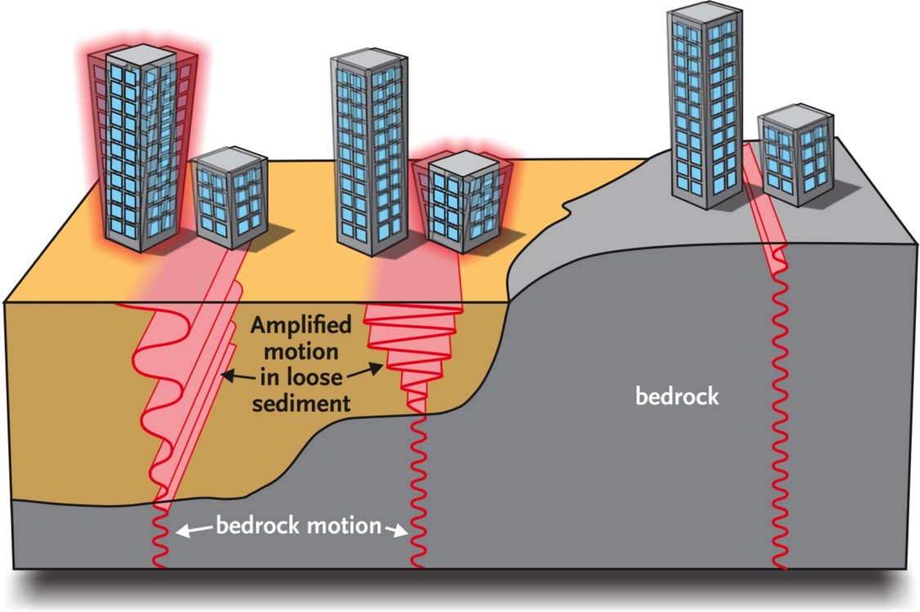
Ground Shaking Amplification
Seismic waves are amplified as they pass from bedrock into basins filled with sedimentary rock.

Slide 27
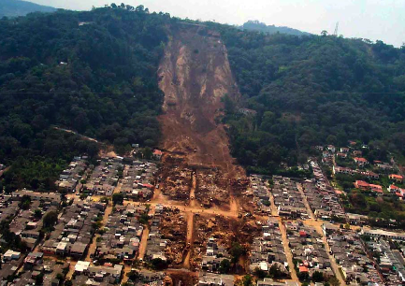
Earthquake-Induced Landslides
El Salvador January 2001 M7.6

Slide 28
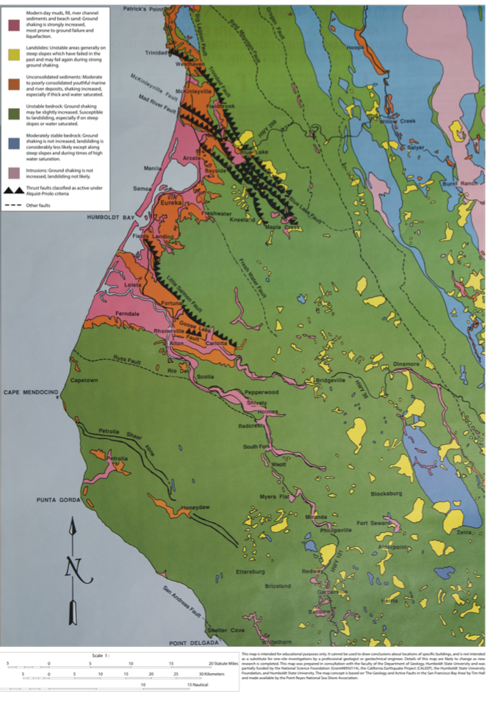
Relative Earthquake Hazards
Relative Earthquake Hazard Maps
Relative EQ Hazard
= Seismic Wave Amplification
+ Liquefaction
Potential
+ Earthquake-
induced
Landslide
Hazard

Slide 29

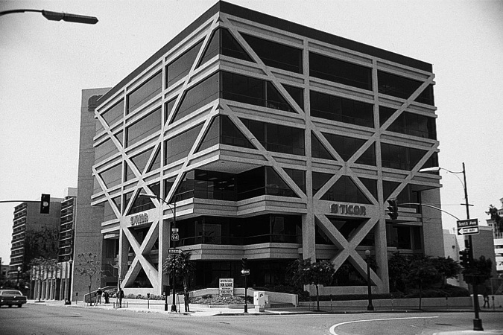

Build a Better Wall
Resistance to shear is critical.
“Earthquakes don’t kill people ……. buildings that collapse during earthquake ground shaking kill people.”

Slide 30
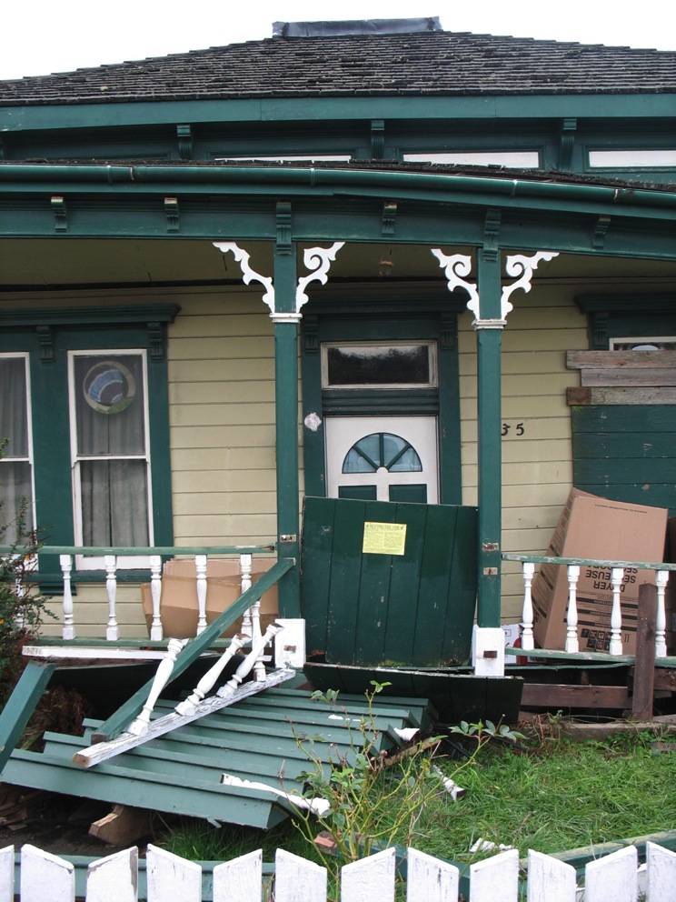
Cripple Wall Failure
Cripple wall failure

Slide 31
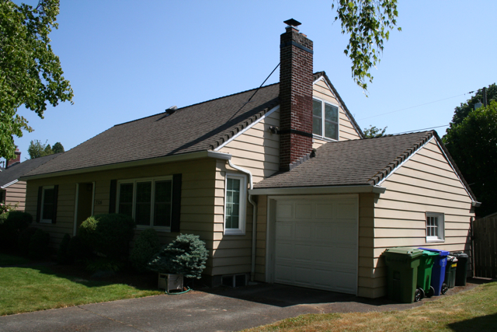
Seismic Retrofit
1942 North Portland House
Wood frame NOT attached to foundation.

Slide 32
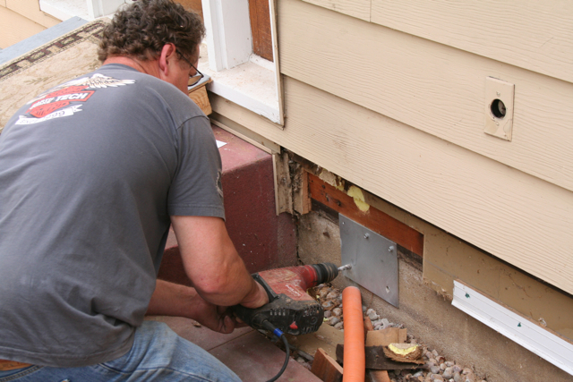
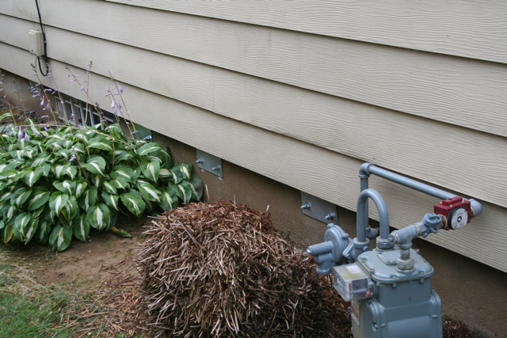
Seismic Retrofit
Bolting frame to foundation on exterior.

Slide 33
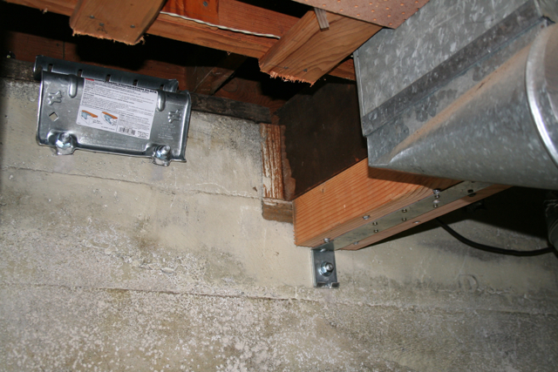
Seismic Retrofit
Post & beam reinforcement.

Slide 34
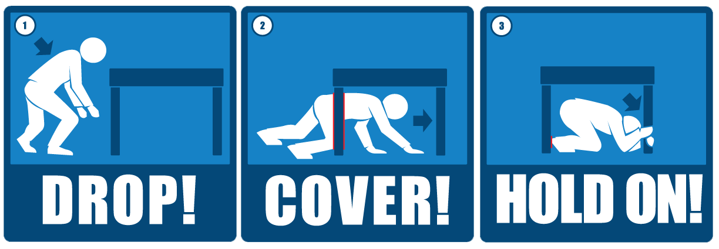
Drop, Cover, and Hold On!

Slide 35
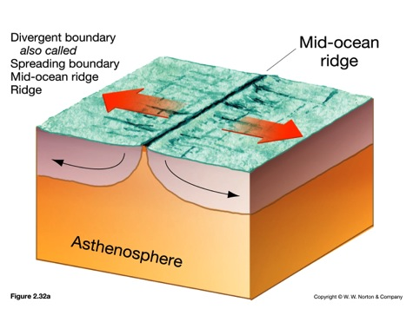
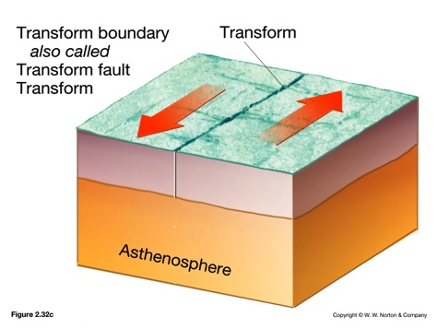
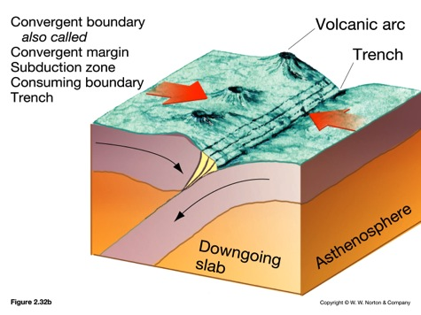
Plate Boundaries & Tsunamis
Divergent
Transform
Convergent
(subduction zones)
Tsunami
Notes:
What basic plate boundary is missing from this illustration? ocean / ocean subduction zone.
Small and shallow earthquakes at ridges do not generate tsunami.
Large earthquakes occur at these boundaries but the action is on land; no tsunami.
Transform faults do not generate tsunami because there is no vertical motion during earthquakes.
Large earthquakes on these boundaries at depths < 30 km are the tsunami generators.

Slide 36
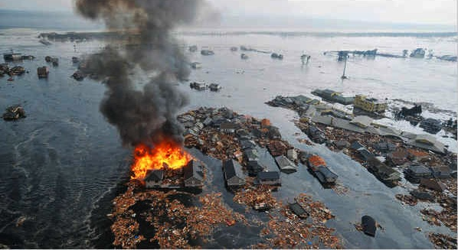
2011 Tohoku Earthquake and Tsunami
15,883 people killed; 6,145 missing; 2,671 injured;
Recovery, Cleanup, and Rebuilding Cost = $235 Billion.

Slide 37
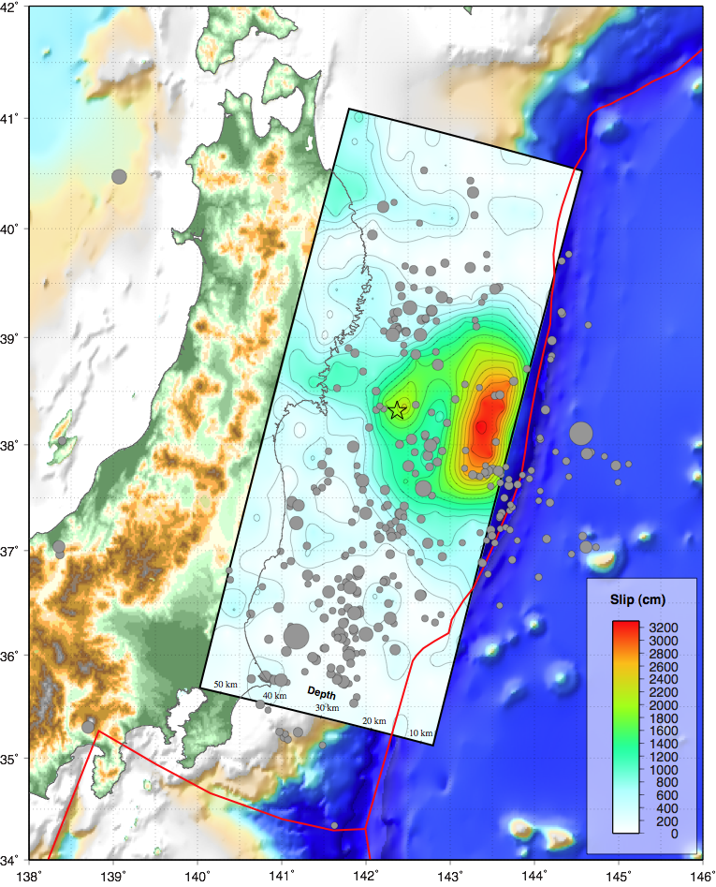
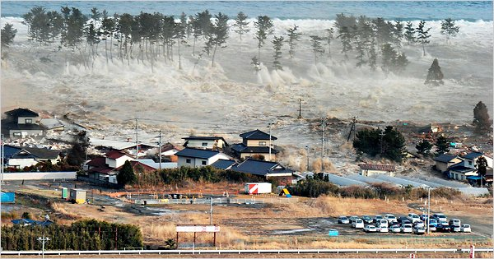
Tohoku Earthquake Fault Displacement Model
Modeling of seismic waveforms shows maximum fault slip over 30 meters!
Maximum slip region is toward the surface from the hypocenter.
Such large fault slip near the surface resulted in large displacement of the ocean floor that in turn generated a large tsunami.
March 11, 2011 Japan Tsunami
Image courtesy of the US Geological Survey

Slide 38
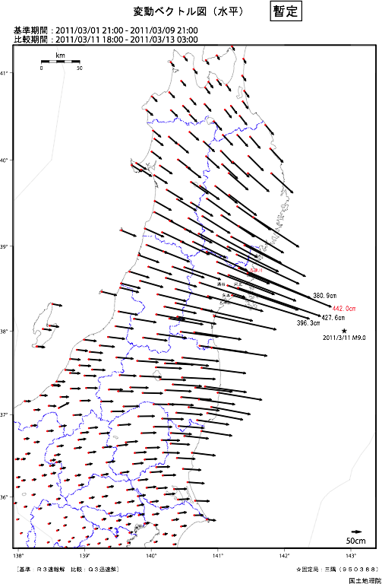
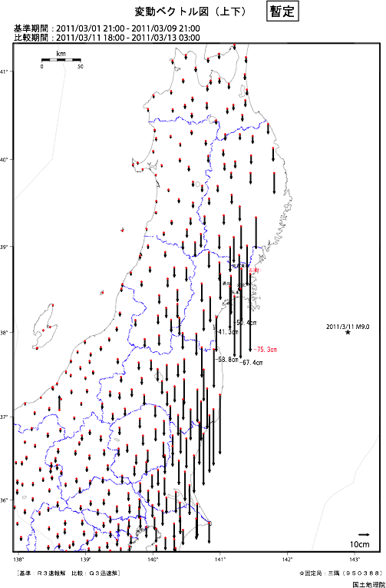
GPS Displacements During the Earthquake
4.42 meters (14.5 feet)
of horizontal displacement
0.75 meters (2.5 feet)
of subsidence

Slide 39
Yuriage
Some Coast Areas Now Below Sea Level
Before After
Some areas that were above sea level on march 10
dropped below sea level on March 11, 2011.
This also happened along the Washington - Oregon coast during the 1700 AD great Cascadia earthquake.

Slide 40
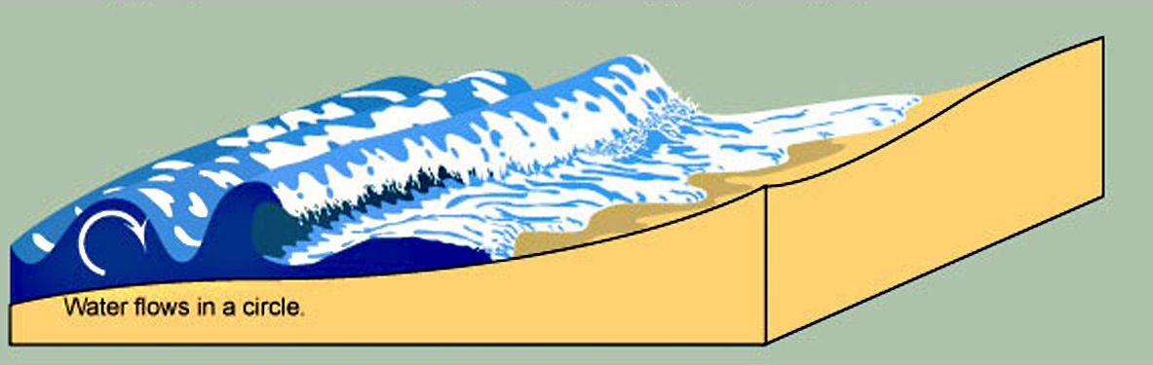
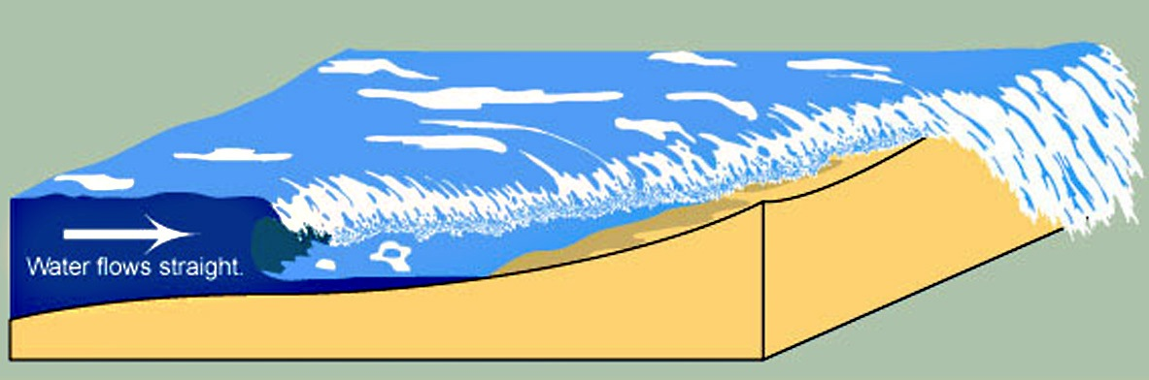
Tsunami Produced by Earthquake
wind wave
Curling, breaking waves, water flows in for less than a minute.
tsunami
Very long surges, water flows in for tens of minutes; large surges continue for days; wavelength to 100s of kilometers.
Notes:
40
A tsunami is a series of waves or surges most often caused by an earthquake beneath the sea floor.
Tsunamis are very long waves - there may be 100s of miles between successive peaks or troughs. The water may continue to flow onto land for 10 minutes or more.
When the flow ebbs, the water flowing back may be as strong as the inflow.

Slide 41
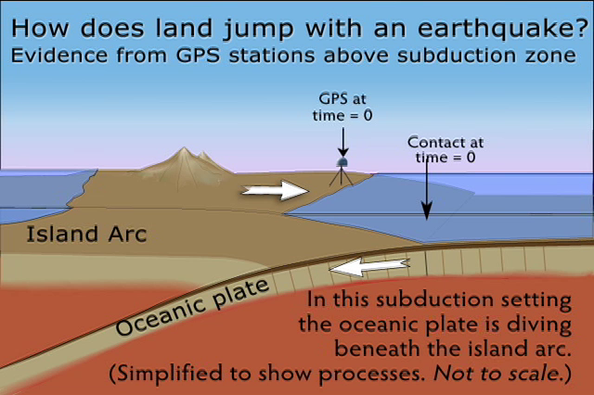
Tsunami Produced by Subduction Zone Earthquake

Slide 42
Cascadia Earthquake Hazard
Map
120°W
45°N
40°N

Slide 43
Lessons from Tohoku, Japan
Earthquake engineering works.
Few buildings collapsed during the Tohoku earthquake.
Cascadia CAN construct earthquake-resilient built environment.
Earthquake and tsunami hazards education improves public safety.
Tohoku tsunami inundation zone had 95% survival rate while
Banda Aceh inundation zone had 10% survival rate.
Tohoku evacuation too slow & relied too much on vertical evacuation.
People could have gotten to high ground if they had evacuated as soon as ground shaking stopped.

Slide 44
Cascadia Great Earthquakes and Tsunamis After Field Trip

