Slide 1
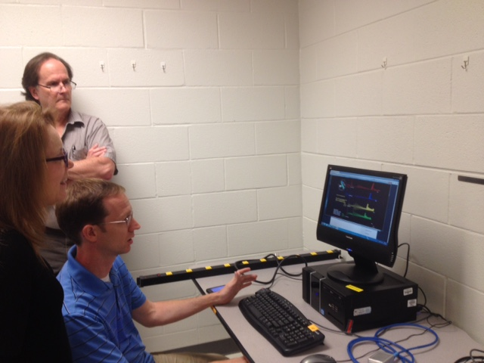
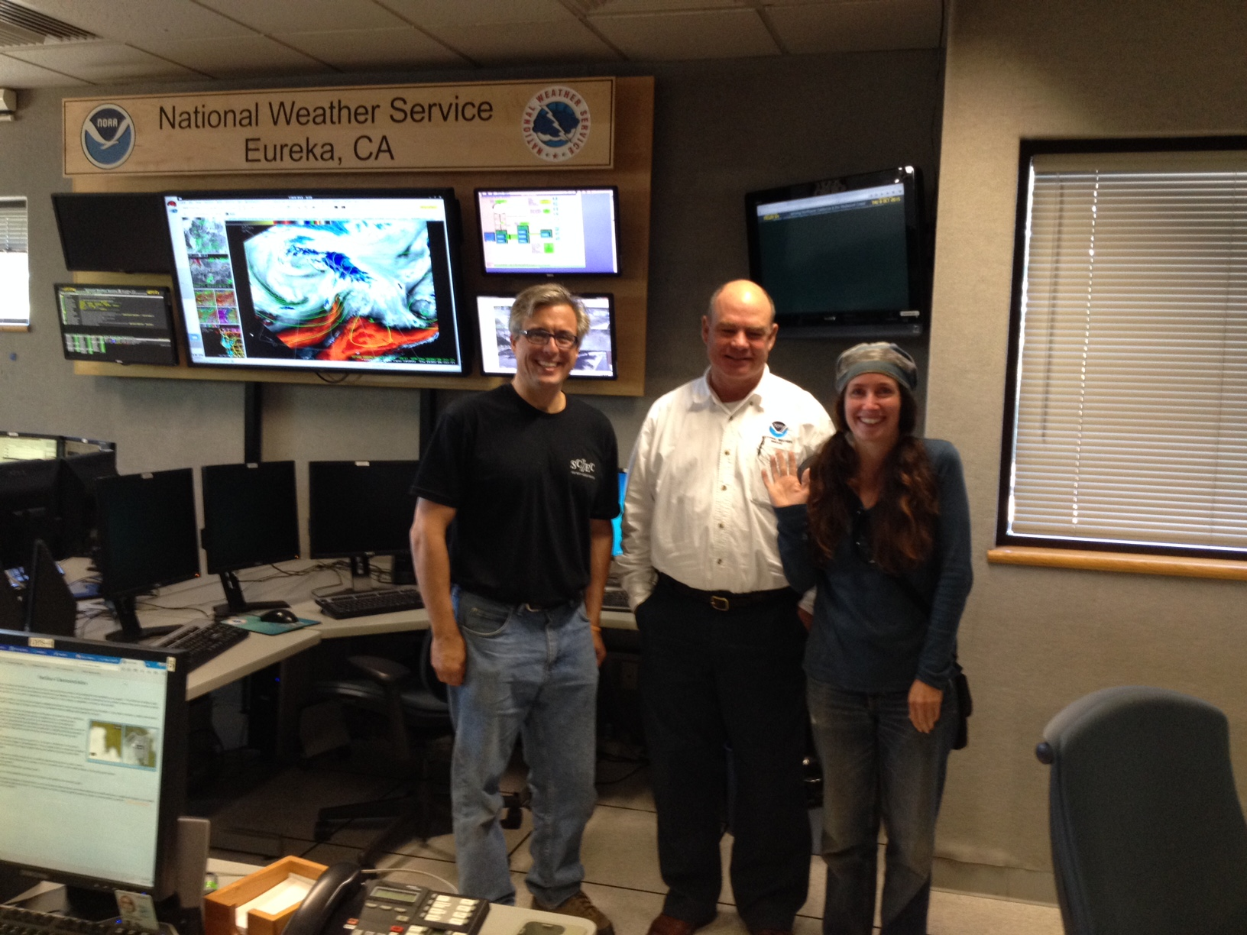
Catching Quakes on the North Coast! Robert de Groot Director for Education, Experiential Learning & Career Advancement Southern California Earthquake Center (SCEC) Cascadia EarthScope Earthquake and Tsunami Education Program 9 – 12 Oct 2015 – Arcata, CA degroot@usc.edu

Slide 2
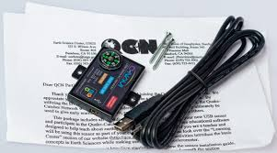
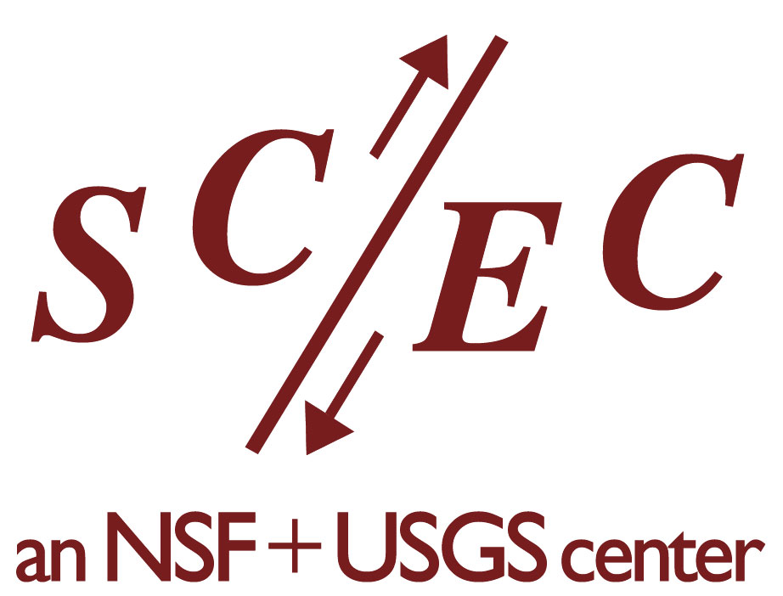
Quake Catcher Network (QCN)
A Citizen Science program where participants have an opportunity do authentic science through collecting data from real earthquakes.
The data collected by your QCN station aids in the better understanding of earthquakes.
Provides an educational opportunity that aligns with the Next Generation Science Standards for K-12 schools.
Is used extensively in museums, libraries, and park visitor centers to provide informal learning opportunities for a broad audience.
As a participant you can get earthquake seismograms from an earthquake in your local area or from over 5000 QCN stations around the world!
QCN has been successfully coupled with other opportunities such as The Great ShakeOut.

Slide 3
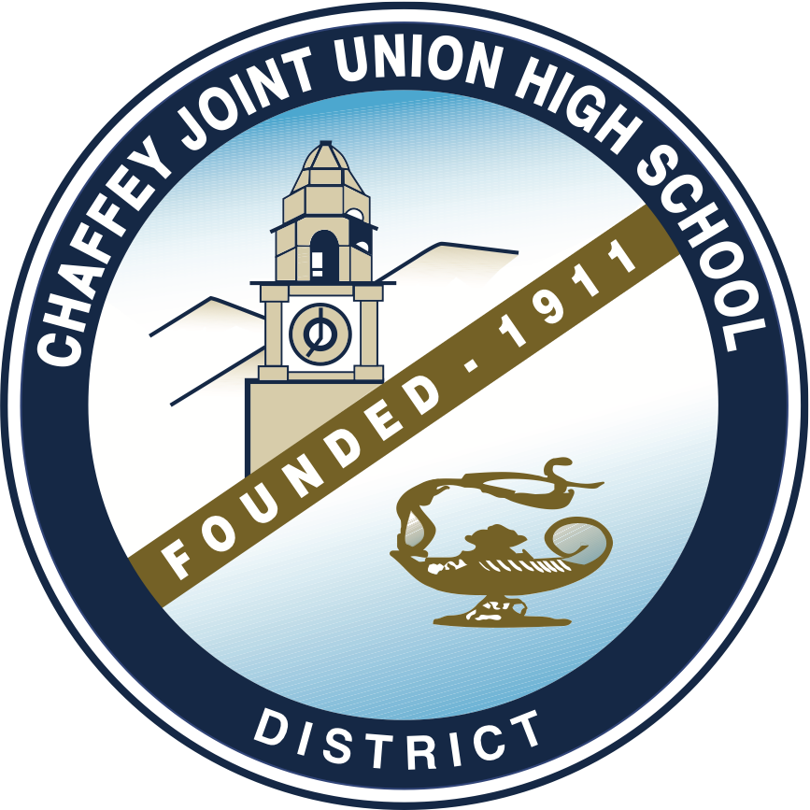
The QCN-EPIcenter Team is Growing!
Local Growth and Program Development:
QCN Expansion in the Coachella Valley led by
Sunnylands Center and Gardens (Rancho Mirage)
Expansion into K-12 schools
Current Coachella Valley participants in QCN:
- The Living Desert
- Rancho Mirage Public Library
- Sunnylands
- Palm Springs Aerial Tramway
- Santa Rosa & San Jacinto NM
Visitor Center
- Whitewater Visitor Center (pending)
Partnership with the Chaffey Joint Union High School District
- District wide programming and connections with feeder districts: Ontario Montclair School District & Mt. View School District

Slide 4
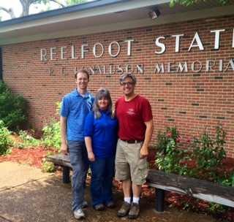
The QCN-EPIcenter Team is Growing!
Join over 150 schools and free choice learning institutions in OR, WA, AK,CA, AR, TN, MS, MO, and even as far east as Maine!
Summer 2015: 14 New QCN Stations in MO, TN, MS, & AR!
Saint Louis Science Center - Saint Louis, MO (QCN Hub for Central US)
Blytheville Elemenatary and Middle Schools – Blytheville, AR
Bootheel Youth Museum – Malden, MO
DeSoto Central Primary School – Southhaven, MS
Central US Earthquake Consortium – Memphis, TN
Tunica County Museum – Tunica, MS
Reelfoot Lake State Park – Tiptonville, TN
Lara Kendall Elementary School – Ridgely, TN
Lewisburg Elementary School – Olive Branch, MS

Slide 5
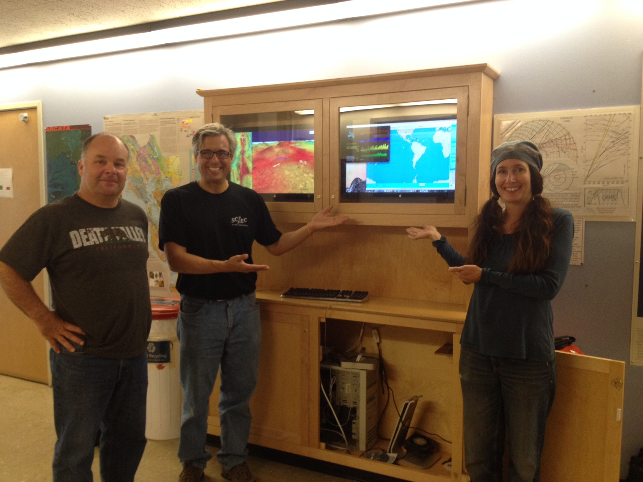
The QCN-EPIcenter Team is Growing!
Fall 2015: CEETEP Facilitated Expansion on North Coast
7 New Stations Since Wednesday & More on the Way!
Humboldt County Office of Emergency Services – Eureka, CA
Humboldt State University Geology Department Station – Arcata, CA
Pacific Watershed Associates – Arcata, CA
National Weather Service WFO Eureka Station – Eureka, CA
McKinleyville High School – McKinleyville, CA
Del Norte County High School – Crescent City, CA
Sunny Brae Middle School – Arcata, CA

Slide 6
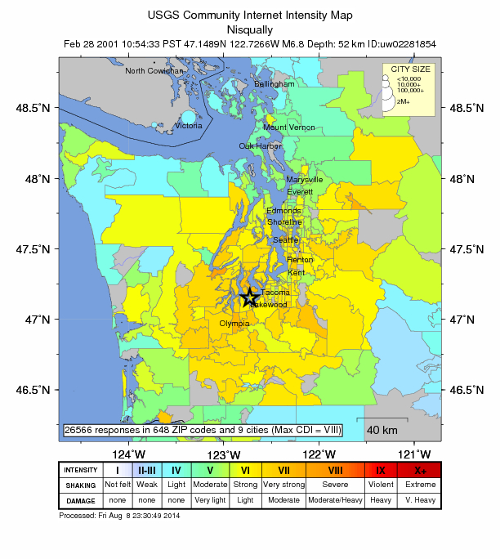
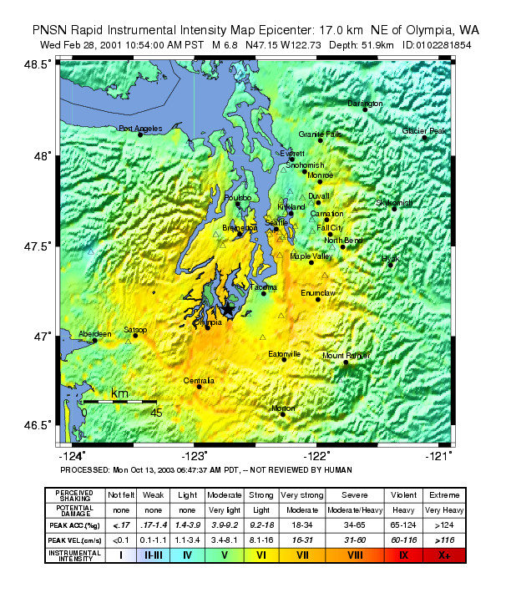
ShakeMap - Instrumental
Did You Feel lt? - Community

Slide 7
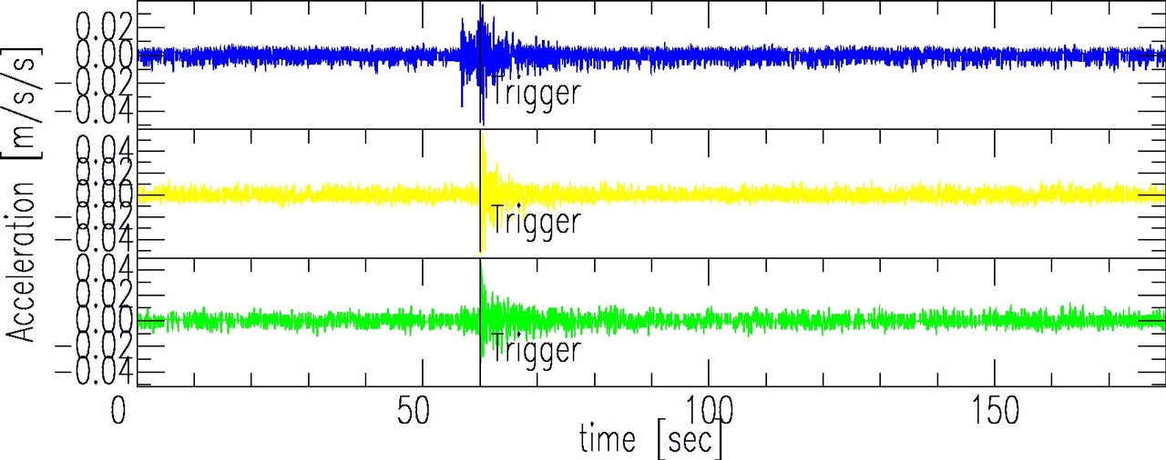
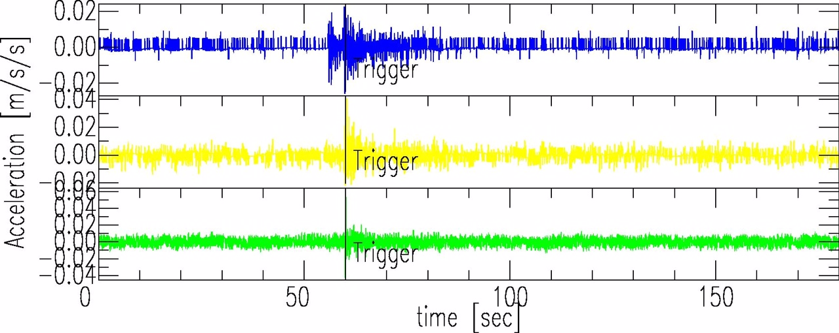
M 5.1 La Habra Earthquake 3/28/14
Recorded at Montclair High School
Recorded at Colony High School

Slide 8
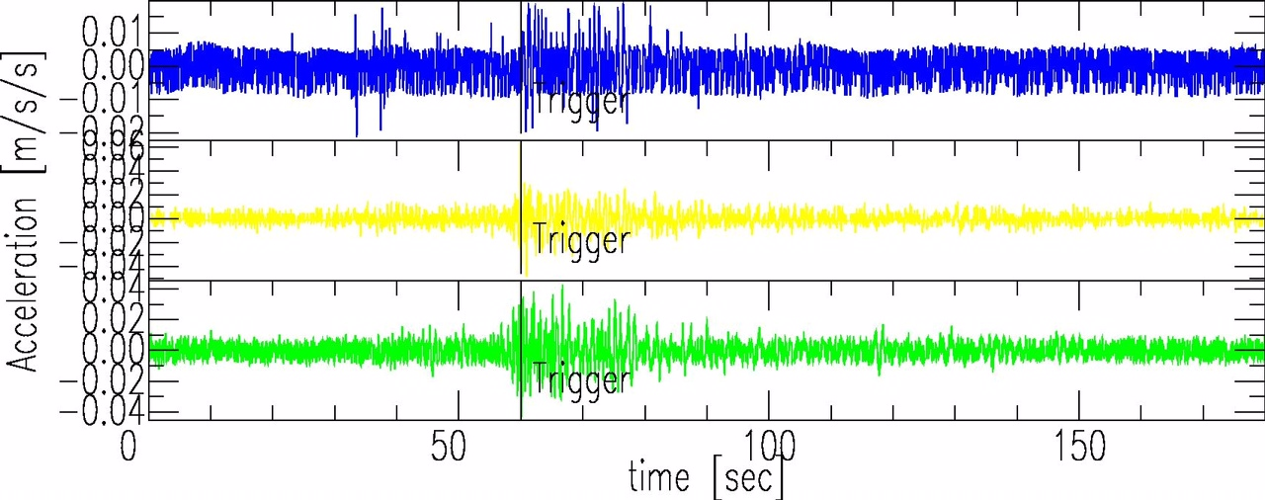
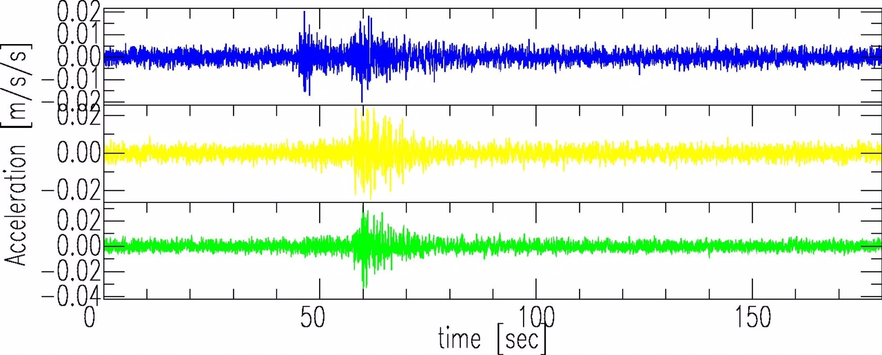
M 5.1 La Habra Earthquake 3/28/14
Recorded at Salton Sea SRA – Visitor Center
Recorded at Morongo Reservation School

Slide 10
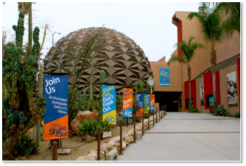
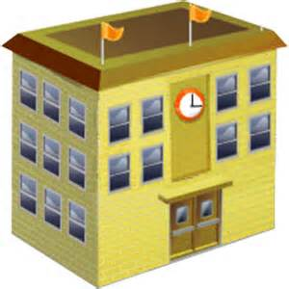
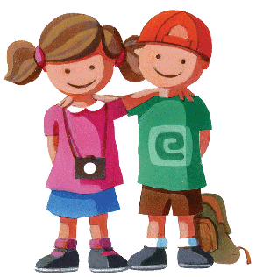
As people become take part
in seismic monitoring,
they feel more safe and educated about SFIP operations

Slide 11
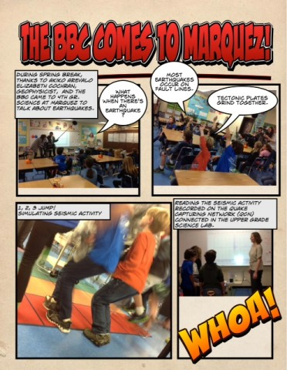
In April 2013,
the BBC came to
Marquez Charter School (Pacific Palisades)
to see QCN in action!

