Slide 1
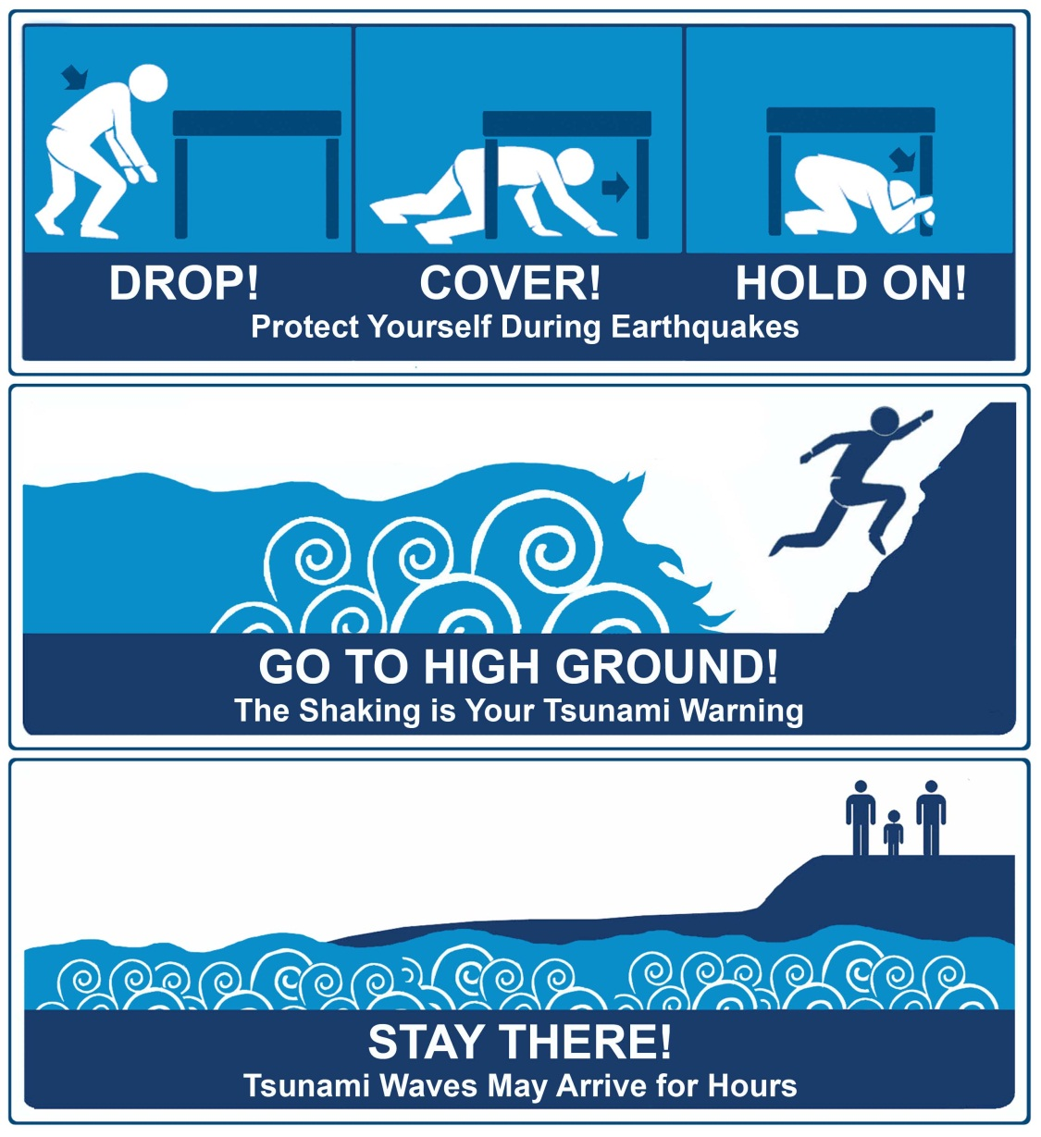
First of all:
CEETEP - 2015

Slide 2
Tsunami: Are you ready?

Slide 3
NW California
Tornados
Hurricanes
Extreme winter weather
Lightning
Extreme Heat

Slide 4
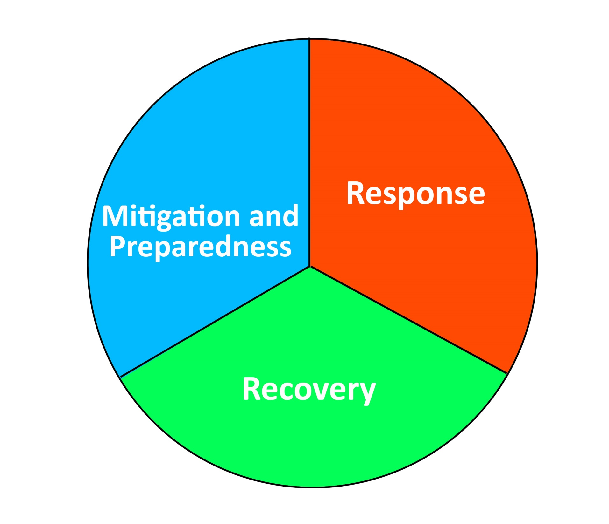
Troy and Lori
Dorie

Slide 5
RCTWG
Fire/Police/ NWS
Emergency Services Manager/Coordinator
FEMA

Slide 6
Tsunami: Are you ready?
CEETEP - 2015

Slide 7
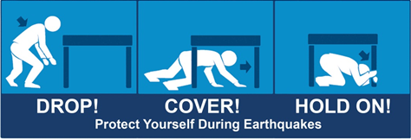
Survive the Earthquake:
Lori covered to this point
CEETEP - 2015

Slide 8
Survive the Earthquake:
Lori covered to this point
I’m going to cover from here on
CEETEP - 2015

Slide 9
Not just earthquakes:
Receding ocean
Loud roar

Slide 10
Survive the Earthquake. Then what?
How do I know if I’m in the tsunami zone?
How do I know if the earthquake is big enough to cause a tsunami?
How long until the tsunami gets here?
When do I start to evacuate?
What if I’m outside?
What if the earthquake is in Alaska?
CEETEP - 2015

Slide 11
How do I know if I’m in the zone?

Slide 12
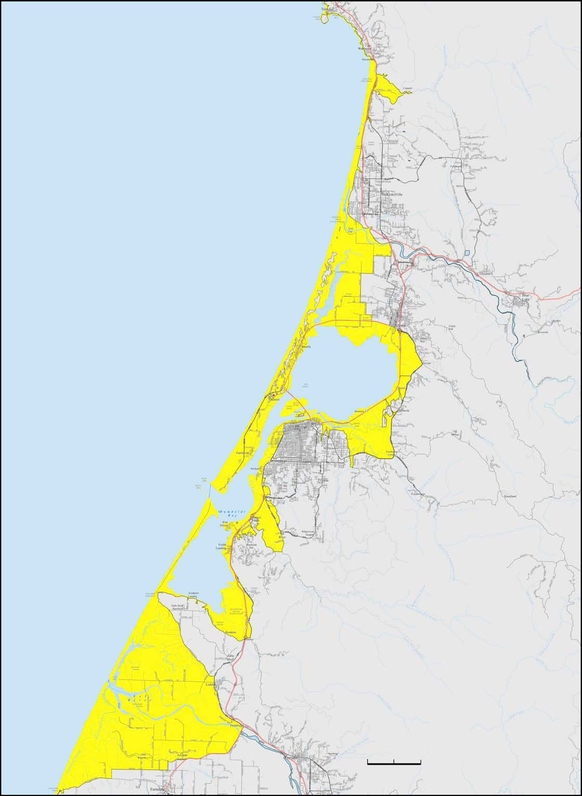
One line in the sand*
Gray = Safe

Slide 13
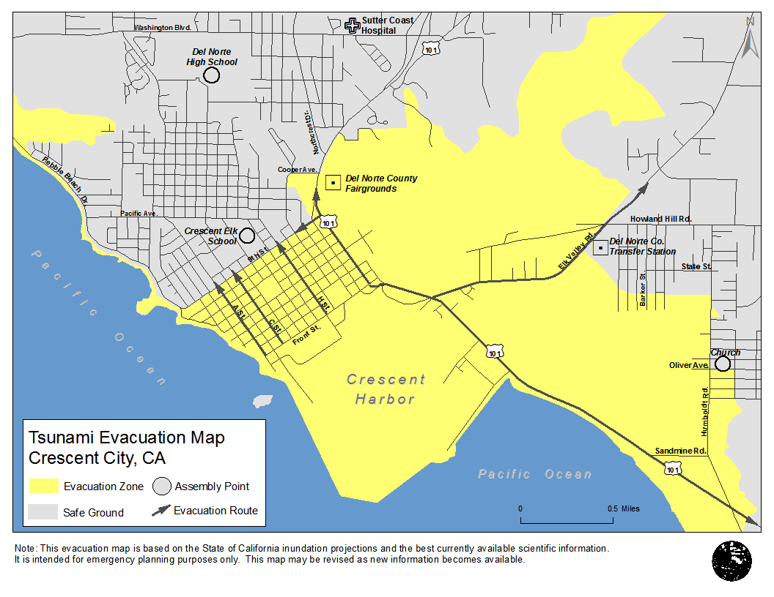

Slide 14
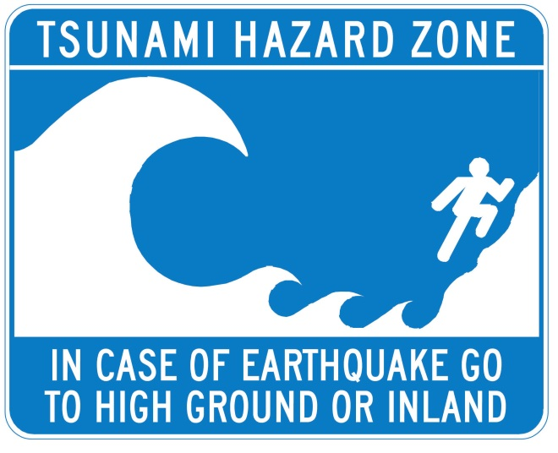
Know your Zone - Signs

Slide 15
How do I know if the earthquake is big enough to cause a tsunami?
The longer the earthquake,
the higher chance of a tsunami

Slide 16
How do I know if the earthquake is LONG enough to cause a tsunami?
1 sec

Slide 17
How do I know if the earthquake is LONG enough to cause a tsunami?
1 sec
5 minutes

Slide 18
How do I know if the earthquake is LONG enough to cause a tsunami?
When in doubt, drill it out
1 sec
5 minutes

Slide 19
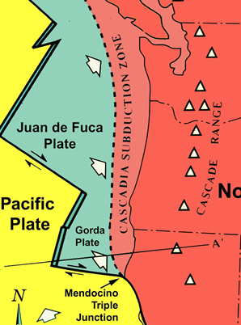
How long until the tsunami gets here, and when do I start to evacuate?
- 10 minutes* - As soon as it is safe to move*

Slide 20
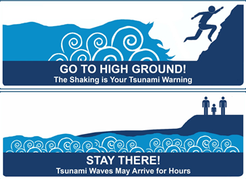
What if I’m outside?
If at the coast: For any earthquake

Slide 21
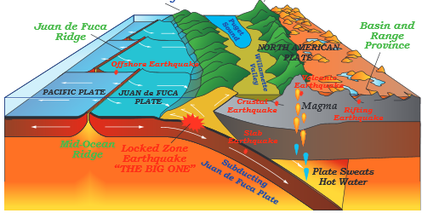
What if the earthquake is in Alaska?

Slide 22
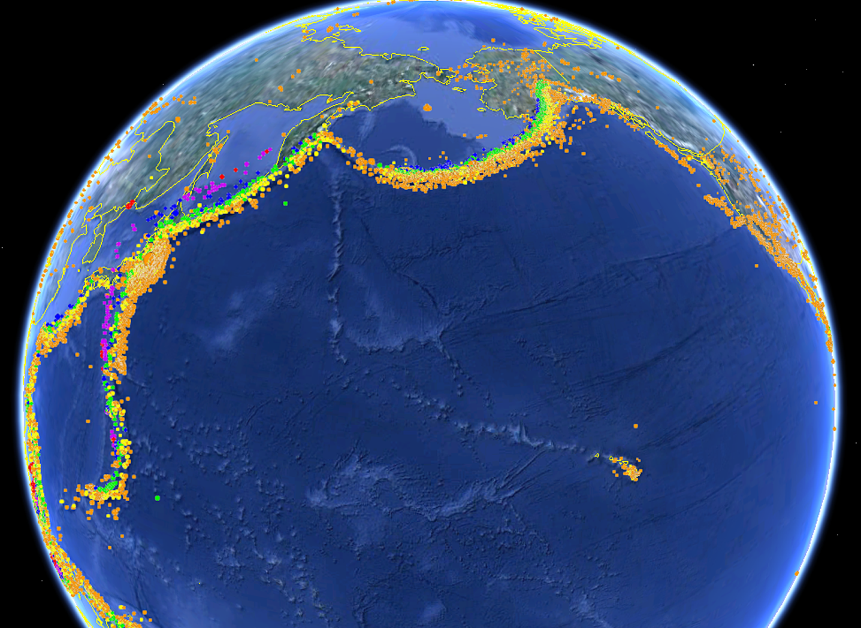
1964
1952
1946
2006
1700
2011
Humboldt
2004
1960
2010
2009

Slide 23
1964
1952
1946
2006
1700
Humboldt
2011
1960
2010
2009

Slide 24
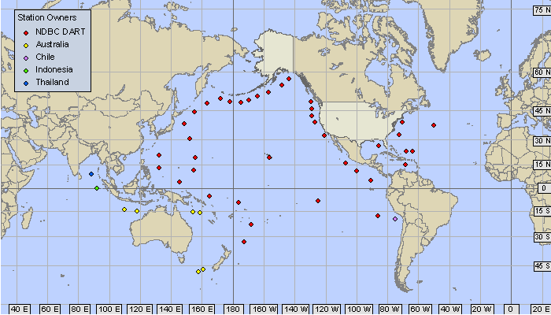
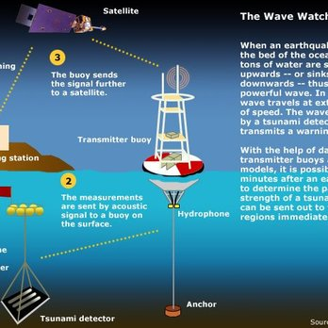
2011
CEETEP - 2015

Slide 25
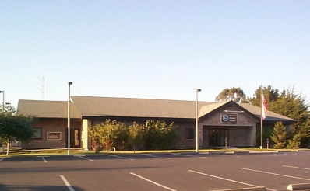
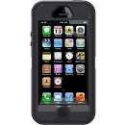
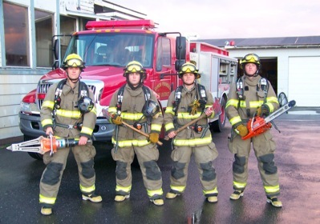
Tsunami Warning
NWS Eureka
WEA

Slide 26
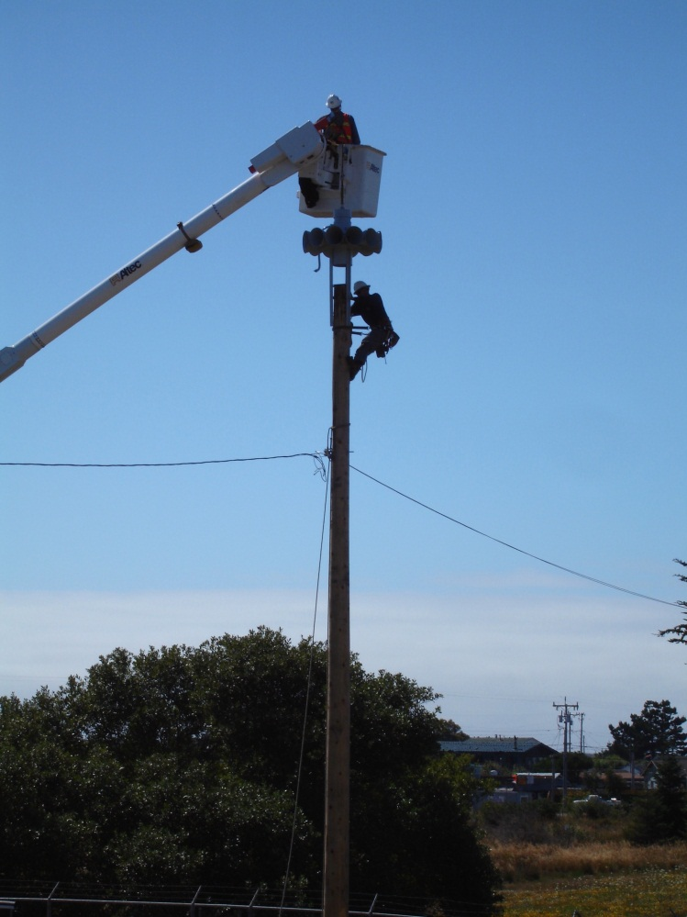
Tsunami Warning System
Sirens
Civil Air Patrol
Emergency Alert System
NOAA Weather Radio
Social media
Door-to-door
Wireless Emergency Alert (WEA)

Slide 27
Tsunami Warning Test
March 23rd between 11:00 a.m. and Noon

Slide 28
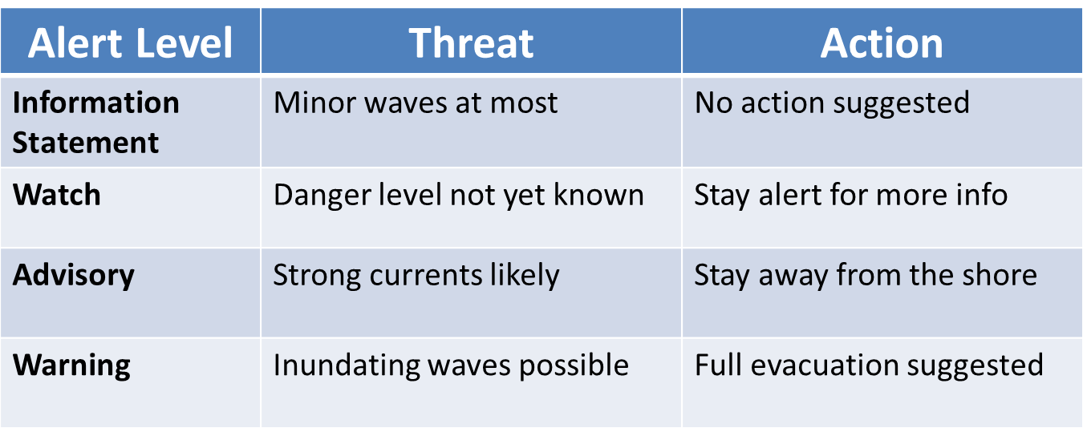

Slide 29
Ground shaking = Natural warning
NWS Eureka
WEA

Slide 30
CEETEP - 2015

Slide 31
Go to High Ground:
How do I know where high ground is?
Or: How do I know when I’m out of the zone?
Or: How high do I have to go?
What do I bring? What about my cats?
How do I find my shoes in the dark?
Who is going to help me?
CEETEP - 2015

Slide 32
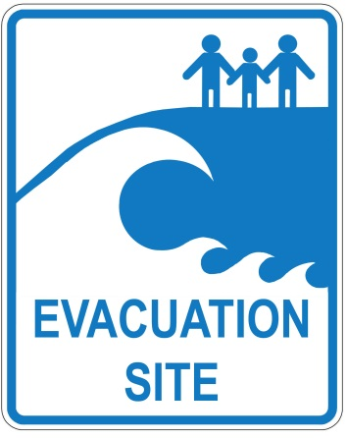
Live
Work
Play
Travel

Slide 33
How to use the maps…and can I trust them
Easy case
Impossible case
Hard case

Slide 34
Cross section of map

Slide 35
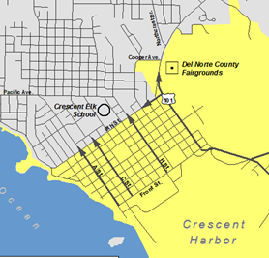
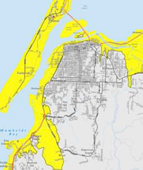
Easy case

Slide 36
Easy case

Slide 37
Easy case

Slide 38
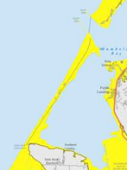
Impossible case

Slide 39
Hard case
I wonder if the map was right

Slide 40
Live
Work
Play
Travel

Slide 41
Go to High Ground:
How do I know where high ground is?
Or: How do I know when I’m out of the zone?
Or: How high do I have to go?
What do I bring? What about my cats?
How do I find my shoes in the dark?
Who is going to help me?
NWR handout
CEETEP - 2015

Slide 42
Go to High Ground:
What if I can’t get to high ground in 10 minutes on foot?
If it helps, drive
Find the political will to create high ground
NWR handout
CEETEP - 2015

Slide 43
Evacuation Preparation and practice
Know your Zone
Know your routes and evacuation site
Have a bag ready to go
Pre arrange help for those who need it
Plan for evacuating pets
Head lamp
Drill!

Slide 44
CEETEP - 2015

Slide 45
Stay there:
How long do I need to stay there?
Who is coming to get me?
Where is the bathroom?
CEETEP - 2015

Slide 46
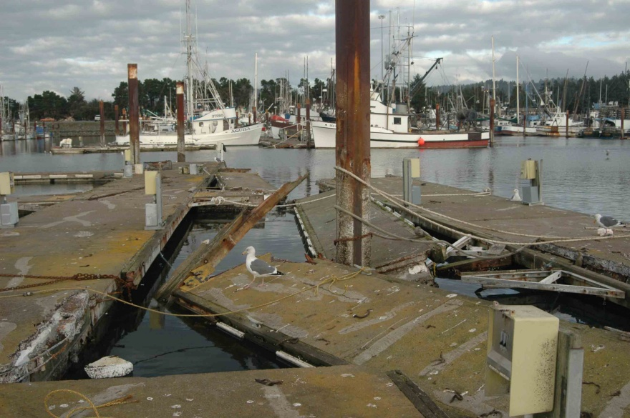
Going back too soon…
Crescent City
2006 Near miss
Crescent City, CA

Slide 47
Going back too soon…
Crescent City
1964 Half the deaths
2006 Near miss
2010 Chile
2011 Japan
Crescent City, CA

Slide 48
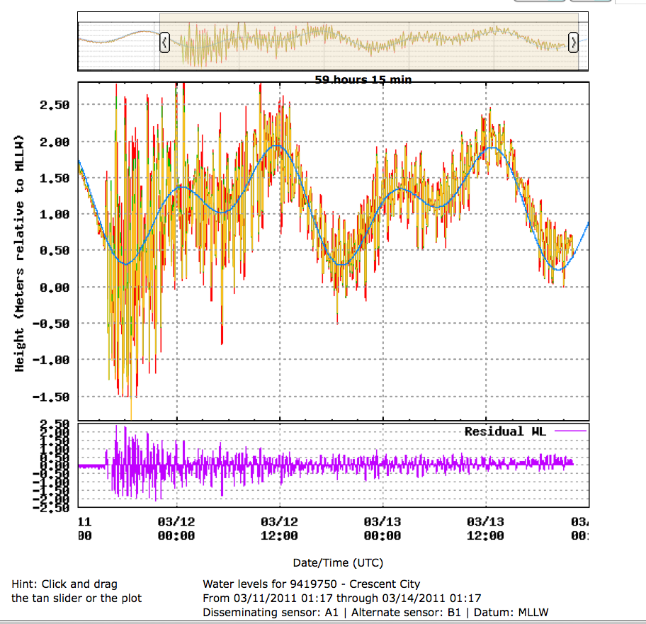

Slide 50
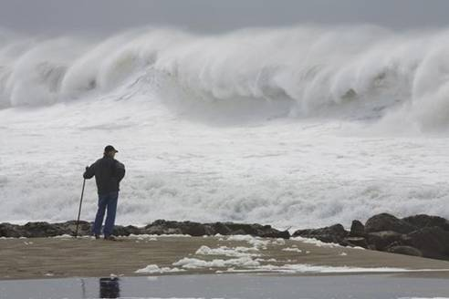

Slide 51
Sneaker wave wording
Very large waves can suddenly appear without warning, even after up to 20 minutes of smaller waves.
Example of tsunami wording:
Just when you think it is all over, another very large wave may come.

Slide 52
Not all educational opportunities are created equal:
The degree to which you have your audience’s attention
CEETEP - 2015
Notes:
52

Slide 53
A person on their way to the beach:
“Hi, I’m from Kansas and don’t know anything about tsunamis. I’ve got to catch up with my family but can you tell me what the deal is?”

Slide 54
3 second message:
CEETEP - 2015
Notes:
54

Slide 55
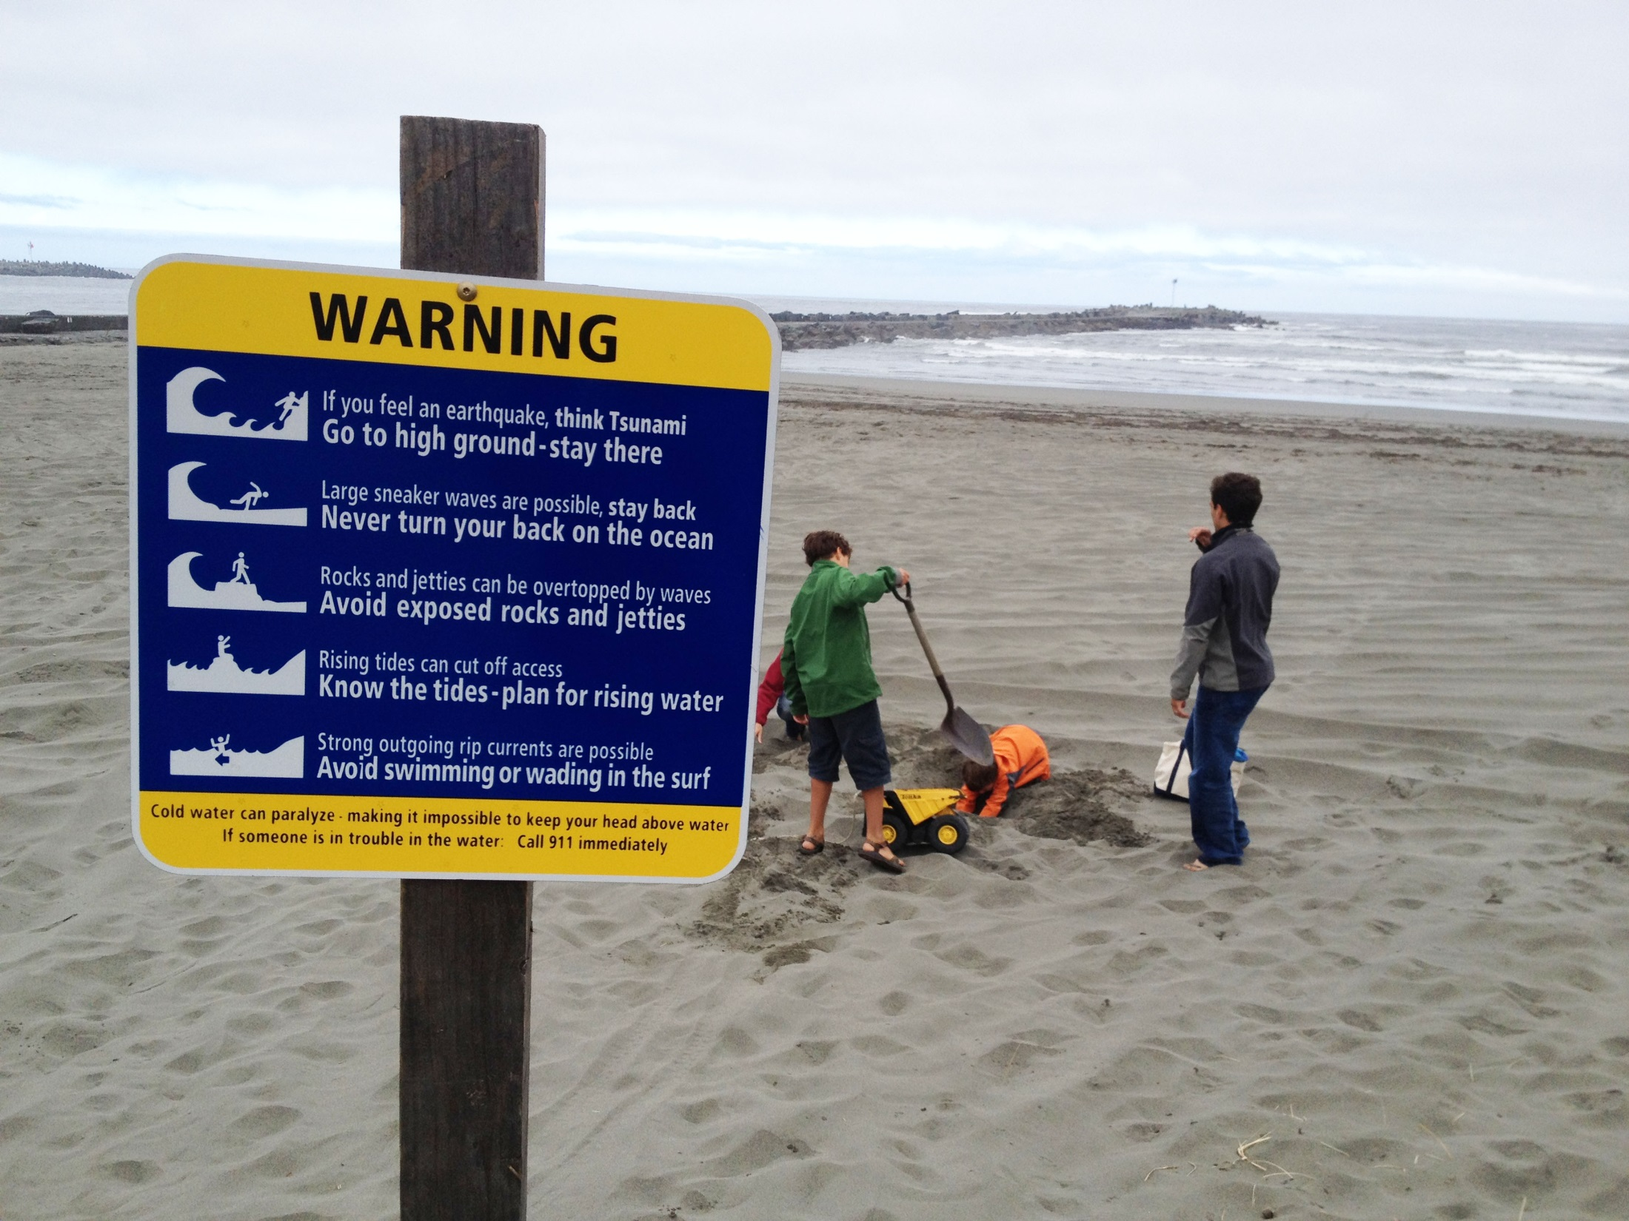

Slide 56
“We’re staying in a hotel near Crescent City Harbor and I saw a tsunami zone sign. What do I need to know to keep my family safe?”

Slide 57
20 second message:
CEETEP - 2015

Slide 58
20 second message:
interpreter
CEETEP - 2015

Slide 59
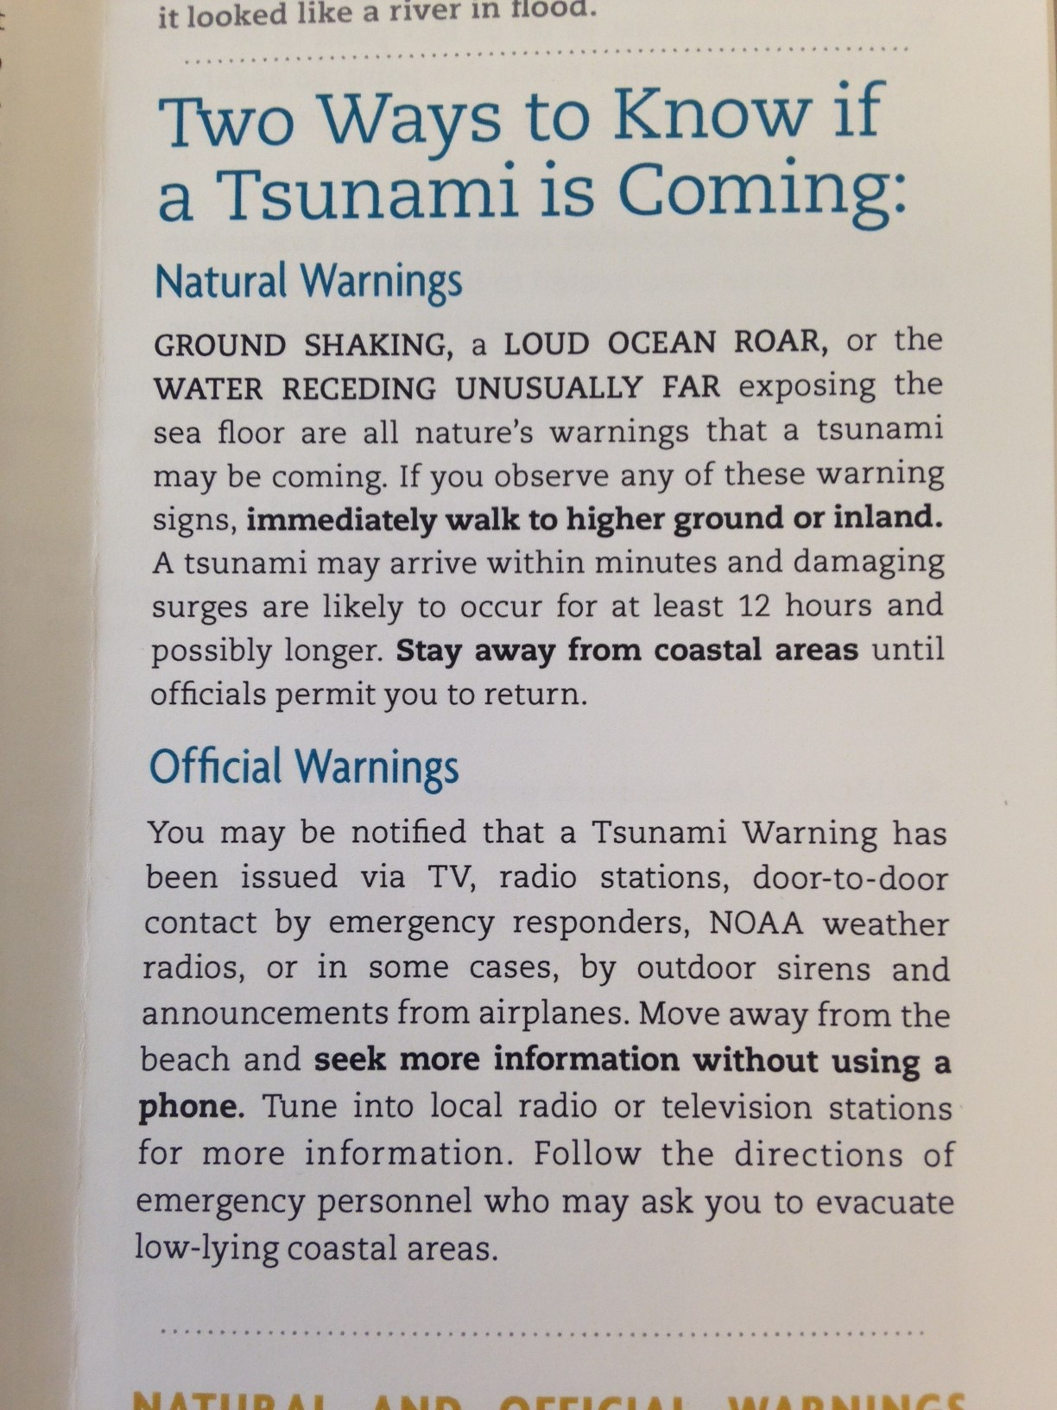
3 minute message

Slide 60
10 minute message:
Far away earthquake – official warning
Smaller tsunami (in some areas)
More time until arrival (1 – 15 hr)
No felt earthquake
Roads fine
Nearby earthquake
- natural warning
Bigger tsunami (in some areas)
Less time until arrival (10– 15 min.)
No official warning
Damaged evacuation infrastructure
CEETEP - 2015

Slide 61
“What causes tsunamis? I have all day…”
CEETEP - 2015

Slide 62
“What causes tsunamis? I have all day…”
CEETEP - 2015

Slide 63
Earthquake and tsunami
Felt Earthquake
Official tsunami notification
Watch/
warning
Info bulletin
Advisory
No Tsunami Threat
with Tsunami Threat

Slide 64
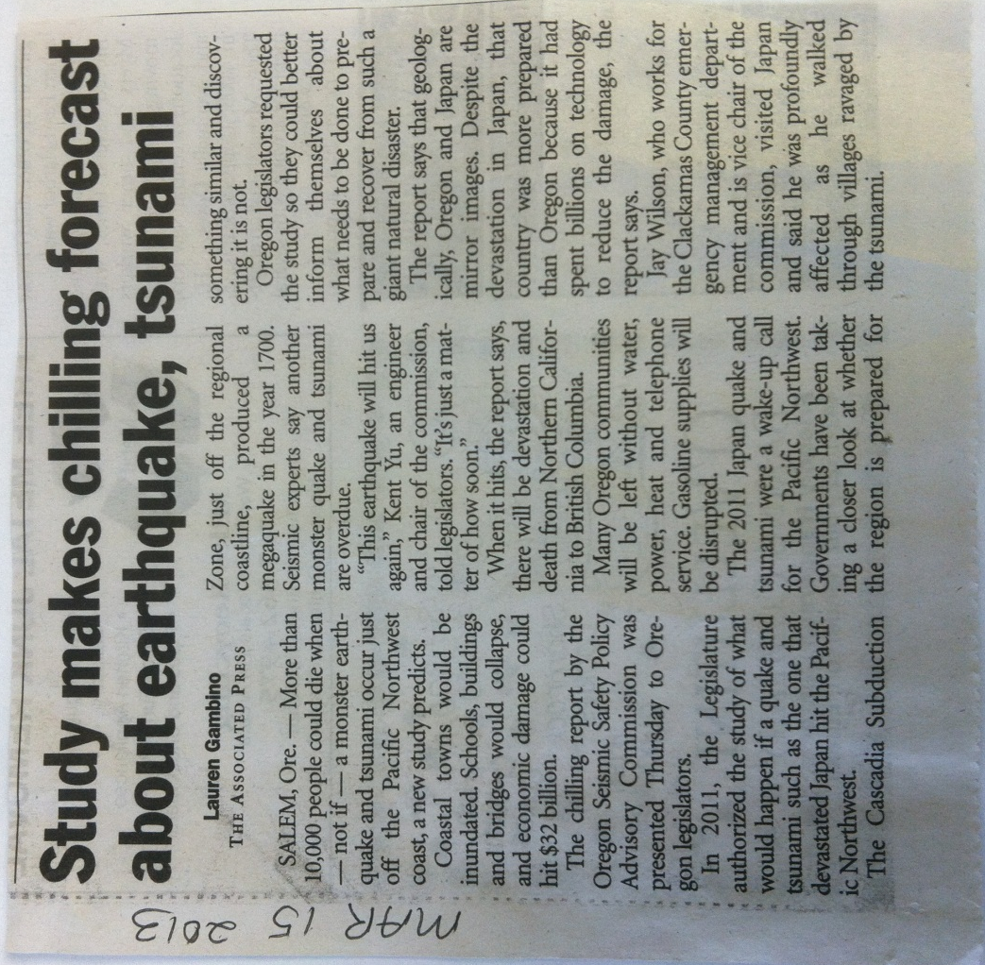
Fear
10,000 will die!
“Everything West of I-5 will be toast”

Slide 65
Fear Doesn’t work for:
Teachers
Interpreters
Emergency management educators
Notes:
65

Slide 66
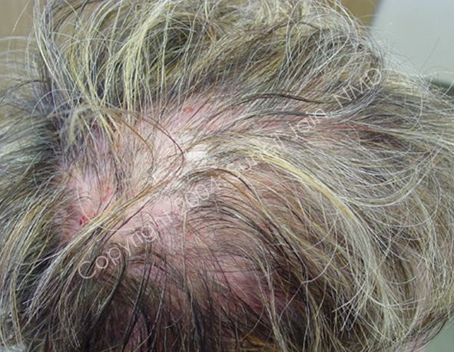
Notes:
66

Slide 67
Notes:
67

Slide 68
“real evacuation felt like a drill”
Notes:
68

Slide 69
Learning activity:
develop a 30 second Public Service Announcement (PSA) for Radio
Goal of your PSA: reduce loss of life from tsunamis
Tip: Start with something like: “This is Cindy Henderson with Del Norte County OES reminding you…
CEETEP - 2015
Notes:
69

Slide 70
Learning activity:
Emergency Manager
develop a 30 second Public Service Announcement (PSA) for Radio
Goal of your PSA: reduce loss of life from tsunamis
Tip: Start with something like: “This is Cindy Henderson with Del Norte County OES reminding you…
CEETEP - 2015
Notes:
70

Slide 71
CEETEP - 2015

