Slide 1
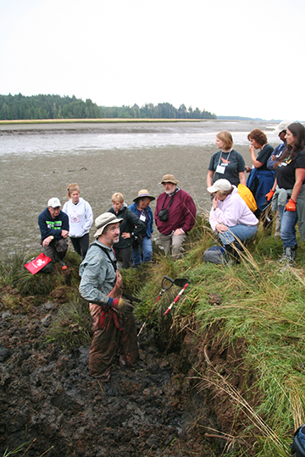
Elk River Estuary, Washington
Cascadia EarthScope Earthquake and Tsunami Education Program (CEETEP)
Exchange of Pedagogies
&
Action Team Planning
Working Together in Coastal Communities to Engage Students, Visitors and Residents on Earthquake and Tsunami Science and Preparedness
Nancee Hunter
Oregon State University
nancee.hunter@oregonstate.edu
Robert J. Lillie

Slide 2
Cascadia Earthquake and Tsunami EarthScope Education Program (CETEEP)
Meanings (Geoscience, Hazards, Preparedness)
Students
The Public
Emergency
Management
Educators
K-12
Educators
Park
Interpreters
Parks & Museums
K-12
Teachers
Formal Learning
Free-Choice Learning
Colleges & Universities
Training
Scientists
Science (EarthScope, Cascadia)

Slide 3
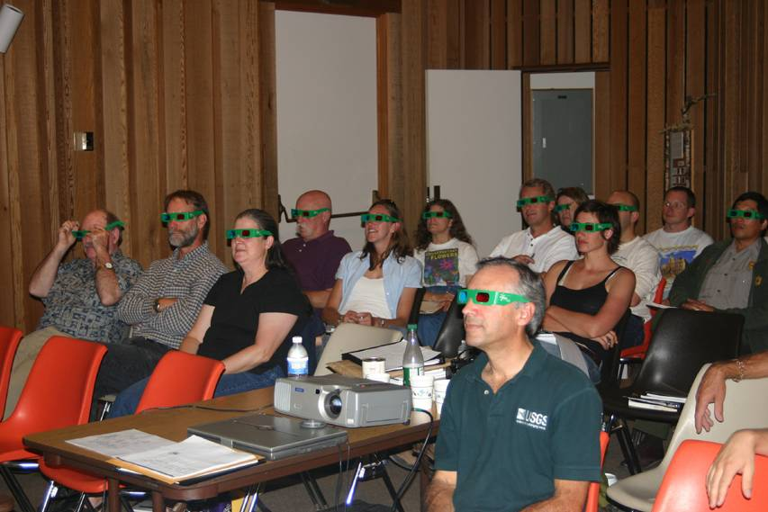
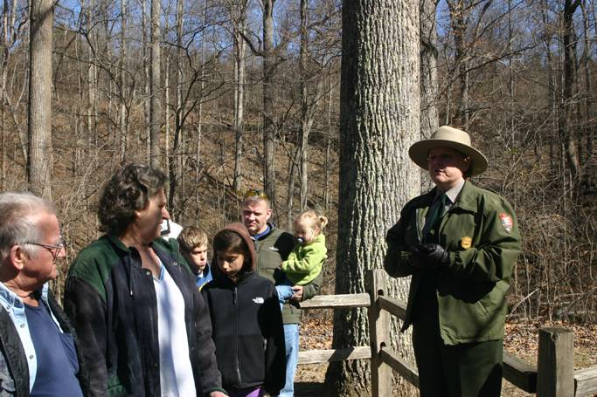
What are the differences between informal and formal learning?
Robert J. Lillie
Robert J. Lillie

Slide 4
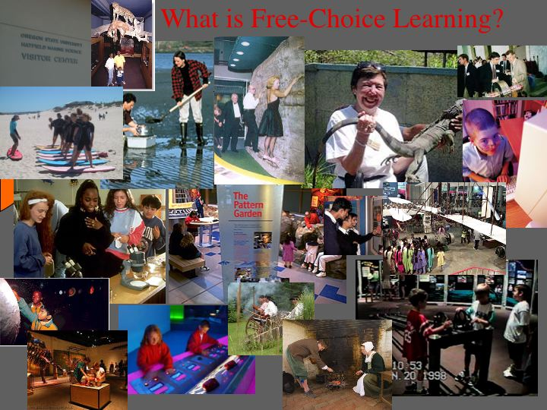

Slide 5
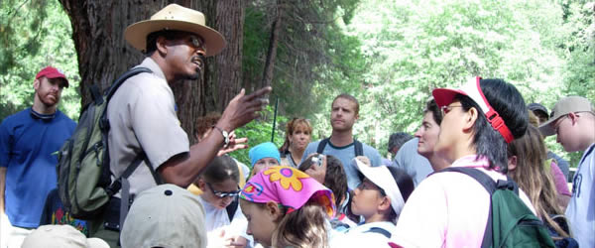
Interpretation
“Interpretation involves translating the technical language of a natural science or related field into terms and ideas that people who aren’t scientists can readily understand.”
“Interpretation ….. creates opportunities for visitors to form their own intellectual and emotional connections to the meanings inherent in a park resource.”
Source: “Environmental Interpretation: A Practical Guide for People with Big Ideas and Small Budgets” (Sam Ham, 1992)
Source: National Park Service (NPS)
Ranger Shelton Johnson, Yosemite National Park, California

Slide 6
Which statement would people most likely remember? Why?
1. A tsunami is a seismically generated wave with an amplitude of less than one meter in the open ocean, growing to 10 meters or more in shallow water.
2. More than a quarter million people were killed when a broad sea wave, caused by an undersea earthquake, raced across the Indian Ocean and swelled to great heights as it approached coastal communities.

Slide 7
Intellectual Connections
A tsunami is a seismically generated wave with an amplitude of less than one meter in the open ocean, growing to 10 meters or more in shallow water.
More than a quarter million people were killed when a broad sea wave, caused by an undersea earthquake, raced across the Indian Ocean and swelled to great heights as it approached coastal communities.

Slide 8
Intellectual Connections; Emotional Connections
A tsunami is a seismically generated wave with an amplitude of less than one meter in the open ocean, growing to 10 meters or more in shallow water.
More than a quarter million people were killed when a broad sea wave, caused by an undersea earthquake, raced across the Indian Ocean and swelled to great heights as it approached coastal communities.

Slide 9


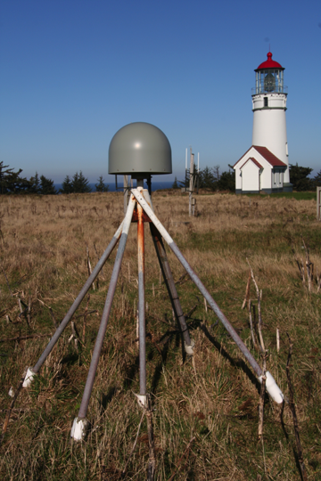
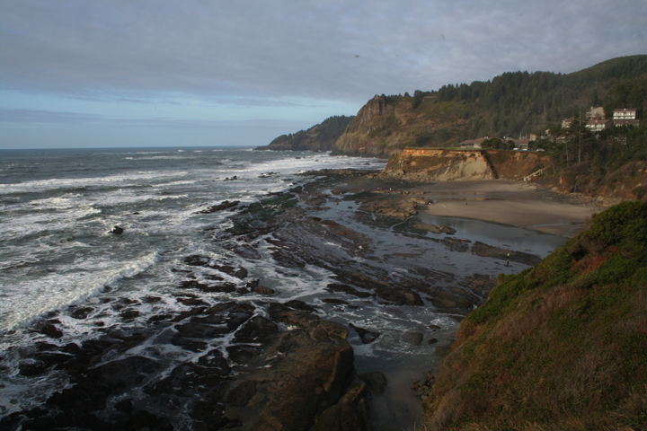
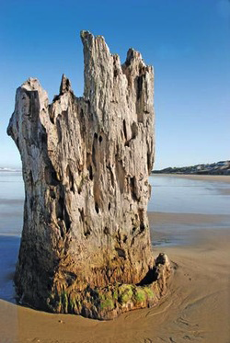
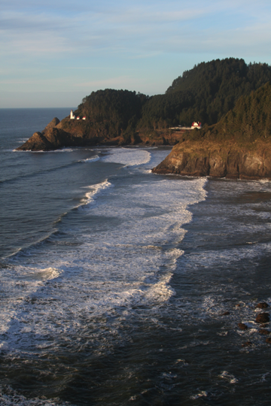
Telling a Story:
Beauty and the Beast
“The same geological processes that sculpt our breathtaking headlands and beaches also threaten our lives with earthquakes and tsunamis.”
http://www.oregoncoasttoday.com/bigstumpbeach.html

Slide 10
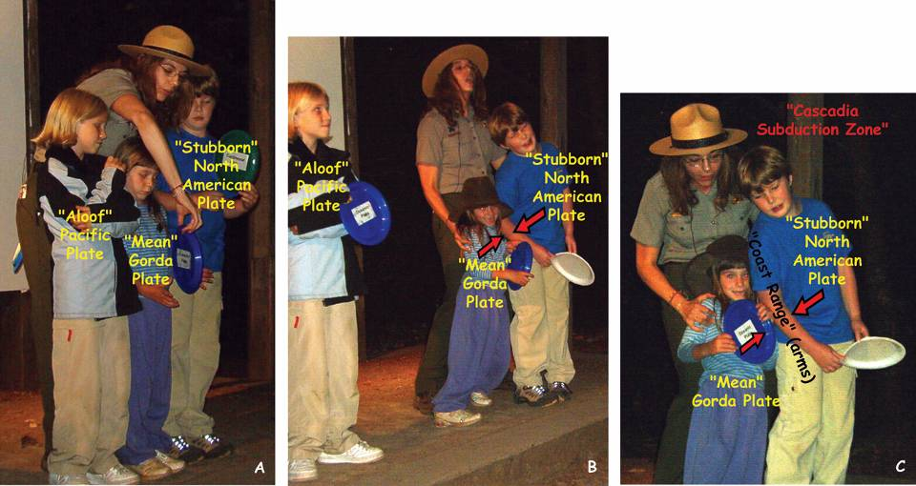
Fun with Plate Tectonics
Jen Natolli, OSU Geosciences Graduate Student
Park Ranger, Redwood National and State Parks, California

Slide 11
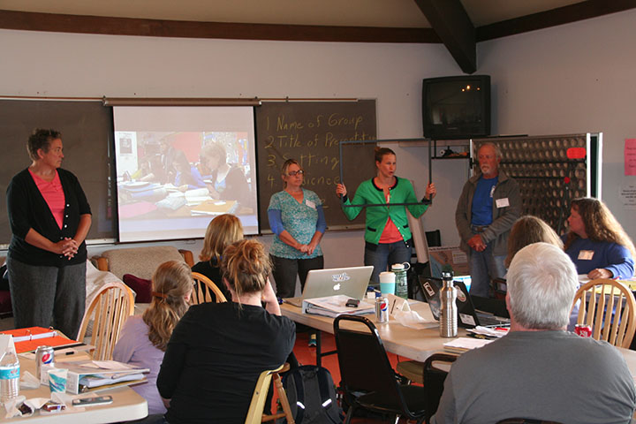
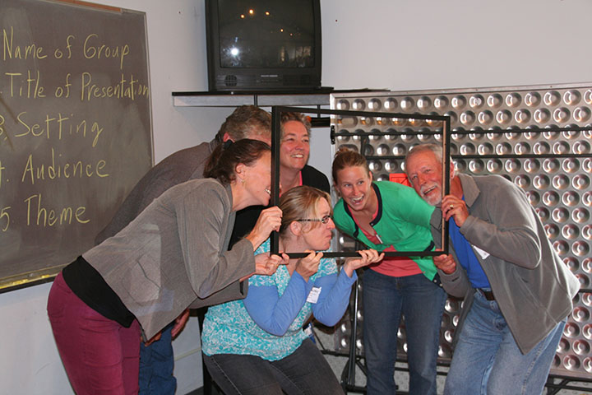
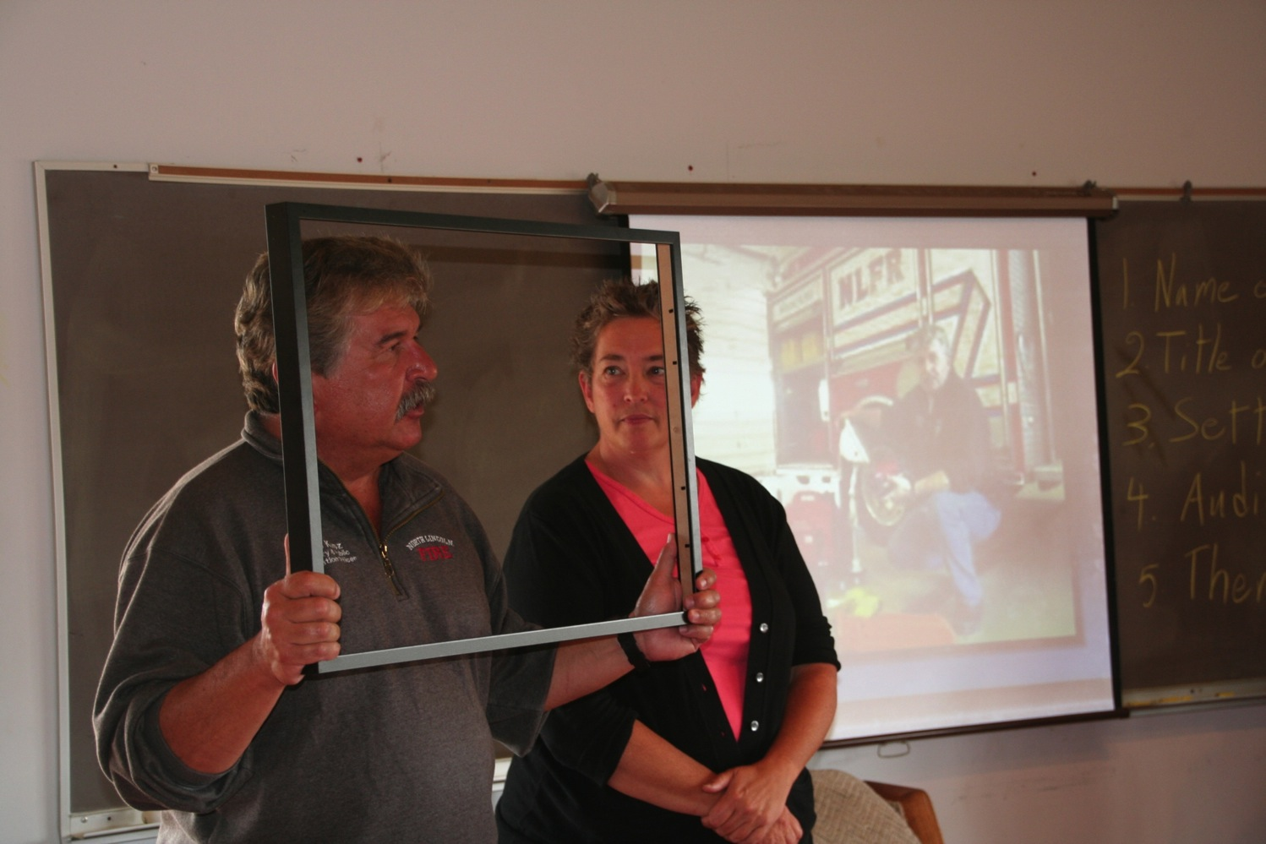
CEETEP Newport Workshop
Action Team 1: Elephant in the Room
Title: “What will be YOUR Story?”
Setting: TV Studio in an Oregon coastal community
Audience: Students or visitors
Theme: “The stories from anyone, anywhere, anytime, any age will survive.”
Robert J. Lillie

Slide 12
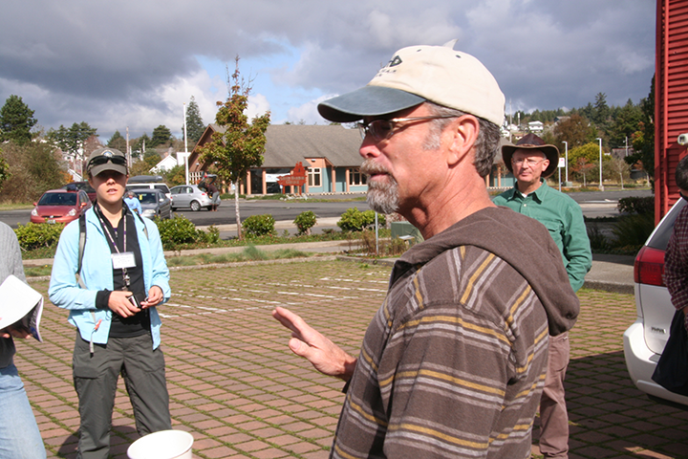
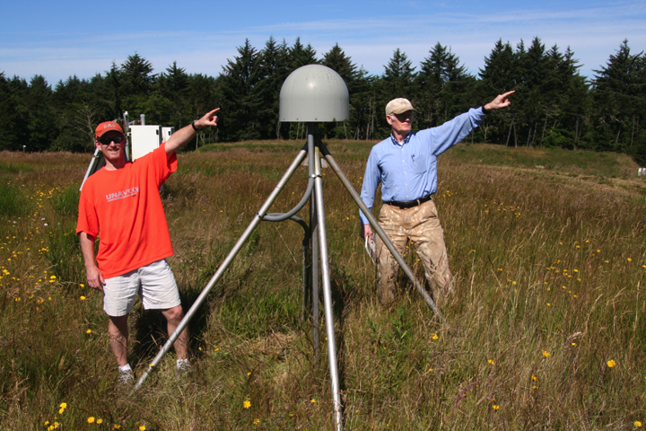
Challenge:
As a community of educators, how can we engage our students and public with EarthScope and other earthquake/tsunami science, as well as local preparedness programs in parks, museums, and classrooms along the Cascadia coast?
Robert J. Lillie
Ilwaco, Washington
Robert J. Lillie
Newport, Oregon GPS Station

Slide 13
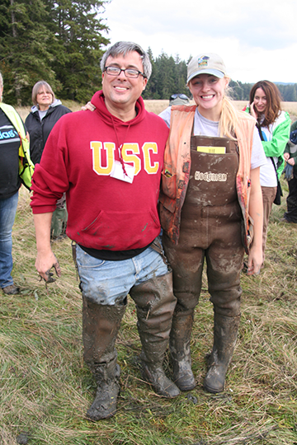
Goal for each Action Team
Work within your local community to implement emergency preparedness plans and teach/interpret subduction zone processes and accompanying hazards in order to advance public understanding of, and preparedness for, earthquakes and tsunamis.
Robert J. Lillie
Niawiakum River, Washington

Slide 14
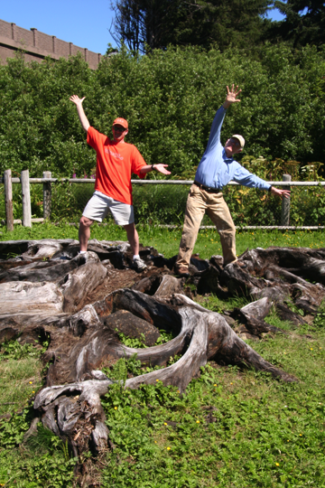
Action Teams:
2 Tasks
Beverly Beach State Park, Oregon
1. Develop and present Action Team Plan
- Develop this afternoon and tomorrow
- Present tomorrow afternoon (10 min + 5 minutes for questions)
2. Develop product(s) for your community that serve your audiences in your settings
- Develop Now - February
- Present at March 5, 2016 Share-a-Thon
Robert J. Lillie

Slide 15
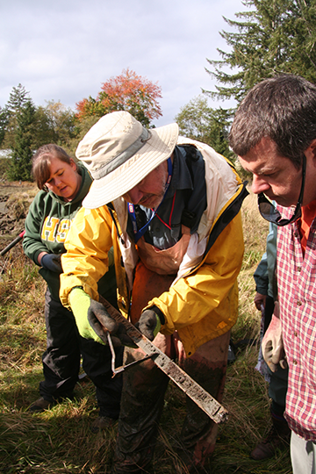
Educational Products
(Now thru February
—and beyond)
Can include direct interaction among team members.
General Examples:
1. Class visits by a informal educator and/or emergency manager
2. Collaboration on a community presentation or activity/event
3. Students or teacher present a children’s program at a park or museum
4. CEETEP-related after-school or family program (e.g., camp, club, day in field, etc.)
Robert J. Lillie

Slide 16
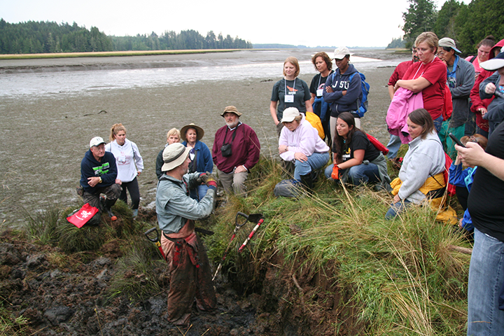
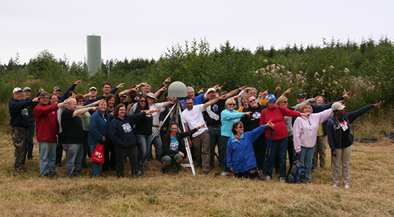
Educational Products
(Now - February)
Elk River Estuary, Washington
Specific example of collaborative project:
Program for Senior Citizen Center
Teacher involve his/her students in educational visit (shared knowledge)
EM Educator presents a emergency preparedness plan
Interpreter brings artifacts or works with students on skit involving earthquake/tsunami science and preparedness
Skit/exhibit presented at Senior Citizen Center, followed by question/answer session
Robert J. Lillie
Aberdeen, Washington GPS Station
Robert J. Lillie

Slide 17
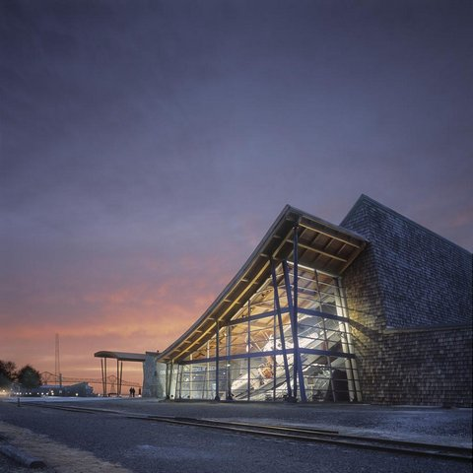
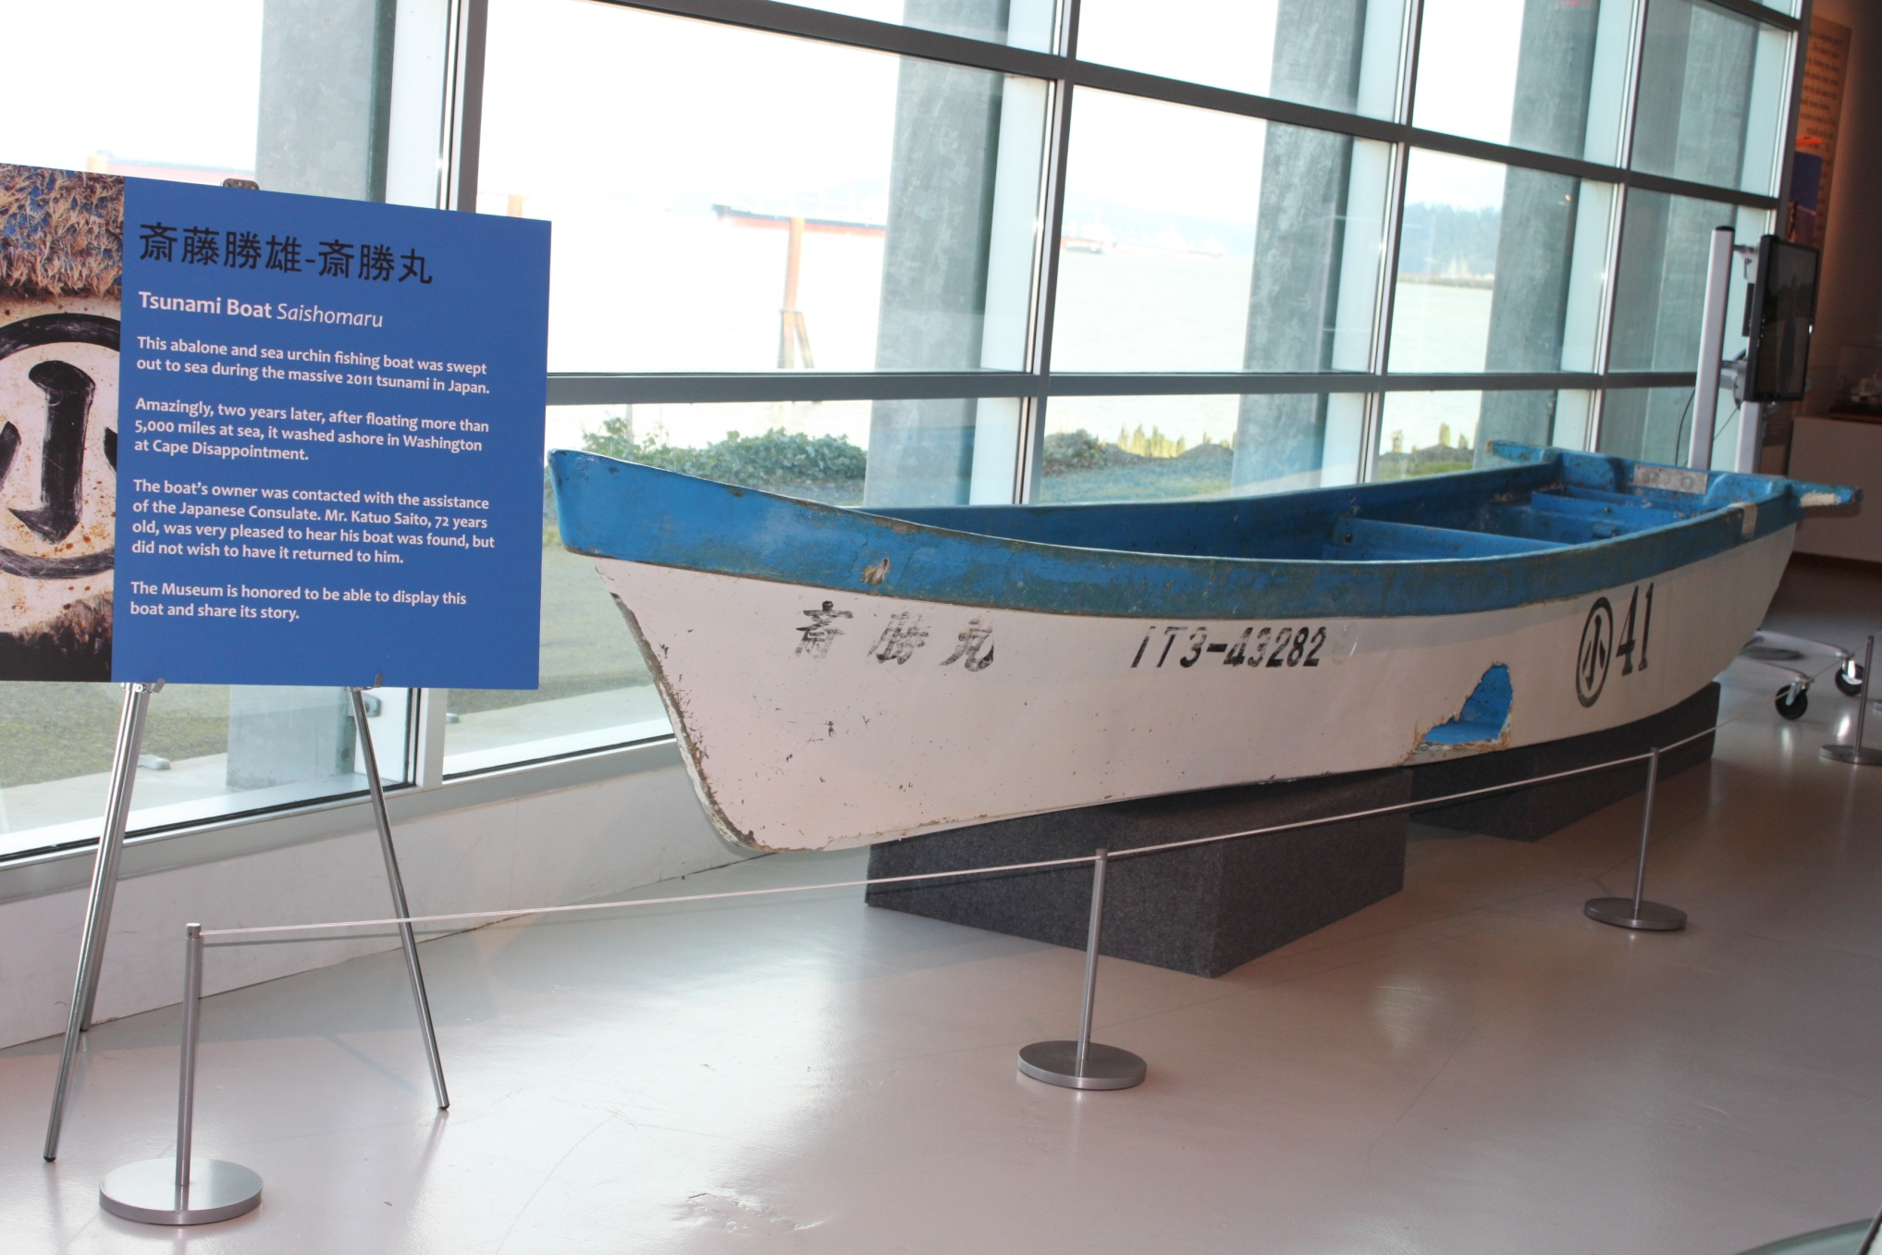
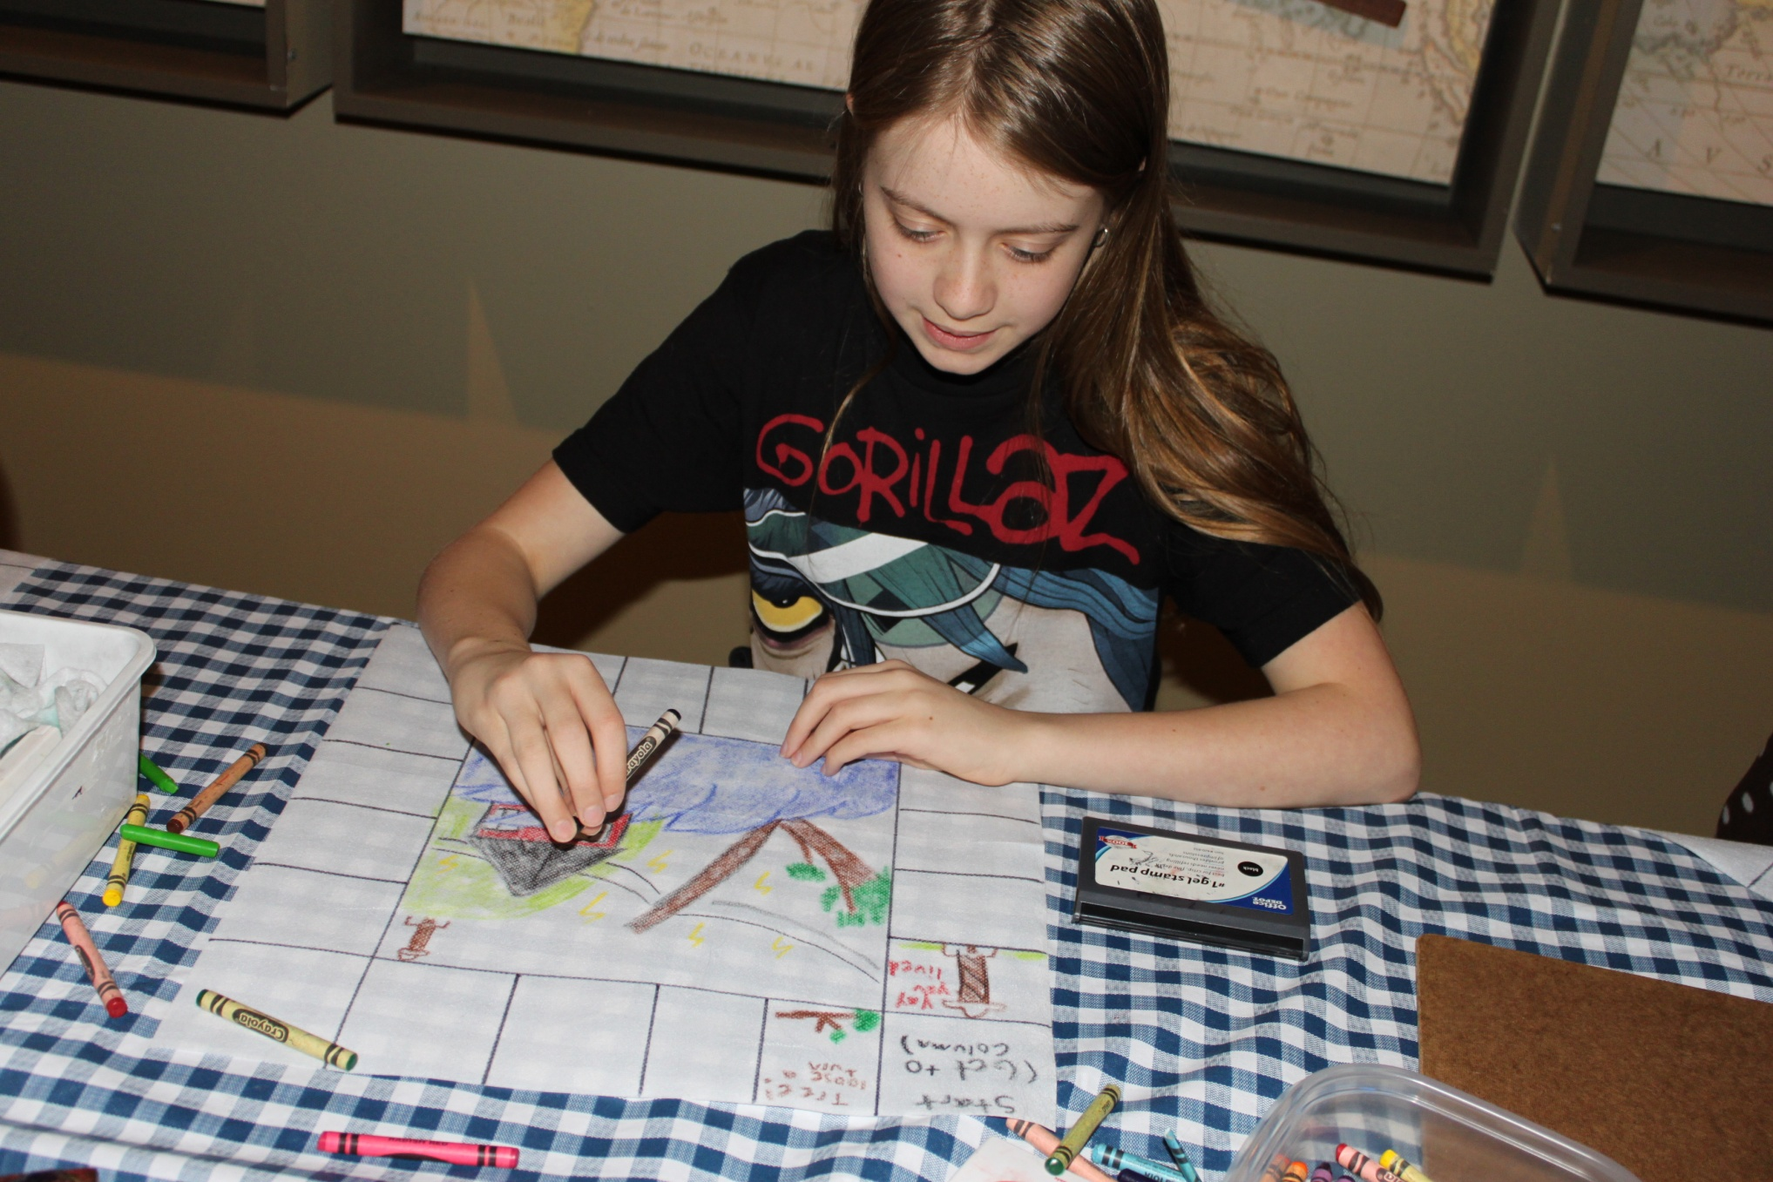
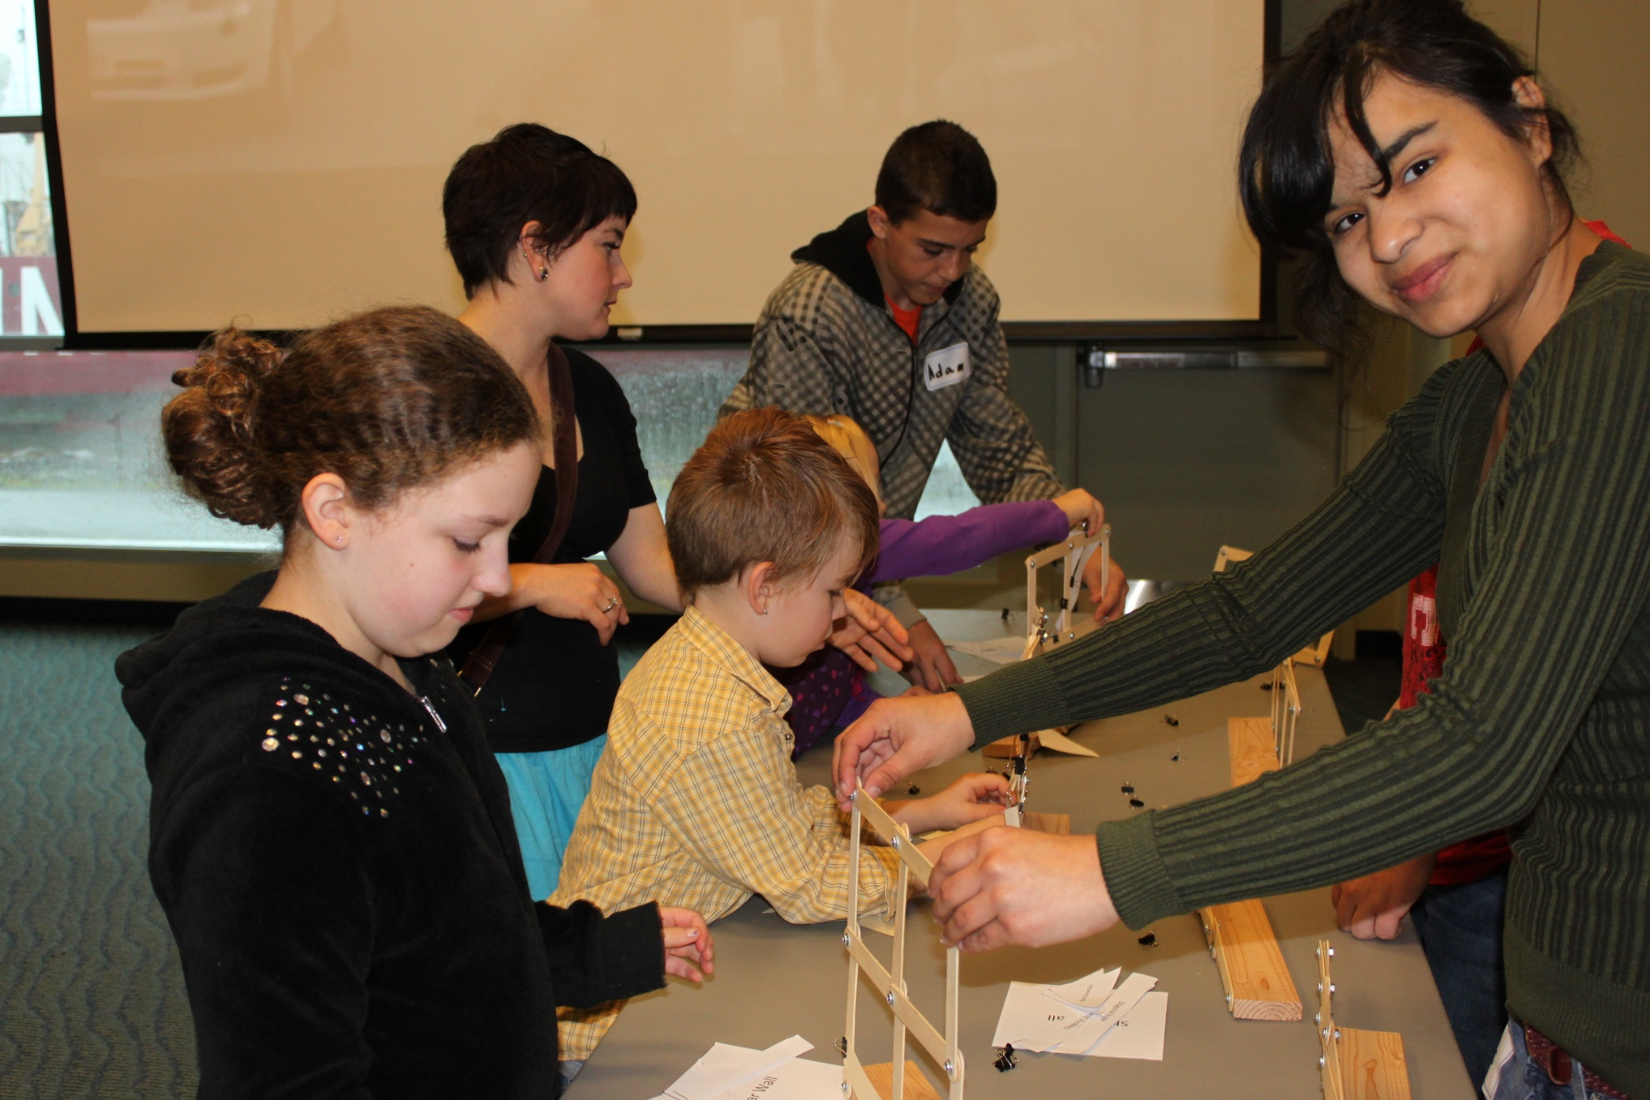
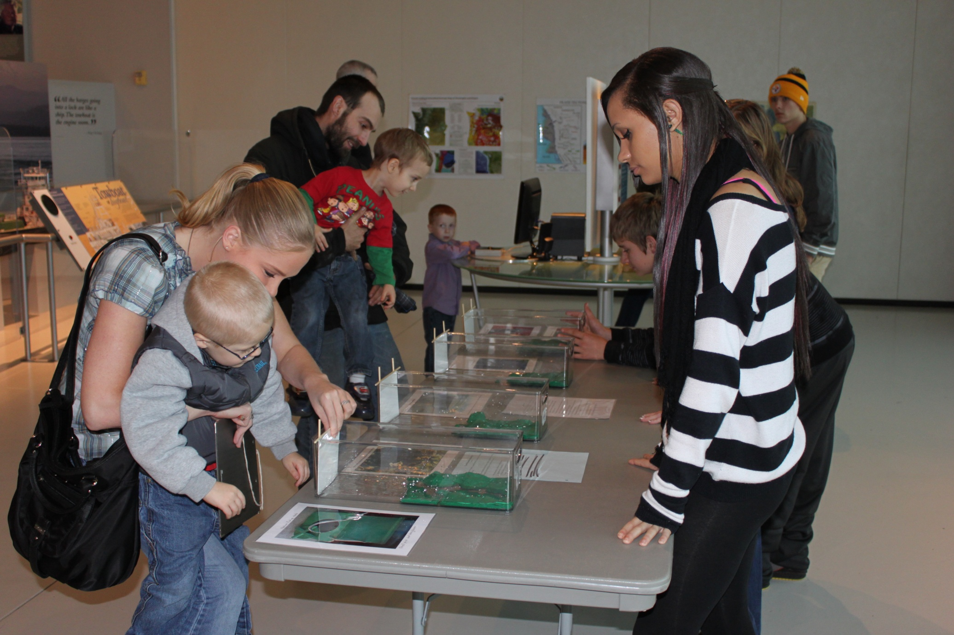
Columbia River Maritime Museum Community Day

Slide 18
Getting started planning
Brainstorm with team
Decide on theme
Decide on specific activities
  Whole group
  Individuals or sub-groups
Initial ideas for what will be presented at Share-a-thon
ESTABLISH Point Person & Next meeting time (virtual or in-person)

Slide 19
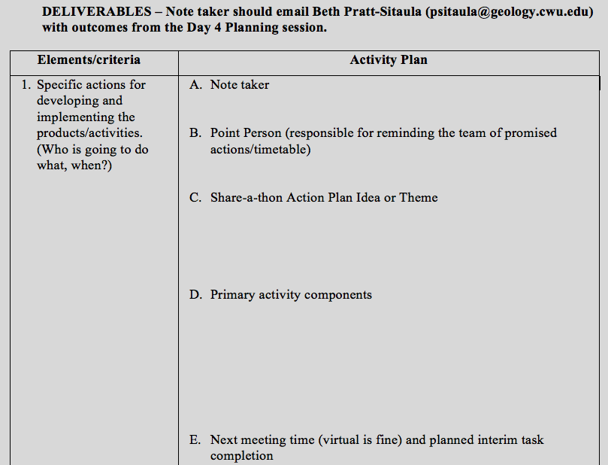

Slide 20
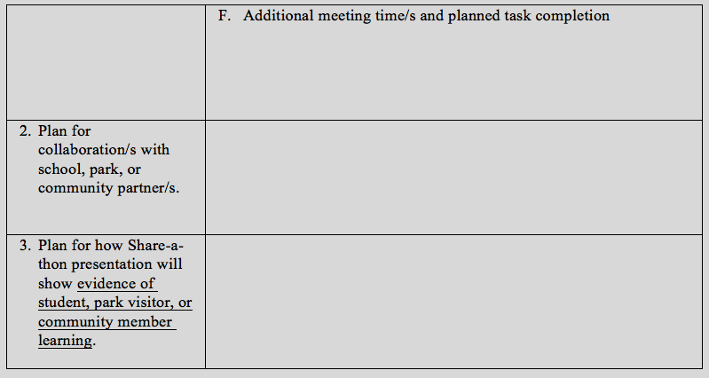

Slide 21
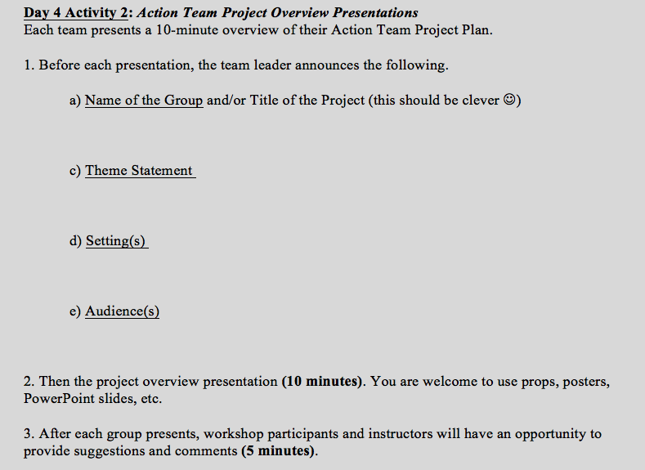

Slide 22
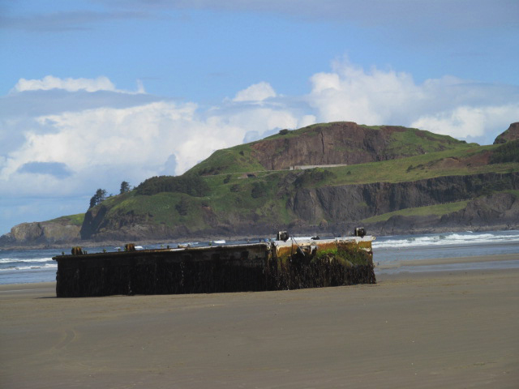
Questions?
Ideas?

Slide 23
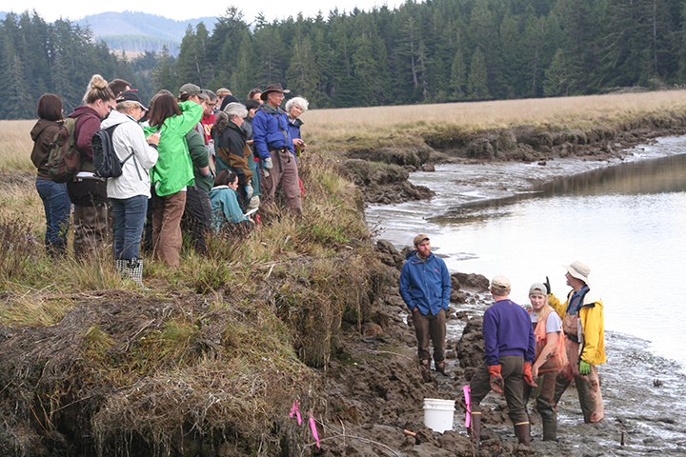
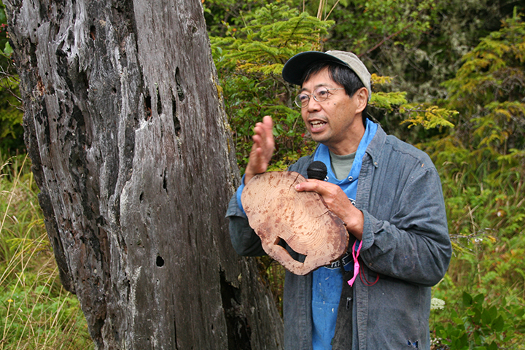
EarthScope Education & Outreach Goals
  Create high profile EarthScope identity
  Promote science literacy through informal education
  Advance formal education in the classroom
  Foster use of data, discoveries, technology
  Establish sense of community ownership
Robert J. Lillie
Robert J. Lillie
Niawiakum River, Washington
Elk River Estuary, Washington

Slide 24

Earth Science Literacy Principles
http://www.earthscienceliteracy.org
Big Ideas:
1. Earth scientists use repeatable observations and testable ideas to understand and explain our planet.
2. Earth is 4.6 billion years old.
3. Earth is a complex system of interacting rock, water, air, and life.
4. Earth is continuously changing.
5. Earth is the water planet.
6. Life evolves on a dynamic Earth and continuously modifies Earth.
7. Humans depend on Earth for resources.
8. Natural hazards pose risks to humans.
9. Humans significantly alter the Earth.

