Slide 1
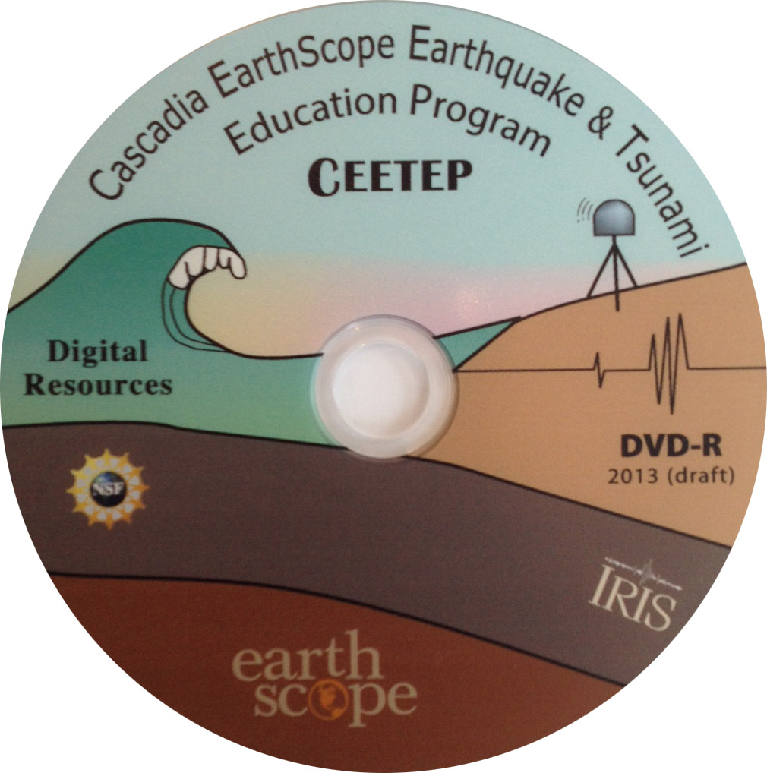
Digital Resources Related to CEETEP Topics
Beth Pratt-Sitaula
CEETEP Workshop

Slide 2
For non-stipend takers
Up to $500 in reimbursable expenses related to pursuing CEETEP-related activities
Ex. Display for visitor center/museum
Ex. Printing costs for educational or promotional materials
Receipts must be turned in to OSU by March 15, 2016.
Please communicate with Nancee Hunter (Nancee.Hunter@oregonstate.edu) prior to purchases to make sure they qualify – keep you team’s technical advisor in the loop too

Slide 4
CEETEP Resources
CEETEP DVD – VIRTUAL workshop
TOTLE-Earthquake, Tsunami, Volcanoes -- Library of resources by Topic
CEETEP Website
Topic-ordered AND
Workshop-ordered

Slide 5
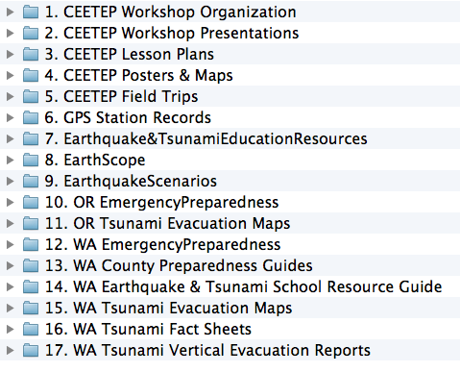
CEETEP DVD – Workshop-ordered

Slide 6
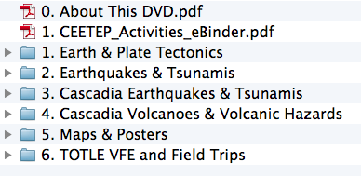
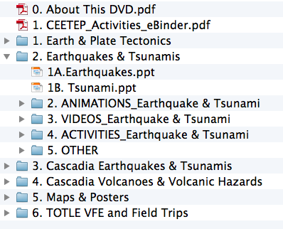
TOTLE DVD – Topic-driven

