Slide 1
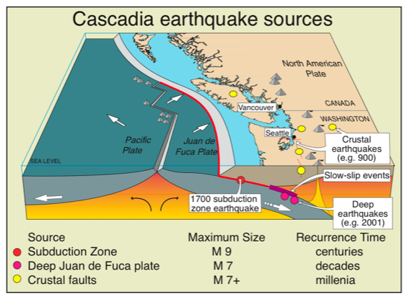
Past Great Cascadia Earthquakes and Tsunamis
Juan de Fuca subducts beneath Pacific Northwest portion of North American Plate at Cascadia subduction zone.
Last great Cascadia earthquake occurred on January 26, 1700 at about 9:00 PM local time.
Analogous to Sumatra 2004, Chile 2010, and Tohoku, Japan 2011 great earthquakes.

Slide 2
Yuriage
Some Coast Areas Now Below Sea Level
Before After
Some areas that were above sea level on march 10 dropped below sea level on March 11, 2011.
This also happened along the Washington - Oregon coast during the 1700 AD great Cascadia earthquake.

Slide 3
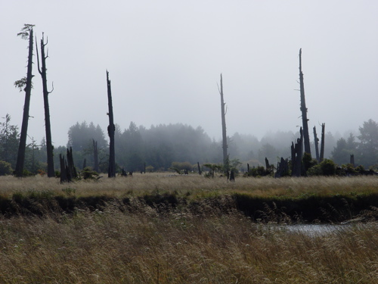
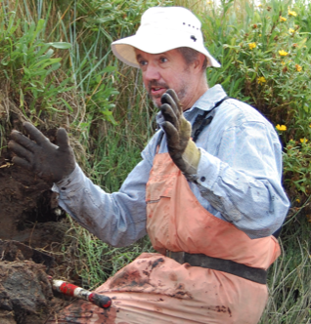
Drowned Forests of Coastal Oregon and Washington
Ghost forest on Copalis River
Brian Atwater, USGS Seattle
Coastal “drowned forests” record the history of slow uplift between and sudden subsidence during great Cascadia earthquakes.

Slide 4
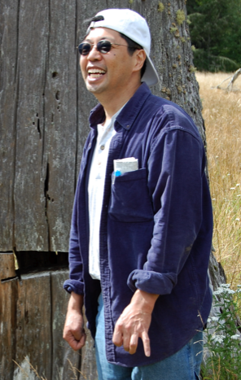
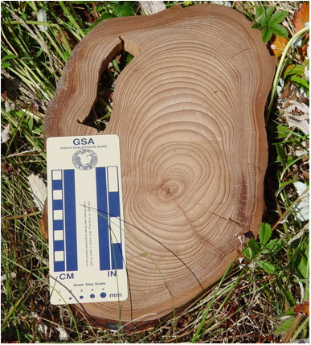
Drowned Forests of Coastal Oregon and Washington
David Yamaguchi
Trees in “drowned forests” near shore died when the ground dropped and seawater killed the trees. Compare rings from victim trees with rings from witness trees on higher ground.
Result: Trees died between fall 1699 and spring 1700.

Slide 5
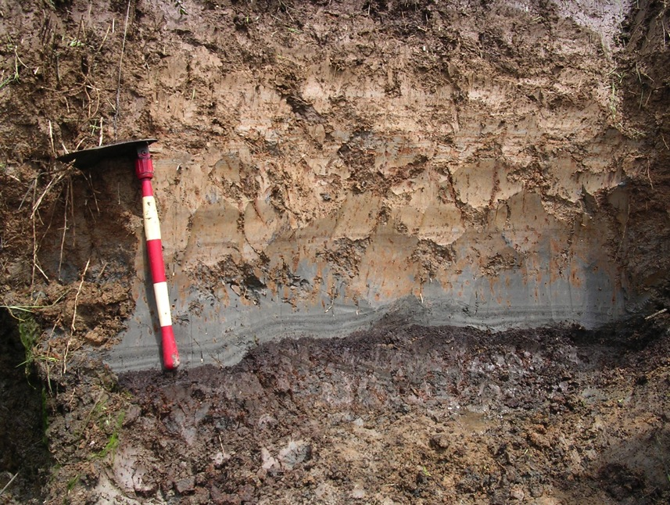
Three-Layer Cake of Cascadia Tsunami Geology
Cupcake Geology
Niawiakum River east of Willapa Bay
Organic-rich forest soil covered by tsunami sand then intertidal mud and clay on top.

Slide 6
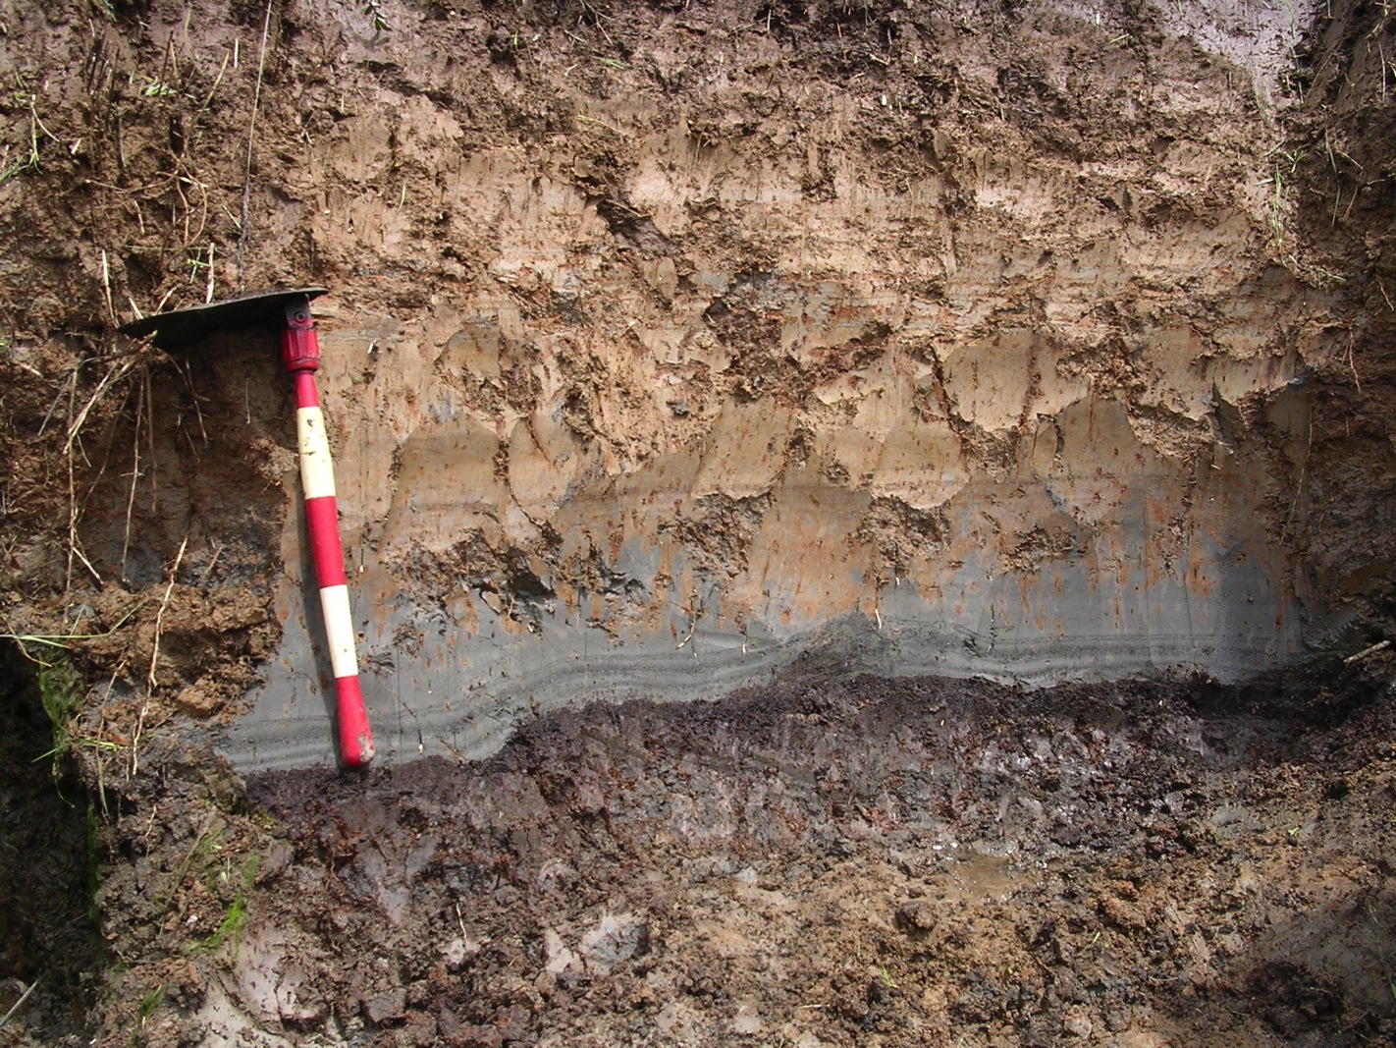
Cascadia Tsunami Geology
Multiple sand layers.
One for each wave of the tsunami!
inland
Clump of marsh grass

Slide 7
Making a Ghost Forest
Notes:
Show Formation of Ghost Forest animation of discovery of the 1700 AD great Cascadia earthquake as illustration of scientific discovery.

Slide 8
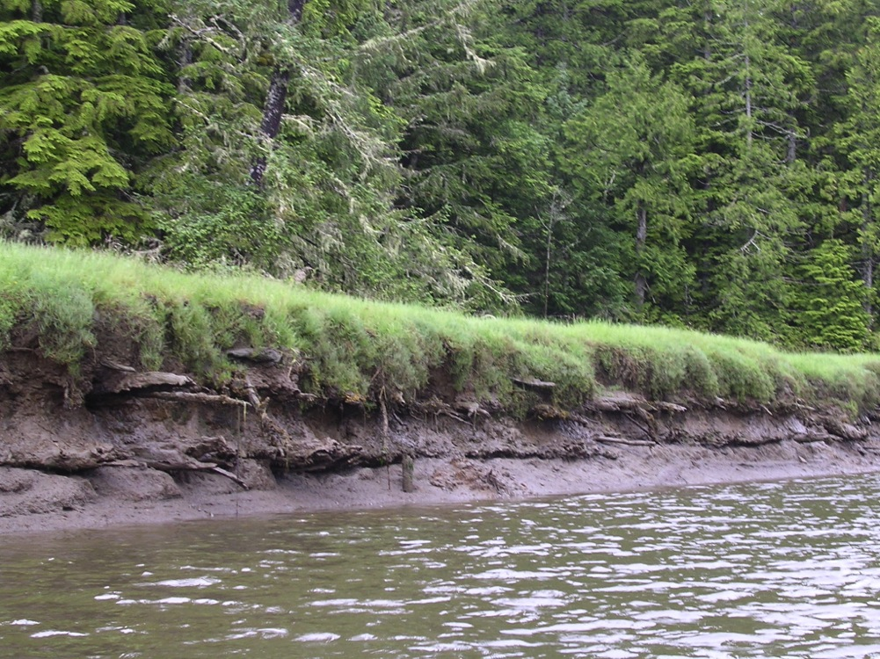
Buried Forest Soils
1700 AD
860(?) AD
Niawiakum River, east of Willapa Bay, WA.
Notes:
This photo shows roots Sitka spruce trees that were killed by ground subsidence during the 1700 AD great Cascadia earthquake AND the preceding great Cascadia earthquake. This field site is located on the Niawiakum River just east of Willapa Bay in southwestern Washington state.
VIRTUAL FIELD EXPERIENCE: A virtual field experience for this field site is provided on this DVD at: 6.TOTLE VFE and Field Trips > Virtual Field Experiences
To run the virtual field experience from this DVD, open the “index.html” file in the Virtual Field Experiences folder in a web browser such as Safari or Firefox or Explorer.

Slide 9
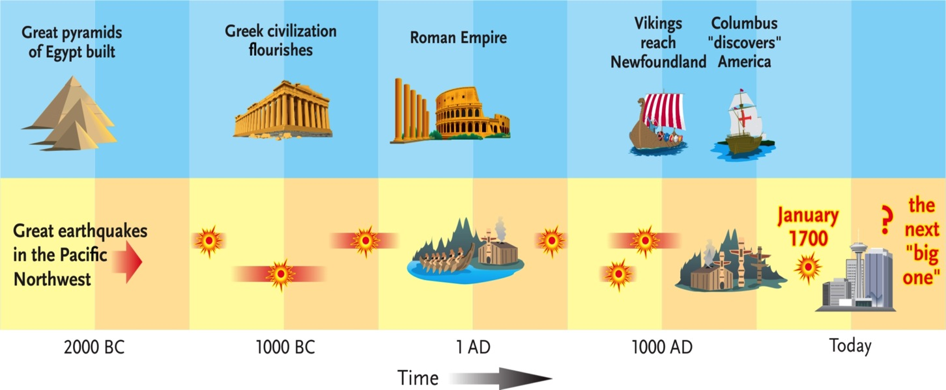
Recent Great Cascadia Earthquakes
Average time between earthquakes = Recurrence time.
Recurrence time for Great Cascadia EQs = 500 years.
We are at 314 years and counting.
Notes:
From At Risk: Earthquakes and Tsunamis on the West Coast, by J. Clague and others.

Slide 10
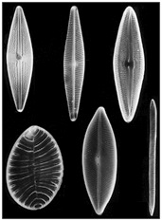
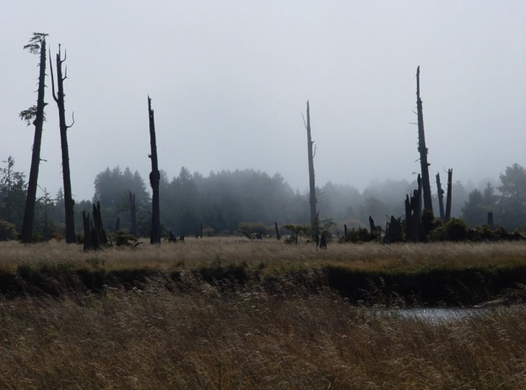
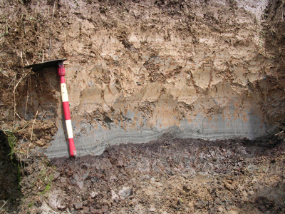
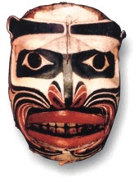
Cascadia Tsunami Geology Storyline
Great earthquake January 26, 1700 @ 9 PM
Ghost forests, buried soils, diatoms, tsunami sand sheets, liquefaction, turbidites, Native American oral history, and written Japanese history.
Intertidal mud & clay
Tsunami sand
Forest soil

Slide 11
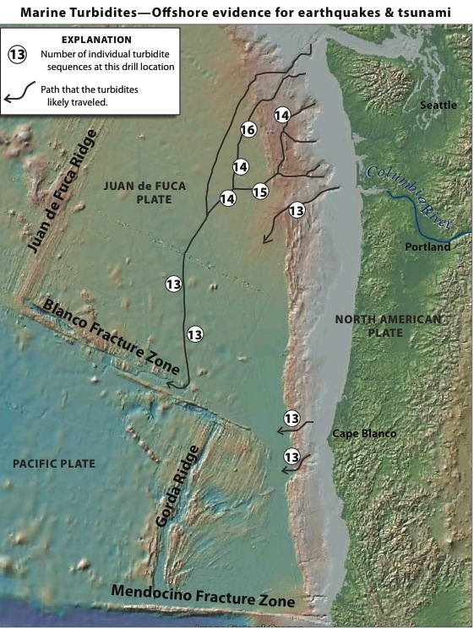
Turbidite in a Jar
Turbidites in Marine Sediment Cores
Sediment deposited on continental shelf can surge down submarine canyons in turbidity currents. The resulting “turbidite” layer has coarse sand on bottom and fine clay on top.

Slide 12
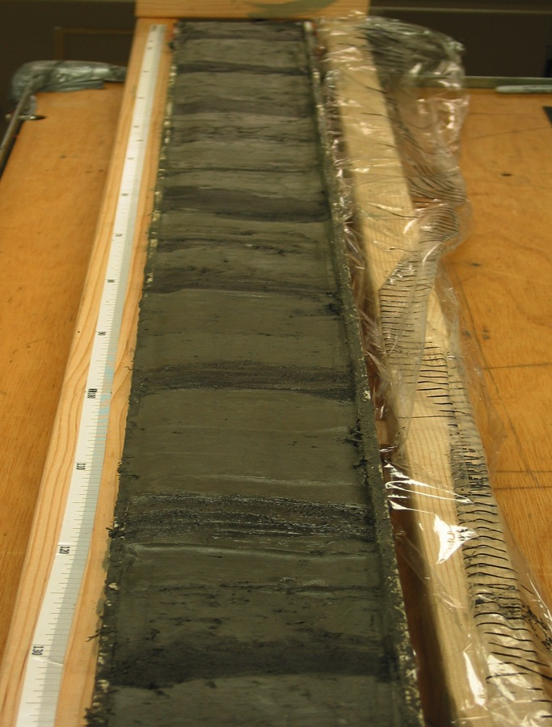
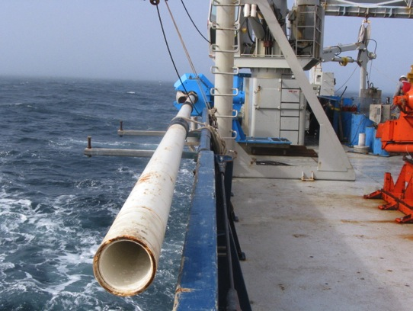
Turbidites in Marine Sediment Cores
Chris Goldfinger (OSU).
Shaking by great Cascadia earthquakes caused turbidity currents.
Ages of many seafloor turbidites match from offshore northern CA to BC.
Requires great earthquakes that ruptured entire or large segments of the plate boundary.

Slide 13
Turbidites: The Movie

Slide 14
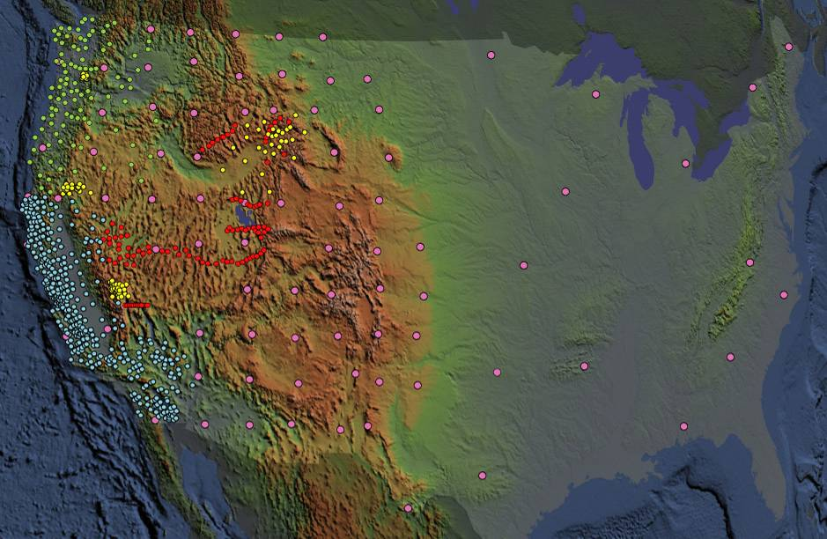
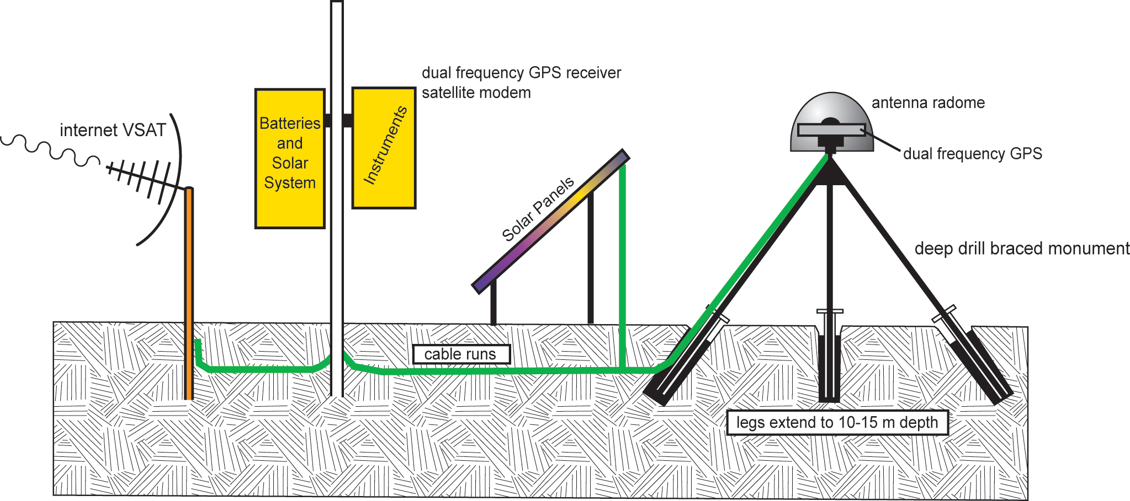
Plate Boundary Observatory (PBO)
-1100 permanent Global Positioning System (GPS) stations
-78 Borehole Seismometers
-74 Borehole Strainmeters (BSM)
-26 Tiltmeters
-6 Laser Strainmeters (LSM)
Measure the broad temporal and spatial spectrum of plate boundary deformation

Slide 15
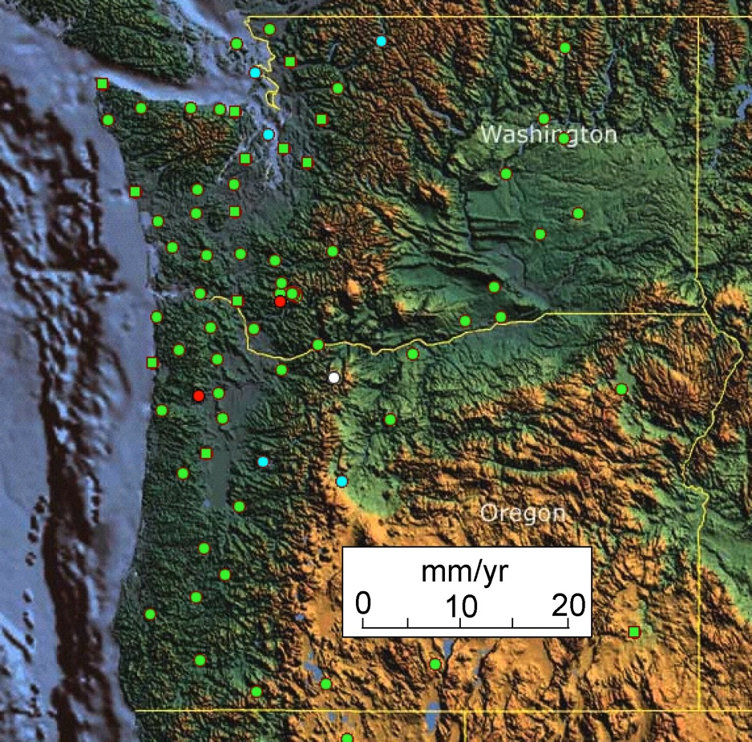
Cascadia Locked and Loading
Examine motions of GPS stations due to Juan de Fuca - North America plate convergence.
Quillayute
Airport
Juan de Fuca Plate

Slide 16
Quillayute, WA GPS Observations
Northward motion = 0.35 inch/yr
Eastward motion = 0.59 inch/yr
Total motion = 0.69 inch/yr
Total motion since 1700 AD = 18.0 feet

Slide 17
Cascadia GPS Animation

Slide 18
Cascadia Locked and Loading
GPS Gum Drop
Stations on coast are moving NE faster than stations in urban corridor.
Cascadia subduction zone boundary is “locked and loading” as it stores elastic energy that will be released in the next great Cascadia earthquake.
If the next great Cascadia earthquake happens tomorrow, Pacific Beach will jump 5.35 meters (17.5 feet) southwest.
Neah
Bay
Pacific
Beach
Tumwater
Othello
Kelso
Tillamook
Wasco
La Grande
Newport
Corvallis
Juan de Fuca Plate

Slide 19
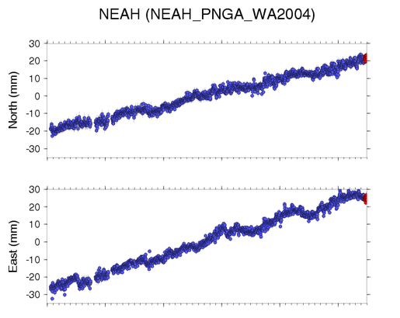
Neah Bay, WA GPS Data
2004
2005
2006
2007
2008
2009
2004
2005
2006
2007
2008
2009

Slide 20
Neah Bay, WA GPS Data
42 mm / 5.5 yr = 7.6 mm/yr
56mm / 5.5 yr = 10.2 mm/yr
2004
2005
2006
2007
2008
2009

Slide 21
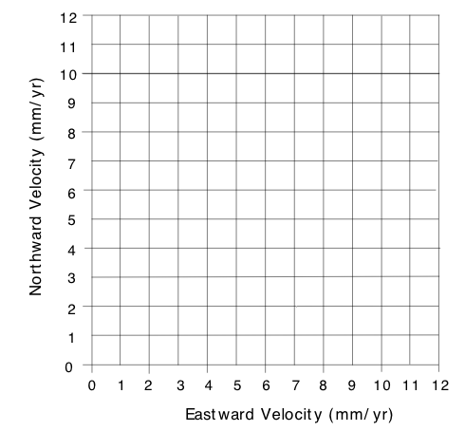
Neah Bay, WA GPS Velocity
12.4 mm / yr

Slide 22
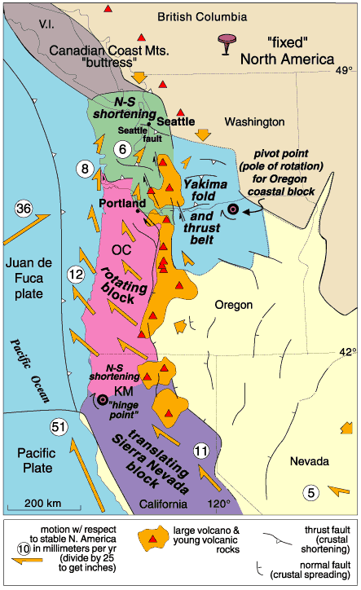
PNW Crustal Block Motions
PNW Crustal Block Model
Crustal blocks are in slow motion. They grind against each other causing EQs along their edges. They also deform internally to make faults and folds.

Slide 23
Animation on Crustal Block Motions

Slide 24
PNW Crustal Block Motions
PNW Crustal Block Model
Explore the model.
Note rotation of Coast Range blocks and opening of Basin and Range in southeastern Oregon.

Slide 25
Earthquakes in Washington 1981-2014

Slide 26
Earthquakes in Washington 1877-1987

Slide 27
Cascadia Earthquake Early Warning

Slide 28
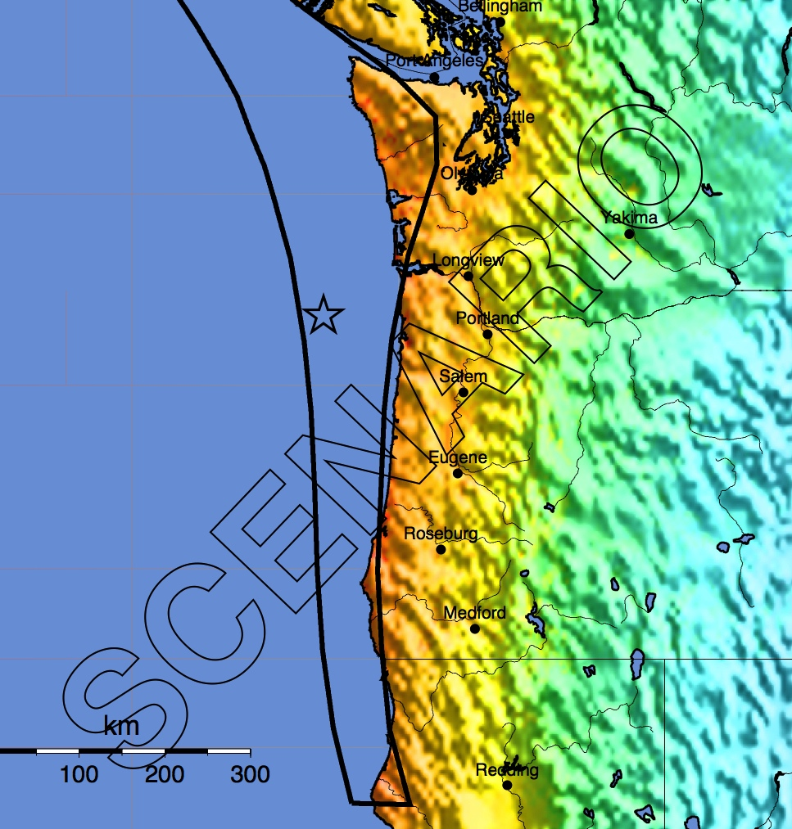
ShakeMap for 2011 Japan M9 EQ
ShakeMap for M9 Scenario Cascadia EQ

Slide 29
Pacific Northwest Crustal Block Motions
Sierra Nevada block moving northwest.
Basin and Range extension.
Coast Range blocks migrating north.
Canadian Coast Mts “buttress”.
Seattle gets squeezed.

Slide 30
Bainbridge Island LIDAR reveals fault scarps that were previously impossible to detect.
Paleoseismology indicates these faults have been active in the last 1000 years. We are learning a lot about the EQ history of faults in the Seattle area.

Slide 31
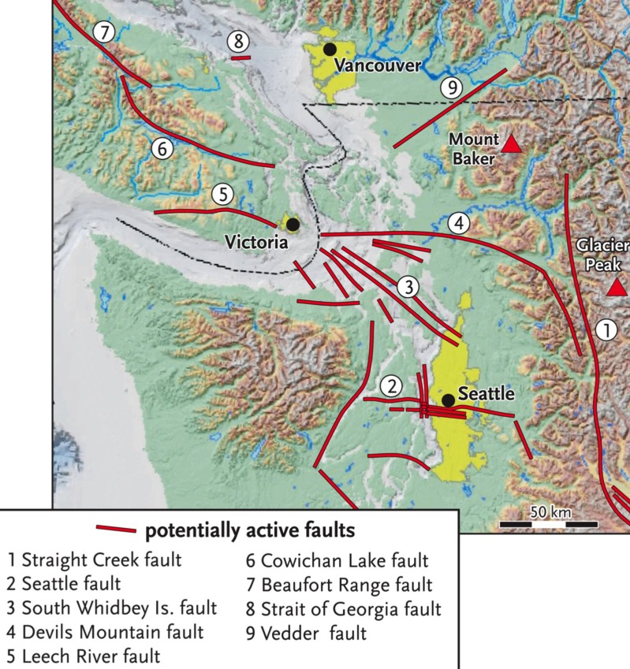
Evidence for 900 AD EQ on Seattle Fault: 1. Former Puget Sound shorelines uplifted 7 meters (> 20 feet). 2. C-14 dates from trees on landslide deposits in Lake Washington. 3. Tsunami deposits around Puget Sound. 4. Rock slides in Olympic Mtns dated at 900 AD. An ominous convergence of observations!
Fig. 3-14a

Slide 32
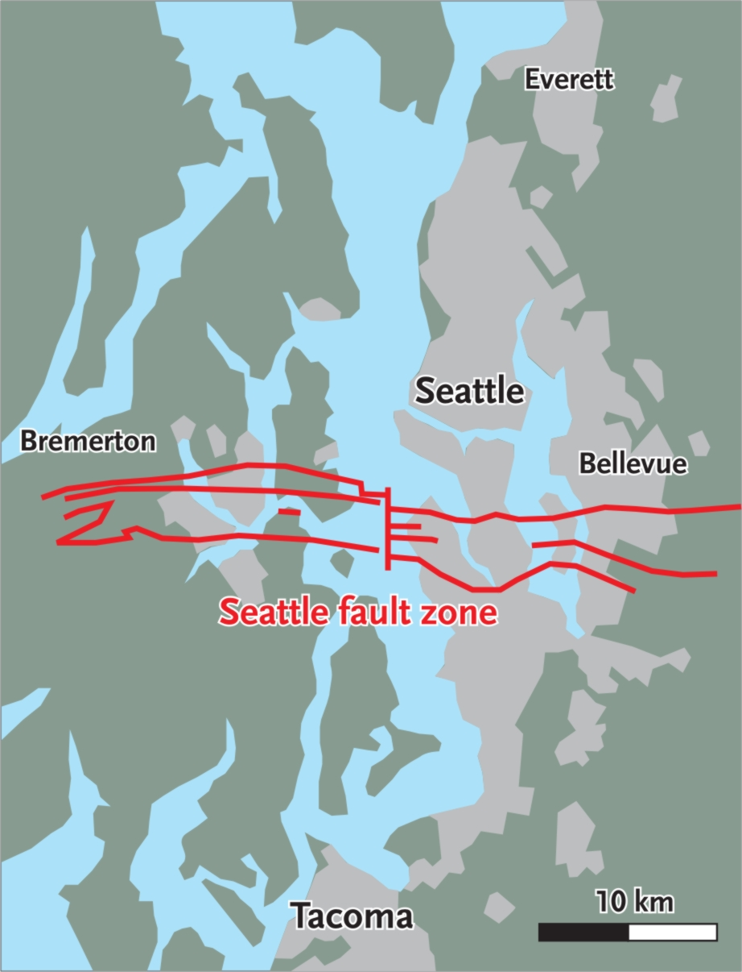
Evidence for 900 AD EQ on Seattle Fault: 1. Former Puget Sound shorelines uplifted 7 meters (> 20 feet). 2. C-14 dates from trees on landslide deposits in Lake Washington. 3. Tsunami deposits around Puget Sound. 4. Rock slides in Olympic Mtns dated at 900 AD. An alarming convergence of observations!
Notes:
There are multiple lines of evidence that indicate that a major earthquake occurred on the Seattle Fault in about 900 AD. The offset on some portions of the Seattle Fault during this earthquake was as much as 20 feet. The magnitude of this earthquake may have been 7.5 and it did produce a large tsunami in southern Puget Sound. The Seattle Fault underlies densely populated areas and is a crustal fault that poses a major earthquake hazard.

Slide 33
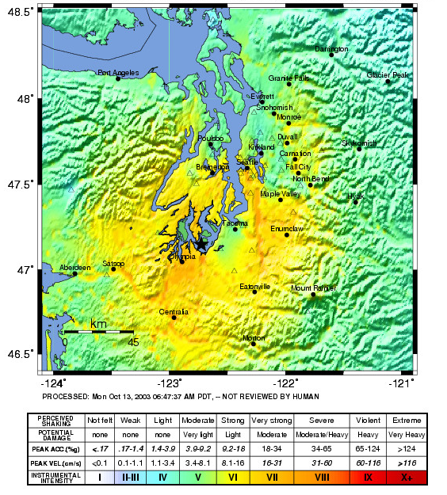
Compare ground accelerations during the Nisqually EQ to ground accelerations during the next EQ on Seattle Fault.
Strongest ground acceleration during Nisqually EQ was ~30% of gravity.

Slide 34
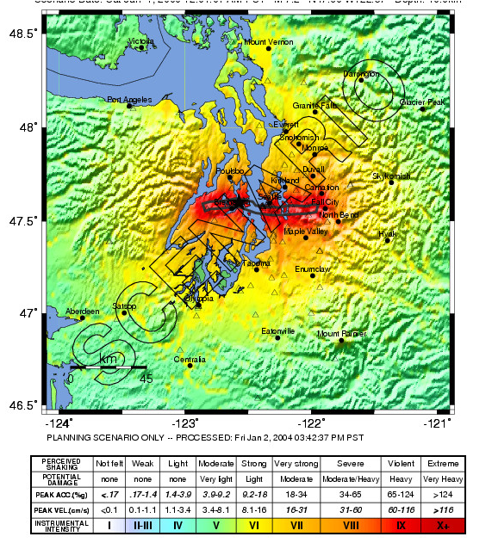
Compare ground accelerations during the Nisqually EQ to ground accelerations during the next EQ on Seattle Fault.
Strongest ground acceleration during Seattle Fault EQ will be ~100% of gravity.

Slide 35
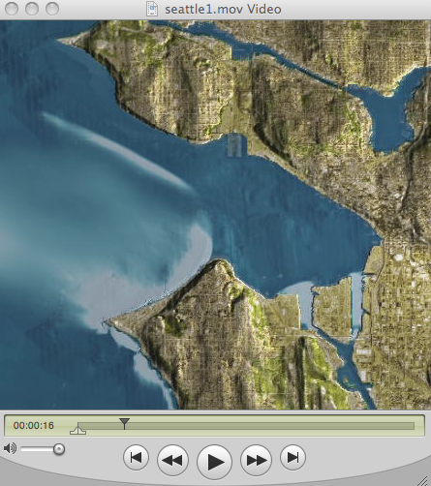
Tsunami Generated by Earthquake on the Seattle Fault
Notes:
ANIMATION: An animation of the tsunami that would result from a magnitude 7 earthquake on the Seattle Fault has been developed by NOAA. This animation can be found at: 3. Cascadia Earthquakes & Tsunamis > 2. ANIMATIONS_Cascadia Earthquakes & Tsunamis > Tsunami animations > Tsunami Inundation-PNW cities > Seattle_Inundation-NOAA.qt

Slide 36
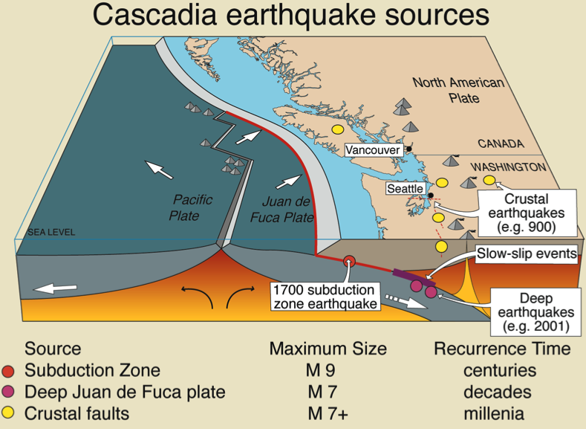
Triple Trouble Three kinds of PNW EQs
In terms of plates, what and where are the three kinds of EQs?
1. Great Cascadia subduction zone EQs. e.g. January 26, 1700 @ 9 PM.
2. EQs within the subducting Juan de Fuca Plate. e.g. Nisqually 2001. Anyone experience that EQ?
3. Crustal EQs within North American continental crust. e.g. 900 AD EQ on Seattle Fault Zone.

Slide 37
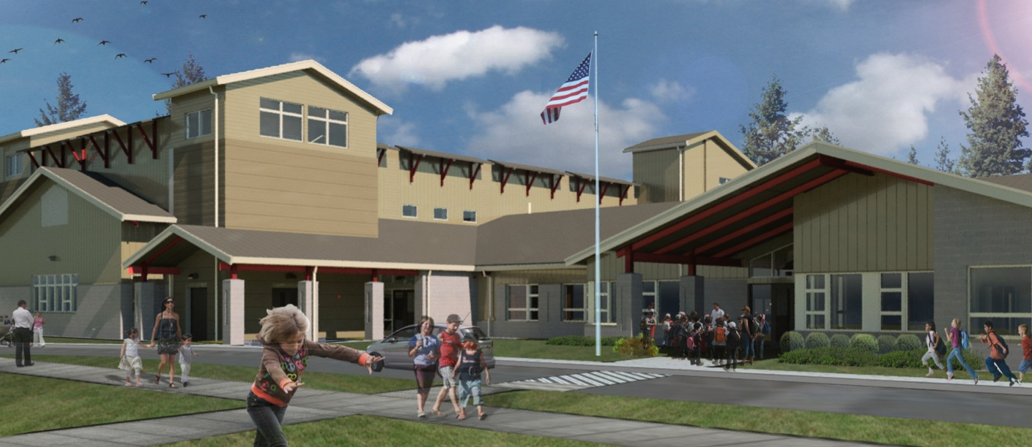
Ocosta Elementary School
If you can’t get out, go up.

Slide 39
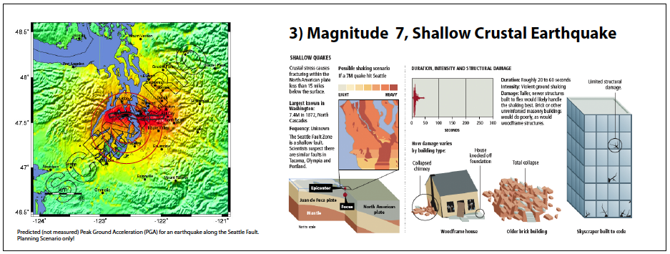
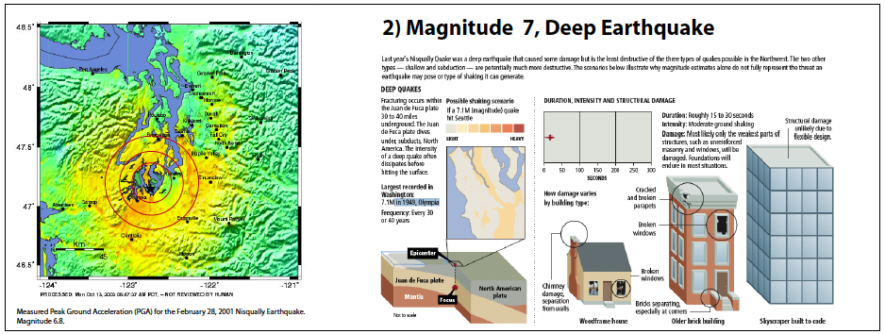
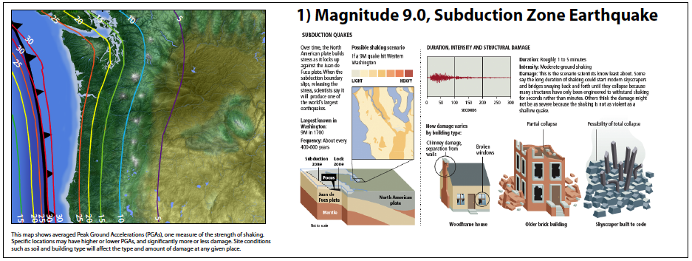
Three kinds of Cascadia EQs = Triple Trouble
Magnitude 7 Crustal Earthquake
20 – 30 seconds of ground shaking.
Magnitude 9 Subduction Zone Earthquake
Ground shaking for 4 – 6 minutes!
Magnitude 7 “Deep” Earthquake
20 – 30 seconds of ground shaking.
Notes:
Three kinds of earthquakes in the Pacific Northwest:
1. Subduction zone earthquakes. These are plate-boundary earthquakes at the interface between the North American and Juan de Fuca plates. The last great earthquake on this boundary occurred on January 26, 1700 at about 9PM. North American geophysics, geology, and dendrochronology, in combination with Japanese written history, have shown that the most recent great earthquake on the Cascadia subduction zone occurred during the evening of 26 January 1700 and that it probably attained a magnitude of nine [Atwater, B. F., S. Musumi-Rokkaku, K. Satake, Y. Tsuji, K. Ueda, and D. K. Yamaguchi (2005), The orphan tsunami of 1700: Japanese clues to a parent earthquake in North America, U.S. Geol. Surv. Prof. Pap., 1707, 133 pp.]. These conclusions are startling, as are the geologic hazards they imply.
2. Earthquakes within the subducting Juan de Fuca plate beneath the Pacific Northwest. The most recent example is the Nisqually earthquake of 2001 that caused approximately $2 billion damage to the southern Puget Sound region.
3. Shallow earthquakes within the North American crust. These earthquakes are a major concern in the Puget Sound area Pacific Northwest (http://seattlescenario.eeri.org/) and to a lesser degree also in the Portland area where these faults apparently move less frequently.

Slide 40
Effects of Near-Surface Geology
Amplitude of oscillation increasing
Notes:
This drawing does not show the S and P-wave arrivals on the seismogram. Rather, it shows how the seismic wave oscillates as it enters different materials.
The least damage occurs where buildings are constructed on bedrock. Note that the seismogram signal through “solid bedrock” is a high-frequency, low-amplitude.
By the time the seismic wave reaches the “well-consolidated sediment” it begins to wobble with more amplitude but less frequently.
The “poorly consolidated” sediment is even worse.
As the wave enters the “water-saturated sand and mud” the wave records a low-frequency, high-amplitude signal. It really gets rolling and can cause liquifaction [during ground shaking, some sandy, water-saturated soils can behave like liquids rather than solids. See the activity in the Exploratorium website noted below.]
Background below from http://www.exploratorium.edu/faultline/activezone/liquefaction.html]
During a quake, the squeezing done by the seismic waves happens very quickly, and the water doesn’t have time to flow out of the way of the sand particles. So as the particles try to move into a denser configuration, they push on the water, causing an increase in water pressure.This increased pressure causes the forces at the contact points between the sand particles to decrease. If the water pressure is high enough, it can reduce the interparticle forces to zero, which means that the sand particles ﾒfloatﾓ away from each other. For a brief time, the sand particles are suspended in the water. This is liquefaction. The soilﾕs loss of strength occurs because thereﾕs no contact between the particles of sand.So What? Many buildings in the San Francisco Bay Area are built on landfill, sand, or mud that can liquefy. Liquefaction caused much of the damage during the 1989 Loma Prieta earthquake. It has also been responsible for major destruction in other quakes, including Kobe, Japan, in 1995 and Mexico City in 1985.

Slide 41
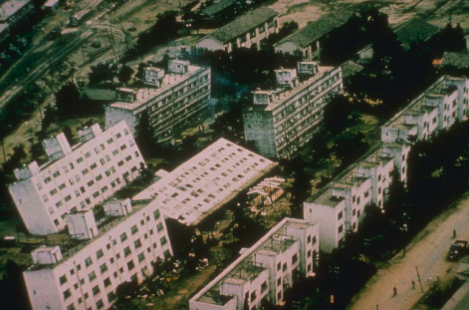
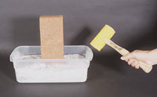
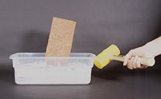
Liquefaction What happens to a structure built on a weak foundation when an earthquake strikes?
Liquefaction
M7.4 Niigata, Japan 1964
Source: National Geophysical Data Center
Notes:
By building a model “shaker table” and using water-saturated sand, we can demonstrate how liquefaction works. Vibrations of water-saturated sand can cause the sand to become “quick”. This means is looses strength and buildings on top of water-saturated sand and mud can sink during earthquake shaking. In Portland and the Puget Sound regions, there is much water-saturated ground around rivers and bays that is vulnerable to liquefaction. These areas are likely to sustain more damage during earthquakes than are areas underlain by hard bedrock.
Another good demonstration is to place a vibrator, such as a rotary sander against the table and watch the brick sink.
For a demonstration of a liquefaction activity go to http://www.exploratorium.edu/faultline/activezone/liquefaction.html
Try the activity with and without water added to the sand.

Slide 42
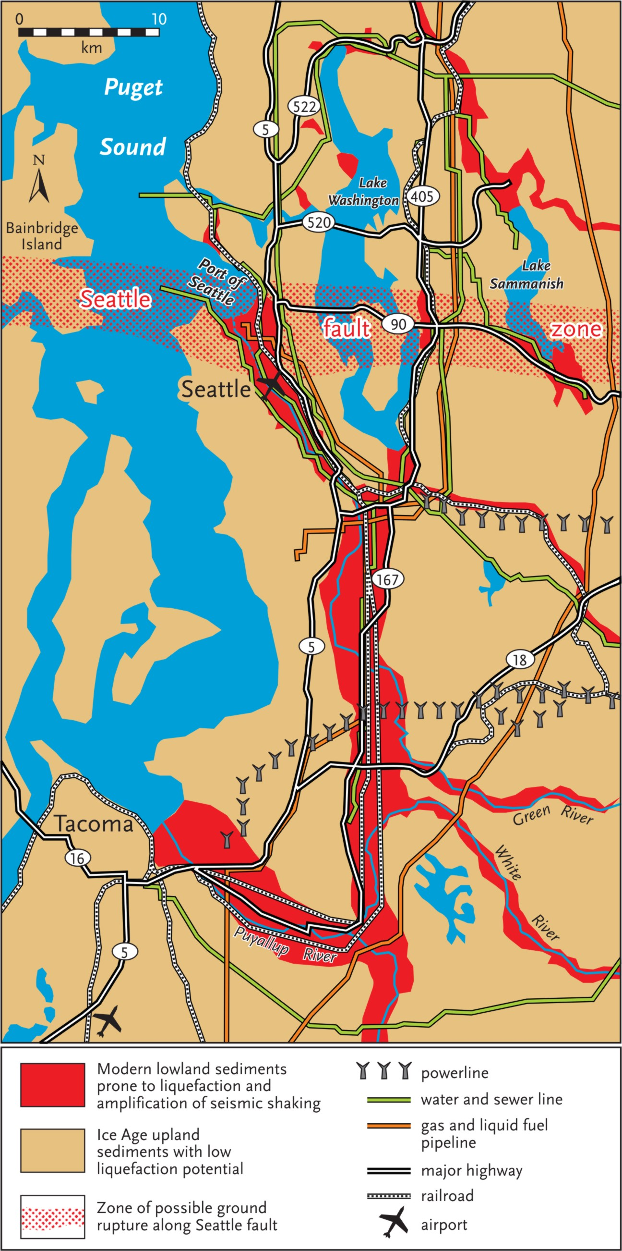
Seattle Infrastructure and Liquefaction Potential
Major transportation and infrastructure arterials follow low-lying valleys filled with soft sediments. These valleys have high liquefaction potential.
Notes:
The densely populated Seattle – Tacoma region has some particularly troubling challenges to earthquake preparedness. Concentration of transportation and infrastructure arterials in regions of high liquefaction potential.
Washington State Department of Natural Resources provides County maps of Relative Earthquake Hazards at: http://www.dnr.wa.gov/ResearchScience/Topics/GeologyPublicationsLibrary/Pages/pub_ofr04-20.aspx

Slide 43
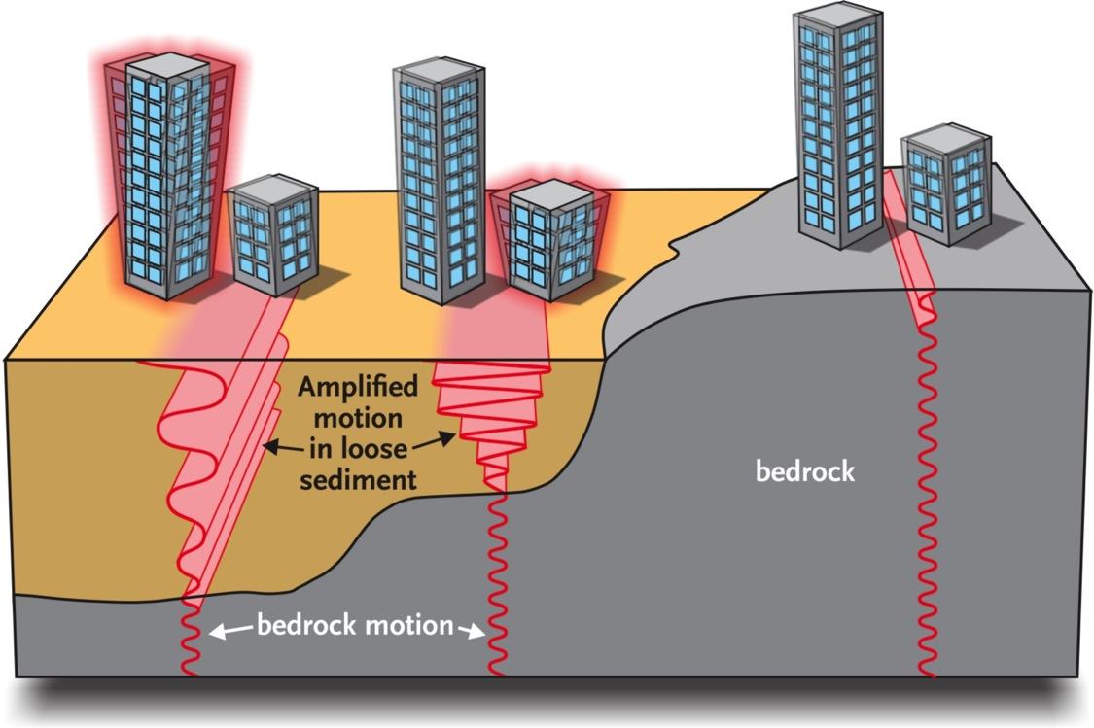
Ground Shaking Amplification
Seismic waves are amplified as they pass from bedrock into basins filled with sedimentary rock.

Slide 44
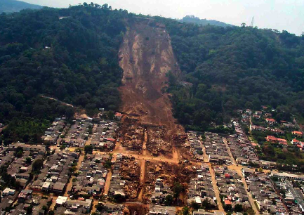
Earthquake-Induced Landslides
El Salvador January 2001 M7.6

Slide 45
Relative Earthquake Hazards
Relative Earthquake Hazard Maps
Seismic Wave Amplification
Liquefaction Potential
Earthquake- induced Landslide Hazard

Slide 46
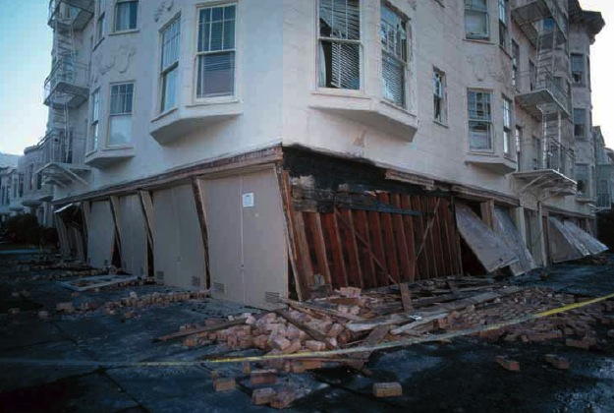
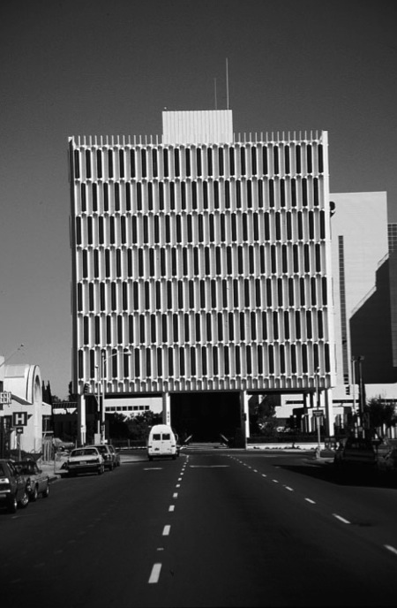
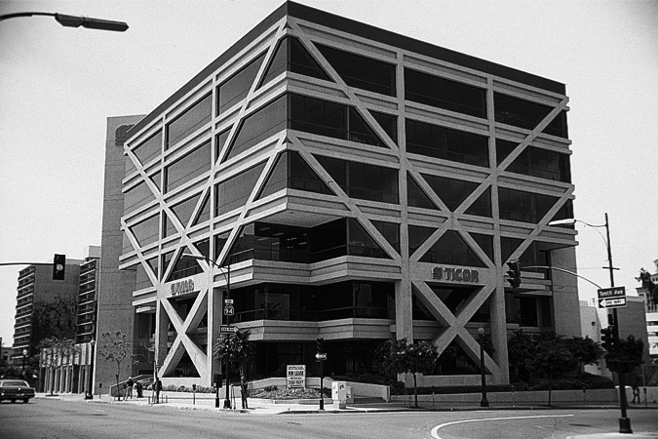
Build a Better Wall
Resistance to shear is critical.
“Earthquakes don’t kill people ……. buildings that collapse during earthquake ground shaking kill people.”

Slide 47
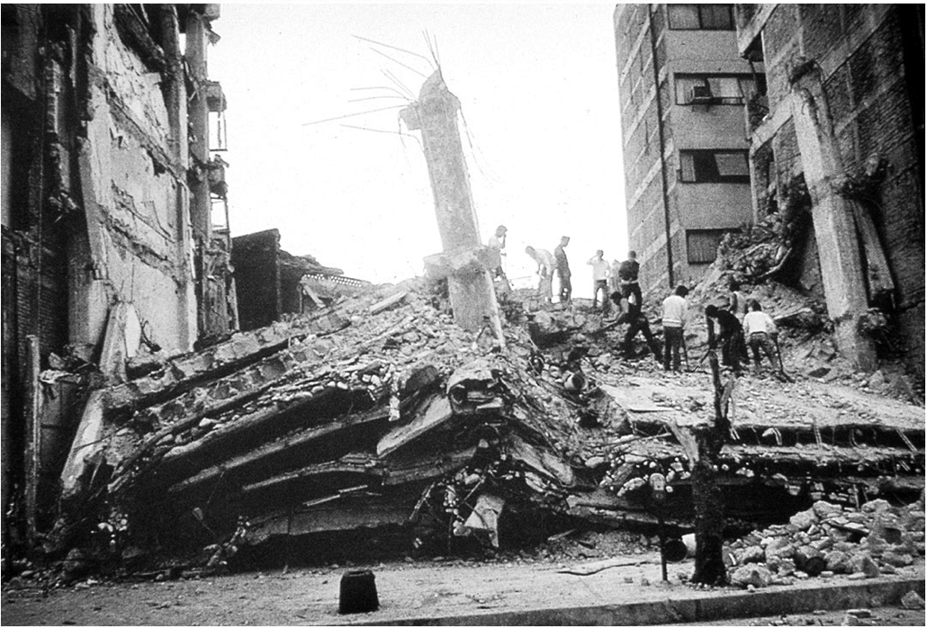
Selective Building Damage
Is it always tall buildings that fall in earthquakes?
Mexico City M8 EQ 1985 ~8000 dead
Many 6 to 16 story buildings collapsed. Shorter buildings AND taller buildings were more likely to withstand the ground shaking.

Slide 48
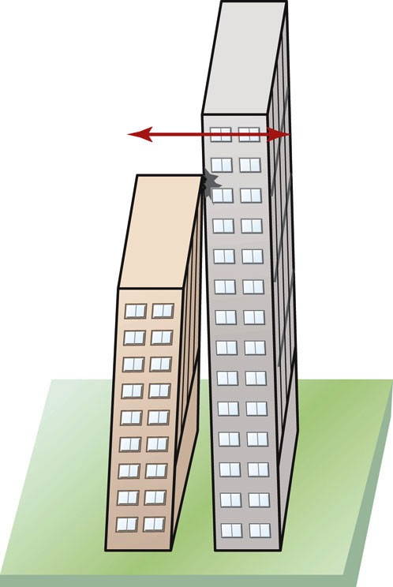
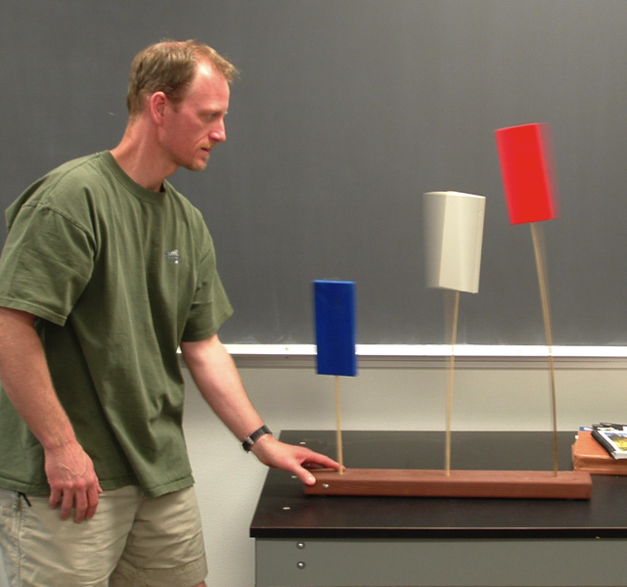
Building Resonance, Fig 4-24
Oscillating blocks experiment

Slide 49
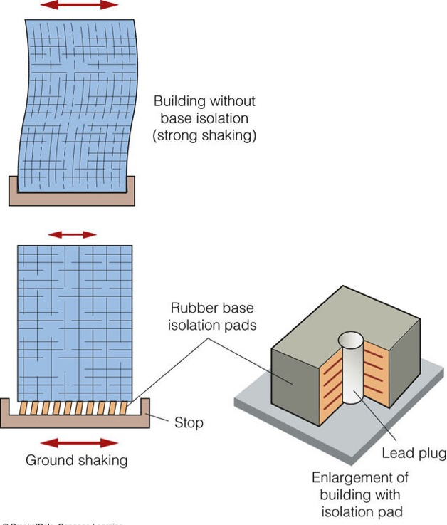
Video on Earthquake Engineering 101
Fig. 4-26
Notes:
QuickTime movie “Structural Design”
Middle School EQ Guide; 3 Animations & Movies; Structural Design & EQ Damage; 7.StructureDesignVideo.mov
Tiime: About 6 minutes

Slide 50
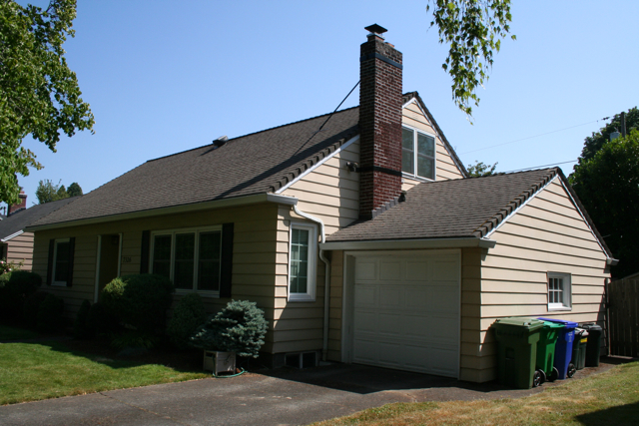
Seismic Retrofit
1942 North Portland House
Wood frame NOT attached to foundation.

Slide 51
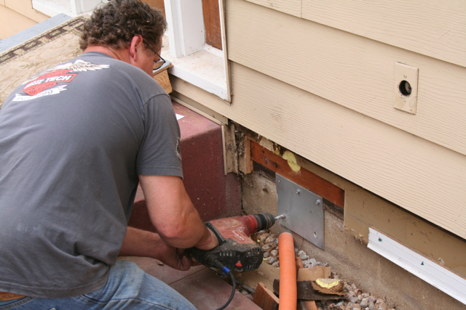
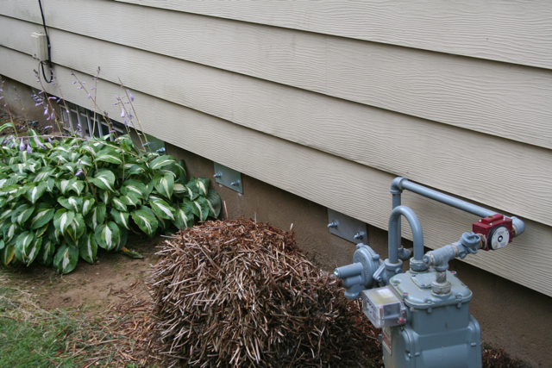
Seismic Retrofit
Bolting frame to foundation on exterior.

Slide 52
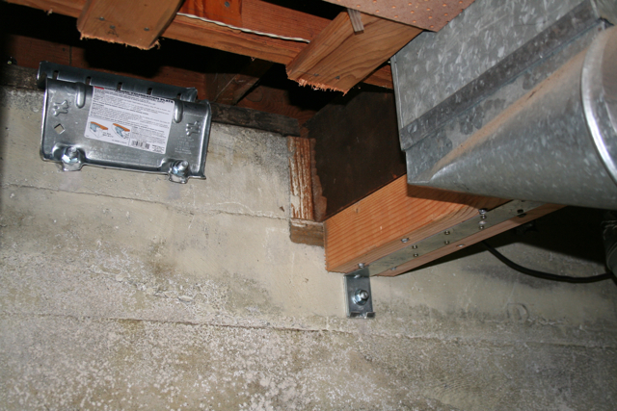
Seismic Retrofit
Post & beam reinforcement.

Slide 53
Drop, Cover, and Hold On!

Slide 54
Tsunami Produced by Subduction Zone Earthquake
Why are tsunamis rarely produced by earthquakes along divergent and transform plate boundaries?

Slide 55
Lessons from Tohoku, Japan
Earthquake engineering works. Few buildings collapsed during the Tohoku earthquake. Cascadia must construct earthquake-resilient built environment.
Earthquake and tsunami hazards education improves public safety. Tohoku tsunami inundation zone had 95% survival rate while Banda Aceh inundation zone had 10% survival rate.
Tsunami Stones on Hillsides
Message: “Do not build below this level.”

